Slide 1
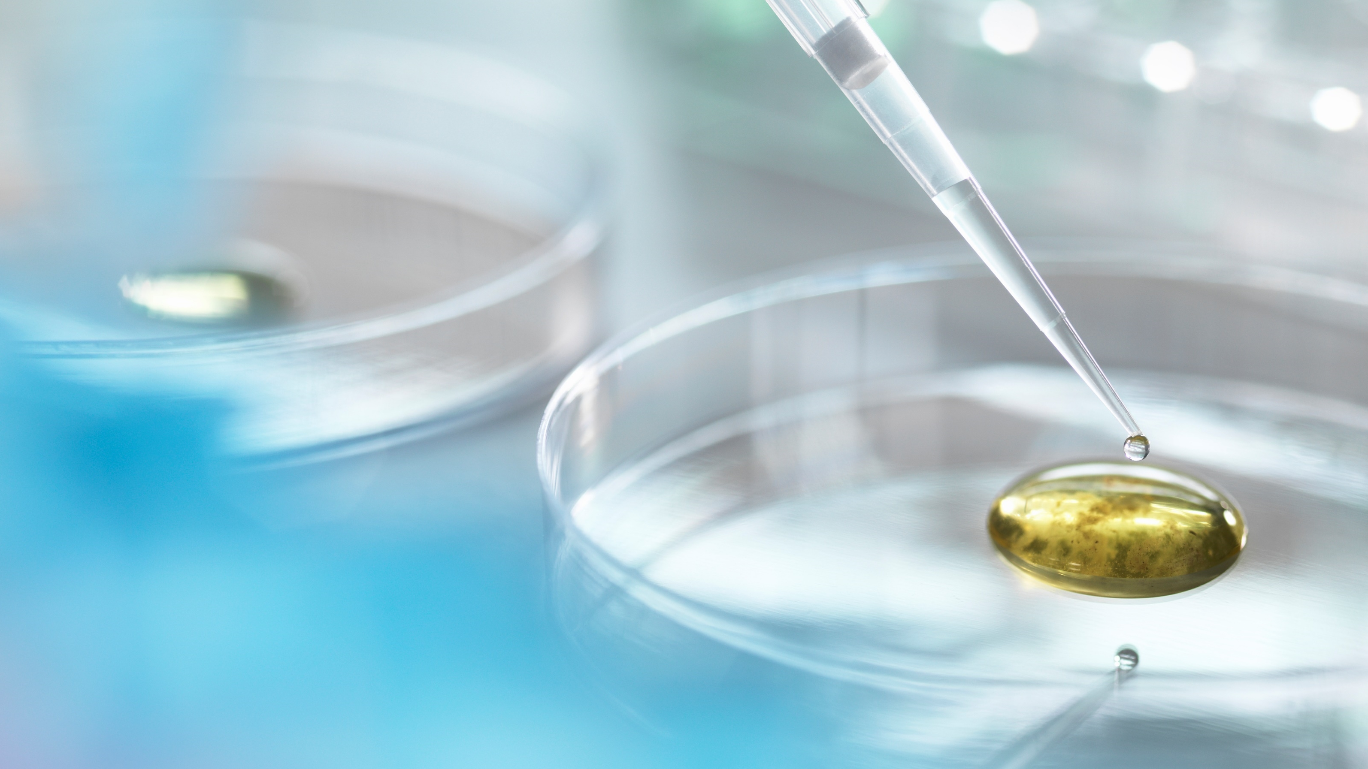
baclink data import module
WHO Collaborating centre for surveillance of antimicrobial resistance
Creating a laboratory from a data file

Slide 2
Part 1. Creating or updating your laboratory from a data file
The purpose of laboratory configuration is to describe to WHONET details about your institution and your laboratory test practices. This tutorial describes how to create a “new laboratory” from a data file.
Note: This is a short-cut to accomplish most of the following Parts. See the BacLink tutorials for more information. The short-cut feature is called “Create a laboratory from a data file”, and can be found under the WHONET “File” menu option.

Slide 3
Part 1. Creating or updating your laboratory from a data file
You can only use this feature after you have successfully converted your data file into WHONET using the BacLink data import module.
To successfully convert your data with BacLink, you must map your Antibiotic, Location, Organism, and Specimen dictionaries and have converted your data into the WHONET structure. From this data file that you create you will use this file to create the WHONET laboratory configuration avoiding manualy data entry of your antibiotics list.
Once the above conditions are met, WHONET offers users the option to create a WHONET laboratory configuration from a data file. Or, will allow users the option to update an existing laboratory configuration from a data file.

Slide 4
Creating a laboratory from a data file
In this tutorial you will learn how to create a WHONET laboratory from a data file.
Part 1. Selecting option for Create a laboratory from a data file
Part 2. Introduce your laboratory to WHONET and select data your data file
Part 3. Find and highlight your data file.
Part 4. Move your data file into the WHONET bucket for analysis
Part 5. Click Ok
Part 6. The laboratory information has been saved in the file
Part 7. Reviewing the laboaratory configuration

Slide 5
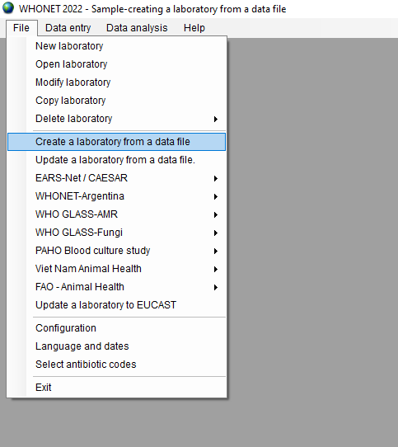
Creating a laboratory from a data file
Part 1. Select File from the dropdown menu and click Create a laboratory from a data file.

Slide 6
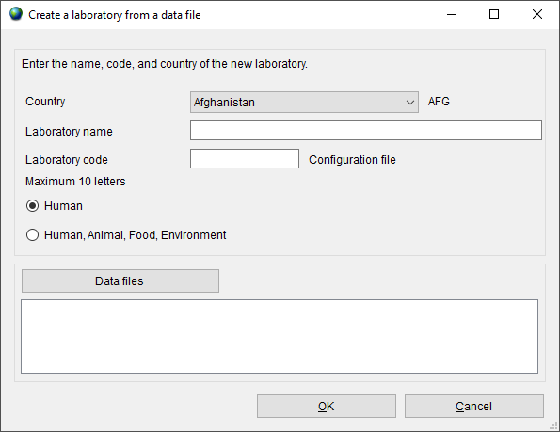
Creating a laboratory from a data file
Part 2. Introduce your laboratory to WHONET and select data your data file

Slide 7
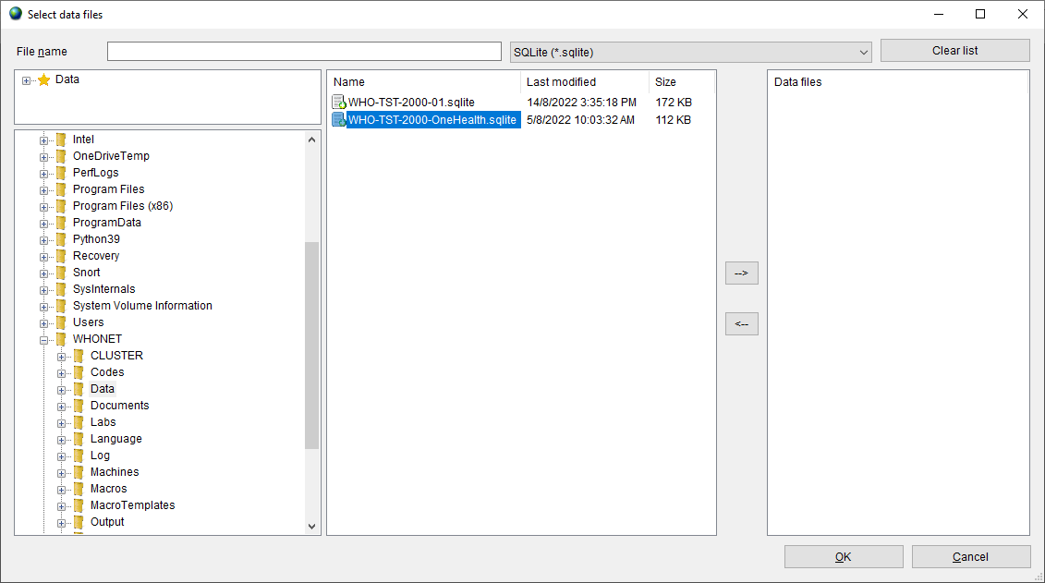
Creating a laboratory from a data file
Part 3. Find and highlight your data file.

Slide 8
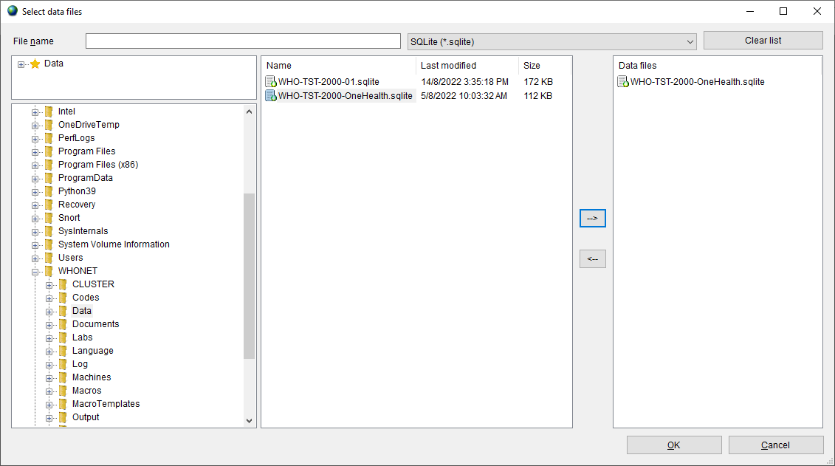
Creating a laboratory from a data file
Part 4. Move your data file into the WHONET bucket for analysis.

Slide 9
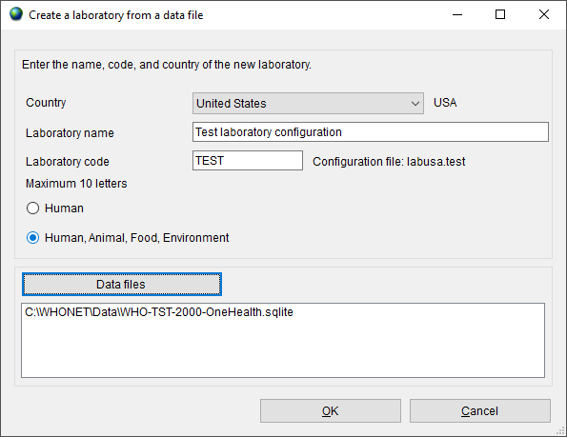
Creating a laboratory from a data file
Part 5. Click Ok

Slide 10
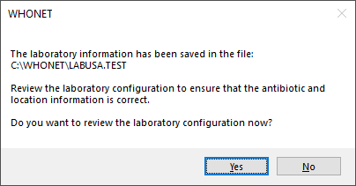
Creating a laboratory from a data file
Part 6. The laboratory information has been saved in the file:

Slide 11
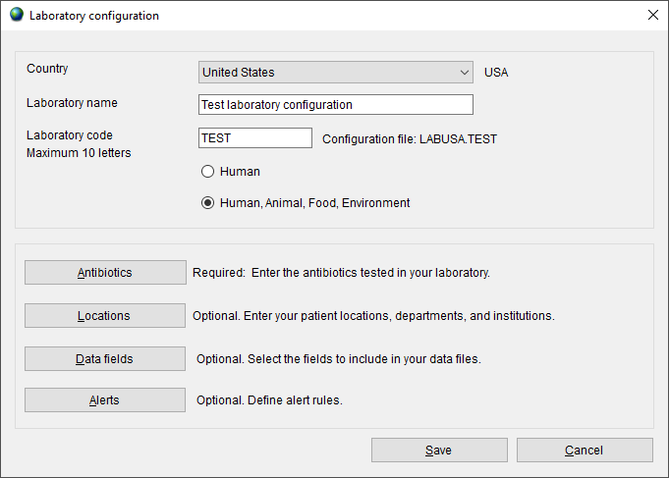
Creating a laboratory from a data file
Part 7. Reviewing the laboratory configuration.

Slide 12
Thank you!
On behalf of the WHONET Team, thank you for learning about the WHONET & BacLink Software!

