Slide 1
baclink data import module
WHO Collaborating centre for surveillance of antimicrobial resistance
Data import: Vitek configuration

Slide 2
BacLink Tutorial – Exporting data from Cerner
The instructions are divided into four parts:
Part 1. Downloading and installing WHONET and BacLink
Part 2. Exporting data with Cerner: You will use the Cerner CCL query generator to create a text file with the desired microbiological information.
Part 3. Instructions for the export of both archived and active data are provided.
Part 4. Converting data with BacLink: BacLink will convert the file that you created with Cerner to a WHONET file
Part 5. Getting started with WHONET

Slide 3
BacLink Tutorial – Exporting data from Cerner
The purpose of this document is to guide users of the Cerner laboratory information system through the export of data to WHONET. These instructions should prove a valuable resource for data managers who are completely unfamiliar with the Cerner report generation and data extraction utilites and a time-saver for data administrators who are.

Slide 4
BacLink Tutorial – Exporting data from Cerner
We anticipate that these instructions should work well with Cerner Classic versions ..... We have not yet developed guidelines for extraction of data from Cerner Millenium. For Cerner users familiar with the creation of CCL queries, feel free to edit the reports to best suit your data management needs.

Slide 5
BacLink Tutorial – Exporting data from Cerner
The frequency of data conversions depends on the local data analysis needs and interests. Many laboratories find that a weekly or monthly download is adequate for their infection control and quality assurance purposes, while less frequent analysis may be adequate if the principal use of the data is in following trends in resistance and guiding treatment recommendations. Automated daily downloads of data from Cerner into WHONET is also a possibility, but is not described in this manual.

Slide 6
PART 2. EXPORTING DATA WITH CERNER
The below steps described the extract of both archived data (from historic EH01 and MB01 records) and active data (PR05 and MB01 records). The steps are very similar.
1. In the folder c:\whonet\machines, you will find a number of CCL query files. Copy the files Cerner_archived_data.ccl, Cerner_active_data.ccl, and Cerner_report.ccl into your ccl directory. If you are using the Reflections emulation software, you should use File, Transfer.

Slide 7
PART 2. EXPORTING DATA WITH CERNER
2. For archived data
Edit the file Cerner_achived_data.ccl at the indicated approximate line numbers to adapt the CCL queries for use in your laboratory, indicating the desired values which your Cerner system is using:
67: Following “MEASUREMENT = “: Indicate which procedure(s) contain the MIC Values in your system. In the example, the procedures 6200830 and 6200832 are used.
73: Following “INTERPRETATION = “: Edit the line to indicate the same procedure(s) you indicated in line 67, e.g. 6200830 and 6200832. This will exclude the MIC values from the MIC interpretation field.
95: After the text “Enter Procedure Number range for Microbiology”, enter the range of procedure numbers used for microbiology test results. In the example, this is: BETWEEN 6200000 AND 6400000
99: Optional. If needed, edit the pattern for the specific accession numbers desired. In the example: S1.ACCESSION1 IN ("*BL*","*MB*")
102: Optional. If you want a full year of data, you could edit out the line stating AND PERIOD = S1.PERIOD1. Otherwise, leave this line in.
107: Indicate the procedure number used in your Cerner which indicates a FINAL REPORT. In the example, this code is 6200885.
129: Optional: If you only wish to export certain patient types, edit this line. Options in the example include EH.PAT_TYPE IN ("L","I","F","E").

Slide 8
PART 2. EXPORTING DATA WITH CERNER
3. For active data
Edit the file Cerner_active_data.ccl at the indicated approximate line numbers to adapt the CCL queries for use in your laboratory, indicating the desired values which your Cerner system is using:
77: Following “MEASUREMENT = “: Indicate which procedure(s) contain the MIC Values in your system. In the example, the procedure 6200832 is used.
83: Following “INTERPRETATION = “: Edit the line to indicate the same procedure(s) you indicated in line 77, e.g. 6200832. This will exclude the MIC values from the MIC interpretation field.
102: After the text “Enter Procedure Number range”, enter the range of procedure numbers used for microbiology test results. In the example, this is: BETWEEN 6200000 AND 6400000
105: Optional. If needed, edit the pattern for the specific accession numbers desired. In the example: S1.ACCESSION1 IN ("*BL*","*MB*")
110, 114, and 142: Indicate the procedure number used in your Cerner which indicates a FINAL REPORT. In the example, this code is 6200885.
119: Optional: Enter any site-specific edits if you wish to exclude any specific comments, observations, etc.
129: Optional: If you only wish to export certain patient types, edit this line. Options in the example include PR.PAT_TYPE IN ("L","I","F","E").

Slide 9
PART 2. EXPORTING DATA WITH CERNER
4. Include the CCL query files in your system, for example with the following syntax:
(%I CCLPROG:CERNER_ACHIVED_DATA.CCL)
(%I CCLPROG:CERNER_ACTIVE_DATA.CCL)
(%I CCLPROG:CERNER_REPORT.CCL)

Slide 10
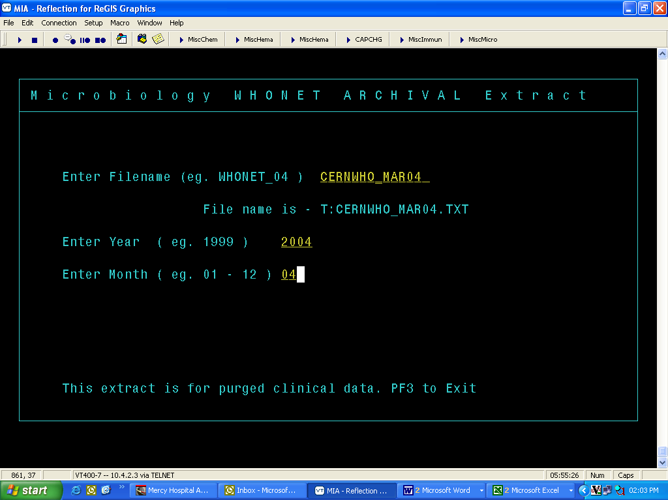
PART 2. EXPORTING DATA WITH CERNER
5. Go to the ccl prompt.
For archived data, type: 1WN GO
For active data, type: 1WHONET GO
For archived data, you will see the following interface:

Slide 11
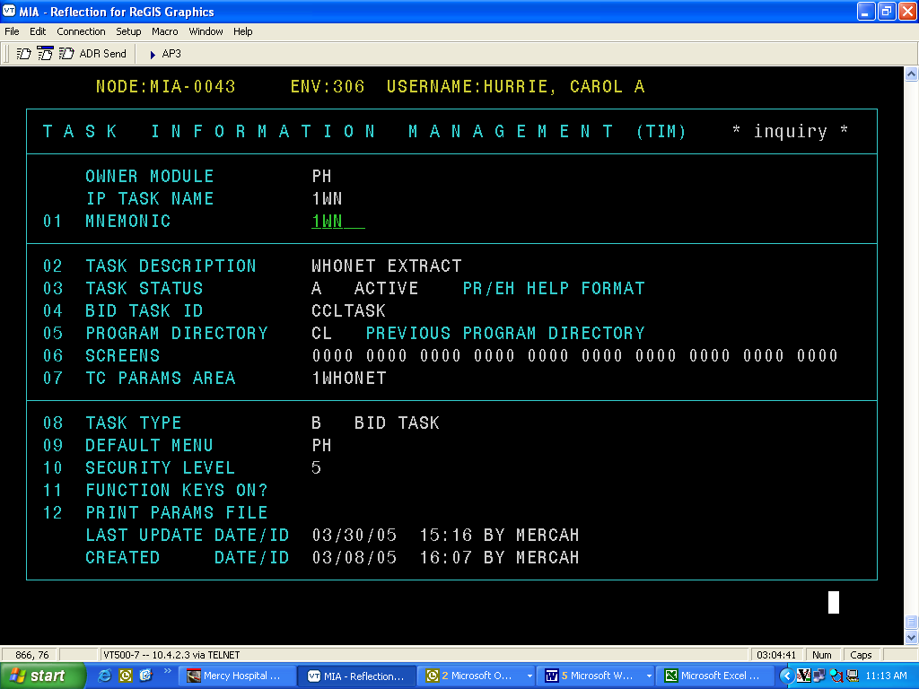
PART 2. EXPORTING DATA WITH CERNER
6. When you run a report, the report files will be written to the T directory.
7. Optional – Feel free to add any additional prompts to your interface, for example asking the user to indicate a specific Institution or Client for the export. You may also add the queries to CCM or create a TIM Record, and run from the Select prompt.
Note: You should NOT change the record length.
SAMPLE TIM RECORD

Slide 12
Thank you!
On behalf of the WHONET Team, thank you for learning about the WHONET & BacLink Software!

