Slide 1
baclink data import module
WHO Collaborating centre for surveillance of antimicrobial resistance
Exporting data from SWIN

Slide 2
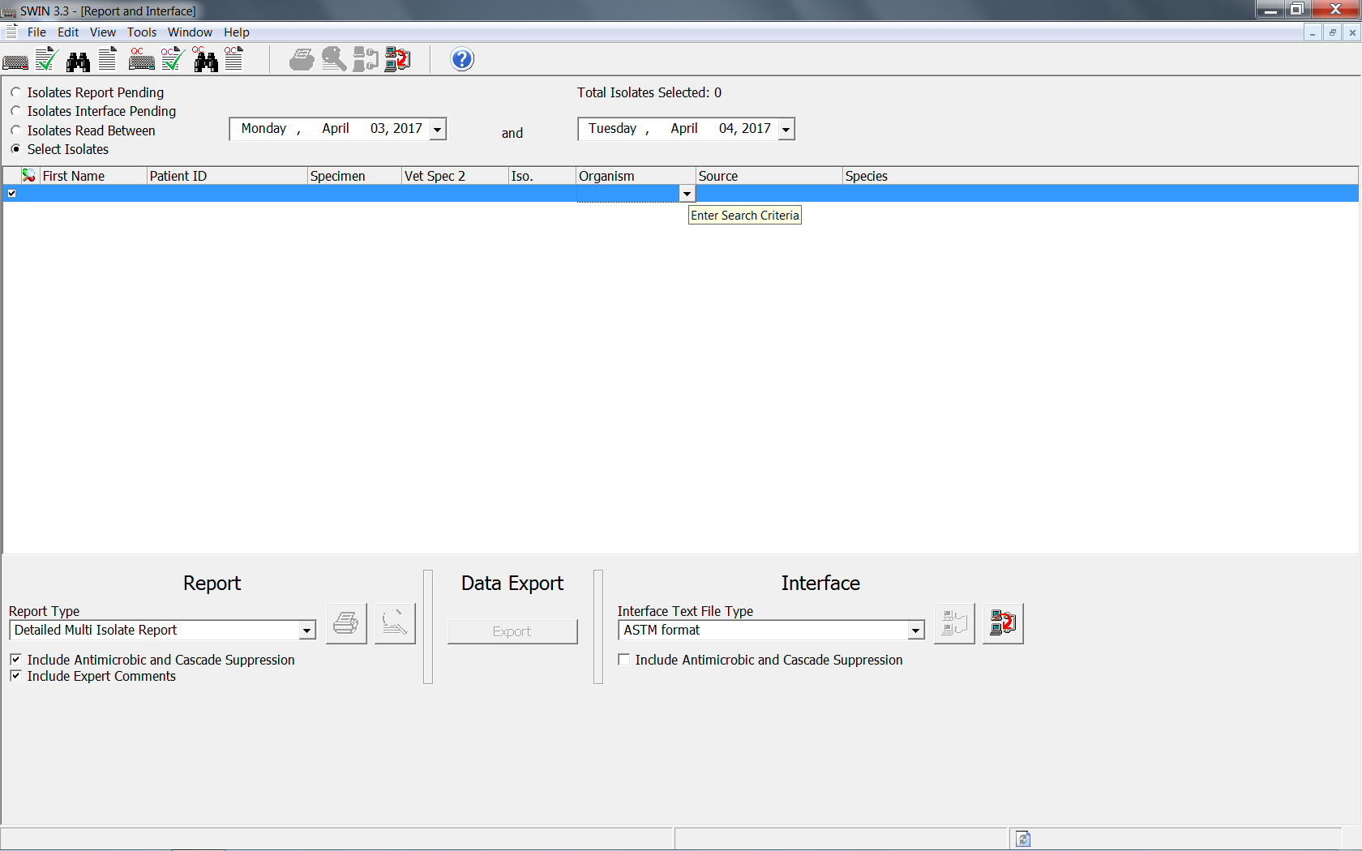
Exporting data from SWIN to a text file
From within the SWIN software, select the “Report and Interface” icon (looks like a sheet of paper)
At the top of the page, select the appropriate bullet for how you want to select the needed isolates
“Isolates Read Between” – enter dates and all isolates read during that time are selected
“Select Isolates” – After making this selection, click on one (or more) of the field names (eg. Organism, Source, Species, etc.) to open a drop down menu arrow. Select the search criteria you would like.

Slide 3
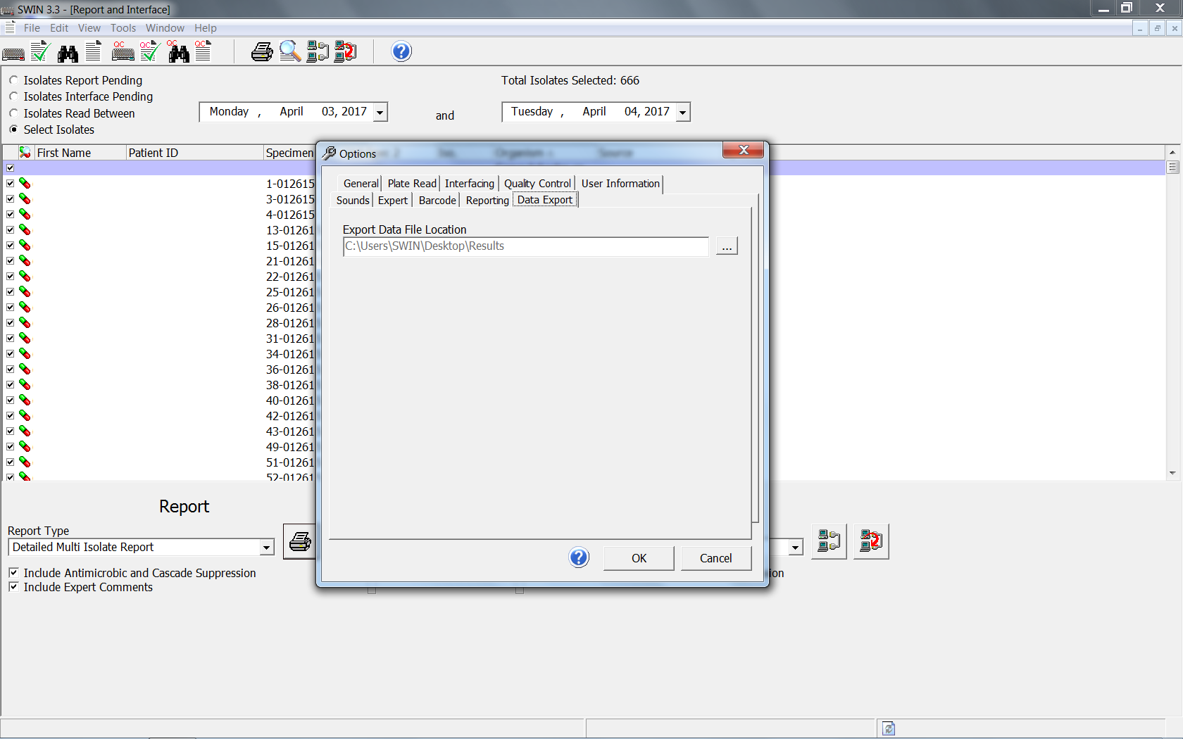
Exporting data from SWIN to a text file
Press <Export> in the middle of the screen. The data.txt file will be saved in a results folder.
To find where your results folder is located (mine is on the desktop):
Select Tools from the menu → Options → Data Export (The window should show “Export Data File Location.”

Slide 4
Exporting data from SWIN to a text file
Navigate to the folder location and your data.txt file should be located there. The file will contain no headers and lots of blank columns that I delete before using BacLink.

Slide 5
Thank you!
On behalf of the WHONET Team, thank you for learning about the WHONET & BacLink Software!

