Slide 1
baclink data import module
WHO Collaborating centre for surveillance of antimicrobial resistance
Creating a laboratory from a data file

Slide 2
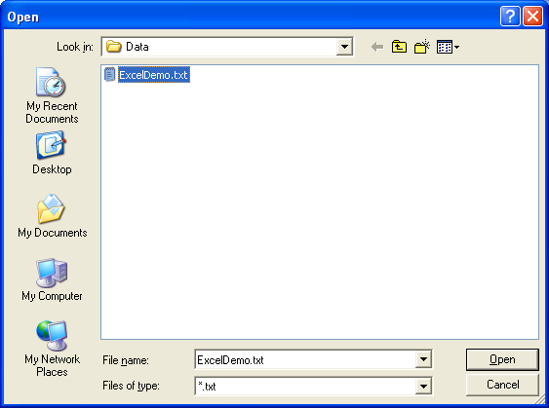
Part 1. Running the conversion
You will now see how to convert your text file to a WHONET file with this new configuration.
You will also see how to check whether the configuration is working and define any of your local data codes that WHONET doesn’t recognize.
Starting the conversion
Original data file: Click on the File format for “BacLink Tutorial Hospital” that you configured in the previous step.
In the upper box called “File name” click on “Browse” to select the file “ExcelDemo.txt”.

Slide 3
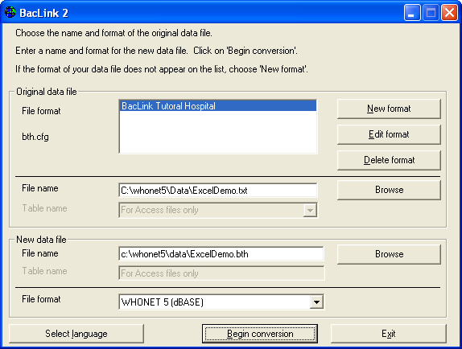
Part 1. Running the conversion
New data file
In the lower box, you need to indicate the name of the new WHONET file that you are about to create. For this tutorial, give the file the name: “ExcelDemo.bth”.
You can give the new file any name that you like, but it will be convenient for your data file management if all of your data files end with the three-letter code that you gave to your laboratory, in this tutorial “bth”.
If you did these steps properly, your screen should look like the following.

Slide 4
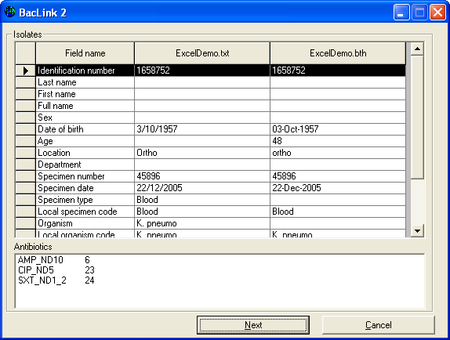
Part 1. Running the conversion
Inspecting the conversion
Click on “Begin conversion”. BacLink will display for you results from the conversion of the first three isolates in the original data file.
The purpose is to allow you to visually inspect the accuracy of the conversion. On the below screen, you see results from the first isolate.

Slide 5
Part 1. Running the conversion
Inspecting the conversion
First focus on the middle column to see whether BacLink is reading the data values correctly, and check the final column to see whether BacLink is converting the data values correctly.

Slide 6
Part 1. Running the conversion
For this first isolate, there seems to be no problem with Identification number, Location, Date of birth, and Specimen number.
There also appears to be no problem with Specimen date – you should always check the reformatting of the date to ensure that you have selected the correct date format (D/M/Y, M/D/Y, MMDDYYYY, Y-M-D, etc.).
You will also notice that BacLink calculates the patient’s age using the date of birth and specimen date fields.

Slide 7
Part 1. Running the conversion
For Organism, you will notice that there are two similar rows: “Organism” and “Local organism code”.
The first of these if intended for the WHONET organism code, while the second is intended to save the original organism code from you data file without modification.
Since you have not yet defined the correspondence between your local code and the WHONET code, the first of these two rows is blank.

Slide 8
Part 1. Running the conversion
The situation with Specimen type is similar. In the row “Specimen type”, BacLink leaves the WHONET field blank because it does not know what the corresponding WHONET code is for “Blood”.
In the row “Local specimen code”, the original entry is copied over. Finally, in the lower box, you will see that BacLink was able to transfer the antibiotic results correctly.

Slide 9
Part 1. Running the conversion
So from this first record, we can conclude that BacLink is reading the data file correctly, and is saving most of the information into the new WHONET file accurately.
However, BacLink has difficulty with the organism and specimen type fields because the codes have not yet been defined.
If you think you may have made a mistake in your configuration, click “Cancel” and return to “Edit format” to make the correction.
Otherwise, click on “Next” to proceed with the second isolate.

Slide 10
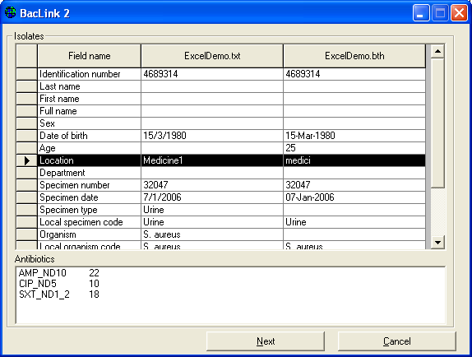
Part 1. Running the conversion
In the second isolate, you will notice a small problem that did not appear with the first isolate.
The location code “Medicine 1” has been abridged to “medici”. This is because the default length of the location field is 6 characters.
This will be easy to fix later by changing the field length to a larger value.

Slide 11
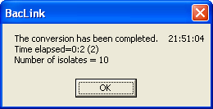
Part 1. Running the conversion
Click on “Next” to see the third isolate, and then “Next” again.
BacLink will now proceed to finish the conversion of the rest of the data file.
BacLink will tell you how many isolates it converted – 10 isolates in this tutorial.
Click on “OK” to continue.

Slide 12
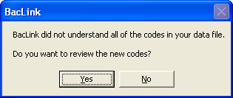
Part 1. Running the conversion
Defining unrecognized codes
When the conversion is finished, BacLink may alert you that it encountered some codes that it did not recognize. In this tutorial, you should see the below message. Click “Yes”.

Slide 13
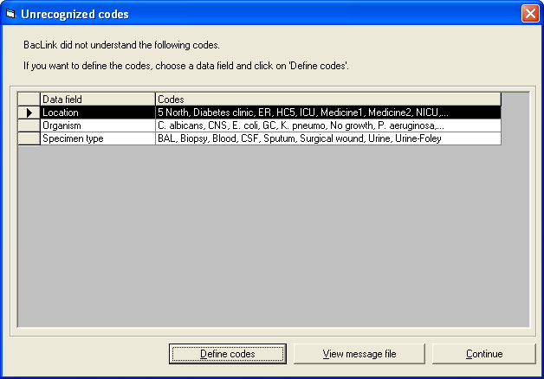
Part 1. Running the conversion
BacLink will show you a summary of all of the different codes that it did not recognize, as in the below screen.

Slide 14
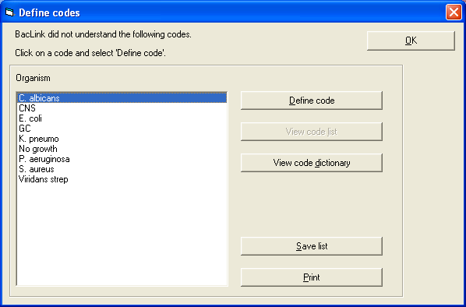
Part 1. Running the conversion
In this tutorial, BacLink indicates that there are unrecognized locations, organisms, and specimen types. We won’t worry about the locations at this point until the problem with the field lengths is fixed (from six characters to a larger value).
Click on the row “Organism”. Now click on “Define codes” to see the following screen with a list of all of the unrecognized organism codes/text.

Slide 15
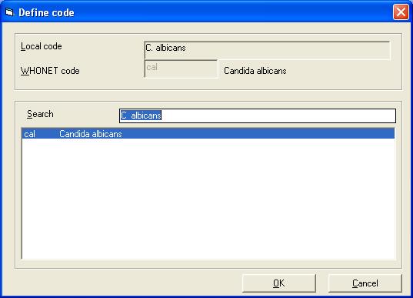
Part 1. Running the conversion
Click on the first organism “C. albicans” and “Define code”.
BacLink will now suggest a number of possible matches for this organism.
If you see the correct match, click on the organism and click “OK”.

Slide 16
Part 1. Running the conversion
If you do not see the organism listed, then use the search box to look for the correct organism.
For example, instead of “CNS” or “Coagulase-negative staphylococci”, WHONET has an entry “Staphylococcus, coagulase-negative”.

Slide 17
Part 1. Running the conversion
To search for an organism, type one or more letters of the genus name and one or more letters of the species name, for example type “Staph coag” to find possible matches for “CNS”.
For “GC”, you should do a search for something similar to “Neiss gon”.

Slide 18
Part 1. Running the conversion
After you match the first organism, continue to match all of the rest of the organisms.
If you cannot find an appropriate match, you can call the organism “Other” or you can leave it undefined.
Then click, “OK” to return to the list with the other undefined codes.
You will see that the organism row has disappeared because all of the organisms have been defined.

Slide 19
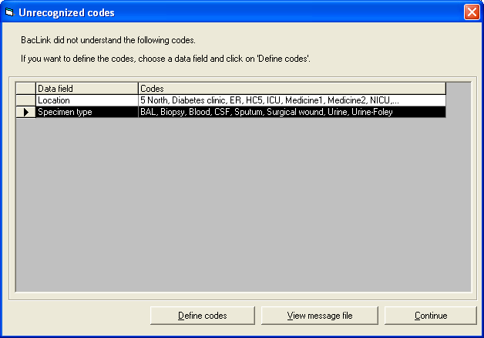
Part 1. Running the conversion
Note: If you have a very long list of codes, there is no need to define all of them.
Begin with the most common or important ones.
If you do not define a code, WHONET will leave the corresponding WHONET field blank, but will still save the original organism code in the column “Local organism code”.

Slide 20
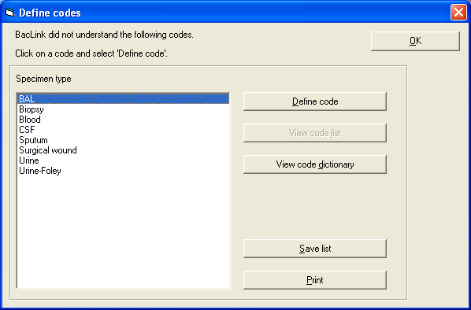
Part 1. Running the conversion
Click on the row for “Specimen type” and “Define codes”.
Define the specimen types one at a time, finding the closest match on the WHONET list.
When you finish matching the specimen types, click “OK” to return to the remaining list of unrecognized codes.

Slide 21
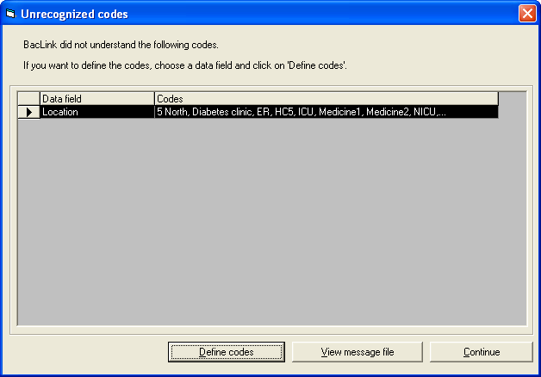
Part 1. Running the conversion
Since we will define the locations later,
click “Continue”.
BacLink then warns that you have defined some additional codes that were not included during the conversion.
Click “OK” to return to the main BacLink screen.

Slide 22
Part 1. Running the conversion
Click “OK” to return to the main BacLink screen.

Slide 23
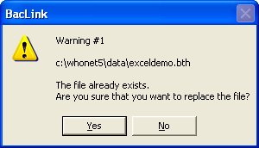
Part 1. Running the conversion again
Now that you have matched some of your codes with the appropriate WHONET codes, run the conversion again.
Click on “Begin conversion”.

Slide 24
Part 1. Running the conversion again
BacLink will give you a warning (Warning #1) that the WHONET file that you want to create already exists, and asks whether you want to replace it.
Answer “Yes”, since the first time was just an initial test.

Slide 25
Part 1. Running the conversion again
BacLink will then ask again (Warning #2) just to make sure that you read the question. Answer “Yes” again.

Slide 26
Part 1. Running the conversion again
BacLink will then ask again (Warning #2) just to make sure that you read the question. Answer “Yes” again.

Slide 27
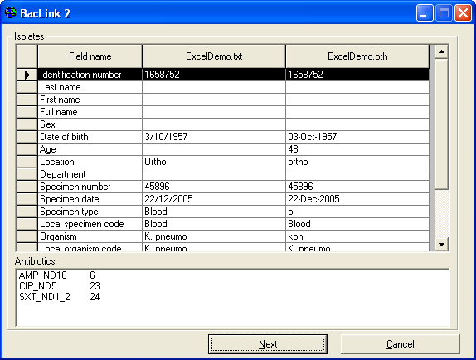
Part 1. Running the conversion again
Click “Next isolate”, and you will see that the problem with the length of the location code field still persists (“medici” instead of “medicine 1”).
Click “Next” and “Next” again to finish the conversion. BacLink indicates that it converted ten isolates.

Slide 28
Part 1. Running the conversion again
Click “OK”, and answer “Yes” to the question about the unrecognized codes. This time, you will see that the list of unrecognized codes is much shorter than before.
Only the locations remain to be defined. Click on “Continue” to return to the main BacLink screen.

Slide 29
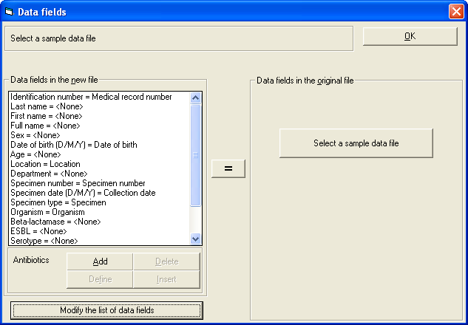
Editing the configuration
The conversion is working in most respects with the exception of the location codes which are being shortened to six characters. This is easy to fix.
Click on “Edit format” from the main BacLink screen to return to the configuration part of BacLink.
Click on “File format” and “Data fields”. This will return you to the screen in which you defined the matches between the fields in the Excel data file and in WHONET.

Slide 30
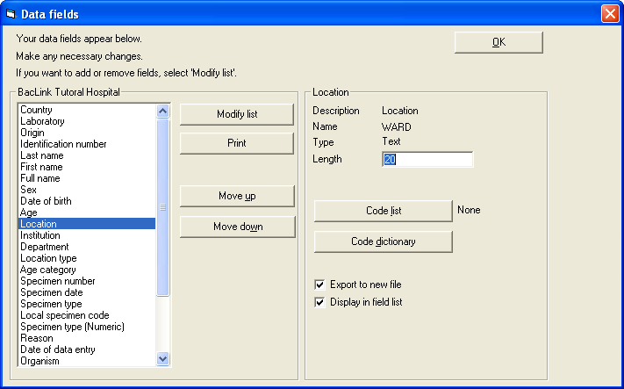
Editing the configuration
Click on “Modify the list of data fields”. You will see the following screen. From this screen, you can configure the current fields, add additional ones to the list, and delete fields that you do not need.
Click on the option “Location”. On the right side of the screen, you will see that this length of this field is set to 6 characters. Change this to 20.

Slide 31
Editing the configuration
Then click “OK”, “OK”, “OK”, “Save”, and “Exit”. This should return you to the main BacLink screen.

Slide 32
Thank you!
On behalf of the WHONET Team, thank you for learning about the WHONET & BacLink Software!

