Slide 1


Slide 2
Cumulative Antibiogram (CA) –
Basics and Pitfalls
Jens Thomsen MD MPH
Section Head, Environmental Health
Abu Dhabi Public Health Center

Slide 3
Learning Objectives
Identify recommendations for CA preparation
Discuss routine versus enhanced CA
Explain how to handle repeat specimens
Explain how to ensure quality of cumulative antibiograms (avoiding common pitfalls)

Slide 4
What is a Cumulative Antibiogram (CA)?
Definitions:
A report summarizing the susceptibility of commonly isolated microorganisms to usual antibiotics in a defined period of time
A periodic summary of antimicrobial susceptibility of clinically relevant bacterial and fungal isolates from clinical samples
..

Slide 5
Routine versus Enhanced Cumulative Antibiogram
Routine CA
  Reporting overall susceptibility rates (no stratification)
  Isolates from all sources / locations / units etc.
Enhanced CA
  Routine CA, plus stratified data (breakdowns)
    By nursing unit or site of care (patient location, e.g. IP/OP/ICU)
    By specimen type (e.g. blood, urine, respiratory, pus, …)
    By infection site (e.g. S. pneumoniae: meningitis/non-men.)
    By clinical service or patient population
  Additional analysis, e.g. combination therapy

Slide 6
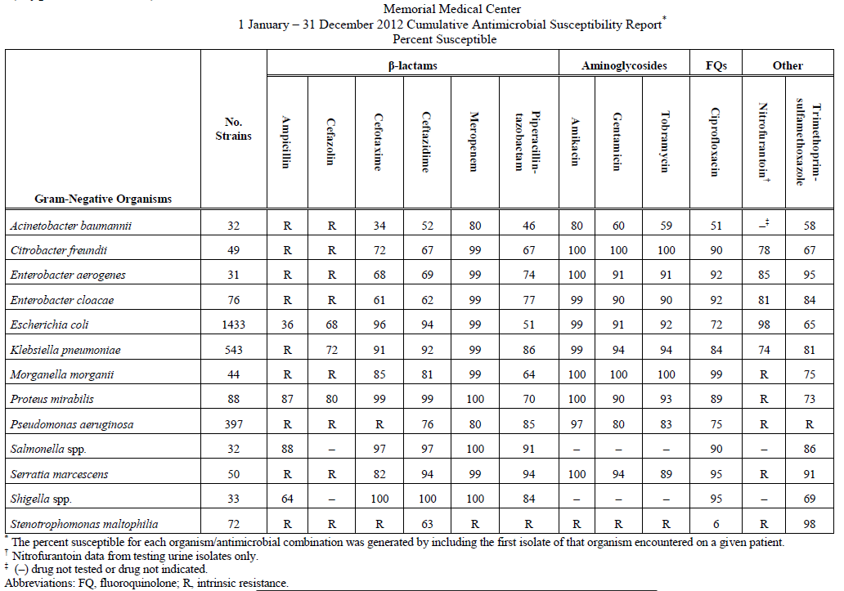
How does a Cumulative Antibiogram look like?
CLSI M39-A4, 2014 [1]

Slide 7
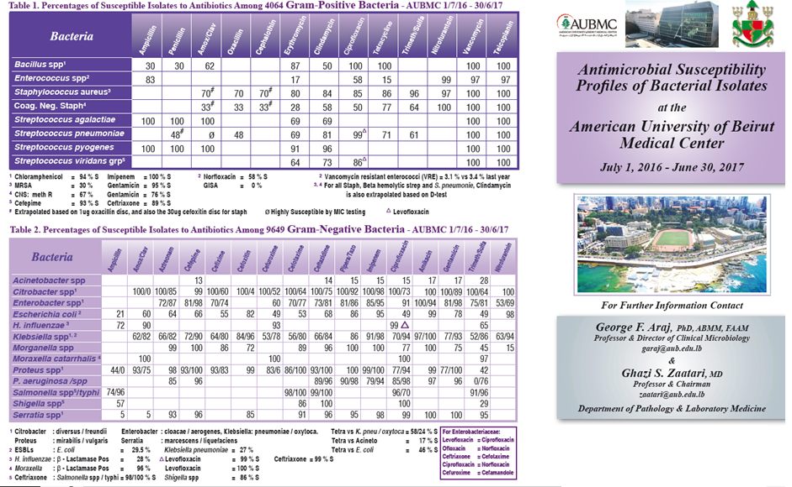
CA: Other examples…

Slide 8
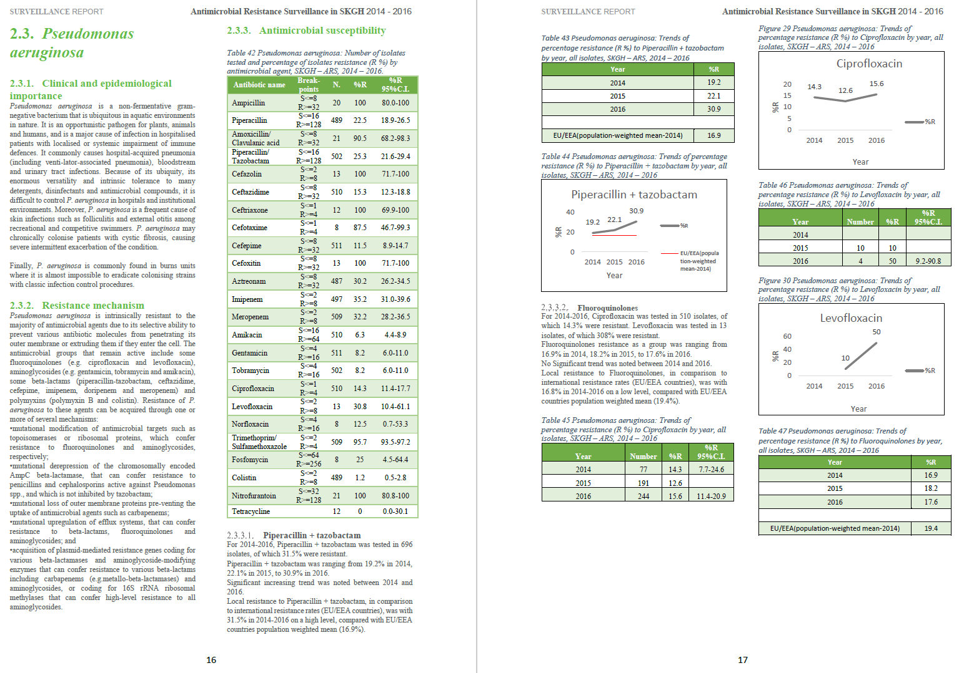
CA: Other examples…

Slide 9
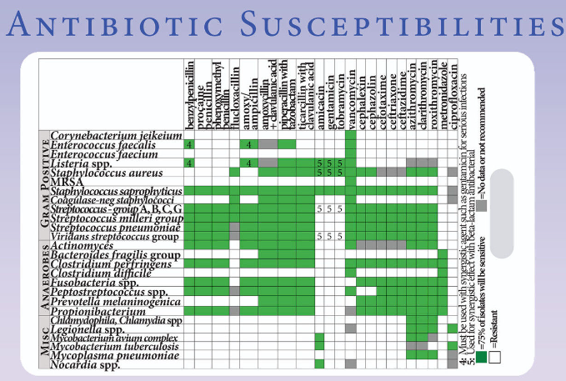
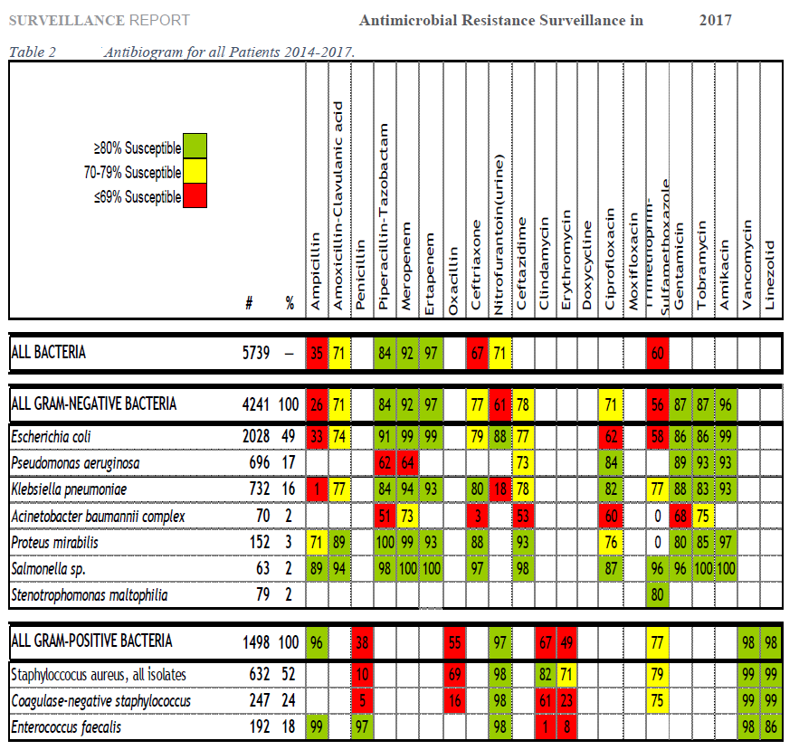
CA: Other examples…

Slide 10
Why a Cumulative Antibiogram?
It is crucial to monitor current levels, and emerging trends in resistance at the local, and national level to support
  Clinical decision making
  Infection control interventions, and
  Antimicrobial-resistance containment strategies

Slide 11
Why a Cumulative Antibiogram? (2) – Recommended by Relevant Guidelines
A calculated therapy with antimicrobial agents for any given patient depends on available microbiological results for this patient and his immediate environment, as well as on the resistance situation of the unit where the patient is treated.
If such data are not available, regional, or national data can be utilized.
S2k Guideline: EAT of bacterial infections in adults (PEG, Germany, 2019) [2]

Slide 12
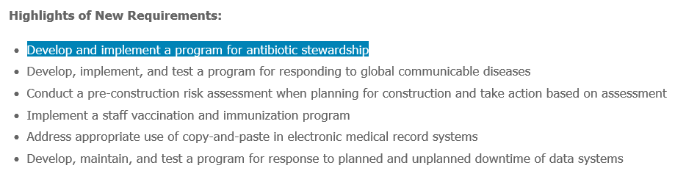
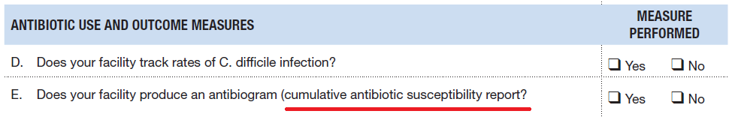
Why a Cumulative Antibiogram? (3) – It is required by Hospital Accreditation Standards (e.g. JCI)
JCI [10]. CDC (2014) [9]

Slide 13
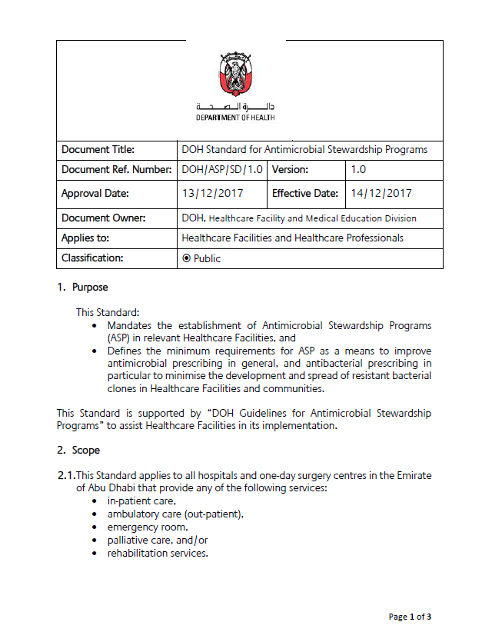
Why a Cumulative Antibiogram? (4) – It is a legal requirement in Abu Dhabi (Dept. of Health)
Mandatory Elements for the Implementation of ASP:
  Clause 4.5 Cumulative Antibiogram:
  “Develop and update a facility-based cumulative antibiogram, at least once a year, and publish internally to ensure access by Healthcare Professionals”
DoH Standard for Antimicrobial Stewardship Programs (Dec 2017) [3]

Slide 14
Why a Cumulative Antibiogram? Overall:
Cumulative antimicrobial susceptibility test (AST) data are needed to
Inform clinicians on local levels and trends of antimicrobial resistance/susceptibilities
Guide clinicians for making decisions on initial empirical antimicrobial therapy for infections
Guide and inform antibiotic stewardship programs (ASPs)
Reveal and document trends in emerging resistance at HCF level
Compare susceptibility rates, within and across different facilities
Benchmark to national and international susceptibility rates, and to
Comply with accreditation and legal requirements

Slide 15
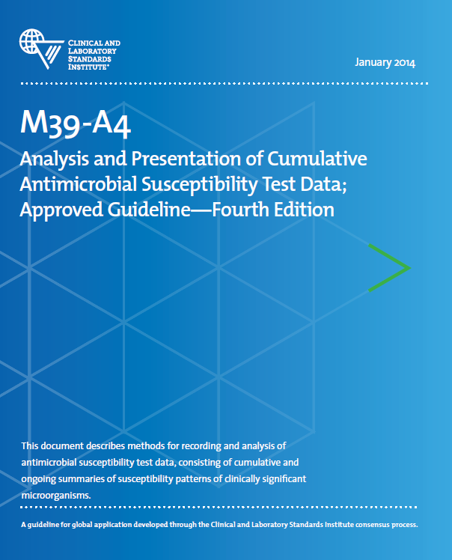
CLSI Guideline M39-A4, 2014
“It is important to recognize that many of the specific recommendations … have been made with the primary aim in guiding clinicians in the selection of initial empirical antimicrobial therapy (EAT)”
CLSI M39-A4, 2014 [1]

Slide 16
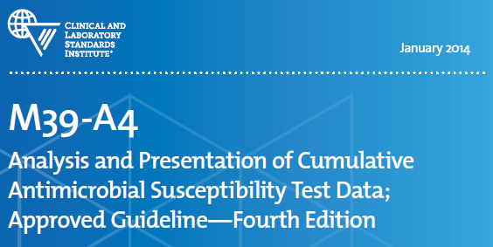
CLSI Guideline M39-A4, 2014
“CA is useful to clinicians in the selection of the most appropriate agents for initial empirical antimicrobial therapy (EAT)”
First isolate per patient only
CA is not suitable for individual patient management
CLSI M39-A4, 2014 [1]

Slide 17
CLSI Guideline M39-A4, 2014 - Summary
Routine CA
  Should be generated at least 1x/year
  Isolates from all sources/location types/units
Enhanced CA
  Sub-group analysis (if number of isolates allows)
  Routine CA + Breakdowns by
    Location type
    Specimen type,
    Patientcare unit, etc.
  Additional analysis
CLSI M39-A4, 2014 [1]

Slide 18
CLSI Guideline M39-A4, 2014 - Summary
DO REPORT
  Final, validated AST results
  Species with results for N≥30 isolates*
  Routinely tested antibiotics
  %Susceptible
  Diagnostic isolates
  First isolate per species/ patient/analysis period
DO NOT REPORT
  Preliminary AST results
  Species with results for N<10 isolates*
  Selectively tested antibiotics
  %Resistant, %Intermediate
  Surveillance + QC isolates
  Duplicate isolates (copy strains, multiple isolates)
*If 10<N<30: Consider grouping, or add a note of caution
CLSI M39-A4, 2014 [1]

Slide 19
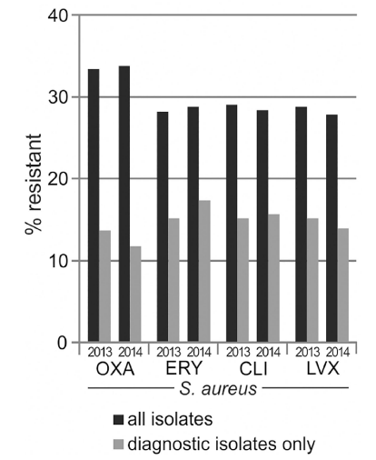
Reporting ‘All Isolates’, versus ‘Diagnostic Isolates’ only
‘All Isolates’ skews %R estimates towards higher resistance rates, thus:
Do not report surveillance or screening isolates:
  MRSA/CRE/VRE Screening
  Nose/axilla/groin?
Report diagnostic isolates
Know your local screening policies, and how the data is coded
How to filter for them?
Kohlmann R, Gatermann SG. PLoS One (2016) [4]

Slide 20

WHONET Software allows to exclude Screening and QC/Lab Isolates
By default, QC/Lab isolates are excluded from analysis
By default, Screening isolates are excluded from analysis
WHONET 2019 [11]

Slide 21
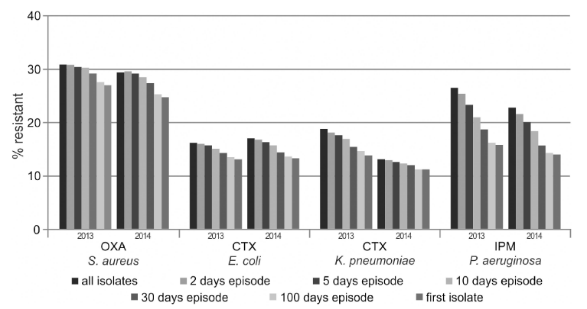
Reporting ‘All Isolates’, versus ‘First Isolate’ only
Report ‘First Isolate per Patient’ only, remove duplicates
How to filter for ‘First isolate’?
By which criteria? (E.g.: Patient? Time interval? Phenotype?)
Kohlmann R, Gatermann SG. PLoS One (2016) [4]. WHO 2001 [7]

Slide 22
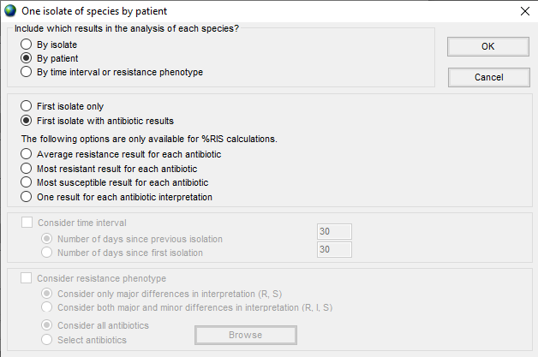
WHONET Software allows to Filter for ‘First Isolate’
By patient
First isolate with antibiotic results
Do not consider time interval, e.g. 30 days
Do not consider resistance phenotype
WHONET 2019 [11]
Note: By default, WHONET considers all isolates (no deduplication)

Slide 23
Presenting the Data
Date of the report
Name of the Laboratory / Facility
Information about the AST methodology and interpretation standard used
Report breakpoint changes, if applicable
Separate tables for relevant Gram-neg. bacteria, and Gram-pos. bacteria
  If applicable: Anaerobes, Yeasts
CLSI M39-A4, 2014 [1]

Slide 24
Presenting the Data (Continued)
Recommended list of Gram-neg. Bacteria:
  Acinetobacter baumannii**
  Citrobacter freundii
  Enterobacter aerogenes*
  Enterobacter cloacae
  Escherichia coli
  Haemophilus influenzae
  Klebsiella pneumoniae
  (Klebsiella oxytoca)
  (Moraxella catarrhalis)
  Morganella morganii
  Proteus mirabilis
  (Proteus vulgaris)
  Providencia spp.
  Pseudomonas aeruginosa**
  Salmonella spp.
  Serratia marcescens
  (Serratia liqufaciens)
  Shigella spp.
  Stenotrophomonas maltophilia**
*now: Klebsiella aerogenes
**Glucose-non-fermenting: may be grouped together
CLSI M39-A4, 2014 [1]

Slide 25
Presenting the Data (Continued)
Recommended list of Gram-pos. Bacteria:
  Enterococcus spp., and separately (if identified to species level):
    Enterococcus faecalis
    Enterococcus faecium
  Staphylococcus aureus
  Coag.-neg. Staphylococci, and separately (if sufficient numbers):
    S. lugdunensis
    S. saprophyticus
  (Streptococcus agalactiae)
  Streptococcus pneumoniae
  (Streptococcus pyogenes)
  Viridans group Streptococci (from usually sterile sources)
CLSI M39-A4, 2014 [1]

Slide 26
Presenting the Data (Continued)
Recommended list of anaerobe Bacteria:
  Bacteroides fragilis
  Bacteroides fragilis group (other than B. fragilis)
  Clostridium perfringens
CLSI M39-A4, 2014 [1]

Slide 27
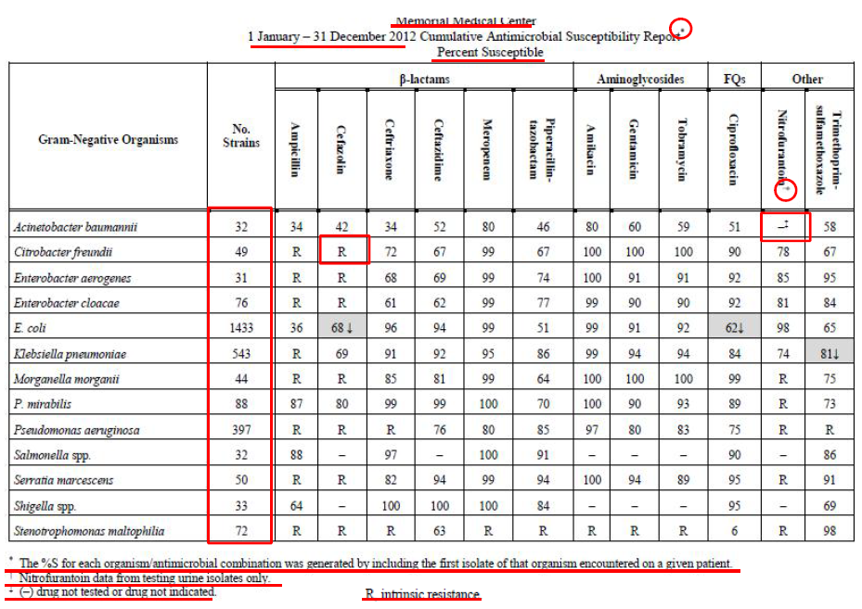
Facility name
%Susceptible
Time period
Antibiotics by Class
Selective testing
(NIT)
Number of isolates
‘-’: Drug not indicated or not tested
R: Intrinsic resistance
Resistance trends
First isolate only

Slide 28
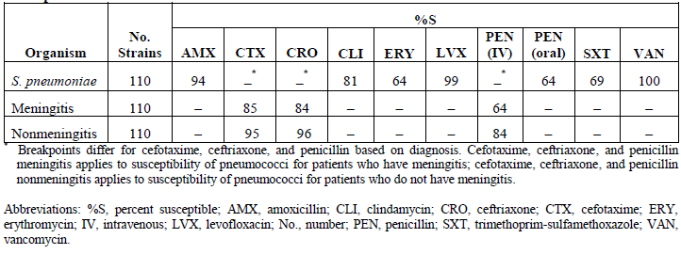
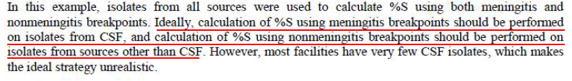
Presenting the Data – Subgroup Analysis (Enhanced CA)
Streptococcus pneumoniae
CLSI M39-A4, 2014 [1]

Slide 29
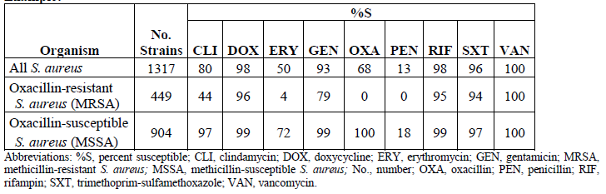
Presenting the Data – Subgroup Analysis (Enhanced CA)
S. aureus / MRSA / MSSA
CLSI M39-A4, 2014 [1]

Slide 30
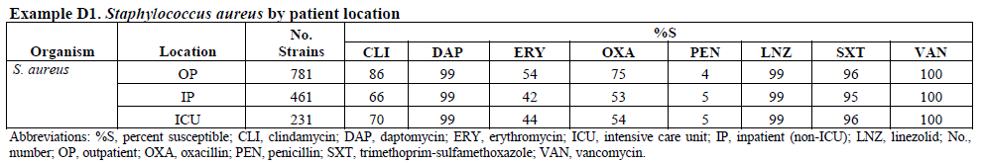
Presenting the Data – Subgroup Analysis (Enhanced CA)
S. aureus – By Patient Location
CLSI M39-A4, 2014 [1]

Slide 31
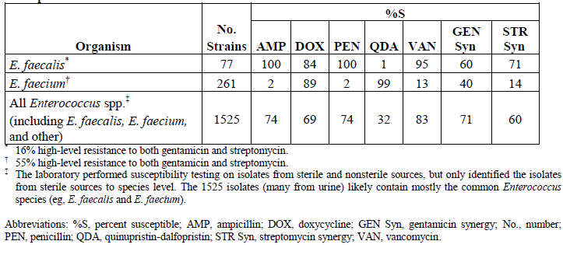
Presenting the Data – Subgroup Analysis (Enhanced CA)
Enterococcus spp. / E. faecalis / E. faecium
CLSI M39-A4, 2014 [1]

Slide 32
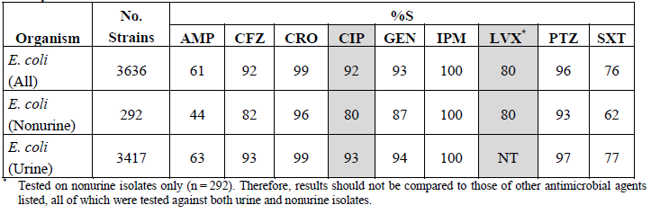
Presenting the Data – Subgroup Analysis (Enhanced CA)
E. coli (all) / Non-Urine / Urine
CLSI M39-A4, 2014 [1]

Slide 33
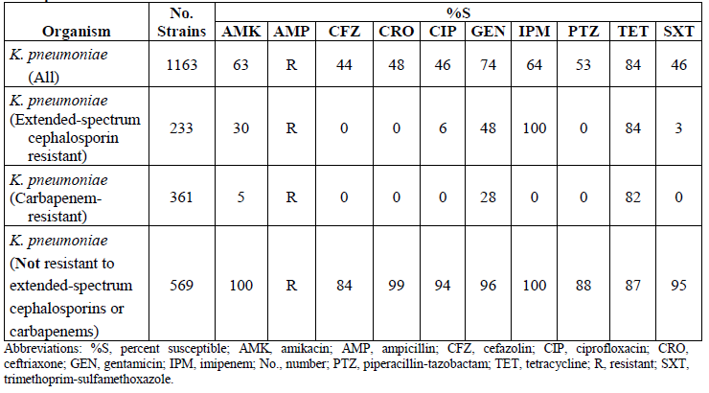
Presenting the Data – Subgroup Analysis (Enhanced CA)
K. pneumoniae – By MDRO Phenotype
CLSI M39-A4, 2014 [1]

Slide 34
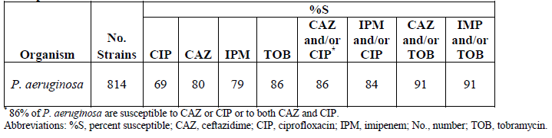
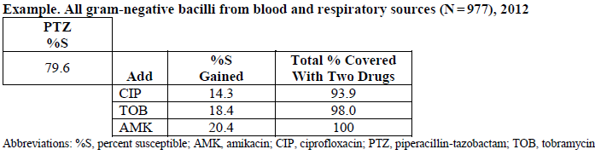
Presenting the Data – Additional Analysis (Enhanced CA)
Single- and Combined-Drug Susceptibility
Note:
This is not a SYNERGY Study
Results are based on the combination of susceptibilities to individual drugs
Very easy to do in WHONET
(Scatterplot Analysis)
CLSI M39-A4, 2014 [1]

Slide 35
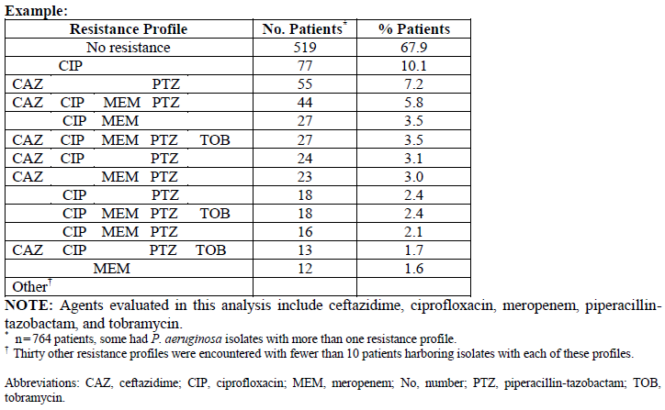
Presenting the Data – Additional Analysis (Enhanced CA)
By Susceptibility Profile
Very easy to do in WHONET
(Resistance Profiles)
CLSI M39-A4, 2014 [1]

Slide 36
Presenting the Data: Why N ≥ 30? Confidence intervals
95% Confidence Intervals (C.I.)* quantify the precision of the %S estimate. They depend on sample size:
12 out of 30 isolates are susceptible: %S = 40 %
  95 % C.I.: 22% - 58 % (±18%)
40 out of 100 isolates are susceptible: %S = 40 %
  95 % C.I.: 30% - 50% (±10%)
400 out of 1000 isolates are susceptible: %S = 40 %
  95 % C.I.: 37% - 43% (±3%)
4,000 out of 10,000 isolates are susceptible: %S = 40 %
  95 % C.I.: 39% - 41% (±1%)
*Agresti and Coull [5]

Slide 37
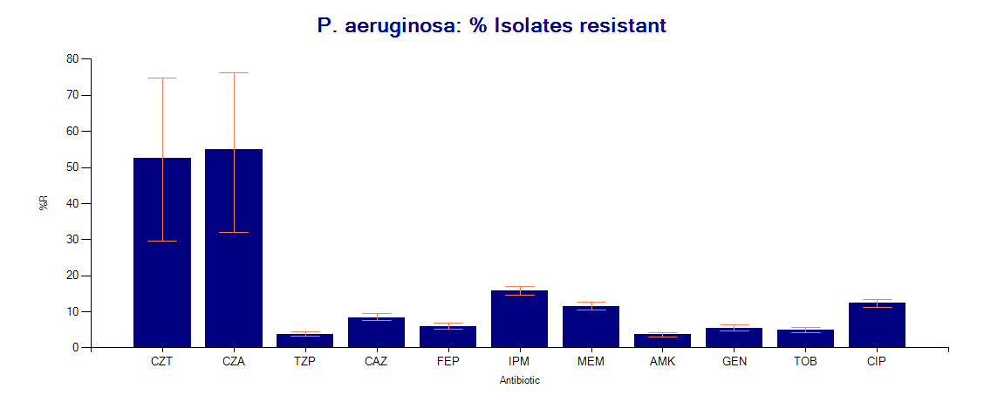
Presenting the Data: Why N ≥ 30? Confidence intervals
Large C.I. = less precise estimate
Small C.I. = highly precise estimate
Antibiotic: CZT CZA TZP CAZ FEP IPM MEM AMK GEN
Isolates tested (N): 19 20 3,159 3,494 3,365 …
CZT: Ceftolozane-Tazobactam
CZA: Ceftazidime-Avibactam
Do not report in CA!
Selectively tested (few MDR isolates)
→ Highly ‘resistant’
→ large confidence intervals

Slide 38
Interpretation Standards: CLSI versus EUCAST, here: Meropenem
Not a problem in UAE, as most labs use CLSI
Pathogen | EUCAST (2019) (S/R) – mg/l | CLSI (2019) (S/R) – mg/l
Enterobacterales | ≤2 / >8 | ≤1 / ≥4
Pseudomonas spp. | ≤2 / >8 | ≤2 / ≥8
Acinetobacter spp. | ≤2 / >8 | ≤2 / ≥8
Staphylococcus spp. | Depends on susceptibility to Cefoxitin | Depends on susceptibility to Oxacillin (or Cefoxitin)
Streptococcus Gr. A, B, C, G | Depends on susceptibility to Penicillin | ≤0.5 / -
Streptococcus pneumoniae | General: ≤2 / >2 Meningitis: ≤0.25 / >1 | ≤0.25 / ≥1
Haemophilus influenzae | General: ≤2 / >2 Meningitis: ≤0.25 / >0.25 | ≤0.5 / -
Neisseria meningitidis | ≤0.25 / >0.25 | ≤0.25 / -
Independent of species | ≤2 / >8 | Not defined

Slide 39
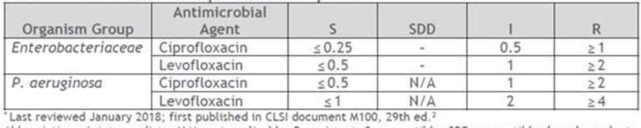
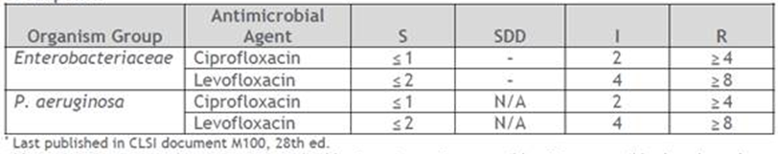
Breakpoints may change over time. Example: Ciprofloxacin
Be aware of breakpoints changes, and report them
Current Fluoroquinolone Breakpoints (CLSI 2019/29th ed.)
Historic Fluoroquinolone Breakpoints (up to CLSI 2018/28th ed.), replaced by Current Fluoroquinolone breakpoints
CLSI MR02 (2019) [14]

Slide 40
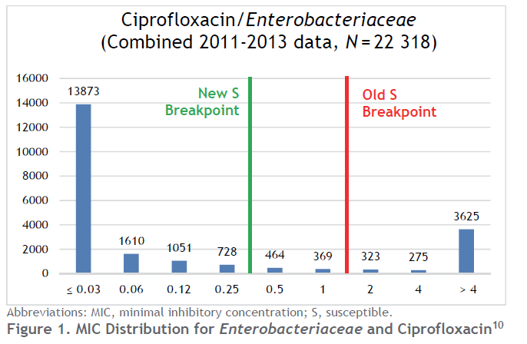
Breakpoints may change over time. Example: Ciprofloxacin
CAs should be based on test measurements (MIC/IZD),
not on interpreted results
This is in particular important for analysis of trends over time
CLSI MR02 (2019) [14]

Slide 41
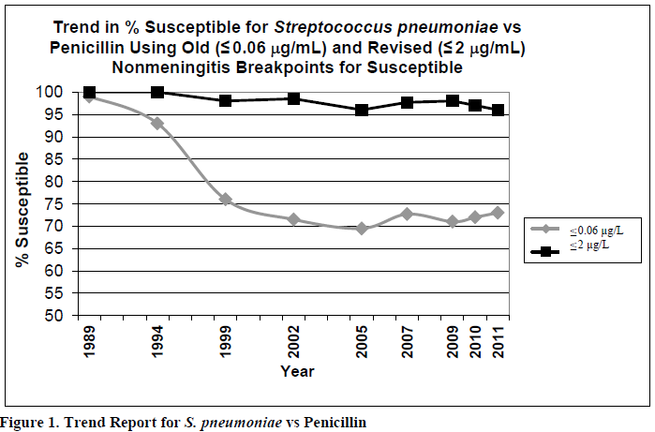
Effects of Breakpoints changes. Example: S. pneumoniae/PEN
CLSI MR02 (2019) [14]

Slide 42
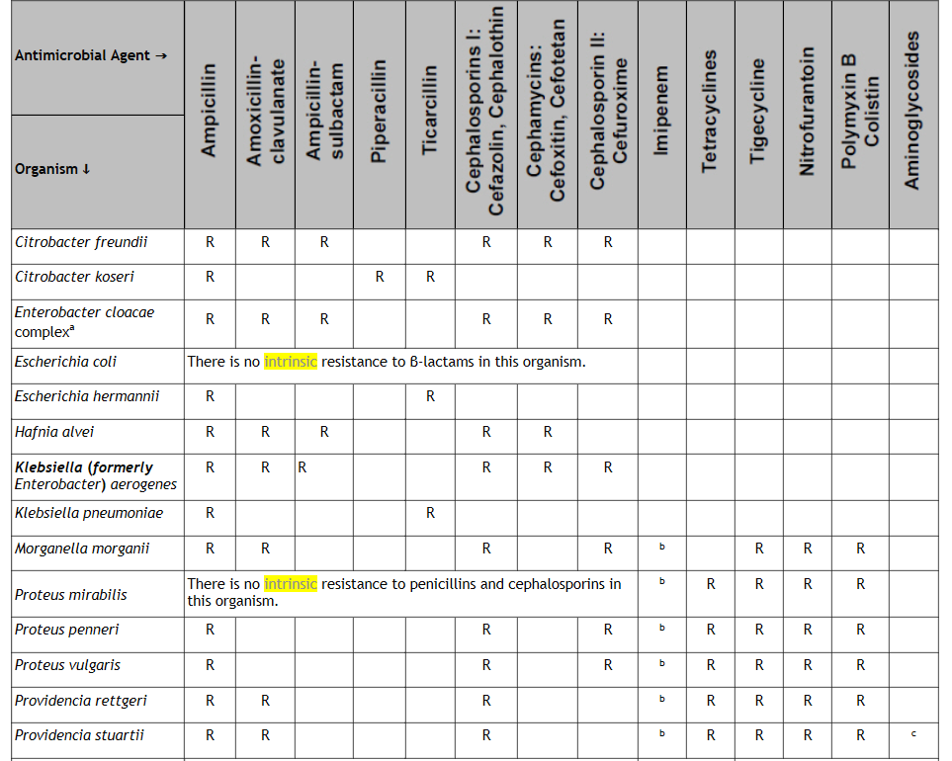
Intrinsic Resistance (R): Gram-neg. Bacteria (Enterobacterales)
  ‘R’ also available for:
  Non-fermenters
  Staphylococcus spp.
  Enterococci
CLSI M100 (2019) [6]

Slide 43
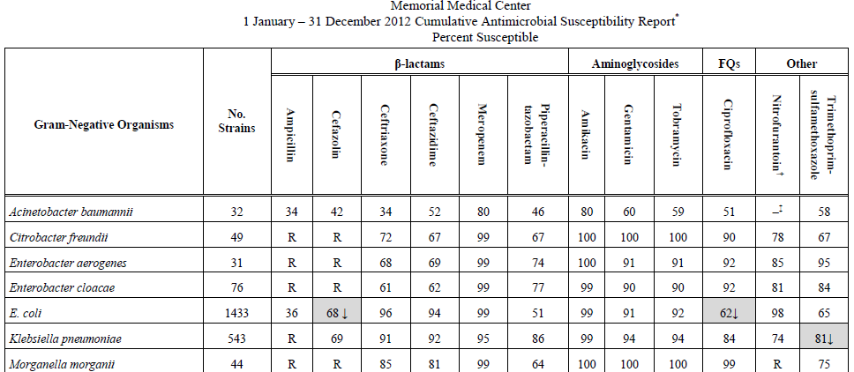
Presenting the Data: Trends over Time (↑↓)
Resistance trends
↓ shows a statistically significant reduction of the percentage susceptible isolates
How to assess statistical significance of trends?

Slide 44
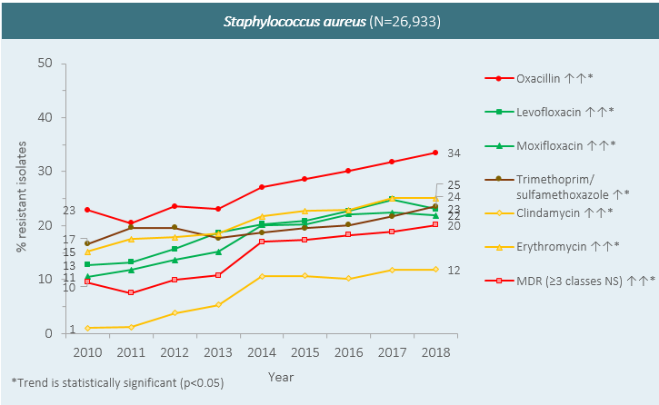
Presenting the Data: Trends over Time (↑↓)
AMR Surveillance. ADPHC/Dept. of Health Abu Dhabi (2019)

Slide 45

Presenting the Data: Comparisons and Trends (↑↓)
Statistical significance of Changes in Susceptibility Rates (%S), e.g.:
  Current year/previous year, inpatient/outpatient, … → Chi-square*
  Multiple years → Chi-square for trends (extended Mantel-Haenszel)
  Can be calculated e.g. with Epi Info (CDC)
p value
  p ≤ 0.05 is generally accepted to indicate that the differences seen are not likely due to chance alone
Note:
  ‘Statistically significant’ difference is not equivalent with ‘clinically/ epidemiologically important’
*if small number of isolates, or %S/%R close to 0: Fisher’s exact test
WHO 2001 [7]. CLSI M39-A4, 2014 [1] Epi Info []

Slide 46

Doing a Chi-Square Test for Trends with Epi InfoTM
Click on
‘STATCALC’

Slide 47
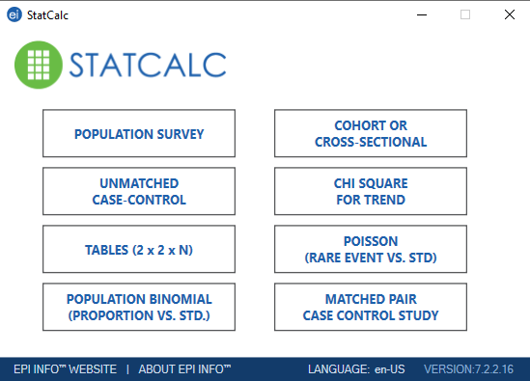
Doing a Chi-Square Test for Trends with Epi InfoTM
Click on
‘Chi Square for Trend

Slide 48
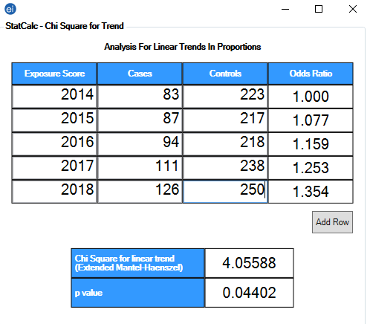
Doing a Chi-Square Test for Trends with Epi Info
Enter the years, and number of cases and controls
P value

Slide 49
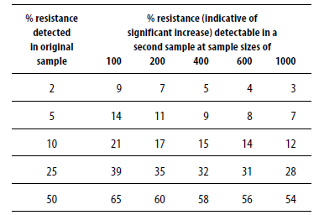
Estimate of Sample Size needed for Documenting increasing Resistance Frequencies
Example:
If 5% of isolates in a sample of 200 is resistant in the first sample:
… an increase to 11% or more in a second sample indicates a significant increase.
WHO 2001 [7]

Slide 50
Presenting the Data: Using Colors, or not?
Using GREEN color only?

Slide 51

Presenting the Data: Using Colors, or not?
Using
GREEN, YELLOW,
and RED colors?

Slide 52
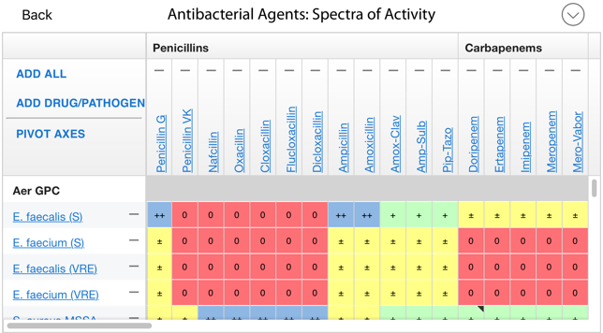
Presenting the Data: Using Colors, or not?
The Sanford Guide to Antimicrobial Therapy [12]

Slide 53
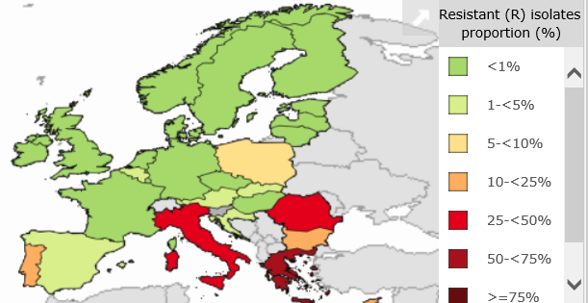
Presenting the Data: Using Colors, or not?
Percentage of K. pneumoniae isolates resistant to Carbapenems (2018)
ECDC Surveillance Atlas of Infectious Diseases (2019) [13]

Slide 54
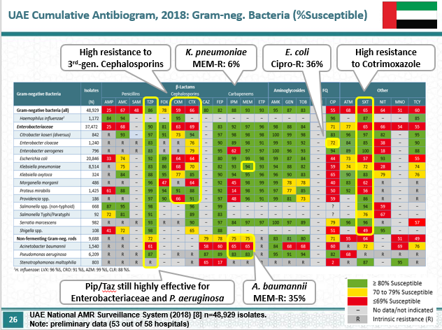
Presenting the Data: Using Colors, or not?
Colors might be helpful to get the key messages across, … BUT:
There is a risk that colors are misunderstood as:
GREEN = ‘GOOD’
RED = ‘BAD’
Which may result in less use of ‘BAD’ drugs, and over-utilization of ‘GOOD’ drugs, incl. Carbapenems

Slide 55
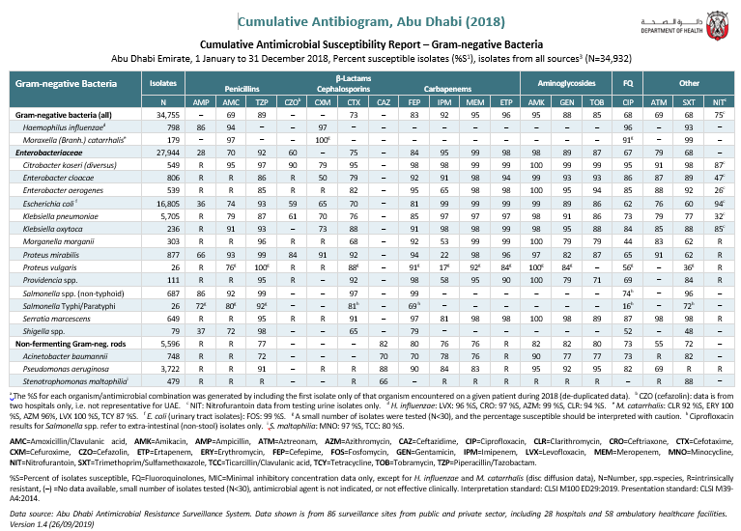
Presenting the Data: Using Colors, or not?
Either don’t use Colors AT ALL
when reporting to
‘ALL DOCTORS’,
OR
Use colors in a smart way
Limit the use of Colors:
Internal discussions (ASP Core Team)
Presentations
(Key messages)
AMR Surveillance. ADPHC/Dept. of Health Abu Dhabi (2019)

Slide 56
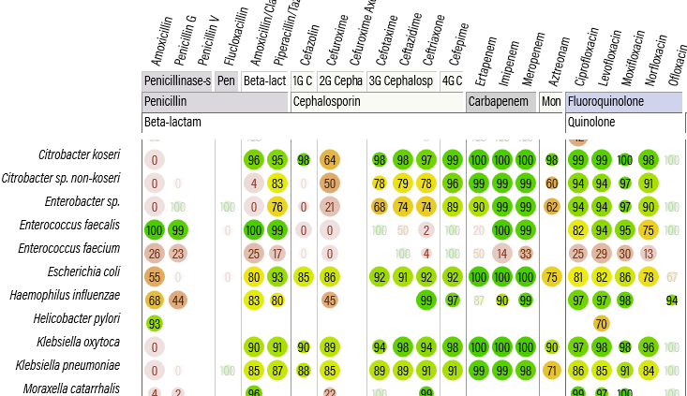
Presenting the Data: Using Colors, or not?
Using colors in a smart way
Color scales
MS Excel:
%S
INFECT.info:
%S
INFECT.info [8]

Slide 57
Summary – The BASICS when reporting CAs:
Facility name
Time period (at least once per year)
Routine CA (all isolates), if possible (N≥30): Enhanced CA
% Susceptible isolates (%S)
Separate tables for Gram-, Gram+, Anaerobes, and Yeasts
Test method and interpretation standard used
First isolate only, no Screening / QC isolates
Routinely tested antibiotics only
Highlight intrinsic resistance (‘R’), and ‘–’

Slide 58
Summary – Common PITFALLS
Small sample size (N<30)
Duplicate isolates
Screening and QC isolates
Antibiotics selectively tested for resistant antibiotics
Statistical significance for comparisons and trends
CLSI versus EUCAST breakpoints
Breakpoints may change over time

Slide 59
Summary – Other PITFALLS
Susceptibility testing not performed correctly
Reproducibility of testing results (e.g. MIC) is not 100%
Sensitivity and Specificity of In-Vitro diagnostic systems and machines for AST is not 100%
Not taking into account expert interpretation rules
Missing isolates with already reduced susceptibility (first-step mutants, e.g. S. pneumoniae and FQs*)
*Pletz et all, AAC 2006[15]

Slide 60
References (1)
Analysis and Presentation of Cumulative Antimicrobial Susceptibility Test Data. M39-A4. Clinical and Laboratory Standards Institute. 4th ed. (2004)
Calculated parenteral initial therapy of bacterial infections in adults. Paul-Ehrlich Society (PEG). S2k Guideline, p32. AWMF 082-006 (2019)
Standard for Antimicrobial Stewardship Programs. Department of Health Abu Dhabi. www.doh.gov.ae (2017)
Analysis and Presentation of Cumulative Antimicrobial Susceptibility Test Data – The Influence of Different Parameters in a Routine Clinical Microbiology Laboratory. Kohlmann R, Gatermann SG. PLoS One (2016) 11(1):e0147965
Agresti, Alan; Coull, Brent A. (1998). "Approximate is better than 'exact' for interval estimation of binomial proportions". The American Statistician. 52 (2): 119–126. doi:10.2307/2685469.
Performance Standards for Antimicrobial Susceptibility Testing. M100:2019. Clinical Laboratory and Standards Institute (CLSI). 28th Edition (2019)
Surveillance standards for antimicrobial resistance. World Health Organization. WHO/CDS/CSR/DRS/2001.5. www.who.int (2001)
INFECT by anresis.ch. https://infect.info/

Slide 61
References (2)
The Core Elements of Hospital Antibiotic Stewardship Programs. CDC. https://www.cdc.gov/antibiotic-use/healthcare/pdfs/core-elements.pdf (2014)
JCI Accreditation Standards for Hospitals, 6th Edition. https://www.jointcommissioninternational.org
WHONET. Software for AMR Surveillance. www.whonet.org
The Sanford Guide to Antimicrobial Therapy. https://www.sanfordguide.com/
ECDC. Surveillance Atlas for Infectious Diseases. https://www.ecdc.europa.eu/en/antimicrobial-resistance
Fluoroquinolone Breakpoints for Enterobacteriaceae and Pseudomonas aeruginosa. CLSI rationale document MR02 (2019)
Prevalence of First-Step Mutants among Levofloxacin-Susceptible Invasive Isolates of S. pneumoniae in the USA. Pletz MWR et al. AAC. 2006;50(4):1561-3.
Epi Info. Centers for Disease control and Prevention (CDC). https://www.cdc.gov/epiinfo/index.html

