Slide 1

GLASS-AMR manual
Carmem L Pessoa-Silva, MD, PhD & GLASS TEAM
Unit Head, Surveillance, Evidence and Laboratory Strengthening Unit
Surveillance, Prevention and Control Dept.
Antimicrobial Resistance Division

Slide 2
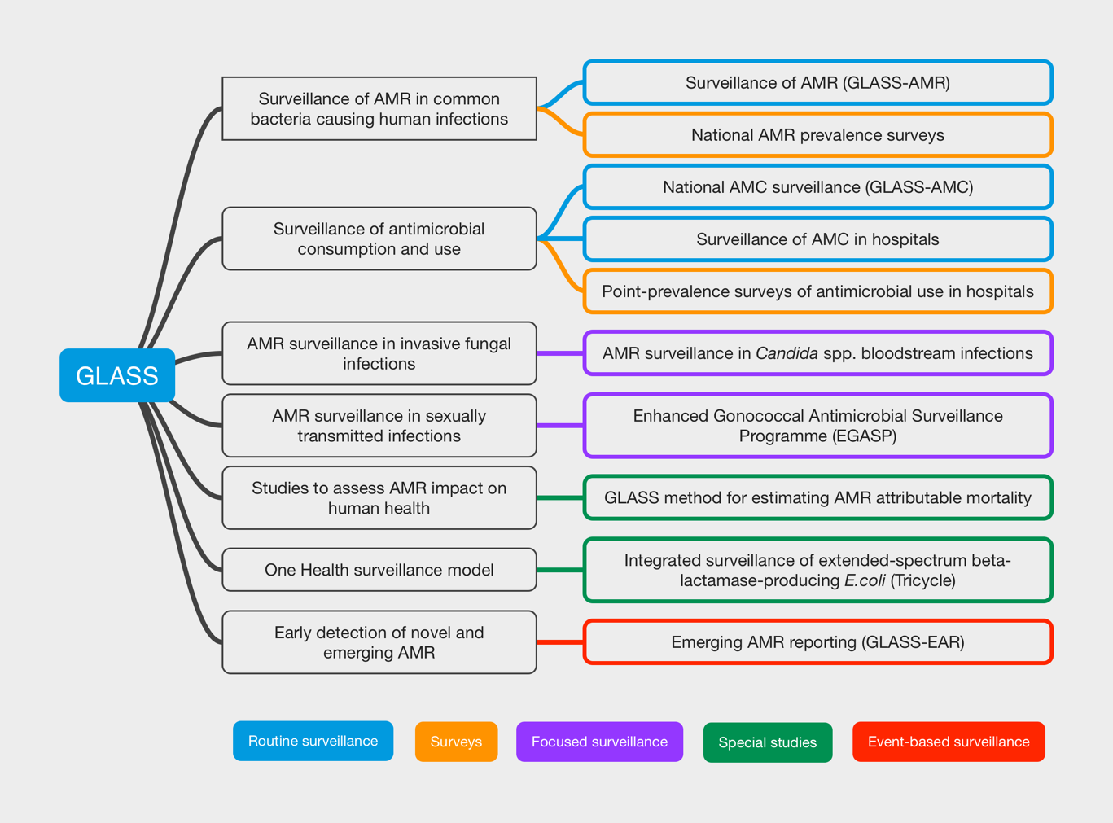
GLASS in 2023

Slide 3







GLASS-AMR core components
Surveillance sites
National reference laboratory (NRL)
National coordinating centre (NCC)

Slide 4
GLASS-AMR data flow
Patient care
Testing indicated
Clinical specimen
Patient information
Microbiological testing
Culture
Species identification
Antimicrobial susceptibility testing
PATIENT
RESULTS
National AMR Action Plan
Allocated Budget
Governance
SURVEILLANCE SITE
Site statistics
Denominators
and metadata
Local data management
Verify data quality
Analyse and consolidate data
LOCAL
REPORT
Individual results
Site statistics
National data management
Verify data quality
Remove repeat isolates
Analyse and consolidate data
NATIONAL
REPORT
NATIONAL LEVEL
Report aggregated data to GLASS
AND/OR
Report anonymized individual level data to GLASS
REGIONAL REPORT
Global data management
Verify data quality
Maintain global AMR data repository shared with regional teams
Analyse data
REGIONAL REPORT
GLOBAL
REPORT
WHO - GLASS
REGIONAL REPORT
WHO REGIONAL
OFFICES & NETWORKS
REGIONAL REPORT
REGIONAL REPORT
REGIONAL REPORT

Slide 5

GLASS-AMR manual
Updated GLASS methods for AMR surveillance in humans
Part of a package of documents and tools to inform GLASS 2.0 implementation
The target readership
  national GLASS focal points
  national public health professionals
  national health authorities related to AMR surveillance in humans
Maybe useful for national professionals from other sectors in the context of the “One Health” approach

Slide 6
Objectives of GLASS-AMR
Generate data to inform AMR prevention and control strategies and assess the impact of interventions;
Foster national AMR surveillance systems and harmonize global standards;
Monitor global AMR trends in bacteria causing common infections in humans and inform the WHO Model Lists of Essential Medicines (33);
Estimate the extent and burden of AMR globally by selected indicators;
Detect emerging resistance and its international spread; and
Inform research and development of new tools for preventing, diagnosing and treating human infections caused by common bacterial pathogens.

Slide 7
GLASS-AMR reporting: what is new [1]
New specimens: cerebrospinal fluid (CSF); respiratory samples; and rectal and pharyngeal swabs for the surveillance of AMR in gonococci
Five new pathogens: P. aeruginosa, N. meningitidis, H. influenzae, S. enterica serovar Typhi and S. enterica serovar Paratyphi A
New antimicrobials to describe the resistance of newly added target pathogens and to include both first - and second-line antimicrobials according to the WHO AWaRe categorization
Revised data model: new variables
New questionnaire (mandatory)

Slide 8
GLASS target pathogens and specimen types
Target pathogens | Blood | CSF | Urine | Stool | Lower respiratory tract | Urethral, cervical, rectal, pharyngeal swabs
Acinetobacter spp. | ● | ○ |  |  | ●
E. coli | ● | ○ | ● |  | ○
K. pneumoniae | ● | ○ | ● |  | ●
P. aeruginosa | ● | ○ |  |  | ●
S. aureus | ● | ○ |  |  | ●
S. pneumoniae | ● | ● |  |  | ●
N. meningitidis | ● | ●
H. influenzae | ○ | ● |  |  | ●
Salmonella spp. (non-typhoidal) | ● | ○ |  | ●
S. enterica serovar Typhi | ● |  |  | ○
S. enterica serovar Paratyphi A | ● |  |  | ○
Shigella spp. |  |  |  | ●
N. gonorrhoeae |  |  |  |  |  | ●

Slide 9
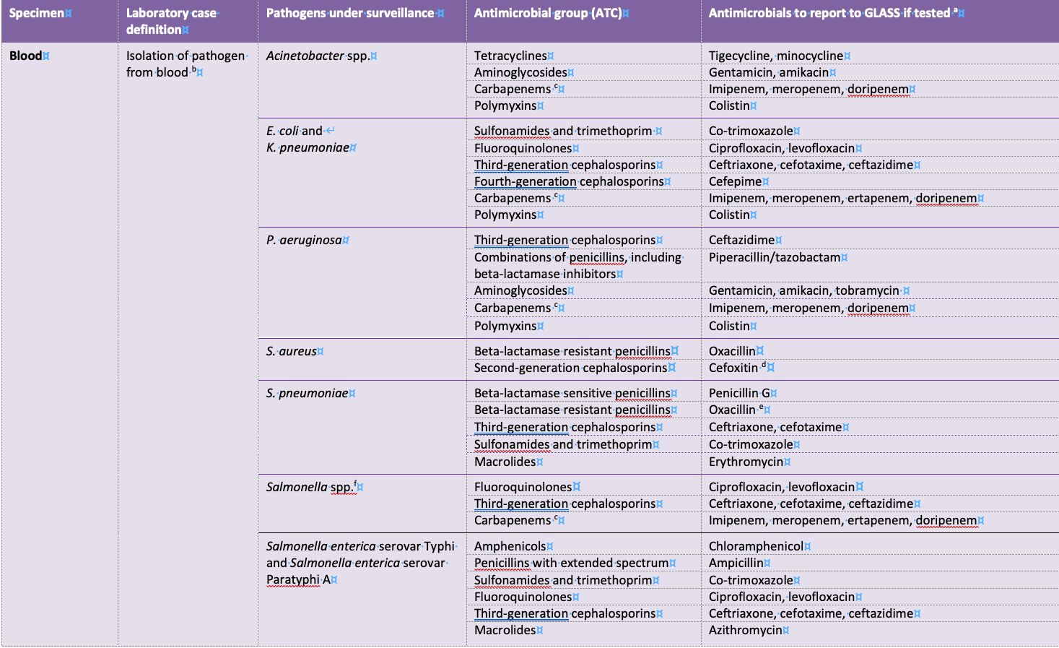
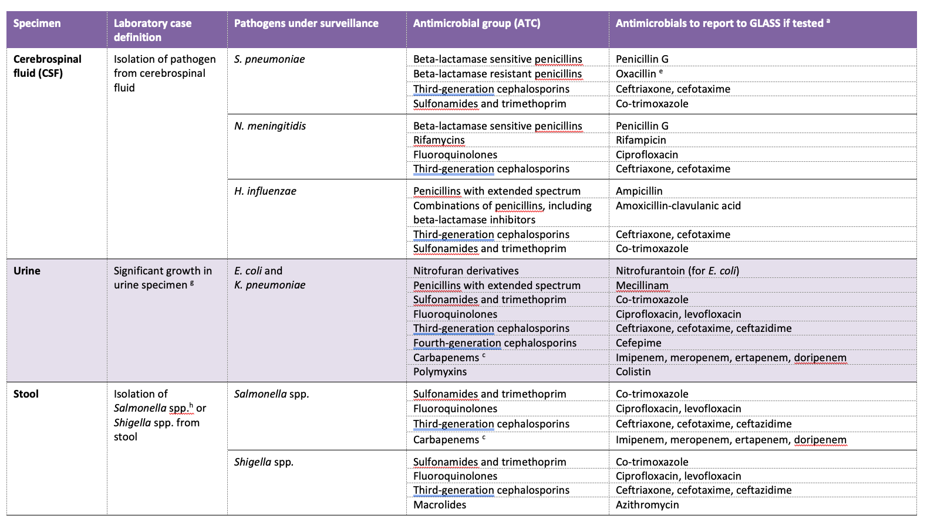
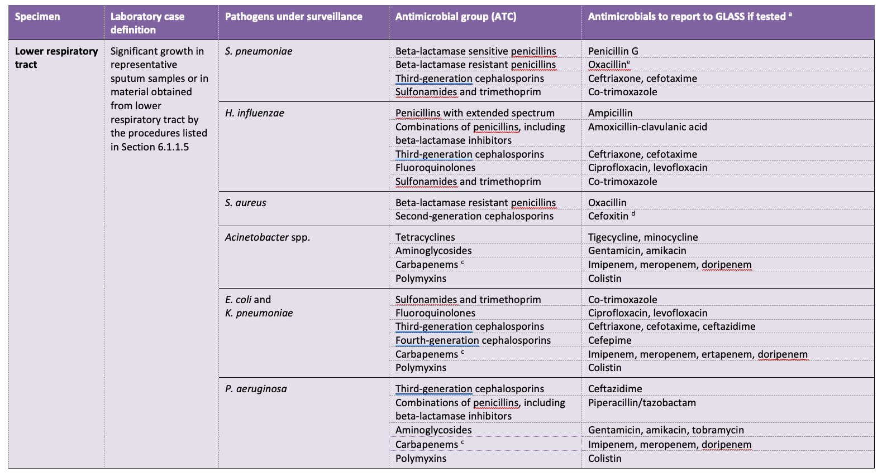
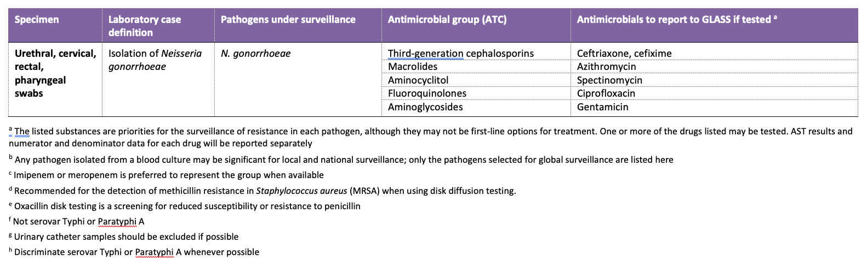
Specimens, pathogens, and antimicrobials selected for global surveillance
Detection of the most important antibiotic resistance mechanisms
Consideration is given to antimicrobials that are commonly used and available nationally
32 antimicrobial drugs selected
According to WHO AWaRe categorization
  11 in “Access” group
  18 in “Watch” group
  3 in “Reserve” group

Slide 10
GLASS-AMR reporting: what is new [2]
Two-pronged approach
  Continue fostering AMR surveillance based on routine patient testing
  Foster periodic national AMR prevalence surveys
An option for submission of anonymized individual patient-level data providing additional opportunities for AMR surveillance data validation and analysis
An option for submission of data generated by molecular AMR diagnostics to complement phenotypic AMR diagnostics data and improve understanding of the underlying mechanisms responsible for resistance
High-level indicators

Slide 11

GLASS-AMR surveillance:
The population under surveillance is composed of patients seeking care in healthcare facilities with symptoms suggestive of infection.
NEW: Two-pronged approach
GLASS-AMR: surveillance based on routine clinical patient testing (referred to as “routine” AMR surveillance). The population under surveillance includes all patients for whom clinical samples are collected for routine microbiological investigations.
GLASS-AMR prevalence surveys: the population under survey includes all patients seeking care at healthcare facilities who meet the infection case definition and for whom clinical samples are collected for quality-assured microbiological investigations.

Slide 13
Methodological principles of national AMR prevalence surveys
Main objective: nationally representative information on the AMR burden in the country.
Cross-sectional (< 12 months survey)
Hospitals selected using probability sampling methods, independent of the availability of microbiology diagnostic services (access to be granted)
Inclusion of consecutive patients with suspected BSIs
Quality-assured microbiology laboratory
Minimum set of demographics and clinical information
Ethical principles adhered to

Slide 14
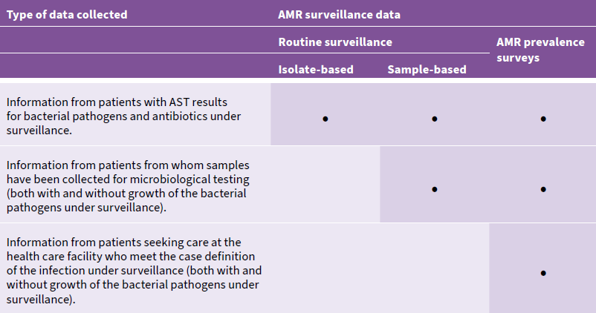
Types of data collected in the two surveillance approaches

Slide 15
NEW: Anonymised individual-level data submission
Advantages include:
Monitor the occurrence of multidrug resistance, which is critical for informing research and development of new therapeutic and diagnostic tools;
Explore additional data analyses and stratifications;
Empower countries to generate state/province or regional statistics;
Inform analysis of drivers and risk factors linked to AMR;
Improve capacity for outbreak detection;
Generate transmission trends using both spatial and genetic information.

Slide 16
Molecular indicators
GLASS target pathogens | Mechanisms of resistance | Molecular targets
Acinetobacter spp. P. aeruginosa | Carbapenem resistance | NDM, OXA, VIM, IMP, GES, KPC
 | Colistin resistance | mcr 1-10
E. coli K. pneumoniae Salmonella spp. Shigella spp. | Extended spectrum beta-lactamases | CTX-M, TEM, SHV
 | Carbapenem resistance | NDM, OXA, VIM, IMP, GES, KPC
 | Colistin resistance | mcr 1-10
S. aureus | Methicillin resistance | mecA/mecC
 | Linezolid resistance | cfr

Slide 17
High-level indicators to monitor a few performance features of the national surveillance systems contributing AMR data to GLASS
Population-level ➔ to monitor population coverage
Healthcare facility-level ➔ to monitor healthcare facility coverage (total number)
Sampling ➔ to monitor sampling coverage in in-patients
Laboratory performance ➔ to monitor the proportion of lab-confirmed infections with AST*
*AST = antimicrobial susceptibility testing

Slide 18
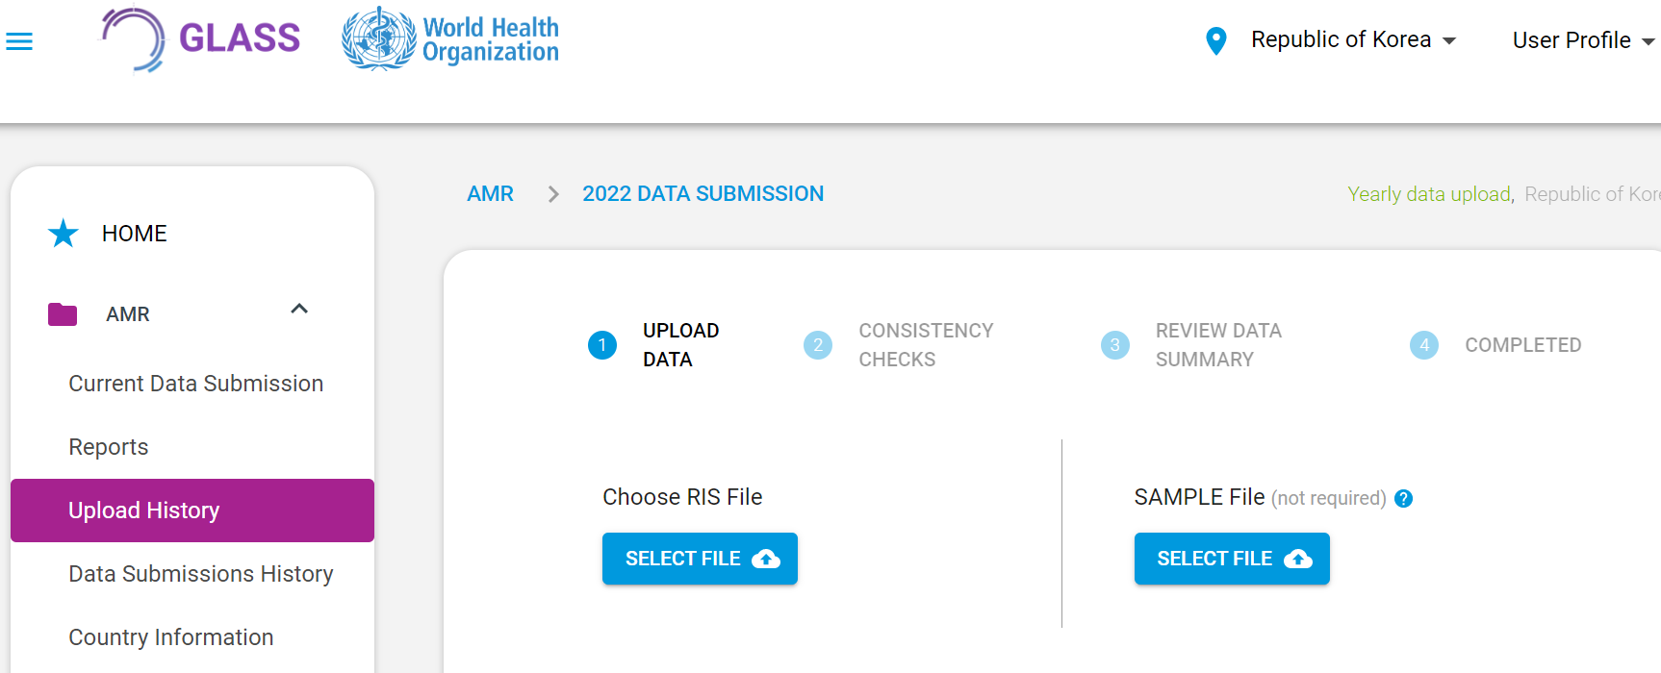
GLASS IT platform 2.0
A new IT platform to meet the ever-growing technical needs of GLASS
Developed using DHIS2 technology
WHO choice, commonly used in countries
Functionality and maintainability of DHIS2

Slide 19
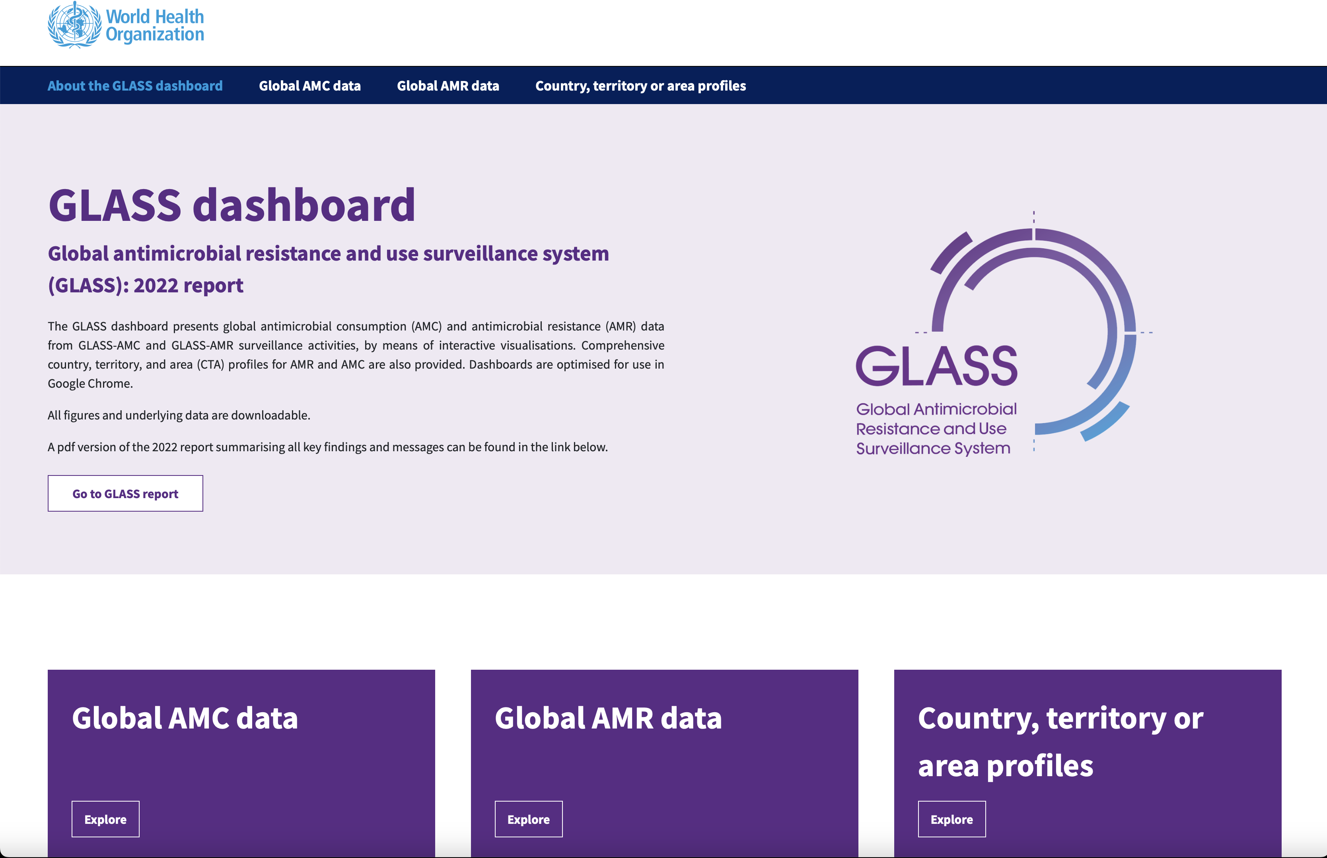
https://worldhealthorg.shinyapps.io/glass-dashboard

Slide 20
GLASS-AMR: the way forward
Enhancing the representativeness and quality of AMR data
  Short-term: application of national prevalence surveys
  Long-term: expand and strengthen routine surveillance
WHO Global Laboratory Diagnostic Initiative
Enhancing the use of data at local and national levels
  GUIDANCE COMING UP SOON
Assessment of AMR impact on human health
Development of genomic surveillance of AMR
Enhancing digital solutions & links to other health data
Improve linkages between data from the human sector with other sectors

Slide 21
Acknowledgements
Countries participating in GLASS
WHO Regional and Country Offices
WHO AMR Surveillance and Quality Assessment Collaborating Centres Network
Partners & Member Stats supporting WHO GLASS & other AMR initiatives
More information on GLASS enrolment procedures, links to the GLASS manuals, the yearly report, and data visualization can be found on the GLASS website http://www.who.int/glass/en/
Other WHO AMR surveillance initiatives
  HIV Drug Resistance http://www.who.int/hiv/pub/drugresistance/hivdr-action-plan-2017-2021/en/
  MDR-TB Surveillance http://www.who.int/tb/areas-of-work/monitoring-evaluation/mdr-tb-surveillance/en/
  Malaria drug resistance and response http://www.who.int/malaria/areas/drug_resistance/en/
  Influenza virus resistance http://www.who.int/influenza/patient_care/antivirals/oseltamivir_summary/en/

Slide 22
High-level indicators of national surveillance systems contributing AMR data to GLASS (1)
Population-level indicator
Population-level indicators | Method
Expected bacterial bloodstream infection cases per 100,000 population (a) | Source for numerator (in order of priority): Country assessment of bloodstream infection prevalence Global burden of disease Systematic review of literature Expert opinion Source for denominator (national population estimates): https//population.un.org
Total bacterial bloodstream infection cases reported to GLASS per 100,000 population (b) | Source for numerator: Data reported to GLASS Source for denominator (national population estimates): https//population.un.org
Indicator = observed versus expected | (b/a) %

Slide 23
High-level indicators of national surveillance systems contributing AMR data to GLASS
Healthcare-level indicator
Healthcare-level indicators | Method
Among the total count of hospitals in your country, the total count of patient days of care in the surveillance calendar year (a) | Source: National data
Among the total count of hospitals contributing data to GLASS, the total count of patient days of care in the surveillance calendar year (b) | Source: National data reported to GLASS
Indicator | (b/a) %

Slide 24
High-level indicators of national surveillance systems contributing AMR data to GLASS
Sampling indicator
Healthcare-level indicators | Method
Expected number of patient days with an indication for blood culture per 1,000 patient days (a) | Source: Literature (expected cases) Expert opinion
The observed number of patient days with blood culture reported to GLASS (b) | Source: Total bacteriologically confirmed bloodstream infections reported to GLASS / 0.1
Indicator | (b/a) %

Slide 25
High-level indicators of national surveillance systems contributing AMR data to GLASS
Laboratory indicator
Healthcare-level indicators | Method
Percentage of bacteriologically confirmed infections with AST result for at least one antibiotic (a) | Source: GLASS data
Indicator | (a) %

Slide 26
Isolate-based surveillance metric
Proportion of drug-resistance:
$$\frac{Number of patients,per specimen type,with infection by pathogen resistant to antibioticy under surveillance}{Population tested during the reporting period per specimen type and infection origin}∗100\%$$
Example:
$$\frac{\text{Number} \text{of} \text{patients} \text{with} \text{bloodstream} \text{infections} \text{caused} \text{by} \text{E}\text{. }\text{coli} \text{resistant} \text{to} \text{cefotaxime}}{\text{number} \text{of} \text{patients} \text{with} \text{BSI} \text{caused} \text{by} \text{E}\text{. }\text{coli} \text{with} \text{AST} \text{results}\text{ (}\text{S}\text{+}\text{I}\text{+}\text{R}\text{) }\text{for} \text{cefotaxime}}∗100\%$$

Slide 27
2 files to submit to GLASS
RIS file with susceptibility testing results
  Data on the number of Resistant, Intermediate, and Susceptible isolates detected in GLASS priority specimens, stratified by gender, infection origin, and age
Sample file with “sample statistics”.
  Numbers of patients from whom specimens have been taken, stratified by the same variables as in the RIS file.
Both files are generated from the same source database

Slide 28
Sample-based surveillance metrics
1. Frequency of infections caused by pathogen_{x}:
$$\frac{Number of patients,per specimen type, with infection by {pathogen}_{x} under surveillance}{Population tested during the reporting period per specimen type and infection origin}∗100000$$
Example:
$$\frac{\text{N} \text{of} \text{patients} \text{with} \text{BSI} \text{of} \text{community} \text{origin} \text{caused} \text{by} \text{E}\text{. }\text{coli}}{\text{N} \text{of} \text{patients} \text{with} \text{suspected} \text{infection} \text{of} \text{community} \text{origin} \text{from} \text{whom} \text{a} \text{blood} \text{sample} \text{was} \text{taken}}∗100000$$
2. Frequency of drug-resistant infections caused by pathogen_{x}:
$$\frac{Number of patients,per specimen type,with infection by pathogenx resistant to antibioticy under surveillance}{Population tested during the reporting period per specimen type and infection origin}∗100000$$
$$\frac{\text{Number} \text{of} \text{patients} \text{with} \text{BSI} \text{of} \text{community} \text{origin} \text{caused} \text{by} \text{E}\text{. }\text{coli} \text{resistant} \text{to} \text{cefotaxime}}{\text{N} \text{of} \text{patients} \text{with} \text{suspected} \text{infection} \text{of} \text{community} \text{origin} \text{from} \text{whom} \text{a} \text{blood} \text{sample} \text{was} \text{taken}}∗100000$$
Example:

Slide 29
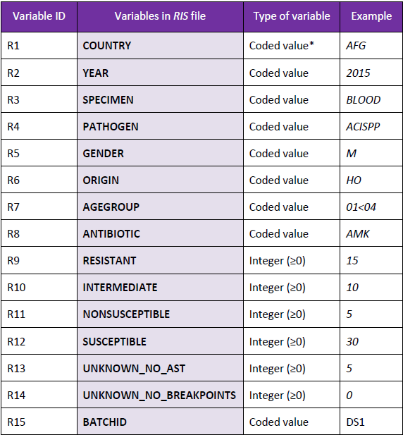

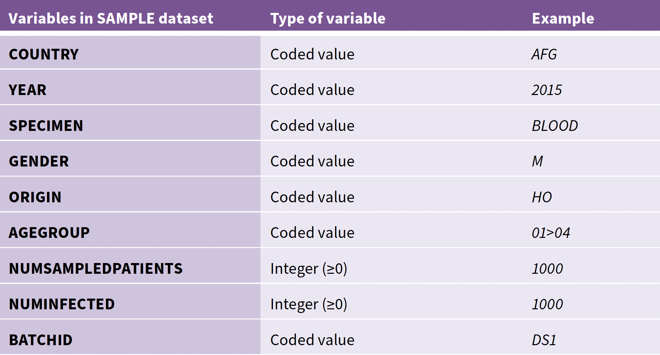

2 files to submit to GLASS
RIS file
Sample file

Slide 30
Aims, objectives and key deliverables
The roadmap to achieving the overarching aim involves a sequence
of proximate, intermediate, and distal deliverables:
Proximate deliverables
Formation of a national multi-disciplinary team of experts.
Distal deliverables
Intermediate deliverables
Proof-of-principle implementation of the first nationally representative surveys.
Development of a framework and a roadmap, to systematically scale-up periodic surveys in LMICs
Definition of surveillance sites & sample size for achieving representative national data.
Co-production of WHO’s technical guidance for national AMR prevalence surveys.
Platform for global surveillance of AMR that can consider infection syndromes other than BSIs
Opportunity for linkage and integration with other activities
Channel for delivery of more detailed studies.
Capacity building

Slide 31

Where should AMR prevalence surveys be carried out
The added value of survey results
Routine surveillance data are poorly informative
Epidemiological criteria
Manageable sample size
Feasibility criteria
Factors required for the successful implementation of a survey are in place
Poor diagnostic stewardship
Public health data suggestive of added value
Magnitude and health burden of AMR expected to be high
Some preliminary census data
Expected count of BSIs above a reasonable threshold

