Slide 1


WHONET Training Course
Module 1 – Introduction to WHONET
Division of Infectious Diseases, Brigham and Women’s Hospital, Boston, United States
WHO Collaborating Centre for Surveillance of Antimicrobial Resistance

Slide 2
1
WHONET Training Course Modules
1
Introduction to WHONET
Laboratory configuration
Data entry
Data analysis – Introduction
Data analysis – Data analysis types
Data analysis – Quick analysis

Slide 3

1
Module 1. Introduction to WHONET
A
What is WHONET?
Download and installation
WHONET main menu
B
C

Slide 4
1
A
What is WHONET?
Notes:
1

Slide 5
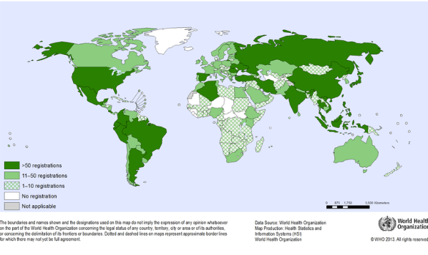
1
What is WHONET?
A
  WHONET is a widely-used free software developed for the management and analysis of microbiology laboratory data to support local, national, regional, and global activities to understand and fight infectious diseases with a special focus on antimicrobial resistance.
WHONET is a desktop software developed for Microsoft Windows.
Two new versions of WHONET are in development
- Web-based data entry
- Version compatible with MacOS and Linux

Slide 6
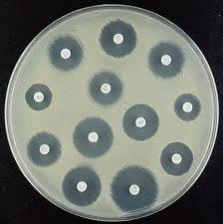
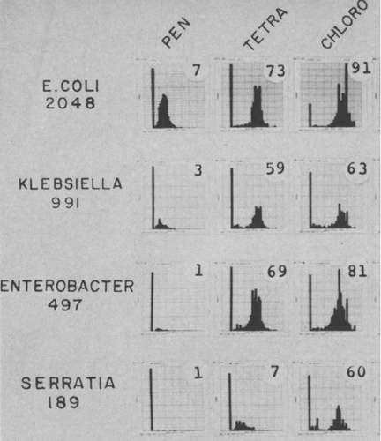
1
Antimicrobial susceptibility testing
Historical perspective
A
Clinical perspective
  William Kirby, Alfred Bauer, John Sherris, and Marvin Turck developed the disk diffusion method as a practical method to be used by routine microbiology laboratories to support therapy decisions by healthcare providers.
Bauer, AW, WMM Kirby, JC Sherris, and M Turck. 1966. Antibiotic susceptibility testing by a standardized single disk method. Am. J. Clin. Pathol. 36:493-496
Epidemiological perspective
Thomas O’Brien understood that disk diffusion zone diameters could be analyzed to recognize and track distinct and evolving microbial subpopulations and changing threats in antimicrobial resistance.
O'Brien TF, Kent RL, Medeiros AA. Computer-generated plots of results of antimicrobial-susceptibility tests. JAMA. 1969 Oct 6. 210(1):84-92.
The name WHONET was given to the software in 1989, but the early programming work started on mainframe computers in the 1960s.

Slide 7
1
WHONET – Vision
A
Human health, animal health, food, and environmental microbiology laboratories worldwide generate a detailed window into evolving microbial populations in real-time. Yet this resource remains largely untapped and underutilized to support policy development and resistance containment interventions.
The use of a common software could and should support local, national, regional, and global collaboration and analyses to support:
  Infection and resistance containment
    Recognition, tracking, and containment of emerging threats in real-time
    Treatment guidelines and antimicrobial stewardship programs
    Public health awareness, advocacy, policy, and interventions
    Basic science, clinical, and operational research
  Diagnostic stewardship and continuous quality improvement in laboratory practices

Slide 8
WHONET and Surveillance objectives
1
A
Objectives |  | Local | National | Regional | Global
Policy and advocacy
 | Priority setting and funding | X | X | X | X
 | Awareness and education | X | X | X | X
 | Legislation and regulation |  |  | X | X
Epidemiology of resistant microbes
 | Pathogen and resistance trends | X | X | X | X
 | Recognition of emerging threats | X | X | X | X
 | Disease and economic burden | X | X | X | X
 | Benchmarking |  | X | X | X
Resistance containment
 | Treatment guidelines | X | X
 | Response to emerging threats | X | X | X | X
 | Assessment of interventions | X | X | X | X
 | New diagnostics and therapeutics |  |  | X | X
Capacity-building
 | Laborotory capacity | X | X | X | X
 | Epidemiological capaciy | X | X | X | X

Slide 9
1
WHONET and Surveillance objectives
A simplified view
A
  Improve the use of local data for local action
    Make proper treatment decisions and therapy guidelines
    Detect, confirm, and respond to new threats, such as new resistance and outbreaks
    Improve laboratory capacity
    Long-term sustainability of surveillance efforts requires that data generators derive sufficient value for their efforts
  Promote national, regional, and global networks collaborations and action… but long-term sustainability at these levels relies on the ongoing efforts at the local level.

Slide 10
1
WHONET Data Sources
A
  WHONET can be used for test results from human and animal health laboratories and food and environmental laboratories.
  WHONET can be used for data from routine daily work, as well as from special surveys and research projects.
  Most laboratories use WHONET to manage data on bacterial and fungal results.
  WHONET can also used be for the management of results for parasites, viruses, and “negative” results, such as “No growth” and “Normal flora”.
  WHONET can also accept clinical data, such as diagnoses, risk factors, treatments, and outcomes. Such data are usually not available to laboratories routinely, but they often can be collected in special studies.

Slide 11
1
WHONET users
A
  A variety of professionals find value in WHONET data analysis
    Microbiology laboratory staff
    Infectious disease and infection control teams
    Human and animal health clinicians
    Epidemiologists and information technology experts
    Pharmacy
    Food producers and environmental scientists
    Policymakers, researchers, and others

Slide 12
1
WHONET Modules
A
  Laboratory configuration
  Data entry
    Option 1: Manual data entry
    Option 2: Import existing data with BacLink
  Data analysis
    Interactive data analysis
    Quick analysis
    Public health reporting

Slide 13
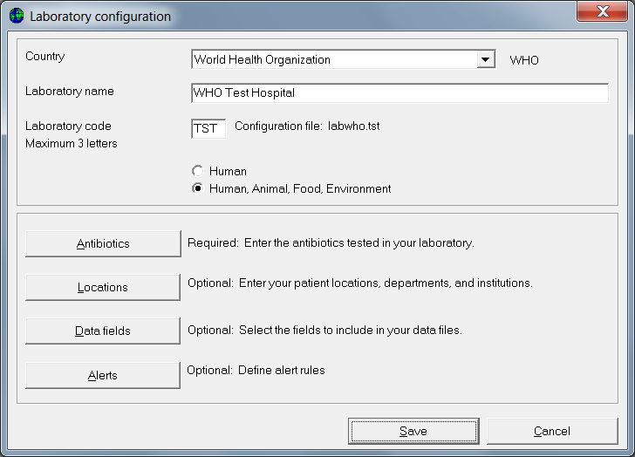
1
Laboratory configuration
A

Slide 14
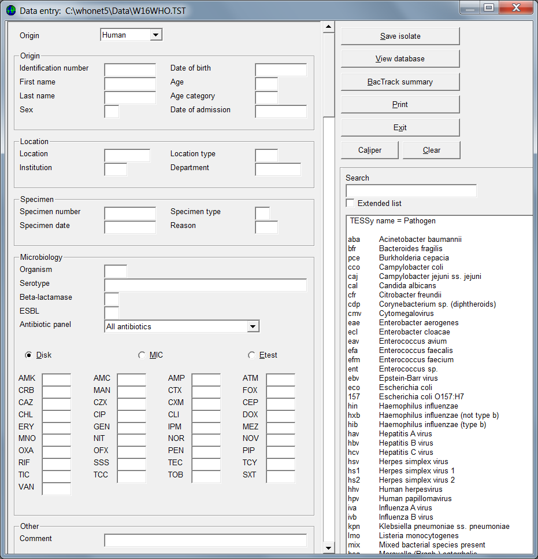
1
Data entry – Manual
A
Sector
Patient, animal, food, environmental details
Specimen location
Specimen details
Organism
Antibiotic results
Other

Slide 15
1
Data entry – Import with BacLink
A
Most laboratories in the world already have a computer system for managing their microbiology data.
    Simple desktop systems: Excel, Access
    Laboratory instruments: Vitek, Microscan, BD Phoenix, Sensititre
    Laboratory information systems: Commercial systems or local systems
This is an obstacle because they are not directly compatible.
But it is also an opportunity! The electronic data have been stored.
The goal of BacLink is converting data from existing incompatible systems into common WHONET files.
WHONET
BacLink
Incompatible local systems
Standard WHONET files
BacLink will be covered in a separate course.

Slide 16
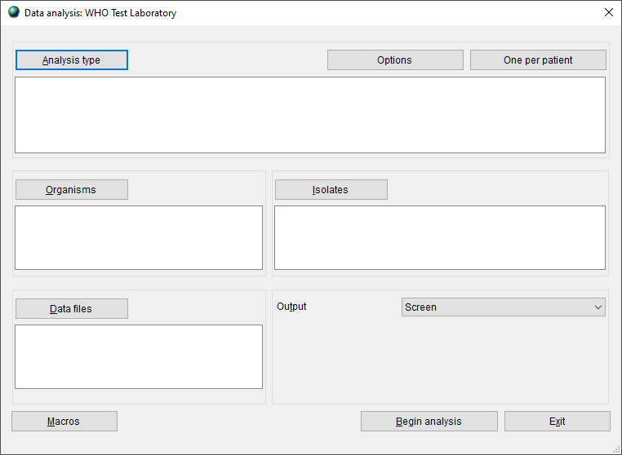
1
Data analysis - Interactive
A
Notes:
9

Slide 17
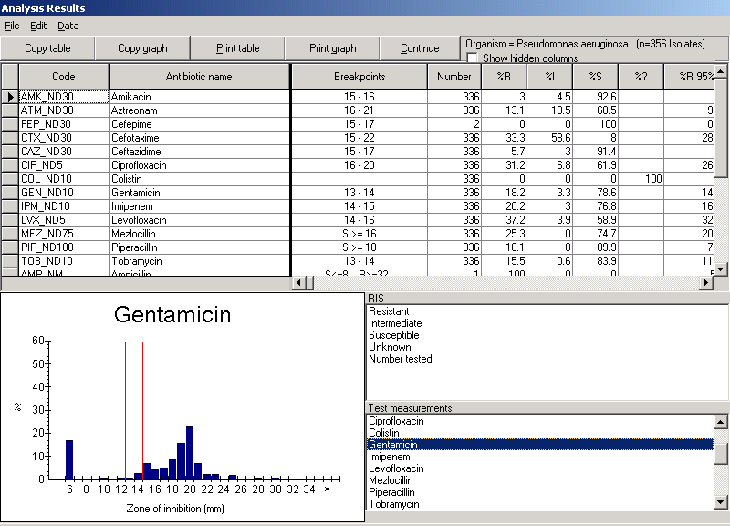
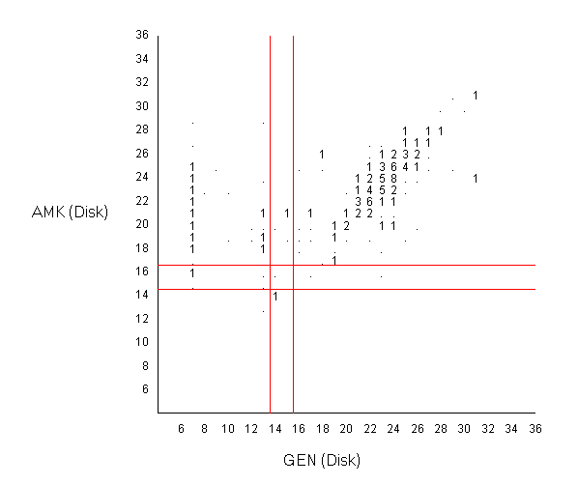
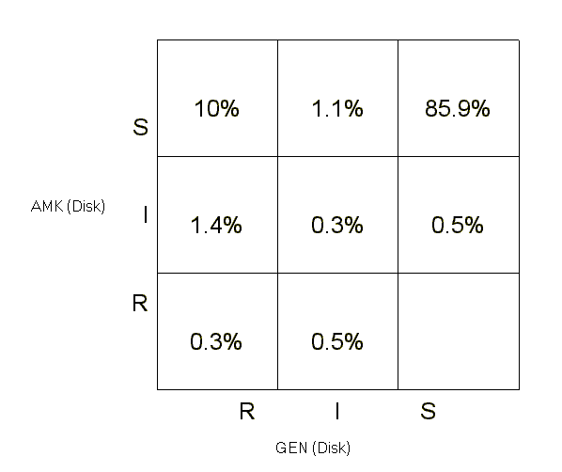
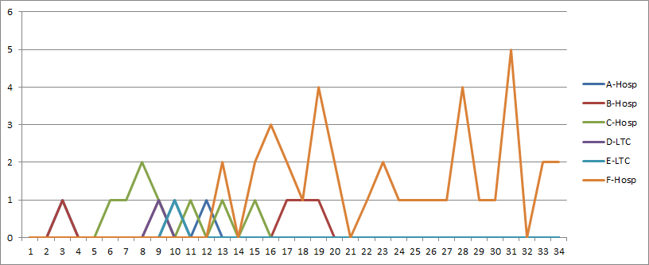
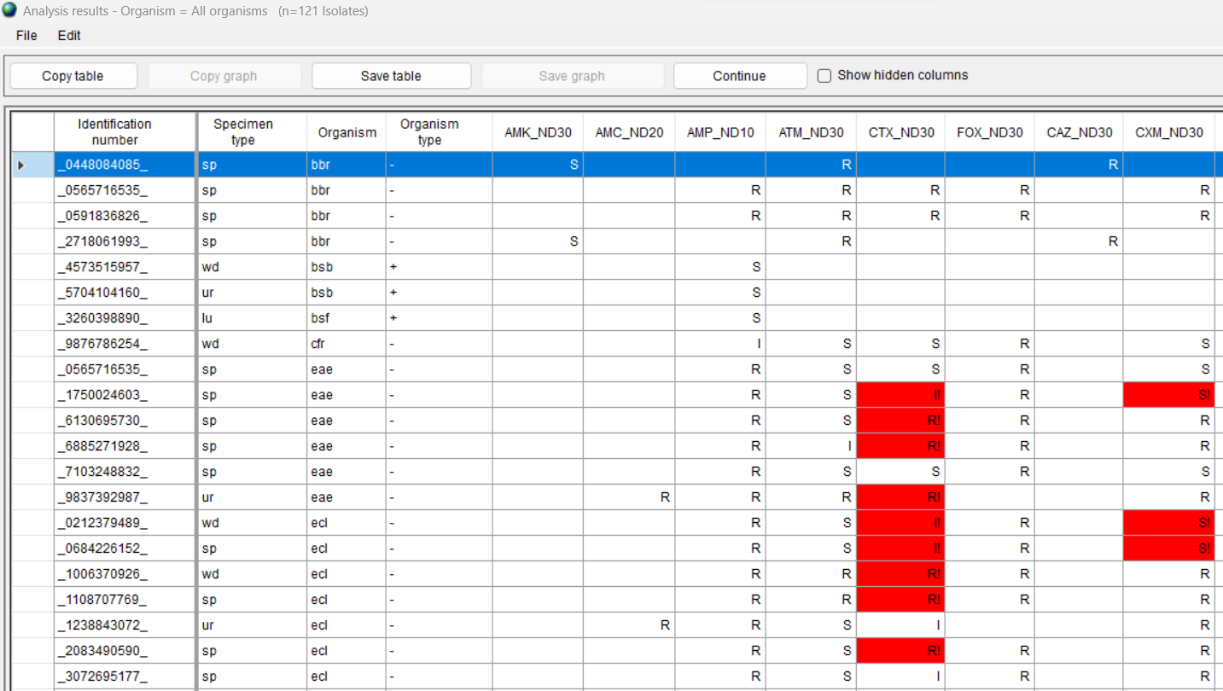
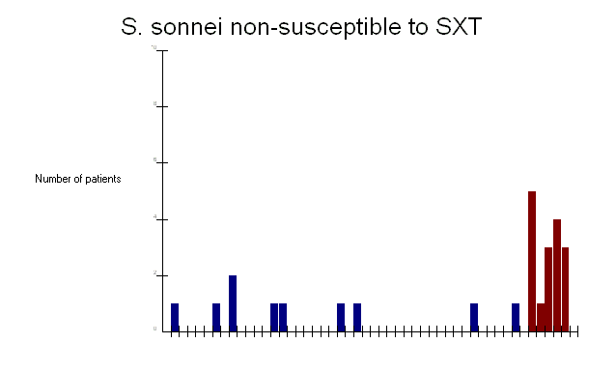
1
Data analysis, alert, and report features
A
%RIS and histograms
Scatterplot
Resistance profiles
Hospital F
Hospital C
Hospital B
Nursing homes
Microbiology alerts
Outbreak detection

Slide 18
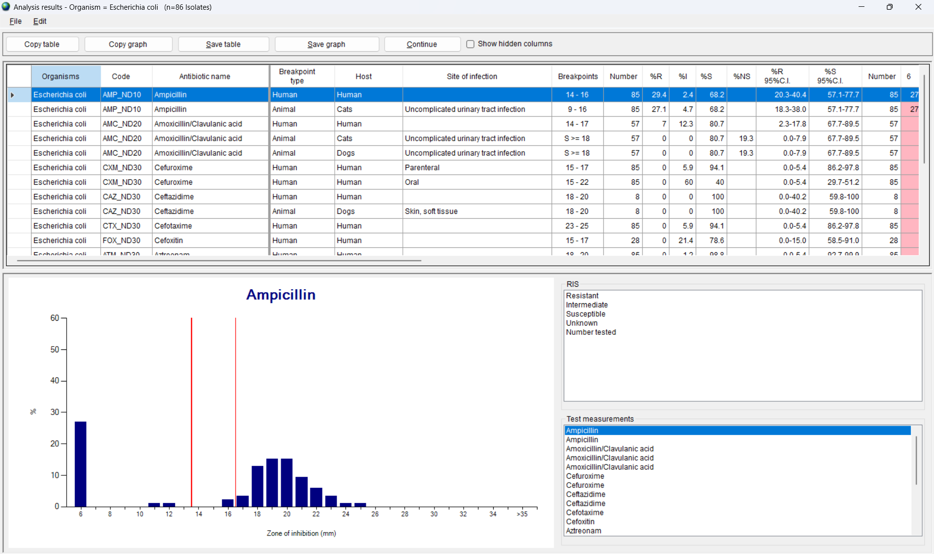
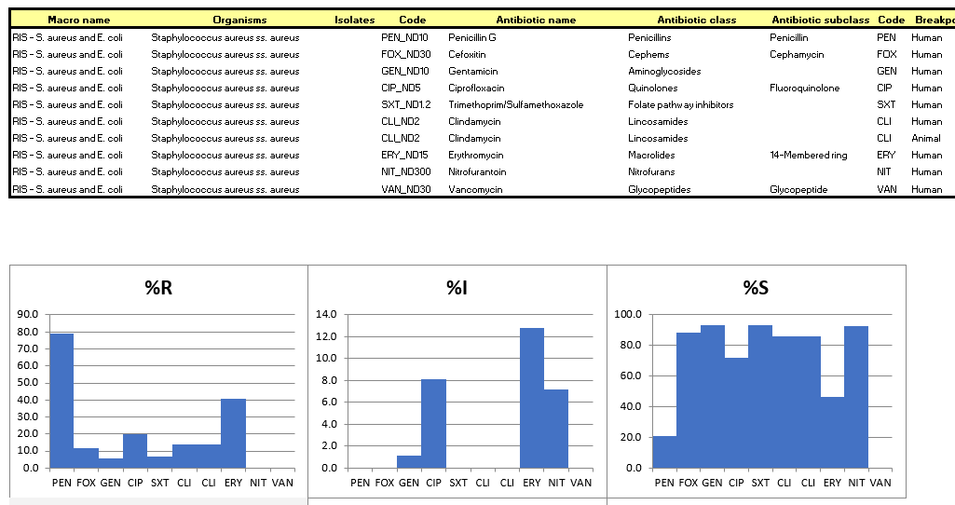
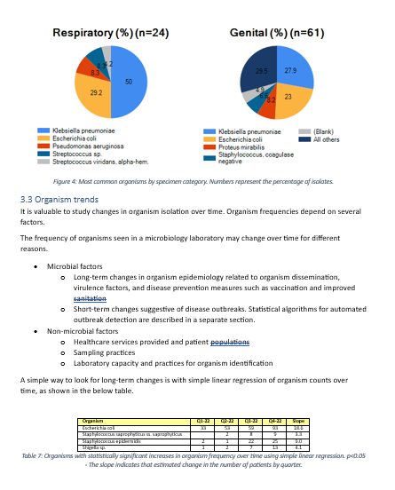
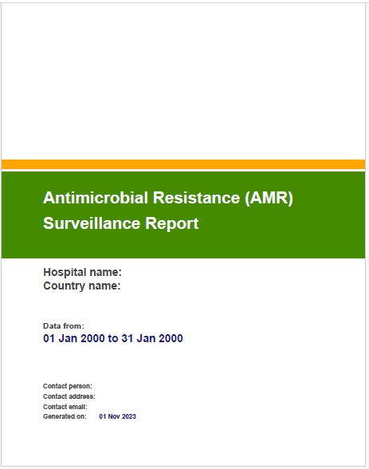
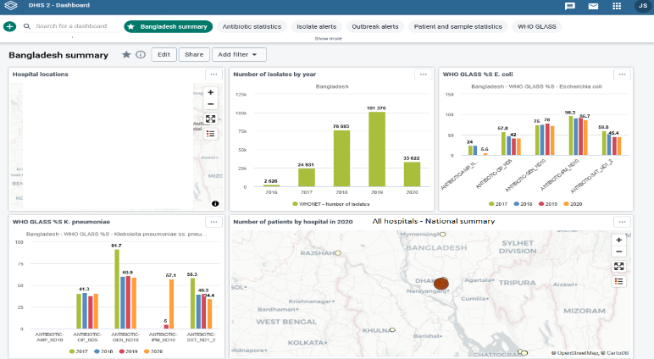
1
Quick Analysis - Output options
A
Screen
Excel
Word
PDF (AMASS)
DHIS2
www.amass.website
www.dhis2.org

Slide 19

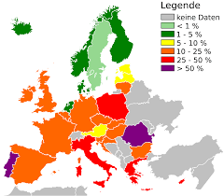
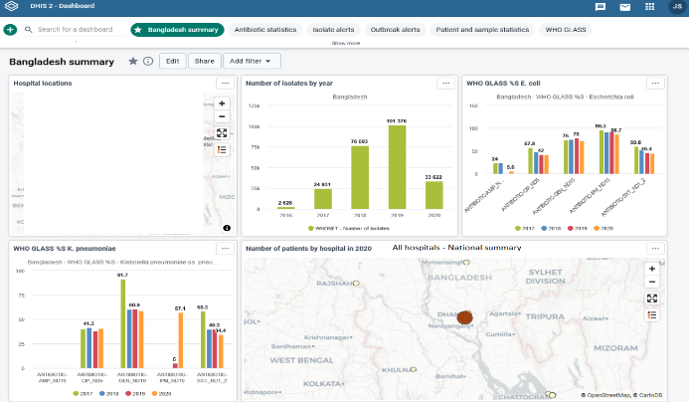
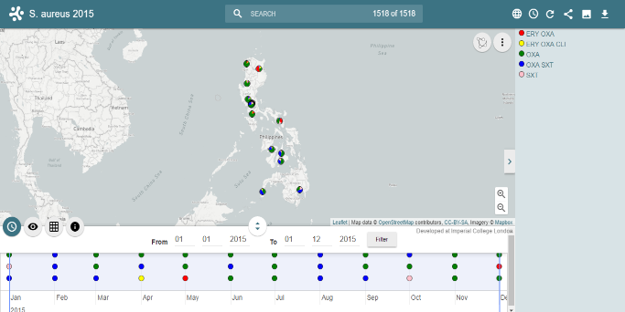
1
Data exports and interoperability
A
As mentioned in the discussion of “data imports” with BacLink, the principle of interoperability is very important to ensure efficiency, sustainability, and impact of collaborative efforts.
This is also true in data exports. WHONET has the ability to export to a number of public health reporting systems such GLASS modules (GLASS-AMR, GLASS-FUNGI, GLASS-EGASP), DHIS2, AMASS, EARS-Net, CAESAR, ASIARS-Net, MicroReact, and others.
WHO GLASS
EARS-Net
DHIS2
AMASS
MicroReact
Figure 4: Screenshot of Microreact File for S. aureus 2015
A representative screenshot of a Microreact File showing the geographical distribution of resistance phenotypes S. aureus in the Philippines in the year 2015.

Slide 20
1
Adaptations for One Health surveillance
A
  Introduced in 2001 with gradual improvements over time with support from WHO, FAO, USDA, FDA, and many others
  Expanded data field lists, code lists, and analyses
    Animal species, production types, food types, etc.
    Specimen types, pathogens, antimicrobials, etc.
    Data entry and report templates for FAO surveillance protocols, InFARM, and the WHO ESBL-producing Escherichia coli TriCycle project
  Interpretation guidelines
    CLSI Human and animal clinical breakpoints
    EUCAST Human and animal clinical breakpoints
    EUCAST Epidemiological Cutoff Values for MIC results
  Training data set with One Health results
    100 isolates each of human, animal, food, and environmental origin

Slide 21
1
Summary
A
WHONET is free software widely used around the world for the surveillance of evolving microbial populations
  One important focus is the annual surveillance of priority resistance trends – to support awareness, treatment guidelines, and advocacy
  But there are many other applications of greater value in real-time
    to support the recognition and containment of emerging threats including novel resistant strains and possible outbreaks
    to improve laboratory capacity and data quality

Slide 22
1
B
Download and installation
Notes:
1

Slide 23
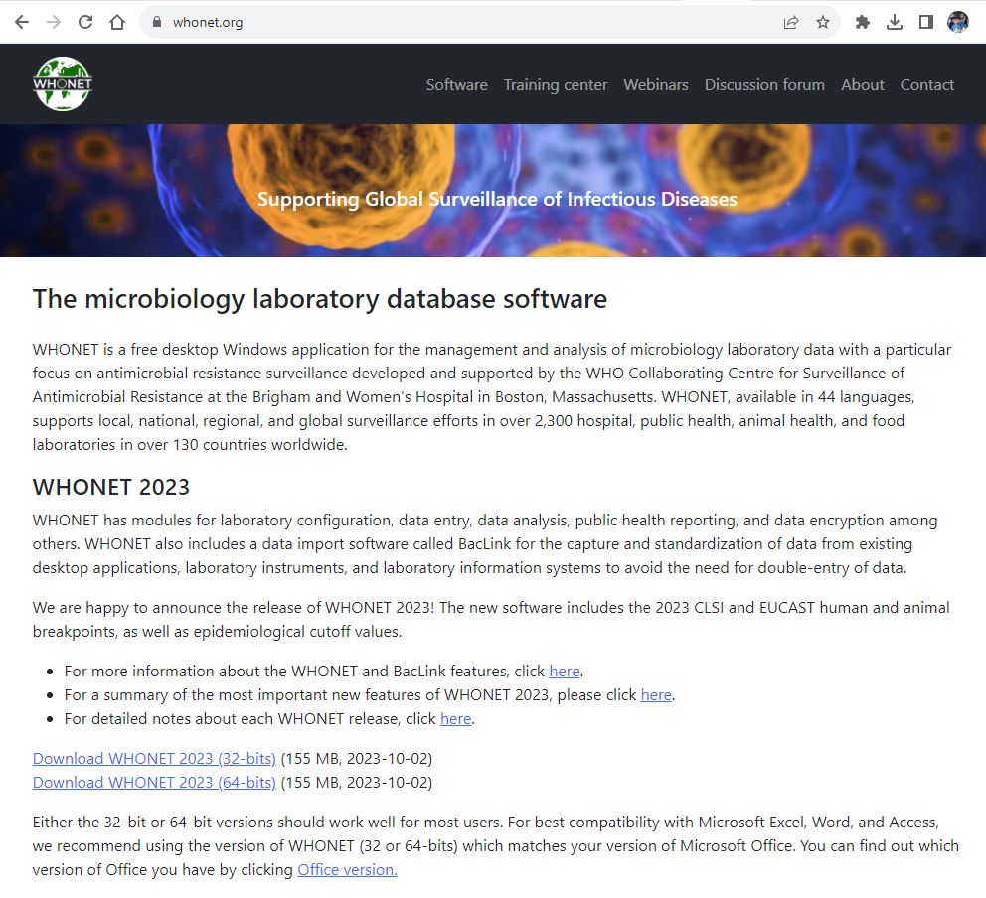
1
WHONET Home page – www.whonet.org
B

Slide 24
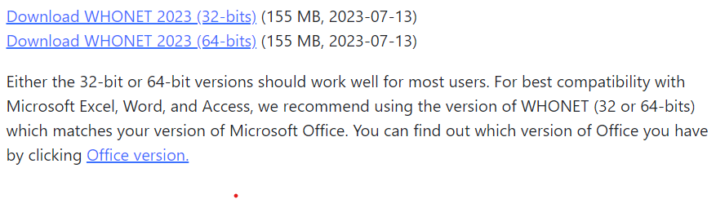
1
Two versions of the installation package
B
Recommendation – if you have a 32-bit version of Microsoft Office, we recommend installing the 32-bit version of WHONET. If you have a 64-bit version of Microsoft Office, then we recommend installation the 64-bit version of WHONET.

Slide 25
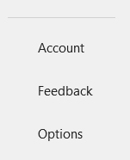
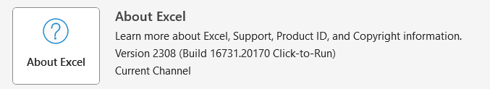

1
Do you have a 32-bit or a 64-bit version of Microsoft Office?
B
1. Open Microsoft Excel or Microsoft Word.
2. On the left menu, click on “Account”.
  If you do not see “Account”, then you probably have a 32-bit version of Microsoft Office.
C
3. Click on “About Excel” or “About Word”.
4. The next screen will indicate “32-bit” or “64-bit”

Slide 26
1
Download WHONET
B
  Click on the link for the 32-bit or the 64-bit version of WHONET, and the installation package will begin to download.
  When the download has completed, click on “Open” or “Run” to begin the installation.
    If you do not see installation package, you can find it in your “Downloads” folder.

Slide 27
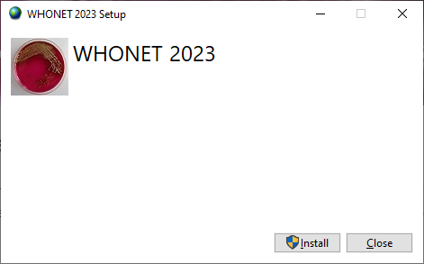
1
Step 1 - Select Install
B
C

Slide 28
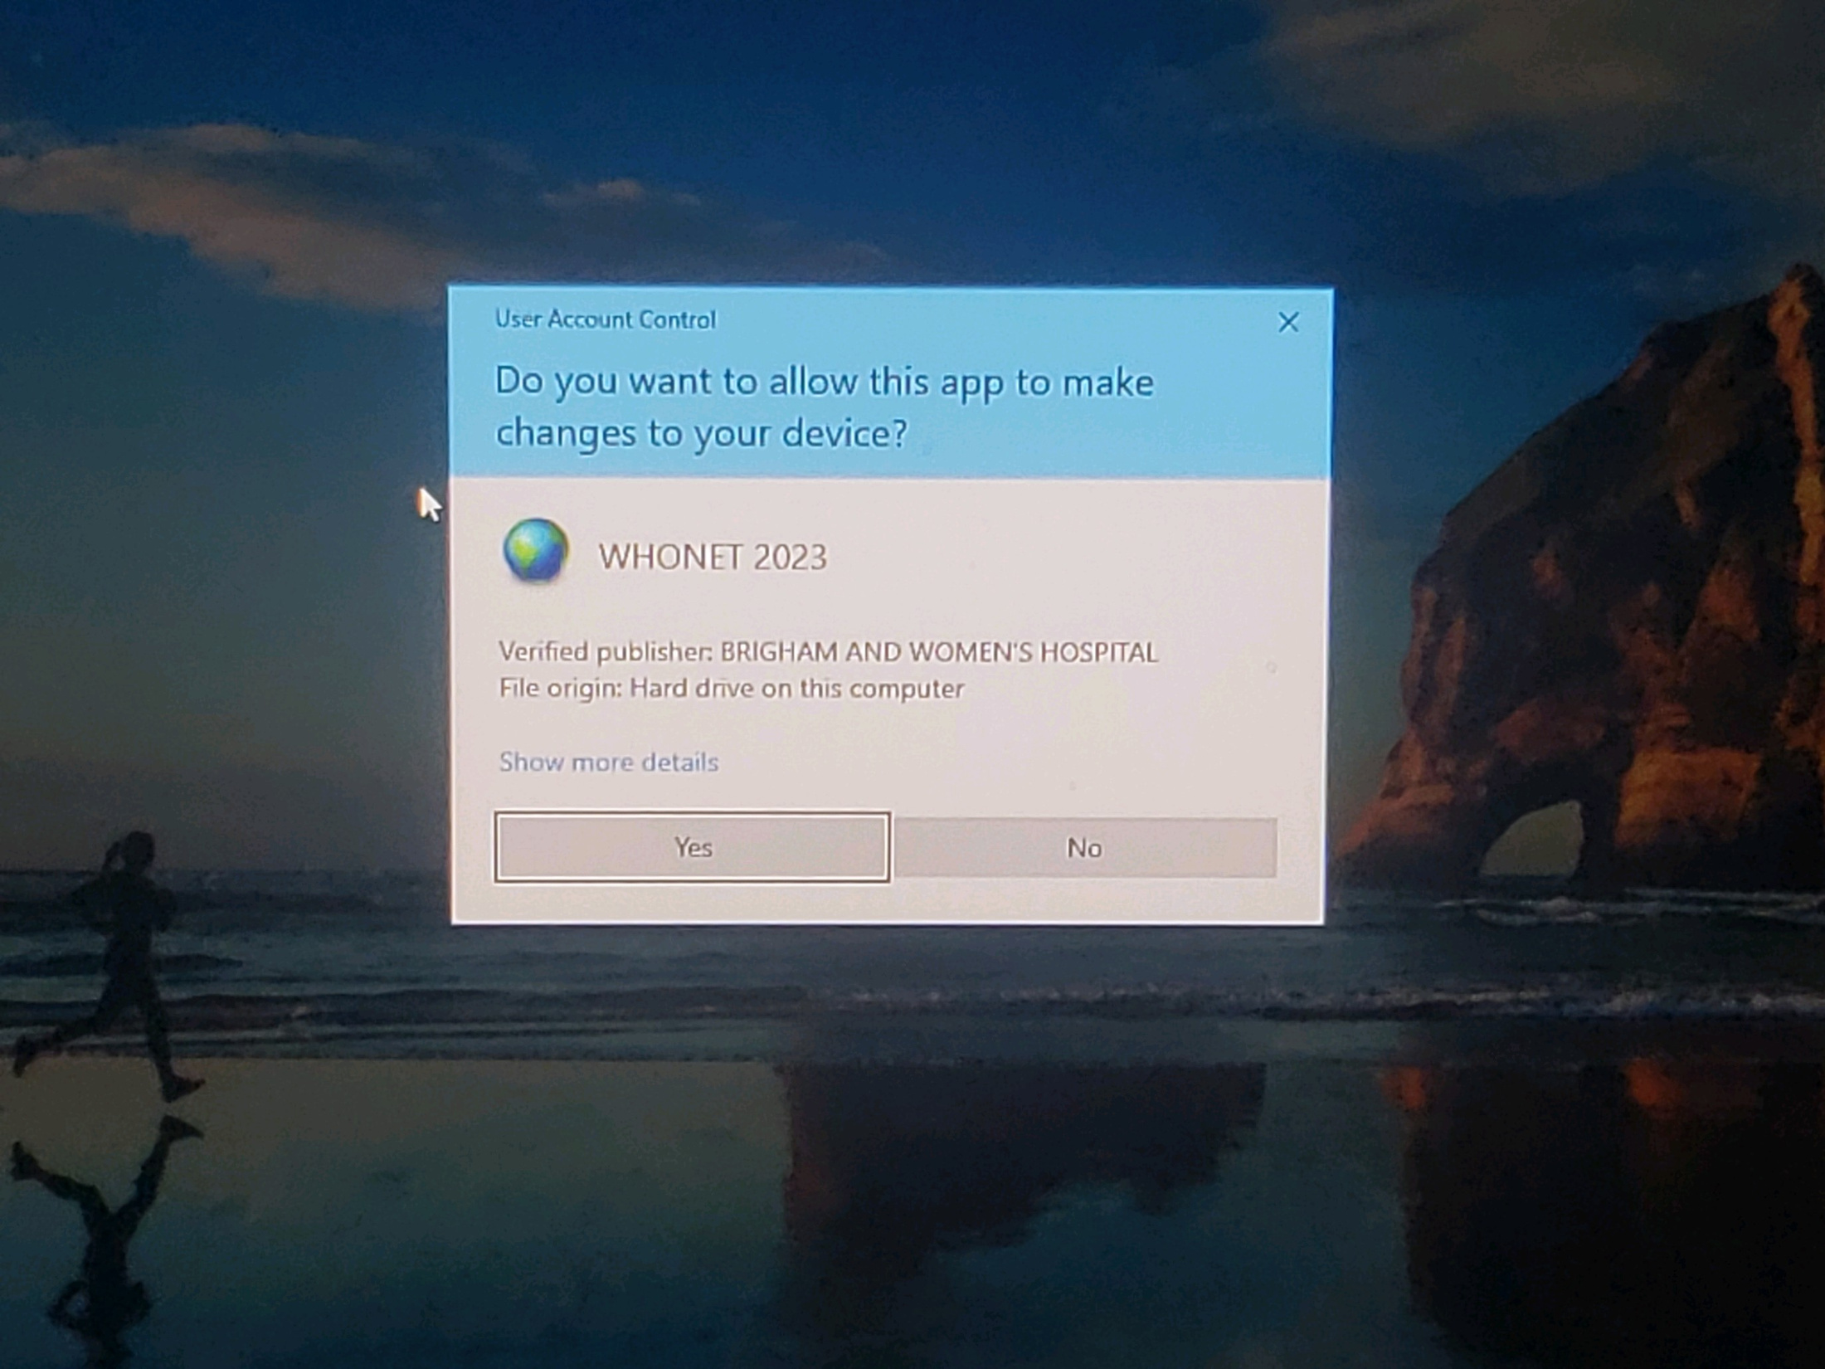
1
Step 2. Allow this app to make changes? Select “Yes”
1
B
C
  Note – Some computers will not ask this question.

Slide 29
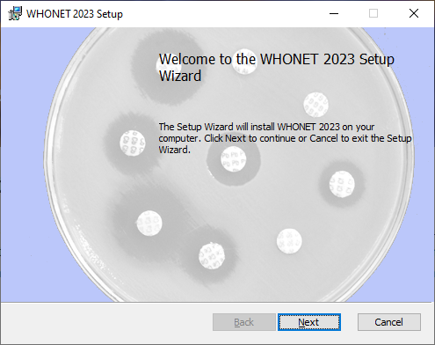
1
Step 3 - WHONET Setup Wizard
Select “Next”
B
C

Slide 30
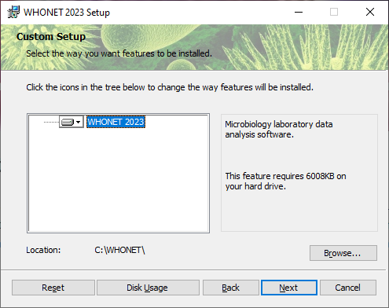
1
Step 4 - Installation folder
B
By default, WHONET will be installed to the C:\WHONET folder. Click “Next”.
Or you can use “Browse” to choose a different location on the local hard drive or on a network drive.
C

Slide 31
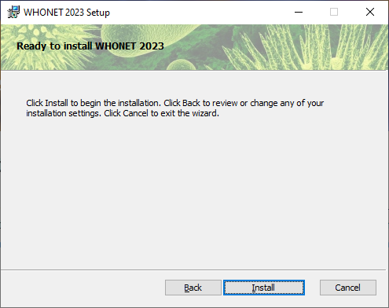
1
Step 5 - Final step Click “Install”
B
C

Slide 32
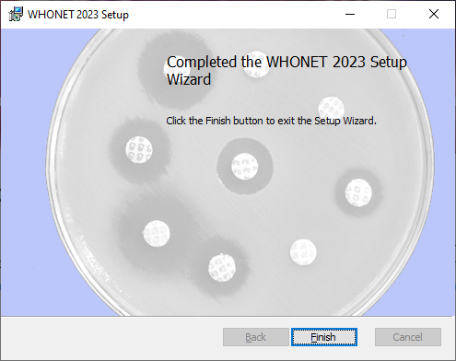
1
Step 6 - Installation completed Click “Finish”
B
C

Slide 33
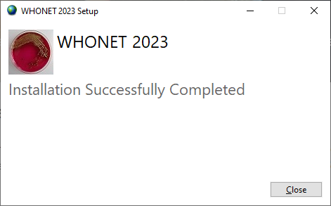
1
Step 7 - Close the installation
software Click “Close”.
B

Slide 34
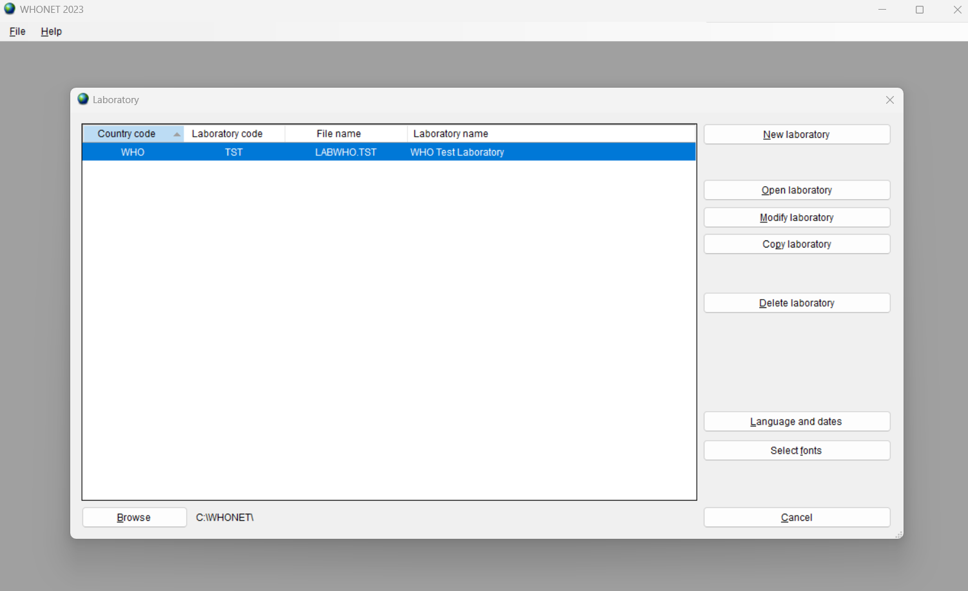

1
After WHONET Installation
B
After the installation is complete, you should see icons for WHONET and BacLink on your desktop.
Double-click on the WHONET icon to begin the software.
C
If you see the above screen, congratulations! You have successfully installed WHONET.

Slide 35
1
If you have installation problems...
B
  Try the process over again.
  Contact your IT team for assistance. In many organizations, only IT staff have the ability to install new softwares.
C
  Try a different computer.
  Contact the WHONET team in Boston
    help@whonet.org

Slide 36
1
If you have a MacOS computer
B
The current version of WHONET was made for Microsoft Windows. Fortunately, there are a few approaches for installing Windows programs onto a Mac computer.
  Create a Windows partition on the Mac hard drive or install a Windows Virtual Machine or a Windows emulation software.
  You can find further details with a web search: “How do I install a Windows program on a Mac?”
The WHONET team has made significant progress towards a version of WHONET that can run on MacOS and Linux, but there is no estimate when this will be available for testing.
C

Slide 37
1
C
WHONET Main Menu
Notes:
1

Slide 38
1
The WHONET Main Menu
1
C
List of laboratory configurations
C

Slide 39
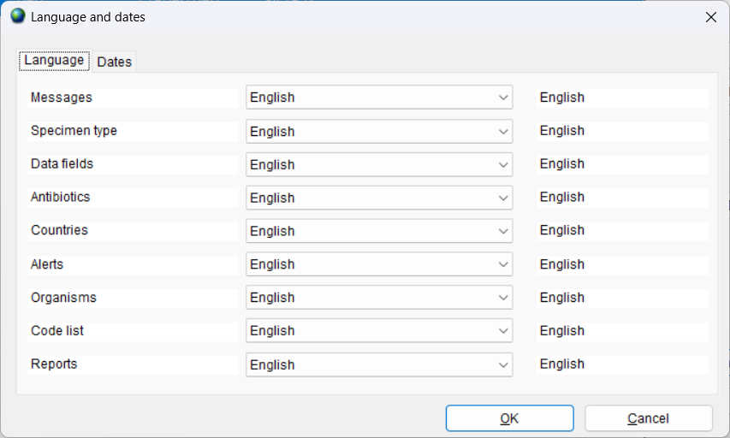
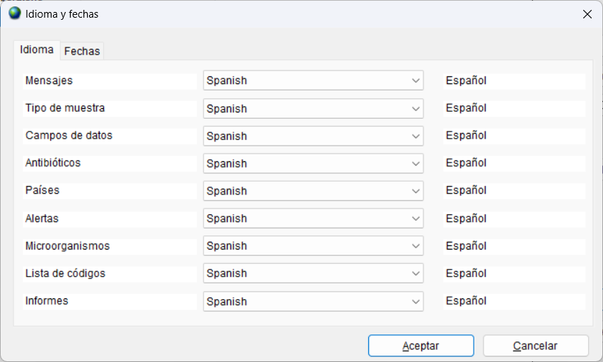
1
1Language selection
C

Slide 40
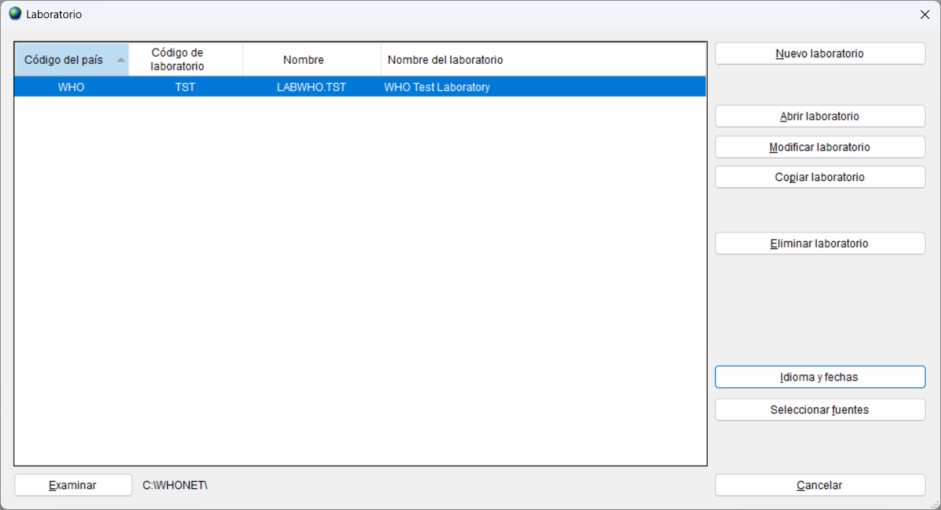
1
1Language selected
C
You can now click on “Idioma y fechas”, and select “English” to continue the course with WHONET in English.

Slide 41
1
Languages in WHONET – 53 languages
C
Here is the current list of languages available in WHONET.
Afrikaans, Albanian, Arabic, Armenian, Bulgarian, Catalan, Chinese (Traditional and Simplified), Croatian, Czech, Danish, Dutch, English, Estonian, Farsi, Finnish, French, Georgian, German, Greek, Hebrew, Hungarian, Icelandic, Indonesian, Irish, Italian, Japanese, Kazakh, Korean, Lao, Latvian, Lithuanian, Macedonian, Malay, Mongolian, Norwegian (Bokmål and Nynorsk), Polish, Portuguese, Romanian, Russian, Serbian, Slovak, Slovene, Spanish, Swahili, Swedish, Thai, Turkish, Ukrainian, Urdu, Vietnamese
Most of the translations were created with Amazon Web Services, and there can be mistakes and suboptimal translations. If you would like to help correct and improve the translations, please contact the WHONET team at help@whonet.org.

Slide 42
1
Open a laboratory
C

Slide 43
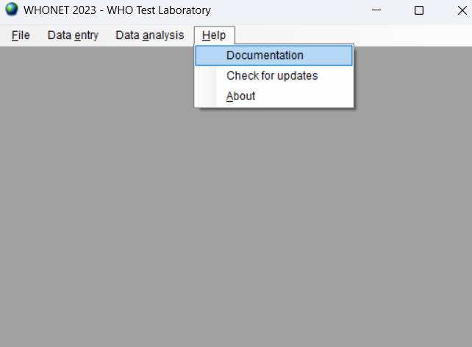
1
WHONET Main menu
C

Slide 44
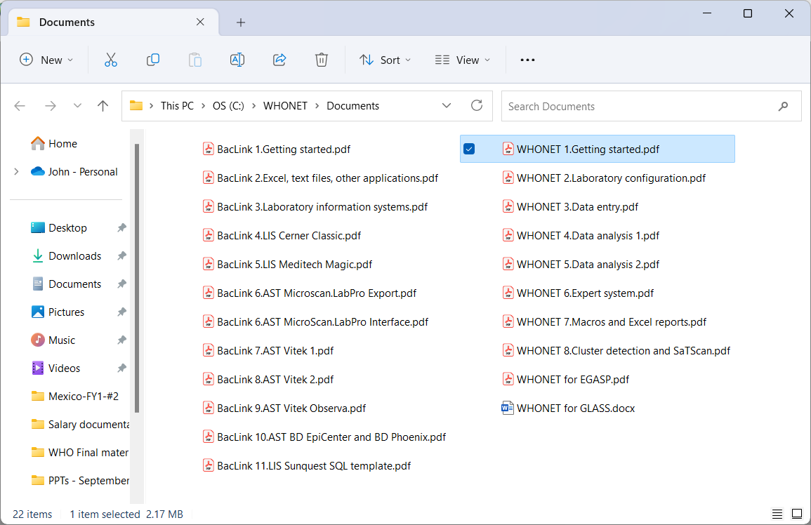

1
Help -> Documentation
1
C

Slide 45
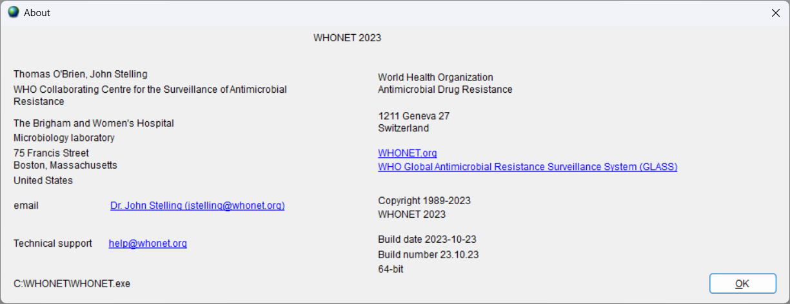
1
Help -> About
1
C

Slide 46
1
Thank you for watching Module 1:
Up next. Module 2: Laboratory configuration

