Slide 1
WHONET Training Course
Module 2 – Laboratory configuration
Division of Infectious Diseases, Brigham and Women’s Hospital, Boston, United States
WHO Collaborating Centre for Surveillance of Antimicrobial Resistance

Slide 2
2
Laboratory configuration
The purpose of laboratory configuration is to prepare WHONET for data entry and data analysis with details specific for your laboratory.
Country and laboratory details
Antibiotics
Locations where samples are collected
Data fields
Microbiological alerts

Slide 3
2
Three ways to create a new laboratory
A
New laboratory
B
Pre-defined laboratory template
C
Create a laboratory from a data file

Slide 4
2
Begin WHONET
Click on "New laboratory"
A

Slide 5
2
Laboratory details
A
Enter the country, the full laboratory name, and a short laboratory code.

Slide 6
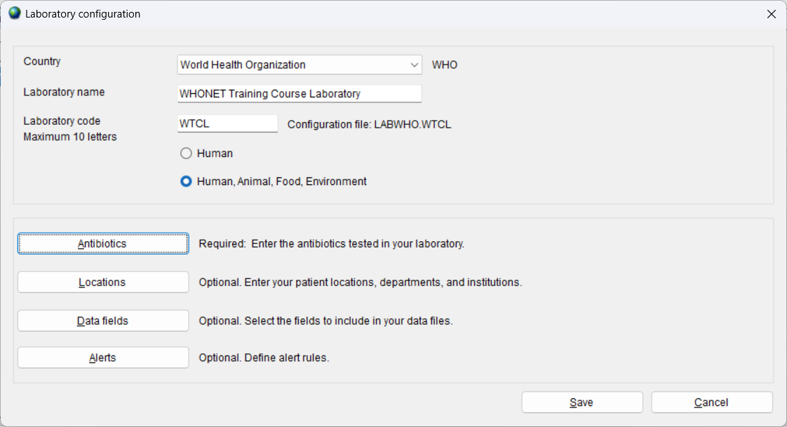
2
Laboratory configuration file
A
When you save your laboratory details, WHONET will create a laboratory configuration file with all of your responses.
You can copy this file to another computer.
You can make a copy of this file as a backup.

Slide 7
2
Laboratory configuration
A
You can enter information about your antibiotics, sample locations, and data fields. You can also create new microbiological alerts.

Slide 8
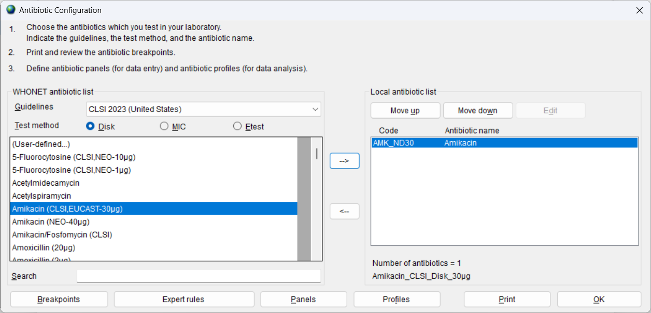
2
Define your antibiotic list
A
For each antibiotic, choose the test guidelines, the test method, and the antibiotic name. Click on the arrow or double-click to select the antibiotic.

Slide 9
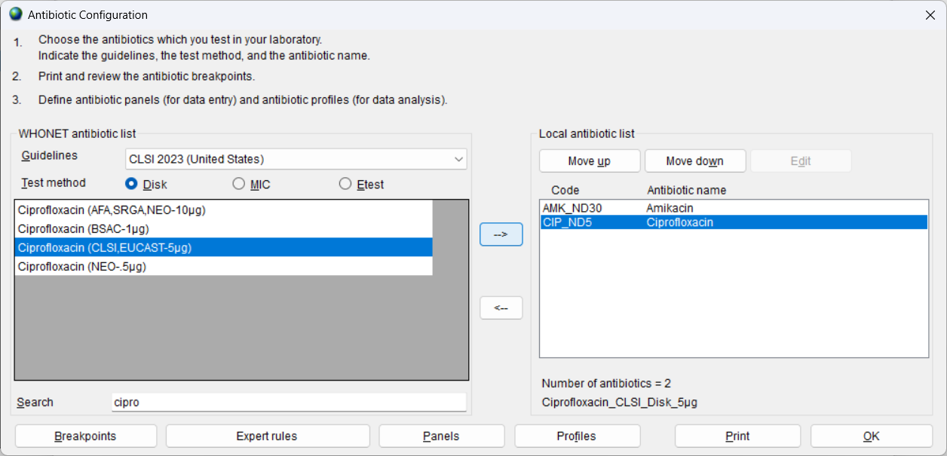
2
Antibiotic details
A
In the below example, "cipro" has been entered into the search box. For disk diffusion tests, it is important to choose the correct disk potency.

Slide 10
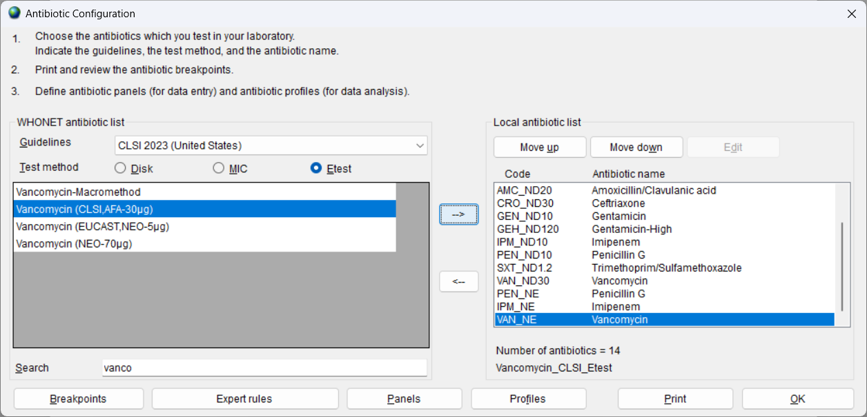
2
Define your antibiotics
A
You can also enter MIC and Etest results.

Slide 11
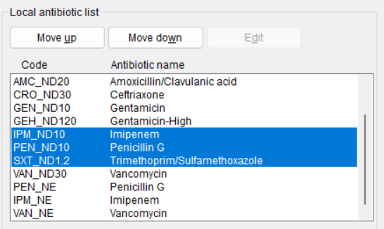
2
Antibiotic sequence
A
Use “Move up” and “Move down” to change the order of antibiotic sequence.
For laboratories doing manual data entry into WHONET, use the order that matches the paper records or notebooks to avoid data entry mistakes
For laboratories using BacLink, alphabetical order is common
You can also organize by antibiotic class and subclass

Slide 12
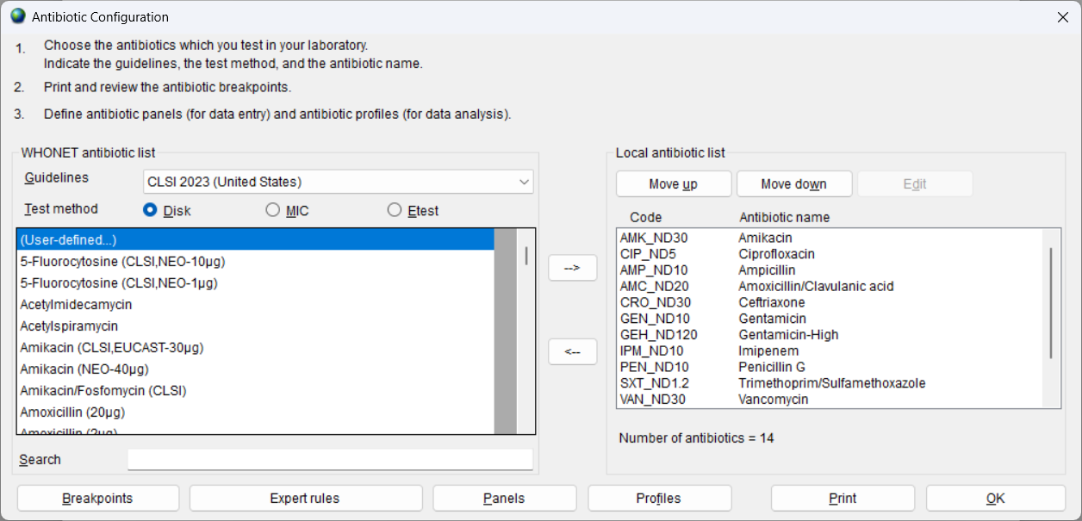
2
Antibiotic configuration options
A

Slide 13
2
Review the antibiotic breakpoints
A

Slide 14
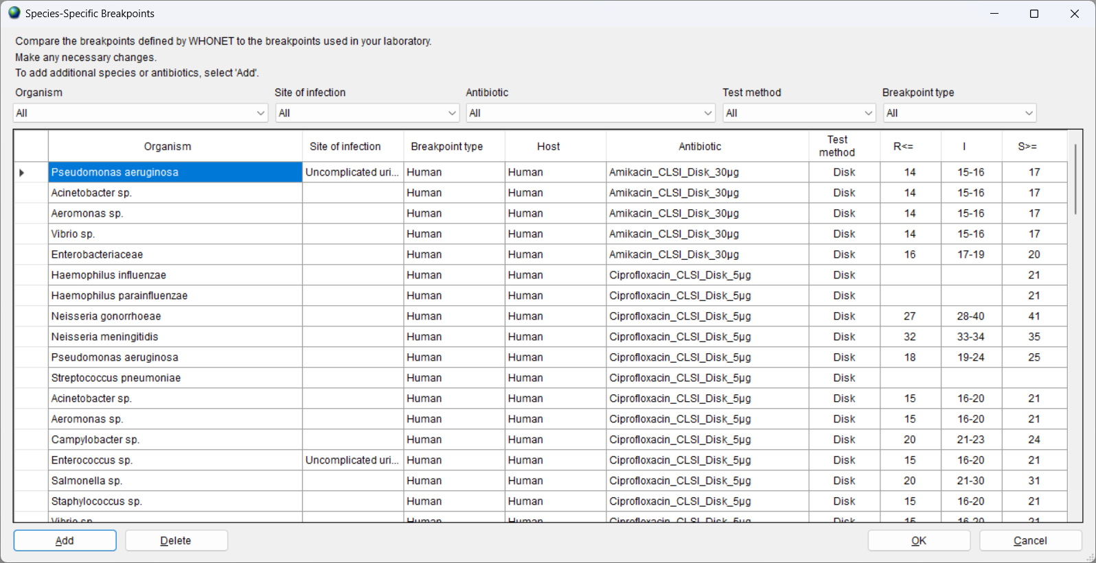
2
Review the antibiotic breakpoints
A

Slide 15
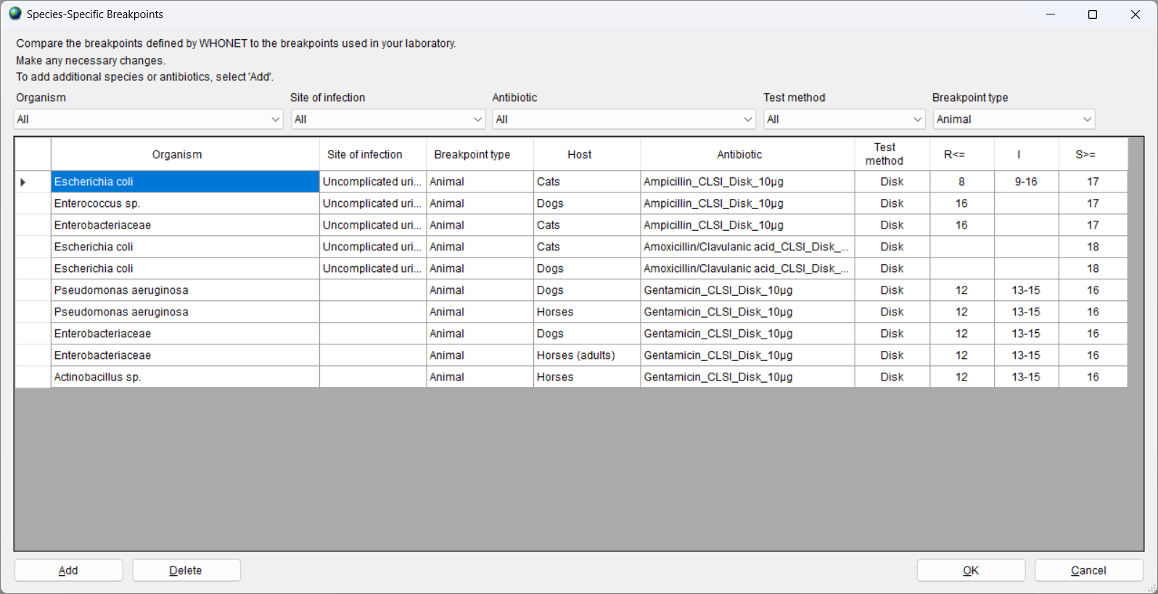
2
You can filter the breakpoints
A

Slide 16
2
Update the breakpoints
A

Slide 17
2
Review the special interpretation rules
A

Slide 18
2
Review the special interpretation rules
A

Slide 19
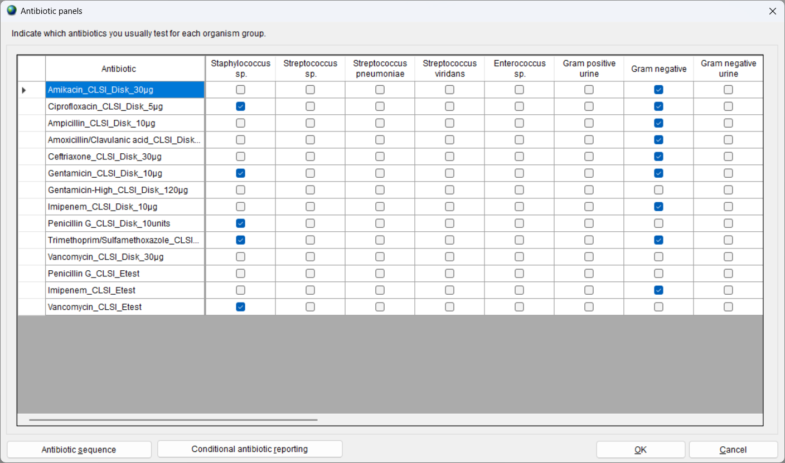
2
Define your antibiotic panels
A
Indicate which antibiotics are tested for each organism group. This will facilitate data entry.

Slide 20
2
Laboratory configuration
A
Create a list of sample collection locations.

Slide 21
2
Define your sample locations
A
Human
wards, clinics, towns, cities, ...
Animal
Farms, veterinary clinics, markets, ...
Food
Markets, restaurants, ...
Environmental
River, Sewage, Hospital surfaces, Farm environmental

Slide 22
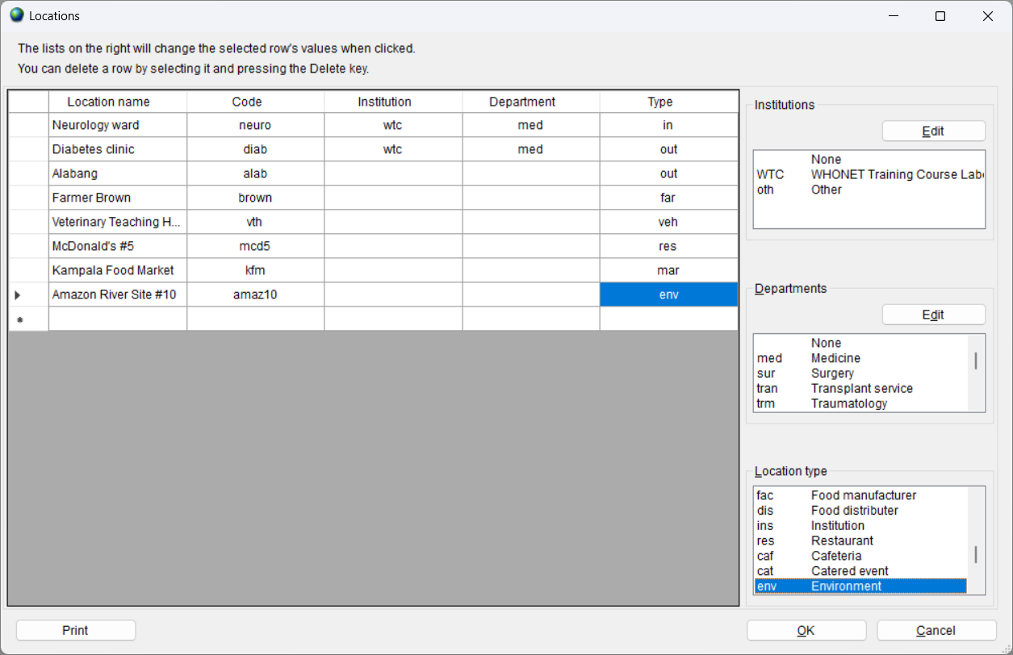
2
Define your sample locations
A

Slide 23
2
Laboratory configuration
A
You can enter information about your antibiotics, sample locations, and data fields. You can also create new microbiological alerts.

Slide 24
2
Define your data fields
A

Slide 25
2
Modify the list of data fields
A
Optional data modules
Clinical information
Microbiology information
WHO GLASS-AMR
WHO GLASS-EGASP
EARS-Net
InFARM
Viet Nam-Animal Health
etc.
Optional data fields
Diagnosis
Physician
Gram stain
Freezer location
Gene sequence results
User-defined data fields

Slide 26
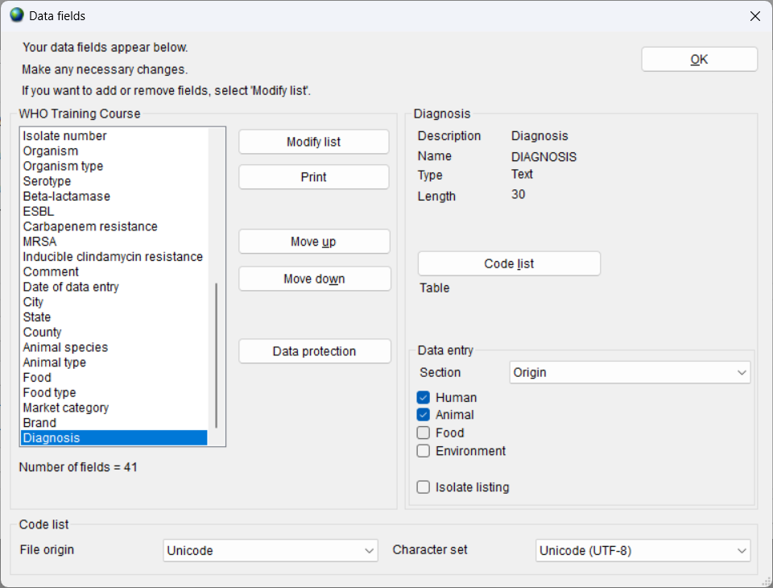
2
Define your data fields
A
You can create a list of codes to be used in data entry.

Slide 27
2
Create a list of codes
A

Slide 28
2
Laboratory configuration
A
You can enter information about your antibiotics, sample locations, and data fields. You can also create new microbiological alerts.

Slide 29
2
Review microbiological alerts
A

Slide 30
2
Save your configuration
A

Slide 31
2
Laboratory list
A

Slide 32
2
Three ways to create a new laboratory
A
New laboratory
B
Pre-defined laboratory template
C
Create a laboratory from a data file

Slide 33
2
Pre-defined laboratory template
This a valuable feature for automatically creating a laboratory configuration according to specific project protocols.
WHONET includes predefined templates for international projects, such as WHO GLASS-AMR, EARS-Net, and FAO InFARM.
WHONET also includes predefined templates for specific country networks, such WHONET-Argentina and Viet Nam Animal Health.
These templates include standard lists of antibiotics, data fields, and code lists. This is useful for introducing standardization across laboratories in a network.
The “Update laboratory” option is useful for maintaining standardization over time if the template changes.
C

Slide 34
2
Laboratory list
A

Slide 35
2
Creating a new laboratory
Select one of the pre-define configuration templates.
B

Slide 36
2
Enter the country and laboratory information
B

Slide 37
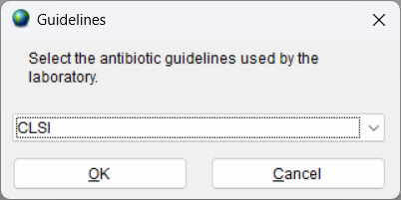
2
Answer the questions asked by WHONET
For WHO GLASS-EGASP, there is a single question. Choose between CLSI and EUCAST.
B
After you answer the last question, WHONET will create a new configuration with the responses that you provide.

Slide 38
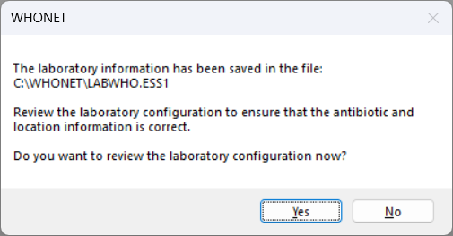
2
Reviewing the configuration
If you would like to review the laboratory configuration, answer “Yes”.
B

Slide 39
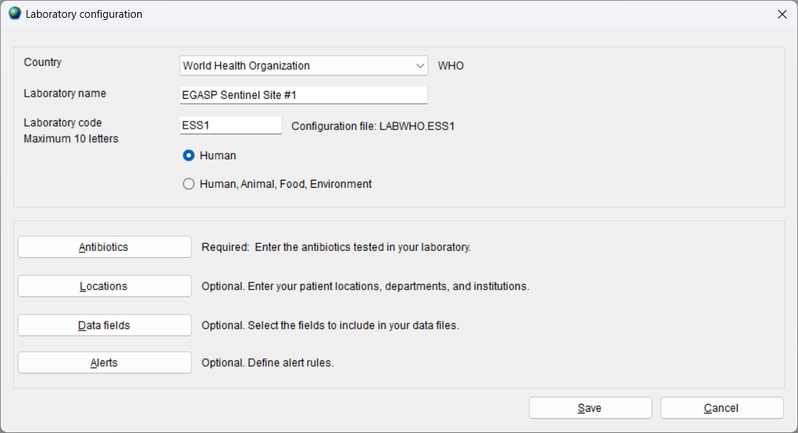
2
Review the laboratory details
B

Slide 40
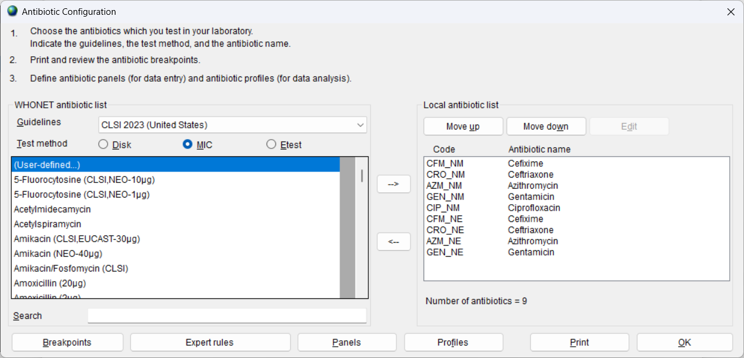
2
Review the antibiotic details
B

Slide 41
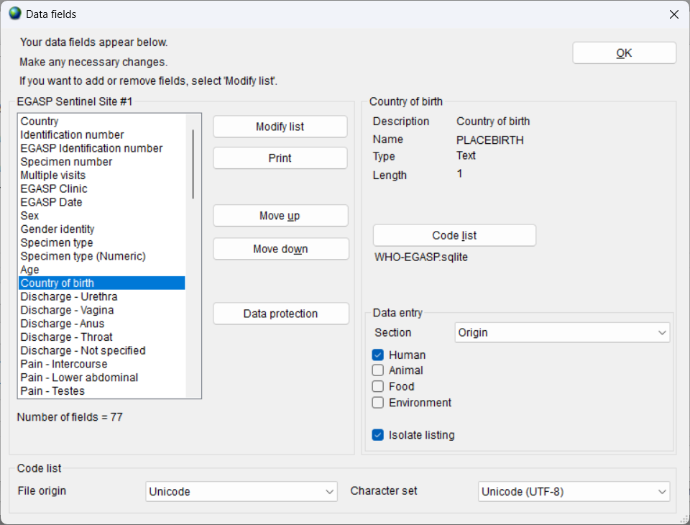
2
Review the data fields
B

Slide 42
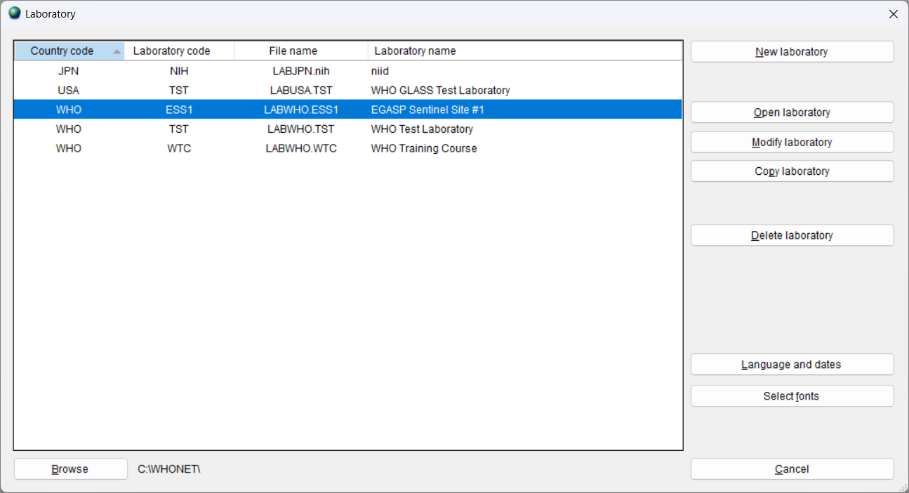
2
The new configuration now appears in the list of laboratories.
B

Slide 43
2
Three ways to create a new laboratory
A
New laboratory
B
Pre-defined laboratory template
C
Create a laboratory from a data file

Slide 44
2
Create a laboratory from a data file
This a valuable feature for automatically creating a laboratory configuration from existing data files. This is useful in a number of importance situations
You have received a WHONET data file from a collaborator, but the collaborator did not send you the laboratory configuration that was used to create the file.
You have created a WHONET file from BacLink.
You are a data manager for a network of laboratories. You can create a “national configuration” or a “network configuration” by incorporating data from all of the network laboratories.
C

Slide 45
2
Three ways to create a new laboratory
C

Slide 46
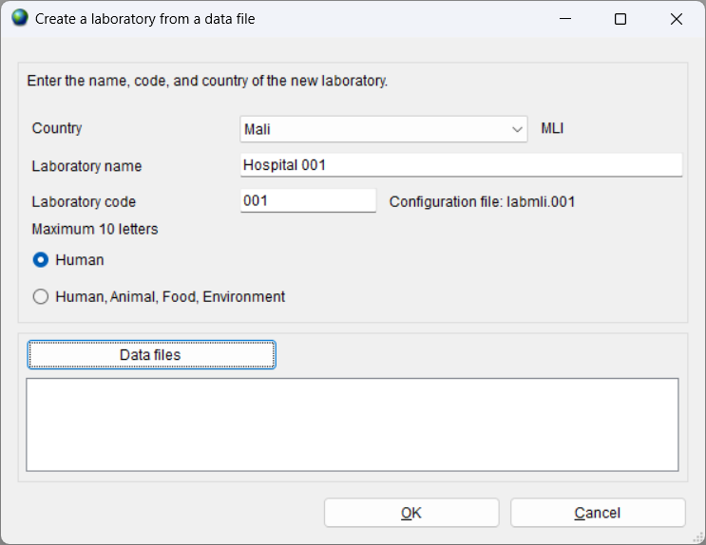
2
Provide the laboratory details
C

Slide 47
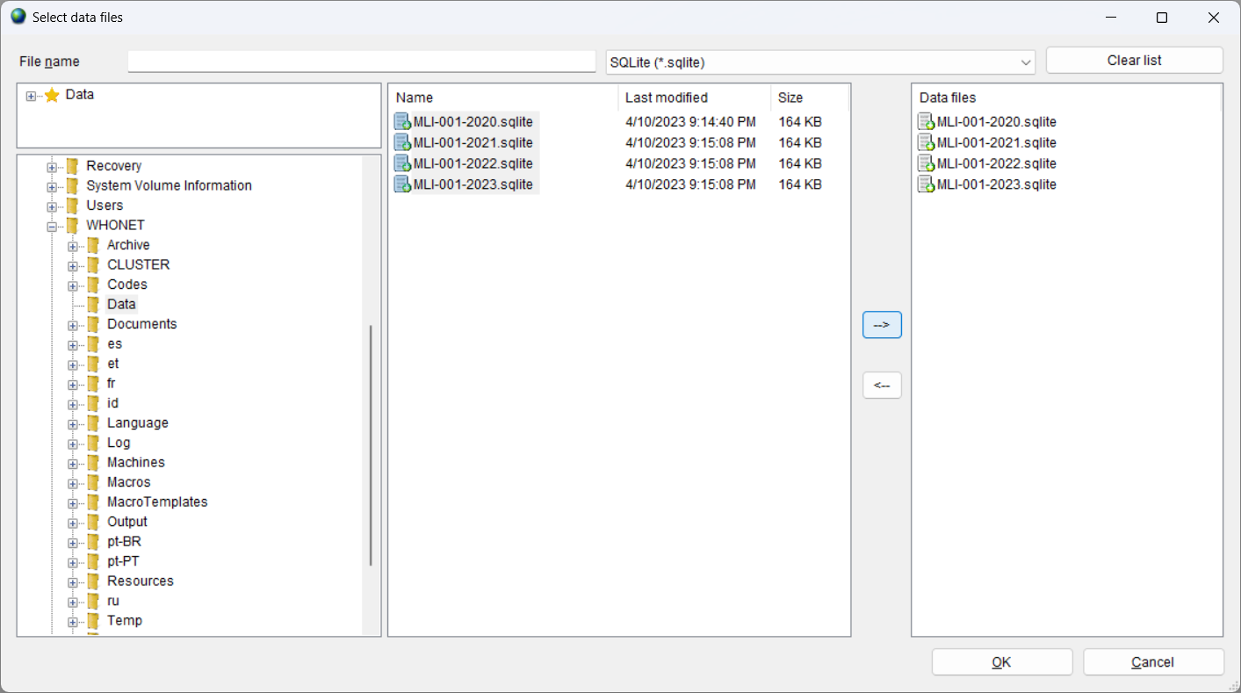
2
Select the data files to scan
In the below example, we have selected four years of data from Hospital 001.
C

Slide 48
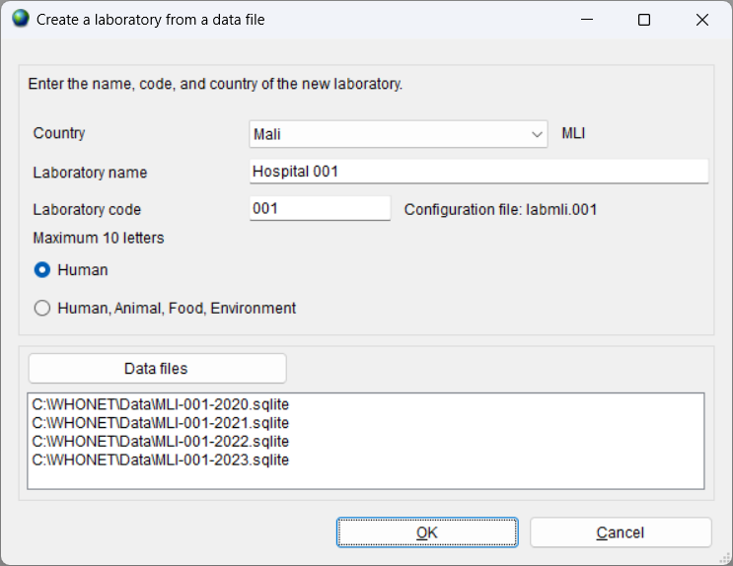
2
Select OK to scan the files from Hospital 001
C

Slide 49
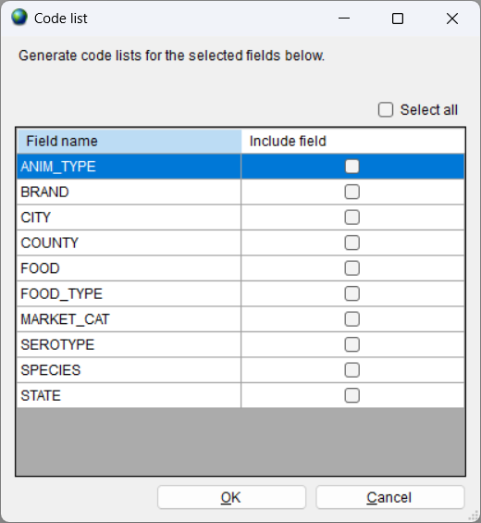
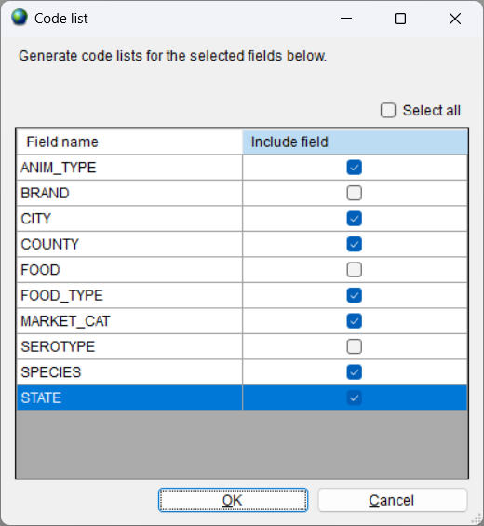
2
Create code lists for relevant data fields
WHONET will show a list of data fields.
Select fields where you think a code list would be useful for data analysis.
C

Slide 50
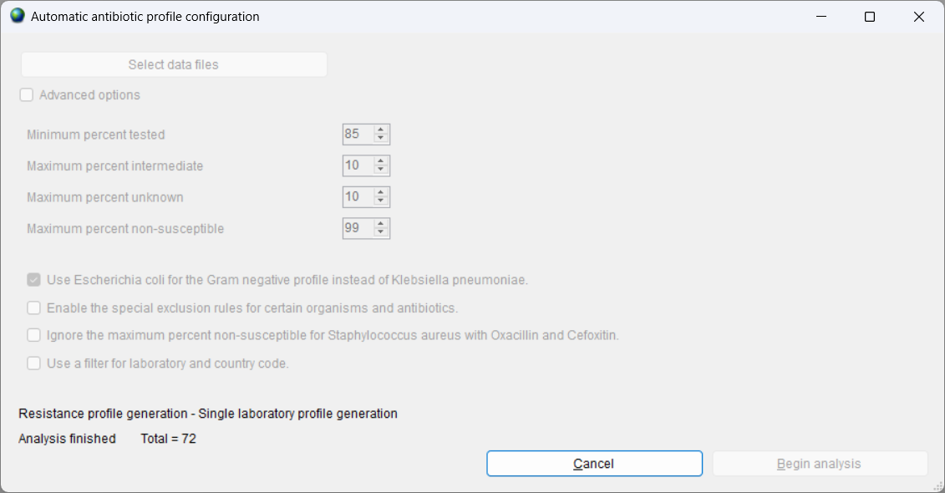
2
Automatic resistance profile configuration
WHONET will examine the antibiotic test practices in the data files selected. Based on these results, WHONET will a generate a set of commonly tested antibiotics to be used for the Resistance Profile analysis for priority organism groups.
C

Slide 51
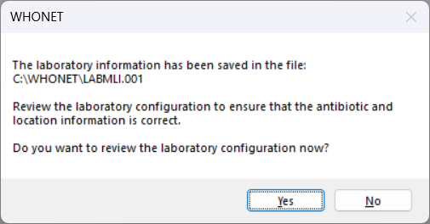
2
Review the laboratory configuration
C

Slide 52
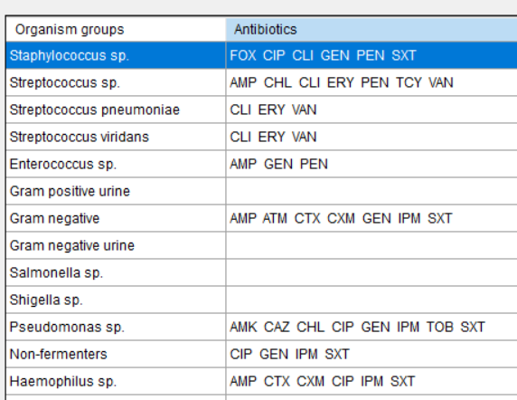
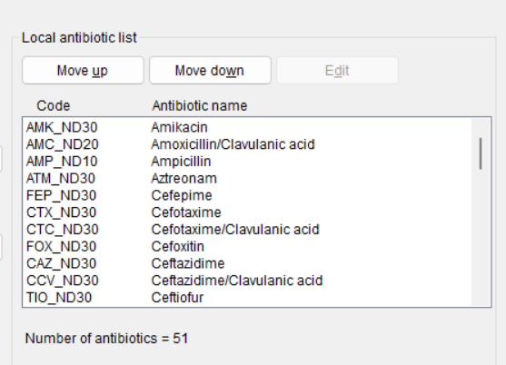
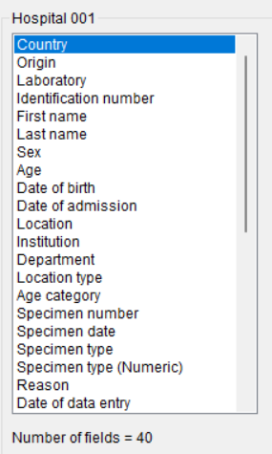
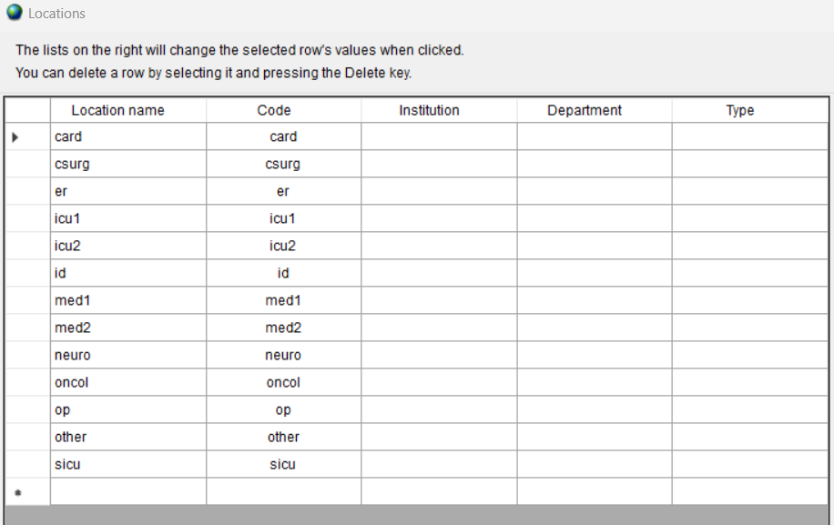
2
Review the antibiotics, locations, and data fields
C
Antibiotics
Resistance profiles
Data fields
Locations

Slide 53
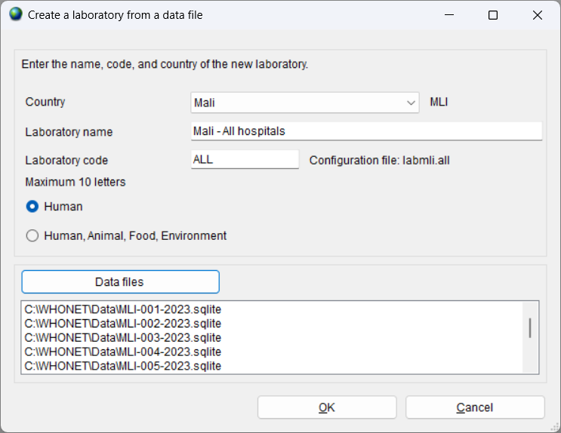
2
Select the data files to scan
In the below example, we have selected one year of data from ten hospitals to create a “National Configuration”.
C

Slide 54
2
View the list of laboratories
C

Slide 55
2
Other configuration options
C

Slide 56
2
File locations
C

Slide 57
2
Thank you for watching Module 2
Up next. Module 3: Data entry

