Slide 1


WHONET Training Course
Module 3 – Data entry
Division of Infectious Diseases, Brigham and Women’s Hospital, Boston, United States
WHO Collaborating Centre for Surveillance of Antimicrobial Resistance

Slide 2

3
Module 3. Data entry
There are two common ways to enter data into WHONET.
  Manual data entry
  You can manually enter data from paper records into the WHONET desktop application. There is also a new web application for data entry in development.
  Importing data with BacLink
  If you already have a computer system for managing your microbiology results, you can usually use BacLink to import your existing data. This avoids the need for double data entry. BacLink is automatically installed when you install WHONET.
    The data could be from a laboratory information system, a laboratory instrument (Microscan, Phoenix, Vitek, etc.), or other spreadsheet or database software (Excel, Access, etc.).
    BacLink will be covered in a separate training course.

Slide 3

3
Module 3. Data entry
A
A
Create a new data file
B
Entering and editing data
C
Opening an existing data file
D
Clinical reports
E
Importing data with BacLink

Slide 4
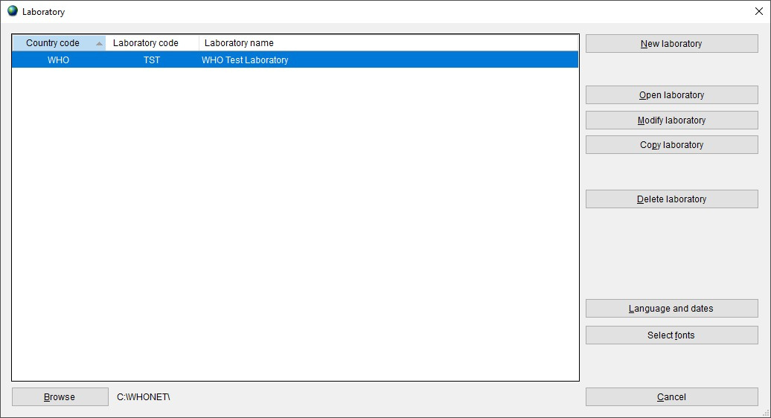
3
Select your laboratory from the list
A

Slide 5
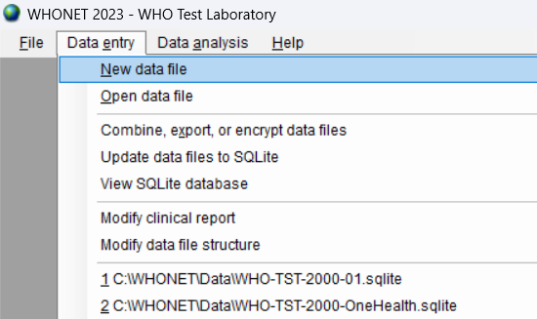
3
Click on "Data entry" and "New data file".
A

Slide 6
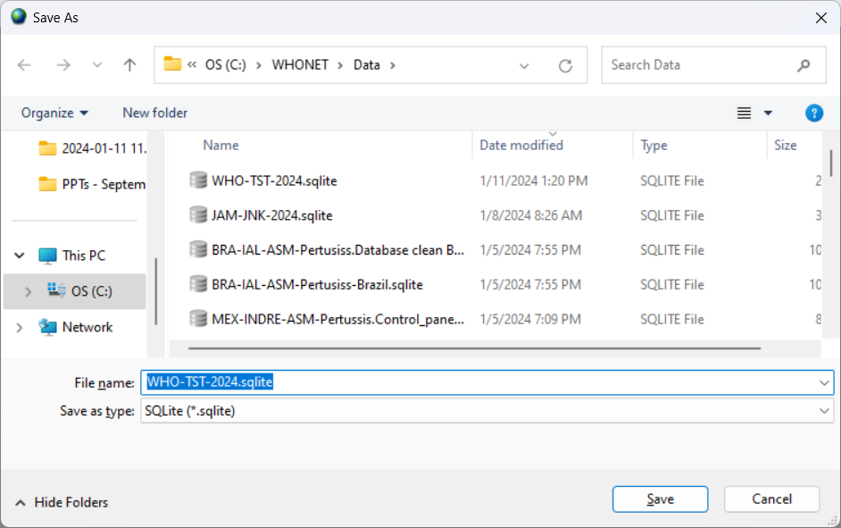
Name and location of the new data file
3
A
Choose the file folder, for example C:\WHONET\Data
Choose the file name, for example, WHO-TST-2024.sqlite
You can save the data on:
- local hard drive
- network server
- cloud folder

Slide 7
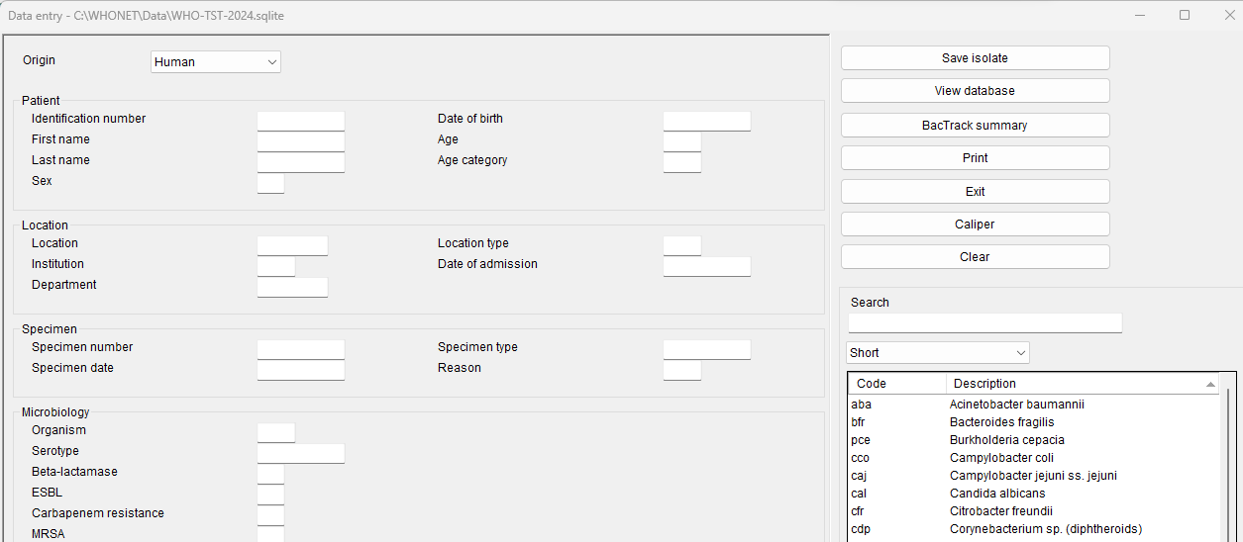
3
Data entry form
A

Slide 8
3
Module 3. Data entry
A
A
Create a new data file
B
Entering and editing data
C
Opening an existing data file
D
Clinical reports
E
Importing data with BacLink

Slide 9
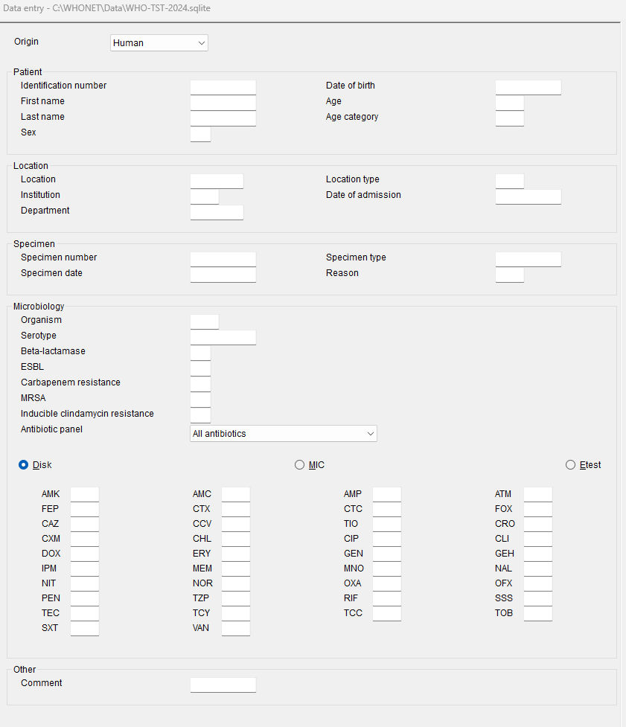
3
Data entry form
B

Slide 10
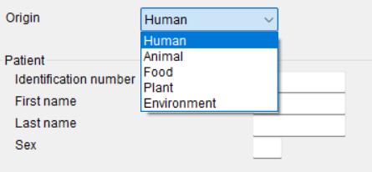
3
Select the origin of the sample
B

Slide 11
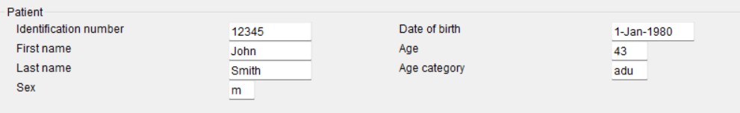
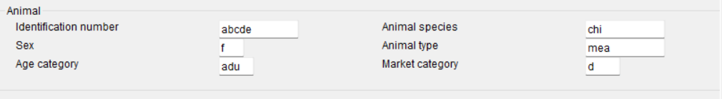
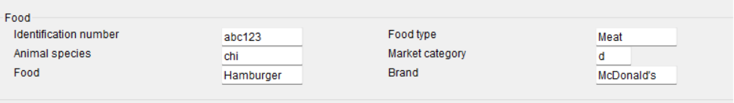

3
Origin of the specimen
B
Human
Animal
Food
Environment

Slide 12
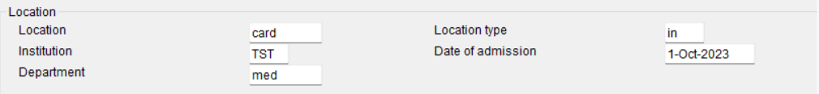
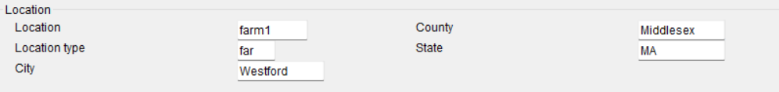
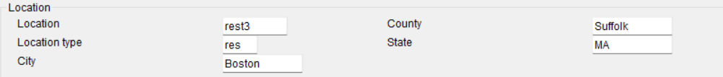
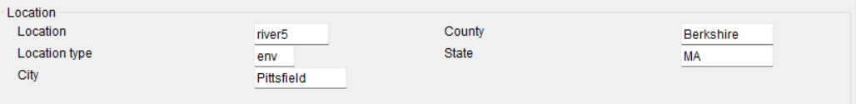
3
Location of specimen collection
B
Human
Animal
Food
Environment

Slide 13
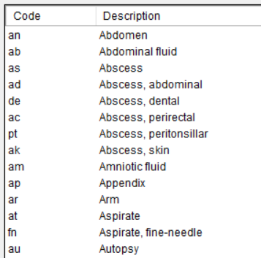
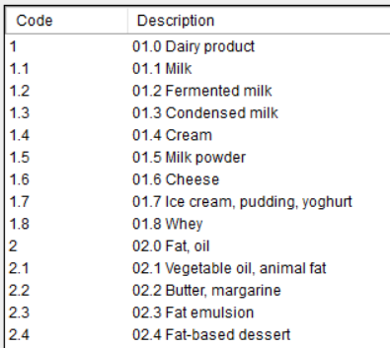
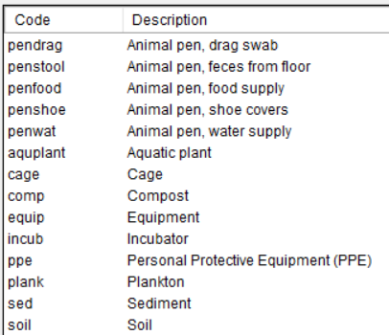
3
Specimen details
B
All sectors
Sample types
Human and animal*
Food
Environment
*Some differences (egg, cloaca…)

Slide 14
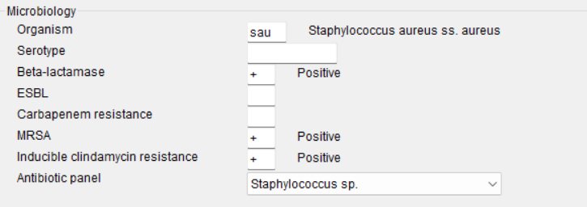
3
Organism results
B
All sectors

Slide 15
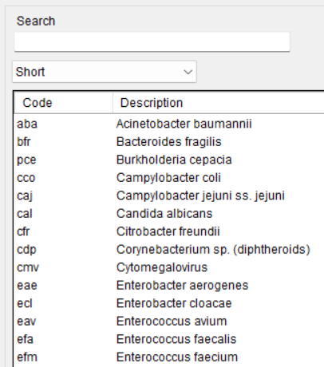
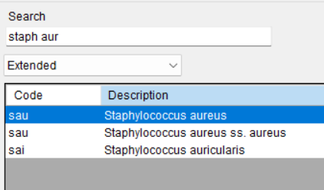
3
Using the search box
B

Slide 16
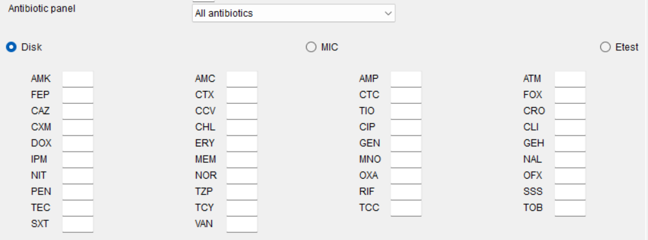
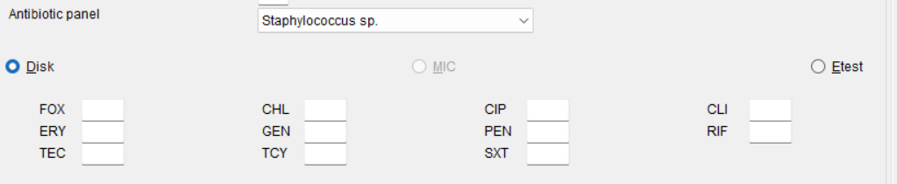
3
Antibiotics and antibiotic panels
B

Slide 17
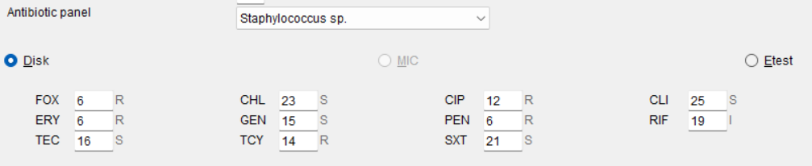
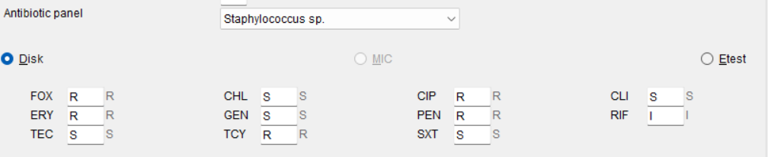
3
Antibiotic test results
B
You can either enter test measurements or test interpretations. We recommend the entry of test measurements.
Zone diameters
Interpretations

Slide 18
3
Entering MIC and Etest data
B
Enter MIC data as shown below.
For cefotaxime and penicillin, you see multiple interpretations. This is explained further on the next slide.
If you are entering data for trimethoprim/sulfamethoxazole, just enter the MIC value for trimethoprim. For example, if the MIC is 1 μg/ml trimethoprim + 19 μg/ml sulfamethoxazole, just enter “1”.

Slide 19
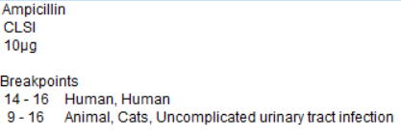
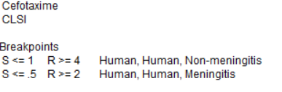


Multiple interpretations
3
B
On the previous screen, there were two antibiotics with multiple interpretations. The reason is that there are multiple breakpoints for this organism and antibiotic.
In the below, there are two breakpoints for Streptococcus pneumoniae. For example, an isolate with an MIC of 2 µg/ml would be considered to be clinically resistant in patients with meningitis, but intermediate in patients without meningitis.
In the second example, a zone diameter of 10 mm would be considered resistant in human patients, but intermediate in cats.
Streptococcus pneumoniae
Escherichia coli

Slide 20
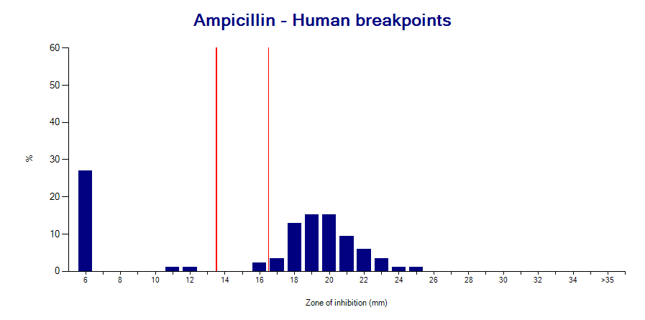
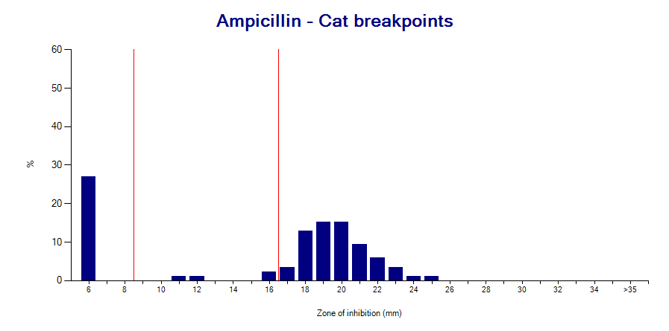
3
The value of test measurements
B
Required for accurate reporting to clinicians
Interpretive criteria can change over time
Measurements permit an assessment of test quality
Measurements facilitate recognition of microbial subpopulations and mechanisms of resistance
Measurements are needed when there are multiple interpretations
  Meningitis, Non-meningitis, Urinary tract infection
  Human, Dog, Horse, Fish, Epidemiological Cutoff Values
Escherichia coli - Humans
Escherichia coli - Cats

Slide 21
3
Test interpretations
B
The most common interpretations are R, I, and S.
R = Resistant
I = Intermediate (CLSI )
I = Susceptible with increased exposure (EUCAST)
S = Susceptible
You may also see some additional interpretations.
SDD (CLSI) = “Susceptible, Dose-dependent”. This is similar to the EUCAST “I” category.
NS = Nonsusceptible (CLSI). There is a “Susceptible” category, but insufficient data to define a “Resistant” category. This category is often used when there is little clinical data to be evaluated by CLSI.
? = There are no breakpoints for this organism and antibiotic
S? and R? are explained on the next slide. Only for off-scale MIC values.

Slide 22
Interpretation categories: S? and R?
3
B
These categories only appear for “off-scale” MIC data such as MIC≤2 when the MIC value does not correspond to the breakpoints. For example, if the breakpoints for an antibiotic are S≤1 and R≥4, and a user enters MIC≤2, then there is ambiguity. The “≤” symbol would suggest that the organism is susceptible. However, an MIC of 2 would be intermediate.
This may happen because of a typing mistake by the user. But more commonly the reason is because of a change in the breakpoints. For example, older MIC panels were designed with imipenem concentrations that corresponded to the old CLSI breakpoint of S≤4. But in 2010, CLSI changed the susceptible breakpoint to S≤1.
WHONET will give the interpretation of “S?” with the idea that most bacteria that were previously considered to be susceptible by the older breakpoints would probably also be susceptible with the new breakpoints. But since we do not know the exact MIC, we cannot be certain.

Slide 23
3
Microbiology alerts
B
WHONET offers microbiology alerts for findings of clinical and public health importance:
Important species
Important resistance
Quality
Therapy
The alerts can help to notify laboratory staff about important findings or results that may suggest an error in the organism identification or the antimicrobial susceptibility test results.
You can also define your own alerts in Laboratory configuration.

Slide 24
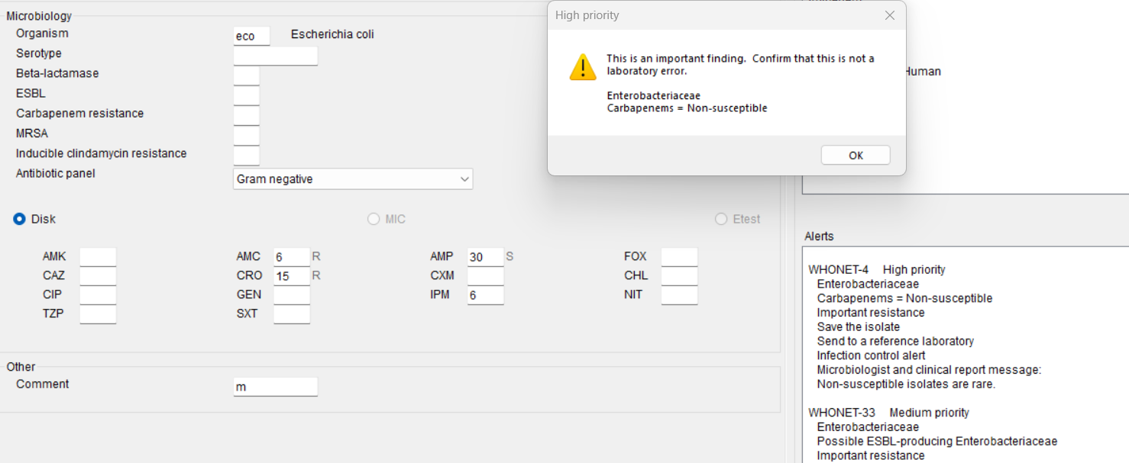
3
Microbiology alert example
B
The below isolate of Escherichia coli generates alerts for resistance to imipenem (high priority) and ceftriaxone (medium priority). There is also a quality alert because the E. coli is susceptible to ampicillin but resistant to amoxicillin/clavulanic acid.

Slide 25
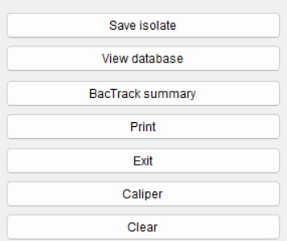
3
Additional options
B
In this module, we will discuss the three items indicated below.

Slide 26
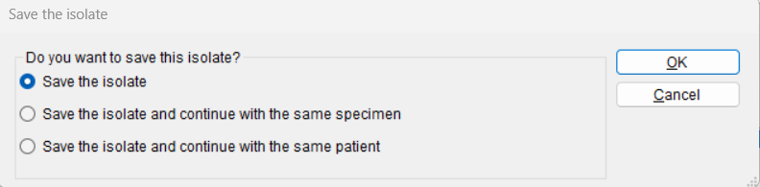
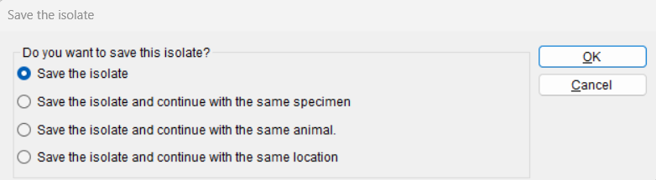
3
Save the isolate
B
This isolate has no microbiology alerts
Human
Animal

Slide 27
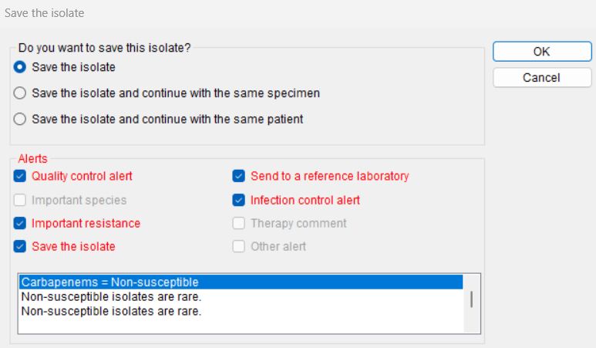
3
Save the isolate
B
This isolate has several microbiology alerts
Imipenem resistance
Ceftriaxone resistance – Possible ESBL producer
Quality alert - Ampicillin susceptible and Amox/Clav resistant

Slide 28
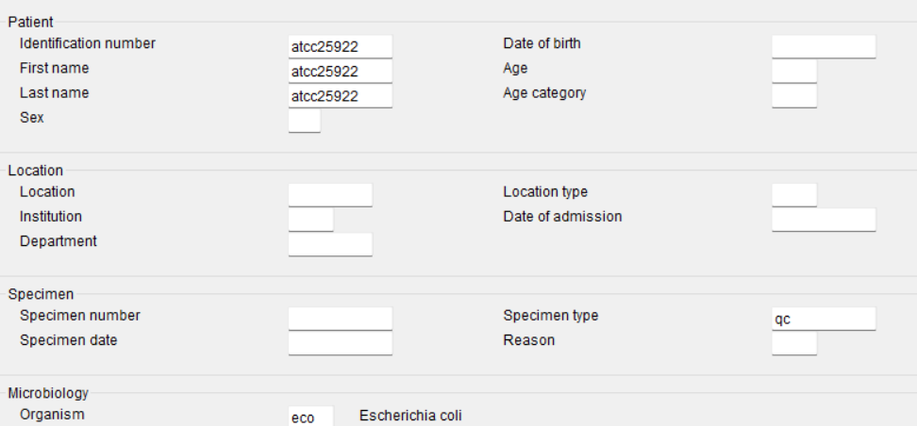

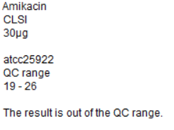
3
Enter a QC isolate
B
Enter the number of the quality control strain, such as ATCC25922.
WHONET will automatically recognize this as a “quality control” specimen. For ATCC25922, WHONET will also recognize this as an Escherichia coli. WHONET will flag results that are outside of the expected quality control range.

Slide 29
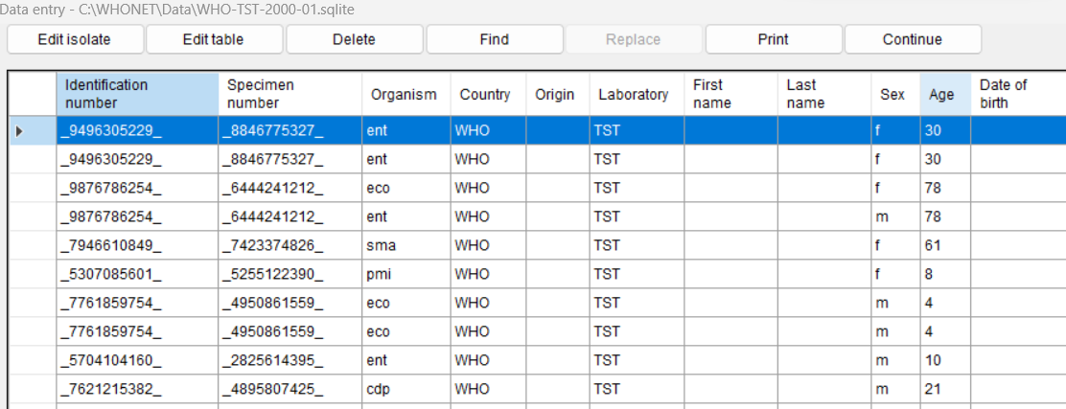
View the database
3
B
Use this screen to make changes to the database, search for records, or print out clinical reports. When you finish, click on Continue.

Slide 30
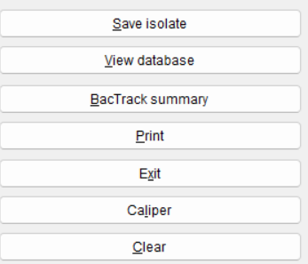
Exit data entry
3
B
WHONET you are finished with data entry, click on “Exit” to return to the main menu.

Slide 31
3
Module 3. Data entry
A
A
Create a new data file
B
Entering and editing data
C
Opening an existing data file
D
Clinical reports
E
Importing data with BacLink

Slide 32
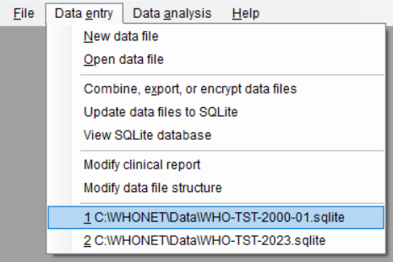
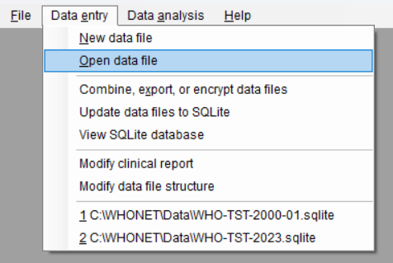
3
Open data file
C
If you see the name of the file that you would like to open, then click on it.
If you do not see the file, then select Open data file.

Slide 33
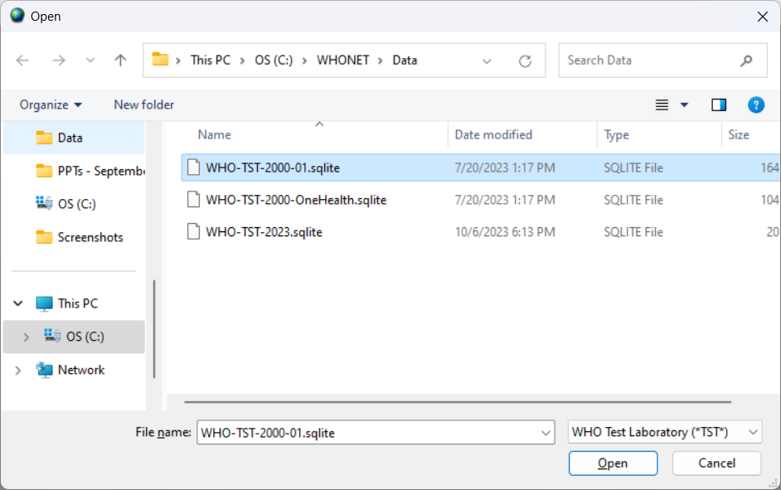
3
Opening an existing data file
C

Slide 34
3
Continue with data entry
C

Slide 35
3
View database
C

Slide 36
3
Module 3. Data entry
A
A
Create a new data file
B
Entering and editing data
C
Opening an existing data file
D
Clinical reports
E
Importing data with BacLink

Slide 37
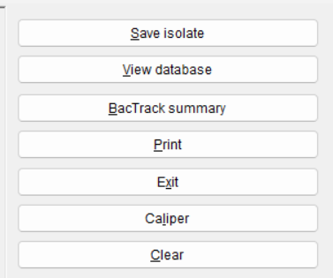
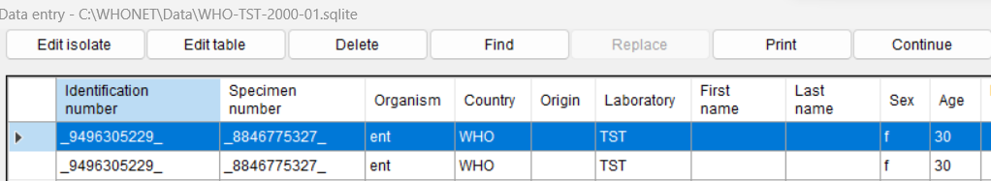
3
Printing results
D
Data entry
View database

Slide 38
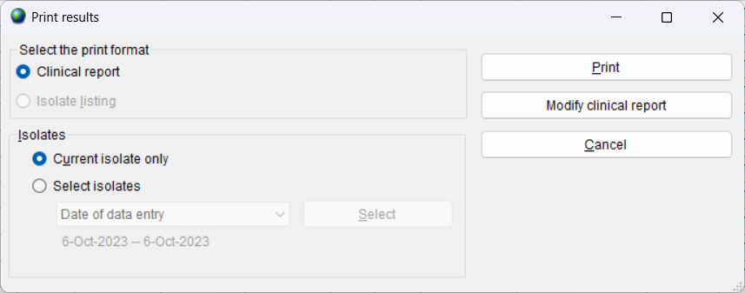
Clinical reports
3
D
You have the option to print out reports or to modify the content and formatting of the reports.

Slide 39
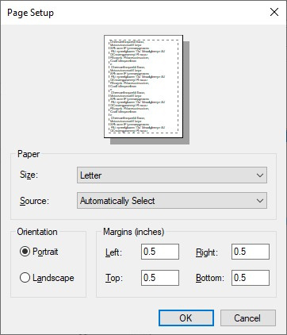
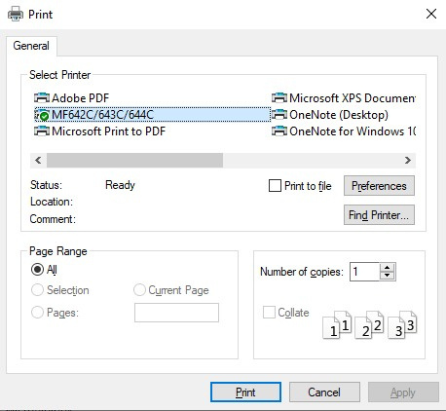
Printing the clinical report
3
D
You can send the report to a printer or to a PDF file. If you select PDF, Windows will ask you to give a name to the new PDF file.

Slide 40
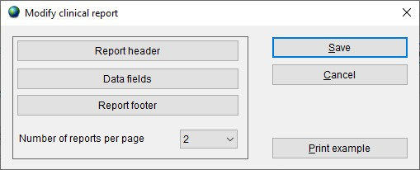
Modifying the clinical report
3
D
You can use the below features to customize the content and formatting of the clinical reports.

Slide 41
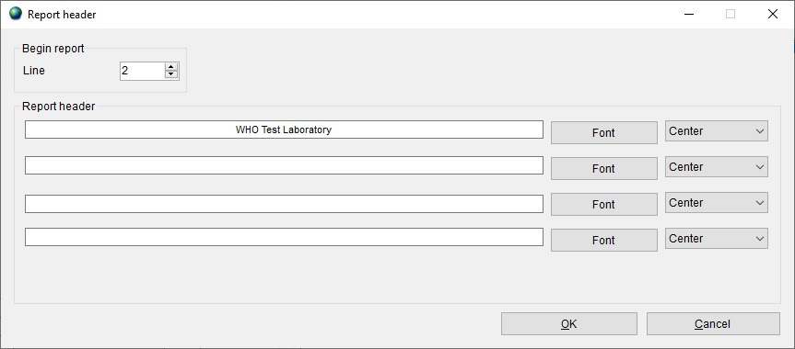
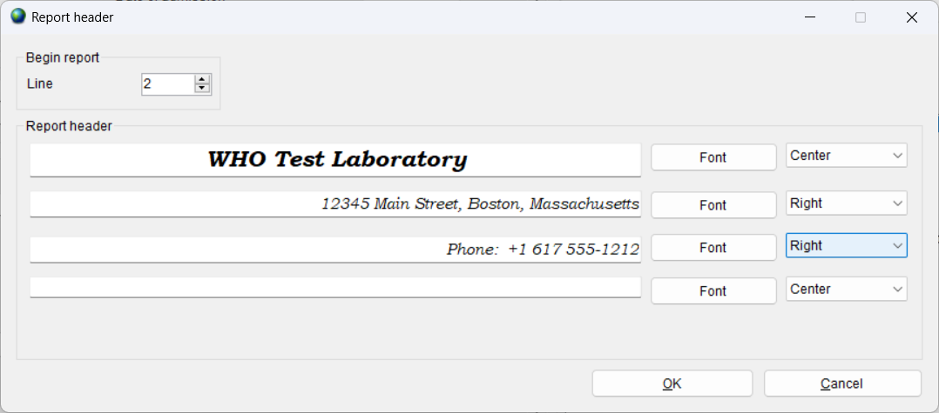
Modifying the report header
3
D

Slide 42
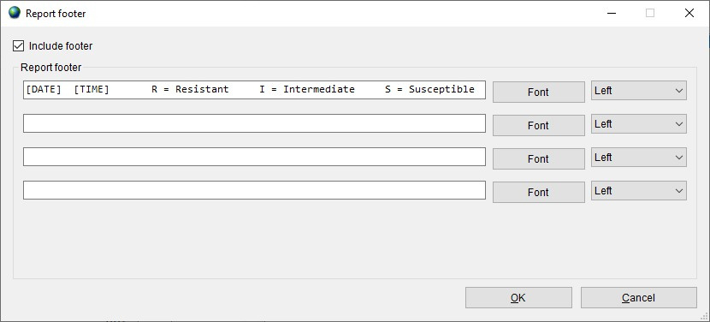
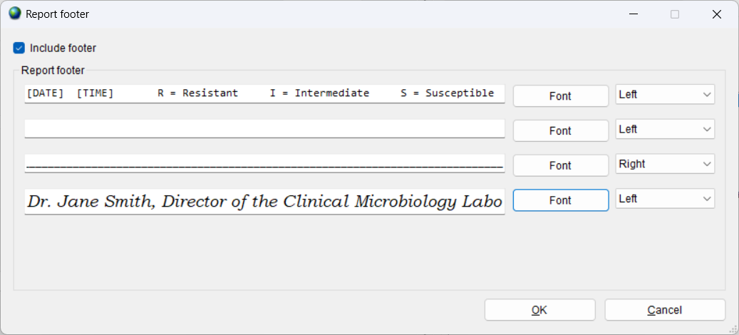
Modifying the report footer
3
D

Slide 43
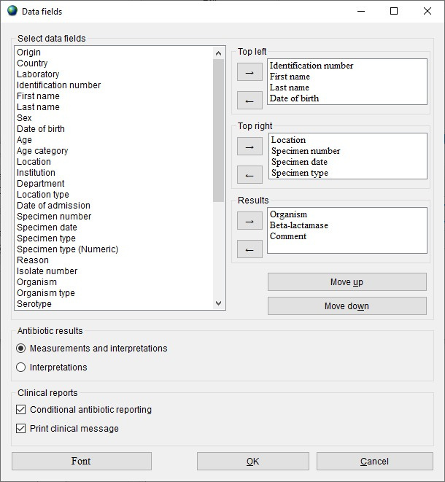
3
Modifying the data fields
D

Slide 44

3
Print example
D

Slide 45
3
Module 3. Data entry
A
A
Create a new data file
B
Entering and editing data
C
Opening an existing data file
D
Clinical reports
E
Importing data with BacLink

Slide 46
3
Importing data with BacLink
E
Most laboratories in the medium- and high-resource world already have computer systems for managing their microbiology data… and also many in low-resource settings.
  Simple desktop systems: Excel, Access,…
  Laboratory instruments: Vitek, Microscan, BD Phoenix, etc.
  Laboratory information systems: Commercial or in-house
This is an obstacle because they are not directly compatible.
But it is also an opportunity! The electronic data have been stored.
The goal of BacLink is converting data from existing incompatible systems into common WHONET files.
BacLink
WHONET
Incompatible Local systems
Standard WHONET files

Slide 47
Thank you for watching Module 3
Next – Module 4: Introduction to data analysis

