Slide 1
WHONET Training Course
Module 5 – Data analysis and interpretation
Division of Infectious Diseases, Brigham and Women’s Hospital, Boston, United States
WHO Collaborating Centre for Surveillance of Antimicrobial Resistance

Slide 2
Module 5. Data analysis and interpretation
5
A
Guiding principles
B
%RIS and test measurements
C
Isolate listing and summary
D
Scatterplot
E
Resistance profiles
F
Microbiology alerts
G
Cluster alerts

Slide 3
Interpretation of results – Focus areas
5
A
Epidemiology of microbes and antimicrobial resistance
Tracking and understanding emerging threats to guide policies, practices, and interventions over time
Analysis needs are different between local, national, regional, and global levels
Continuous quality improvement
Improve the utilization of laboratory services
“Diagnostic stewardship” - timely collection of relevant specimens
Improve the reliability and value of laboratory services
Appropriateness of test practices
Appropriateness of test results
Appropriateness of test reporting

Slide 4
5
The impact of bias on results
A
There are two primary consequences of bias in laboratory-based studies of antimicrobial resistance.
Underestimation of disease burden: There are often no specimens collected from the majority of patients with disease.
Overestimation of resistance rates: Specimens are often collected in patients with treatment failures, with complicated medical histories, and with long hospital stays.
There are no simple or inexpensive strategies to avoid bias. Well-designed protocols can help to minimize bias, and these are worthwhile. However, they are often resource-intensive, time-limited, and focus on a few priority conditions in a few clinical site

Slide 5
5
The interpretation of biased data
A
It is crucial to keep the issue of bias in mind whenever we review results, and we must proceed cautiously when making conclusions and recommendations.
For certain surveillance objectives, the impact of biases can be devastating to appropriate quality policy decisions, while for others, the impact of biases is less.
High impact: Standard treatment guidelines, disease burden estimates
Medium impact: Advocacy and awareness
Lower impact: Outbreak detection, trend monitoring, recognition and confirmation of new resistance, continuous quality improvement in laboratory services.

Slide 6
Module 5. Data analysis and interpretation
5
A
Objectives and principles
B
%RIS and test measurements
C
Isolate listing and summary
D
Scatterplot
E
Resistance profiles
F
Microbiology alerts
G
Cluster alerts

Slide 7
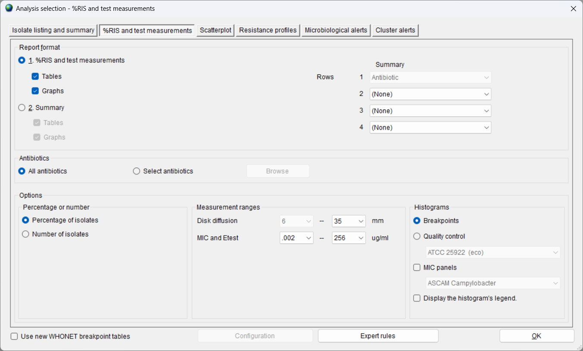
5
WHONET analysis types
B

Slide 8
%RIS and test measurements
5
B

Slide 9
Two report formats
5
B
1. %RIS and test measurements – Detailed report
There will be one table for each organism and one antibiotic test on each row.
Breakpoints, %R, %I, and %S statistics, and 95% confidence intervals
Histograms for disk diffusion and MIC results
Useful for detailed data evaluation
2. Summary – “Antibiogram”
There will be one row for each organism selected and one antibiotic test in each column.
Choose between %R, %I, %S, or %R+%I or %S+%I
High-level summaries
%S or %S+%I – Useful for development of treatment guidelines
%R or %R+%I – Useful for resistance monitoring

Slide 10
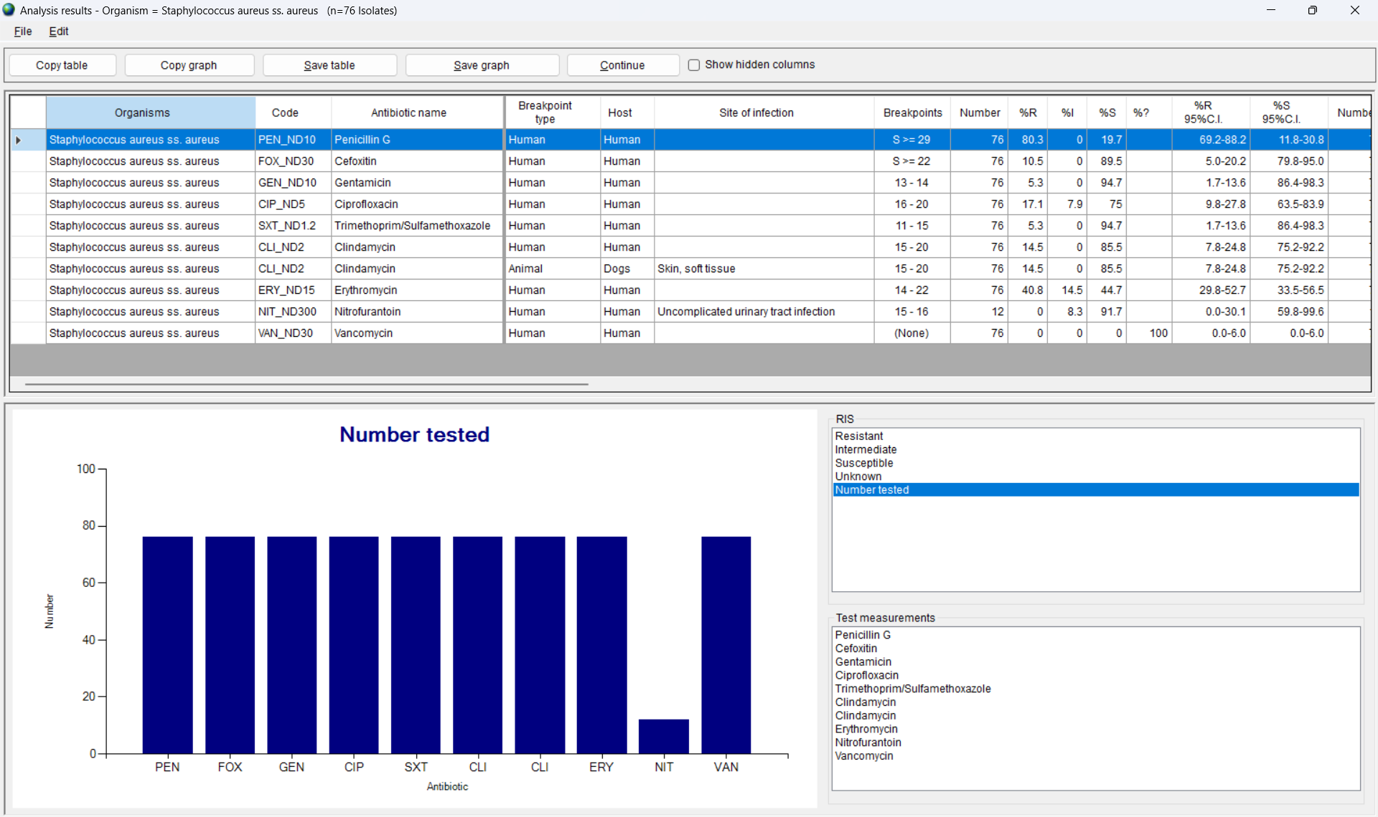
5
%RIS and test measurements
Staphylococcus aureus
B

Slide 11
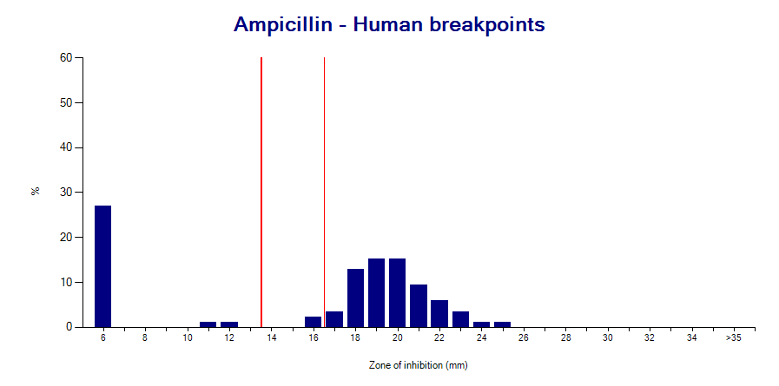
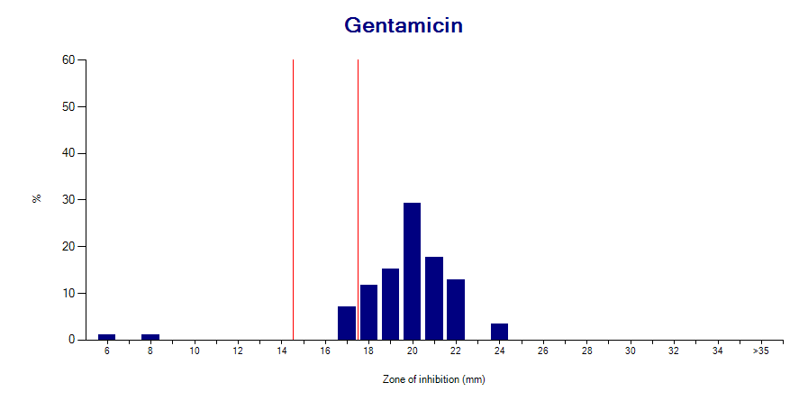
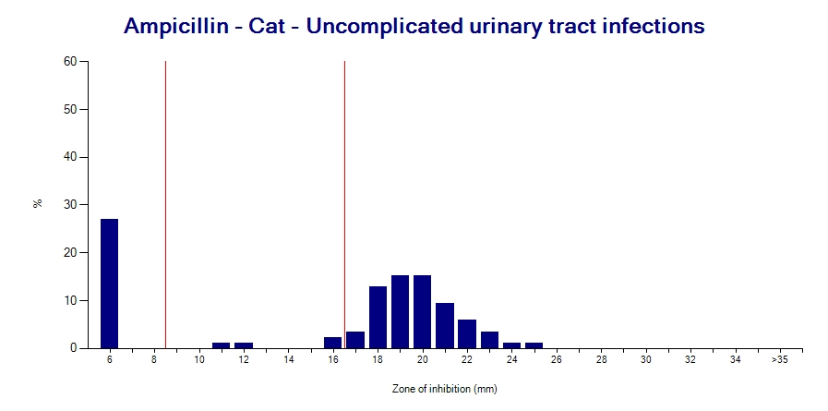
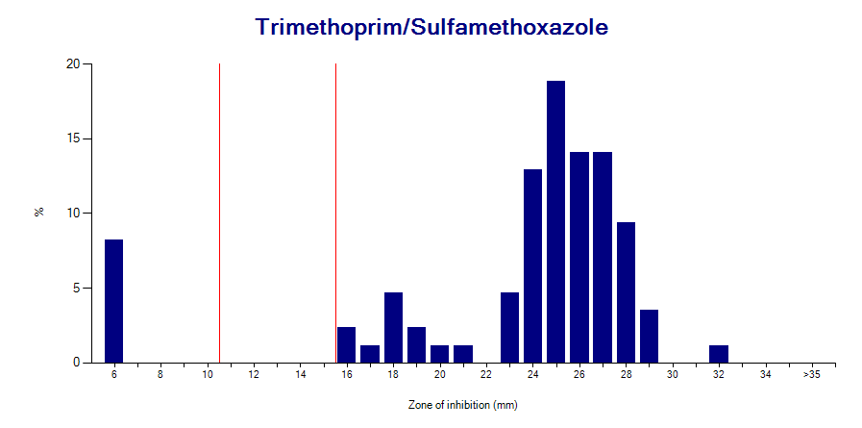
5
Histograms
Escherichia coli
B

Slide 12
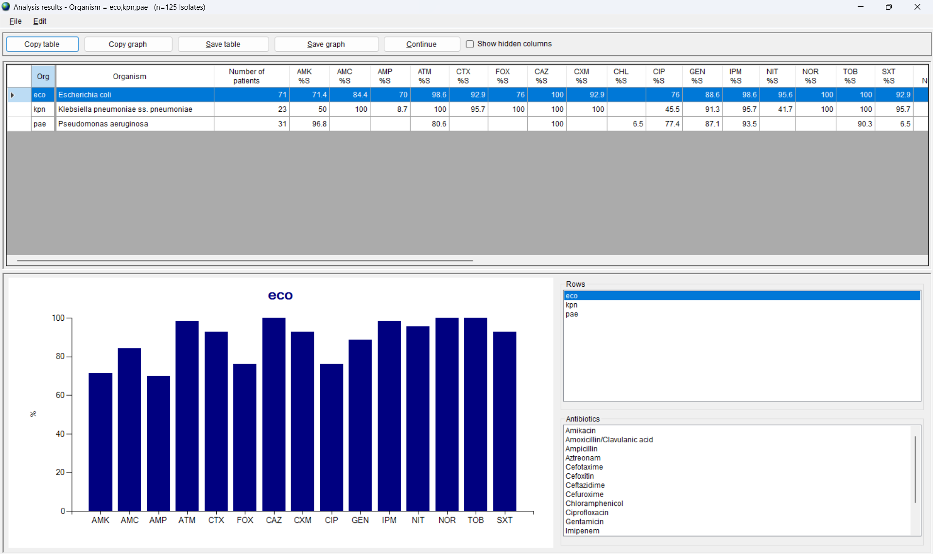
5
%Susceptible summary
Three Gram-negative species
B

Slide 13
%RIS and %S Summary – Uses
5
B
Epidemiology
Monitor resistance trends, track high priority resistance (CRE, MRSA)
Therapy guidelines, antimicrobial stewardship, assessment of interventions
Benchmarking across facilities
Quality assessment
Appropriateness of test practices
Are there antibiotics tested that have no breakpoints? Are there important antibiotics missing that should be tested?
Is there evidence of irregular test practices (stock outages, etc.)? Is there evidence of “second-line” testing? This can introduce significant bias into the statistics.
Unexpected findings that may suggest testing errors
Klebsiella pneumoniae: 20% susceptible to ampicillin
Escherichia coli: 80% susceptible to gentamicin but only 50% susceptible to amikacin

Slide 14
Test measurements - Uses
5
B
Epidemiology
Recognition of distinct phenotypic subpopulations
Re-analysis of results according to human or animal-specific clinical breakpoints or epidemiological cutoff values.
Re-analysis of older data files using the newest breakpoints
Quality assessment
Does the laboratory record test measurements?
For the susceptible population, do the results suggest good quality testing? One should usually see a relatively a symmetric distribution. However, irregular histograms can suggest deficiencies in the media (thickness, pH, calcium and magnesium concentration), in the disks, or in the inoculum.
Is there significant number preference for zone diameters? “Even numbers”? “Multiples of 5”?

Slide 15
%RIS – Other options
5
B

Slide 16
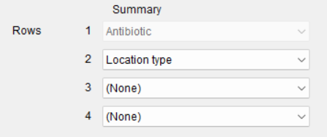
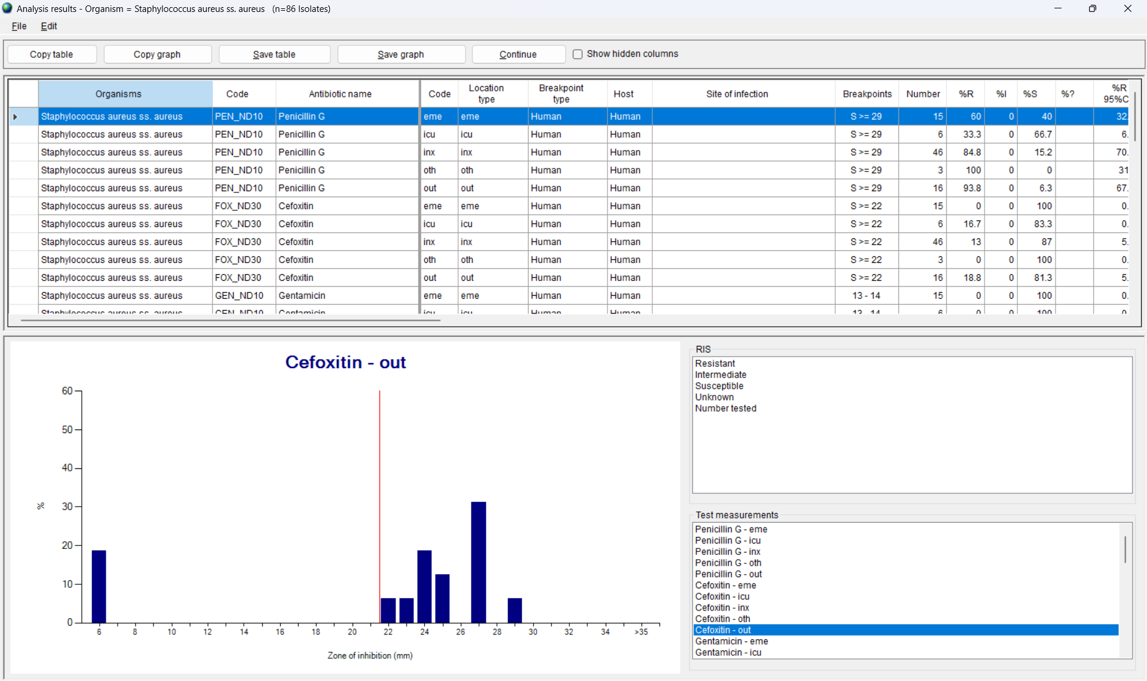
5
%RIS – Data stratification
Staphylococcus aureus by location type
B

Slide 17
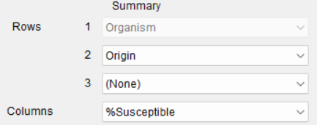
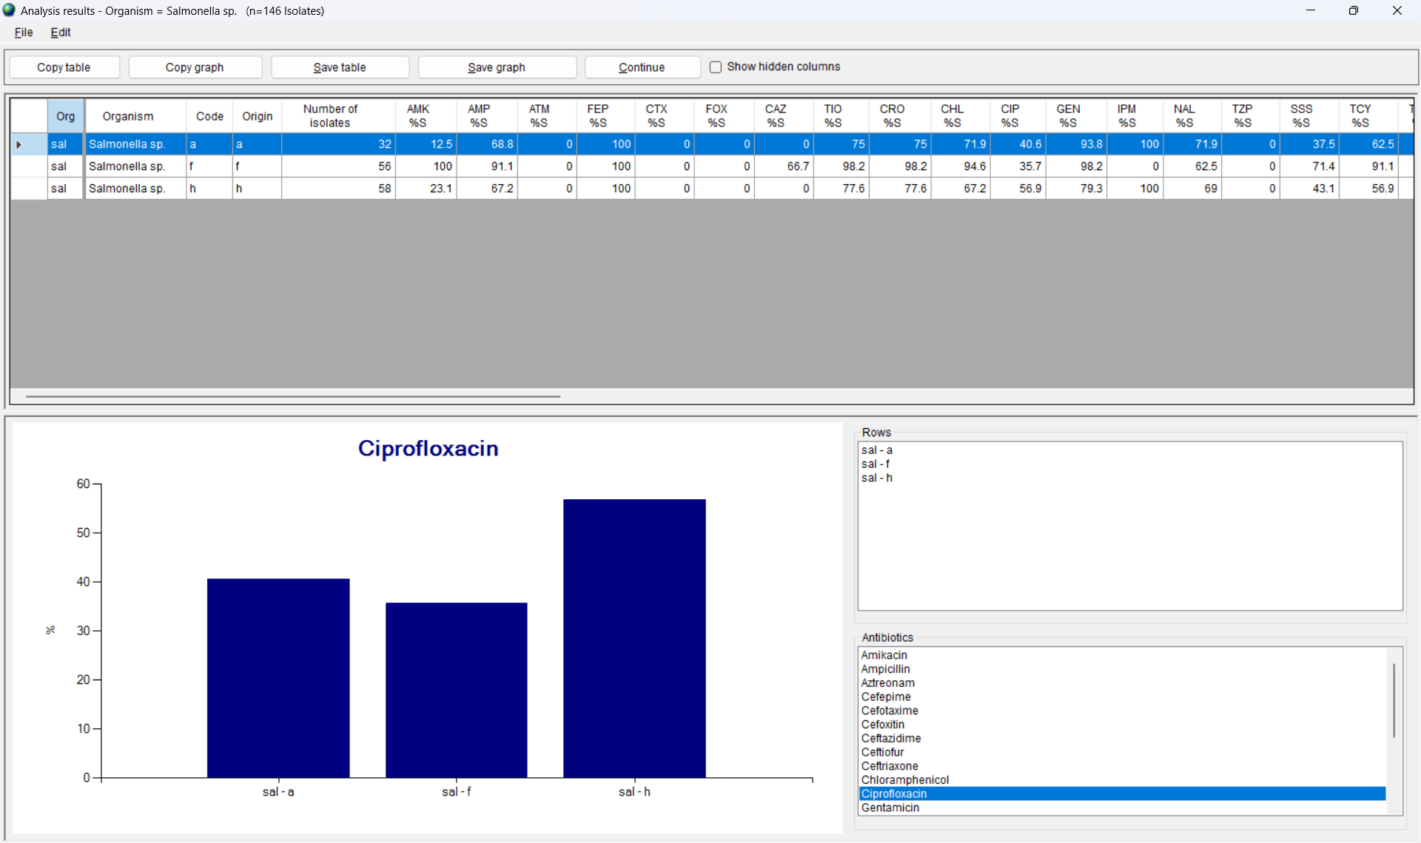
5
%Susceptible – Data stratification
Salmonella sp. by origin (animal, food, human)
B

Slide 18
Module 5. Data analysis and interpretation
5
A
Objectives and principles
B
%RIS and test measurements
C
Isolate listing and summary
D
Scatterplot
E
Resistance profiles
F
Microbiology alerts
G
Cluster alerts

Slide 19
Isolate listing and summary
5
C

Slide 20
Two report formats
5
C
Isolate listing
A list of all isolates that meet the selection criteria.
One row = One isolate
The table includes information like “Patient name”, “Date of birth”, “Animal species”, “Location”, “Specimen date”, “Specimen type”, “Organism”, and all of the antibiotic results.
Summary
Choose a variable for the rows, for example “Organism”, and a variable for the columns, for example “Specimen date by month”. Other examples: “Organism” by “Specimen type”, “State and Farm number” by “Animal species”.
The table includes information like “Number of patients”, “Number of isolates”, and “Number of patients by month”

Slide 21
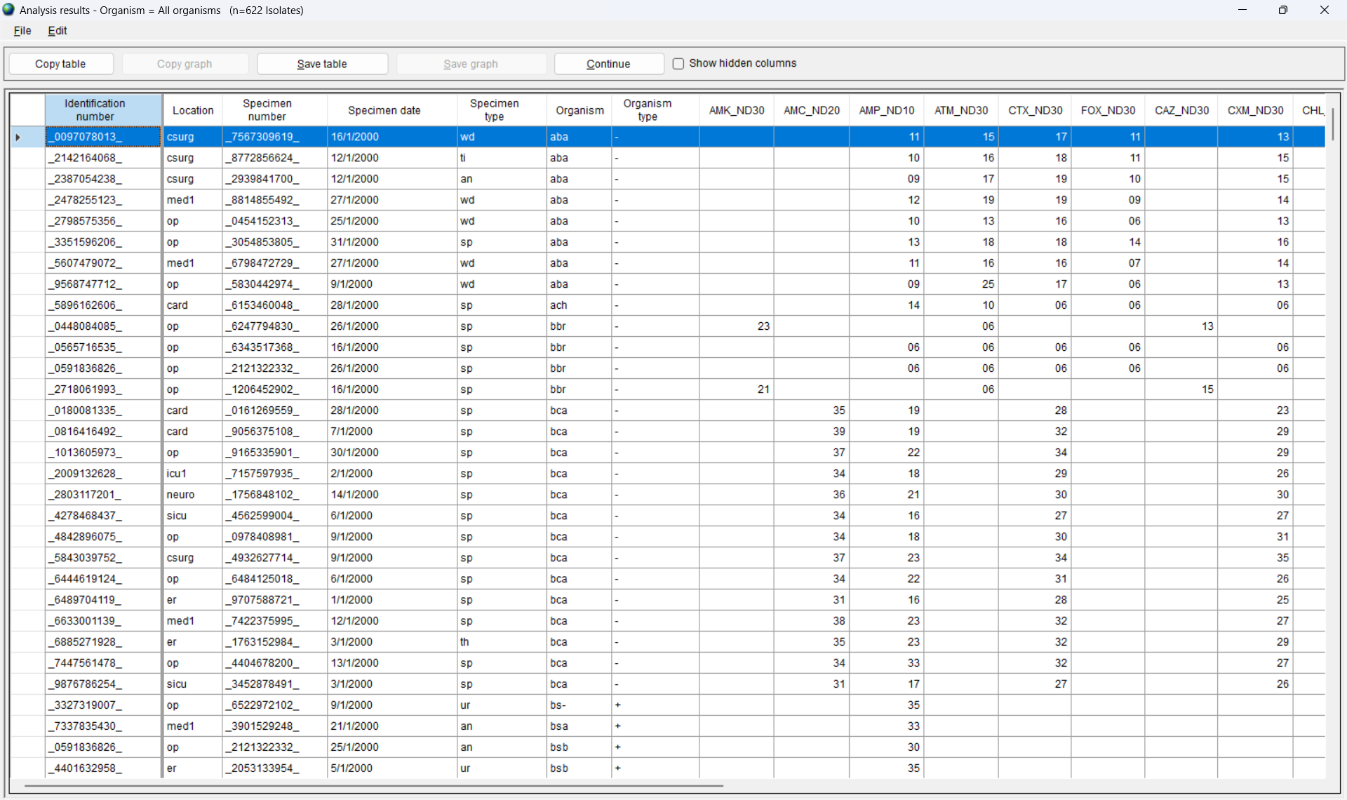
Isolate listing
All organisms
5
C

Slide 22
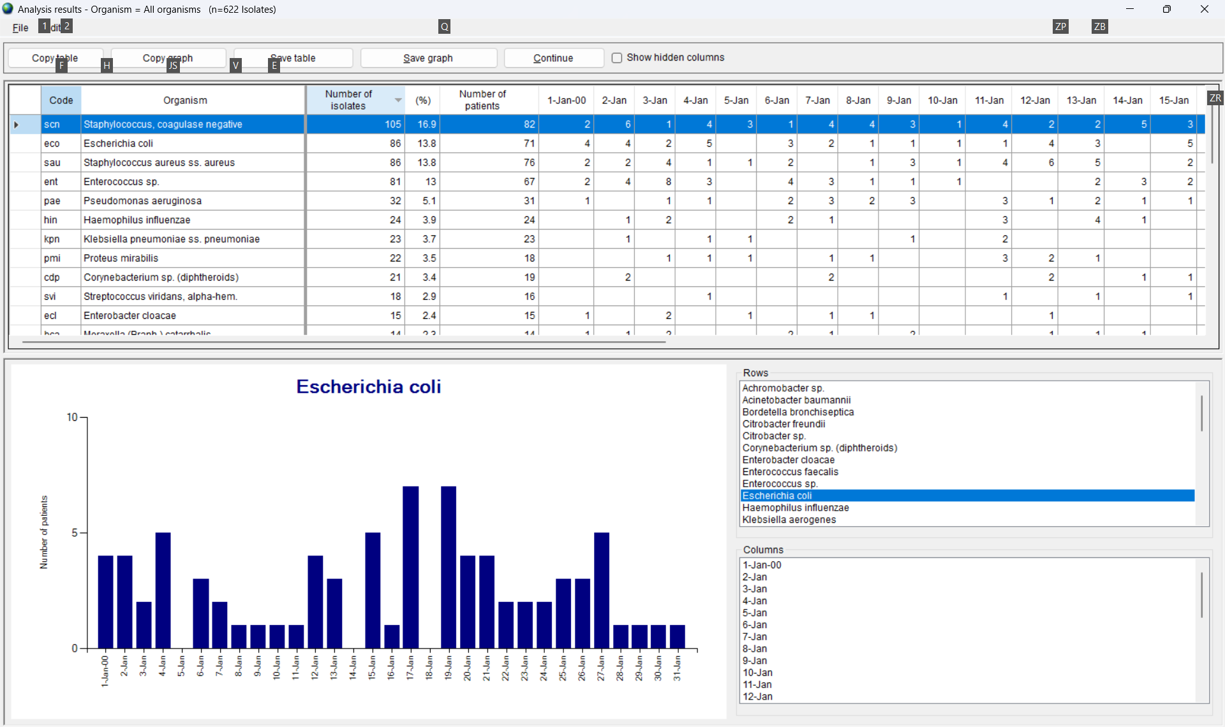
Isolate listing summary
Summary: “Organism by specimen day”
5
C

Slide 23
Isolate listing and summary - Uses
5
C
Listing
Epidemiology: Generate a list of priority results for review and action by healthcare workers, laboratory staff, and disease control authorities.
Quality: Identify incorrect or unlikely results
Summary
Epidemiology: Summarize the workload of the laboratory, describe the human and animal populations studied, and summarize the sample locations, sample types, and microbiological results
Quality: Identify missing time periods and incorrect values

Slide 24
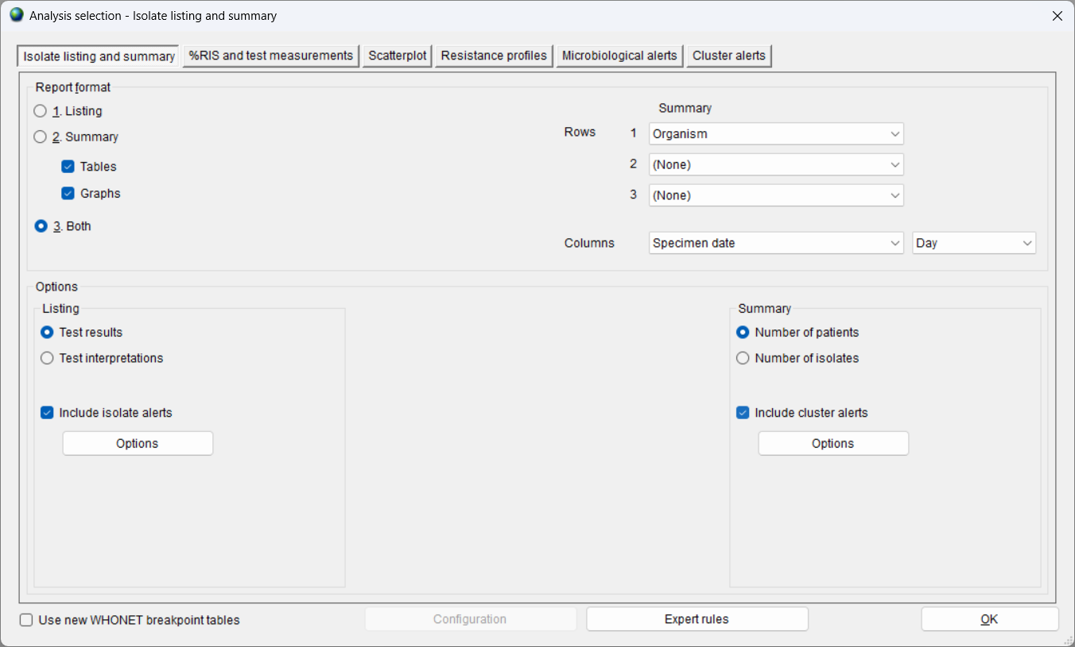
Isolate listing – Other options
5
C

Slide 25
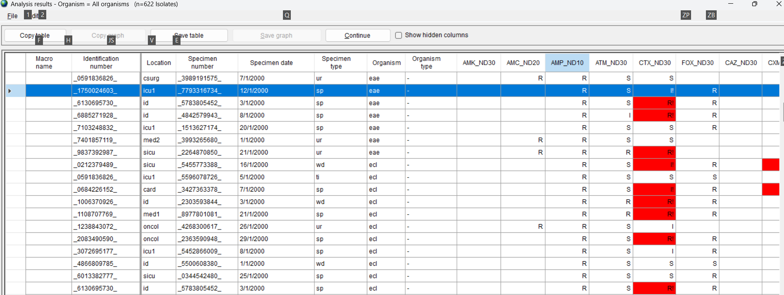
Isolate listing with microbiology alerts
Part 1 – Alerts are marked in red
5
C

Slide 26
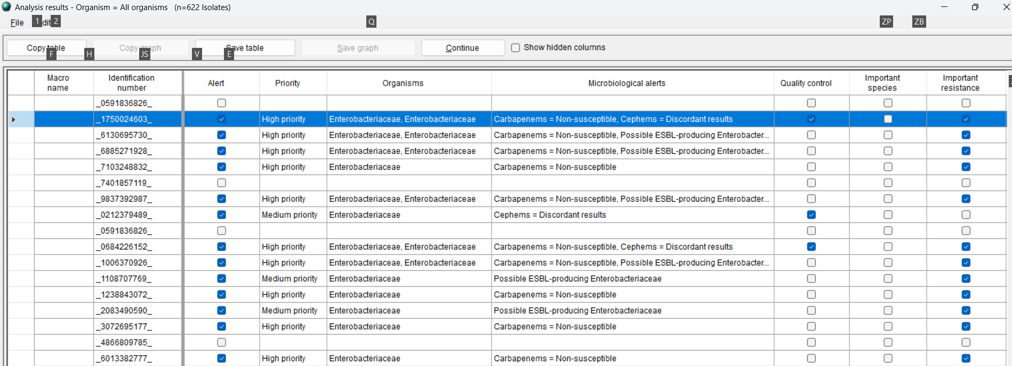
Isolate listing with microbiology alerts
Part 2 – Alert details
5
C

Slide 27
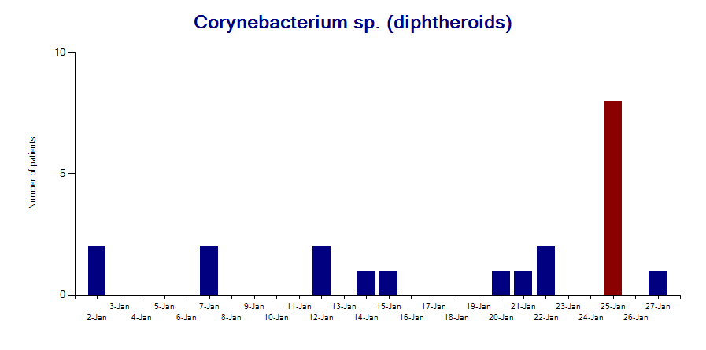
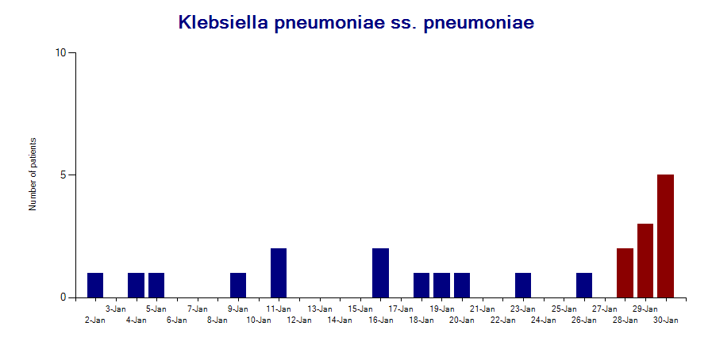
Summary with cluster alerts
5
C

Slide 28
Module 5. Data analysis and interpretation
5
A
Objectives and principles
B
%RIS and test measurements
C
Isolate listing and summary
D
Scatterplot
E
Resistance profiles
F
Microbiology alerts
G
Cluster alerts

Slide 29
Scatterplot
5
D

Slide 30
Two graph formats
5
D
In a scatterplot, we compare the results of two antibiotic susceptibility tests. The antibiotics may be within the same class of drugs (for example “Ciprofloxacin” and “Levofloxacin”) or in different drug classes (for example “Ciprofloxacin” and “Gentamicin”). You can also compare two different test methods, for example “Imipenem-Disk” and “Imipenem-Etest”.
There are two output formats.
Scatterplot with measurements: The graph will indicate the distribution of zone diameters and MIC values for the two antibiotic tests that you have selected.
Scatterplot with interpretations: The table will indicate the distribution of “R”, “I”, and “S” results for the two antibiotic tests that you have selected.

Slide 31
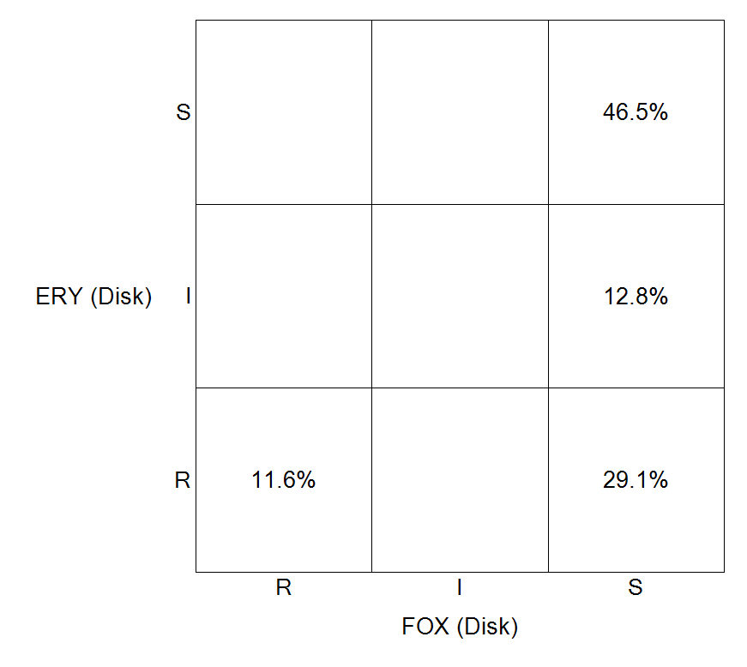
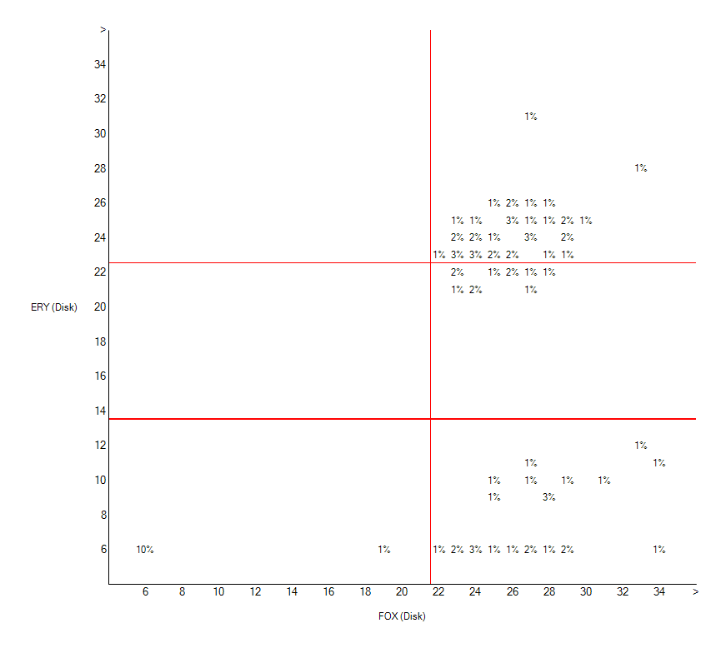
5
Scatterplots
Staphylococcus aureus – Cefoxitin and Erythromycin
D
Interpretations
Measurements
Group A
Group D
Group B
Group C

Slide 32
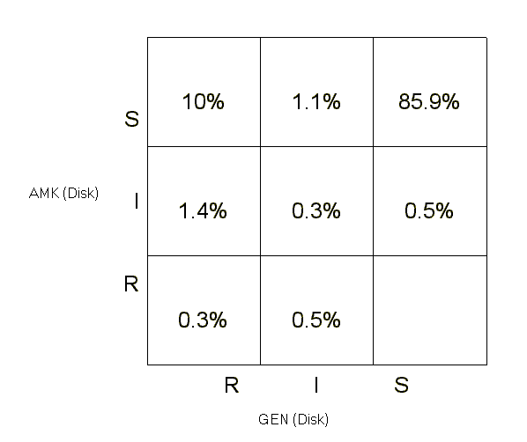
5
Scatterplots – Pharmacy example
Klebsiella pneumoniae – Gentamicin and Amikacin
D
Observations
GEN and AMK are effective in most patients.
AMK is more effective (approximately 10%).
Incorrect conclusion
All patients should be treated with AMK.
Better conclusion
GEN works well in most patients. It is less expensive and an appropriate first-line option for patients with simple community infections.
AMK is a more expensive reserve agent. But its use is justified in patients with severe disease, such as sepsis, with high risk of mortality.

Slide 33
Scatterplots
5
D
Epidemiology
Insights into the mechanisms of resistance, especially if the antibiotics are from the same class.
Insights into the linkage of resistance genes, especially if the antibiotics are from different classes.
Selection of first- and second-line treatment options
Quality assessment
Identification of strains which merit retesting and confirmation
Unlikely results: E. coli susceptible to AMP but resistant to IPM
Infrequent results: E. coli susceptible to GEN but resistant to AMK
Confirmation of important results, for example Imipenem-Disk and Imipenem-MIC

Slide 34
Scatterplot – Other features
5
D

Slide 35
Module 5. Data analysis and interpretation
5
A
Objectives and principles
B
%RIS and test measurements
C
Isolate listing and summary
D
Scatterplot
E
Resistance profiles
F
Microbiology alerts
G
Cluster alerts

Slide 36
Resistance profiles
5
E

Slide 37
Two report formats
5
E
Isolate listing
One row = One isolate
In the column “Resistance profile”, you will see the antibiotics to which the organism is non-susceptible (or non-resistant depending on the user’s choice).
For example: “AMP IPM CIP GEN” means that the isolate is not susceptible to these four drugs, but susceptible to the other antibiotics selected by the user for this analysis.
You can also see the isolates categorized as MDR, XDR, and PDR according to the definitions of the ECDC.
Summary
There will be one row for each “Resistance profile” and columns for “Number of patients” and “Number of isolates”. You can also choose to see the number of patients by “month”, “animal species”, “location”, or other variables.

Slide 38
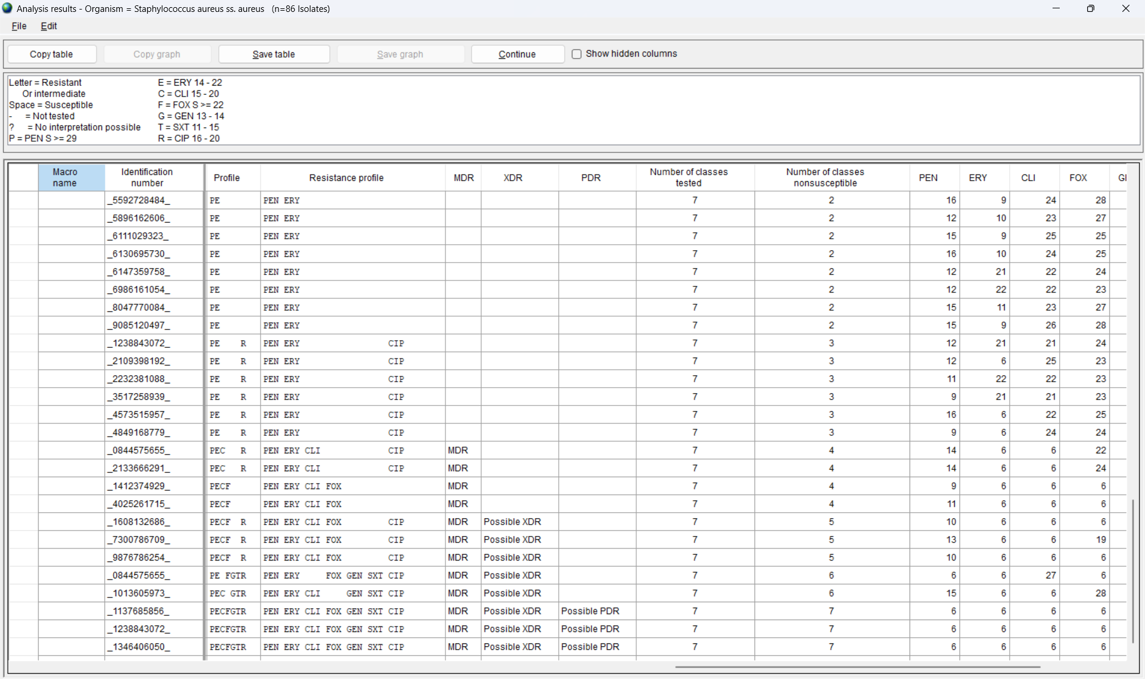
Resistance profile – Listing
5
E
Resistance profiles
ECDC definitions from 2012
MDR = Multi-Drug Resistant
XDR = Extensively Drug Resistant
PDR = Pan-Drug Resistant
Magiorakis et al. Multidrug-resistant, extensively drug-resistant and pandrug-resistant bacteria: an international expert proposal for interim standard definitions for acquired resistance. Clin Microbiol Infect . 2012 Mar;18(3):268-81

Slide 39
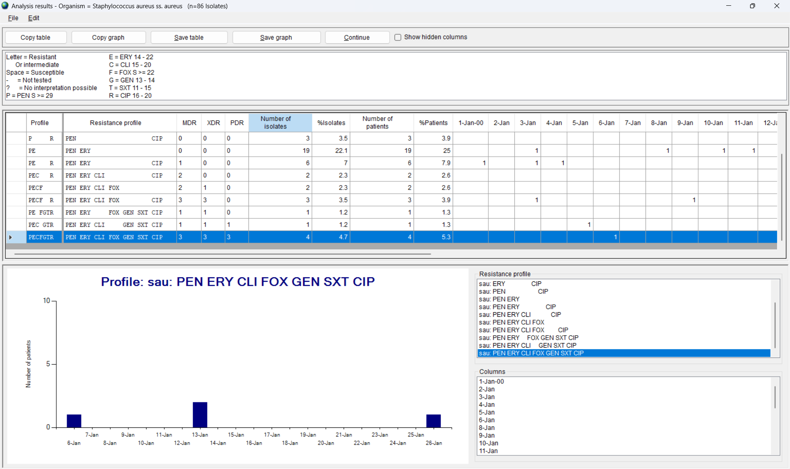
Resistance profile - Summary
5
E

Slide 40
Resistance profiles
5
E
Epidemiology
Multidrug resistance profiles assist in the characterization of possible resistance mechanisms, especially when comparing antibiotics from the same class.
Multidrug resistance profiles assist in the phenotypic tracking of emerging populations including:
Detection and confirmation of new “phenotypic clones”.
Detection, investigation, and containment of possible community or hospital outbreaks
Assistance to the pharmacy in the evaluation of therapy alternatives
Quality assessment
Detection of “impossible” or “rare” resistance phenotypes that may suggest an error in laboratory testing. For example, an isolate of Escherichia coli resistant to ceftriaxone and imipenem, but susceptible to ampicillin.

Slide 41
Resistance profiles – Other options
5
E

Slide 42
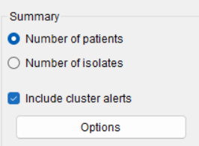
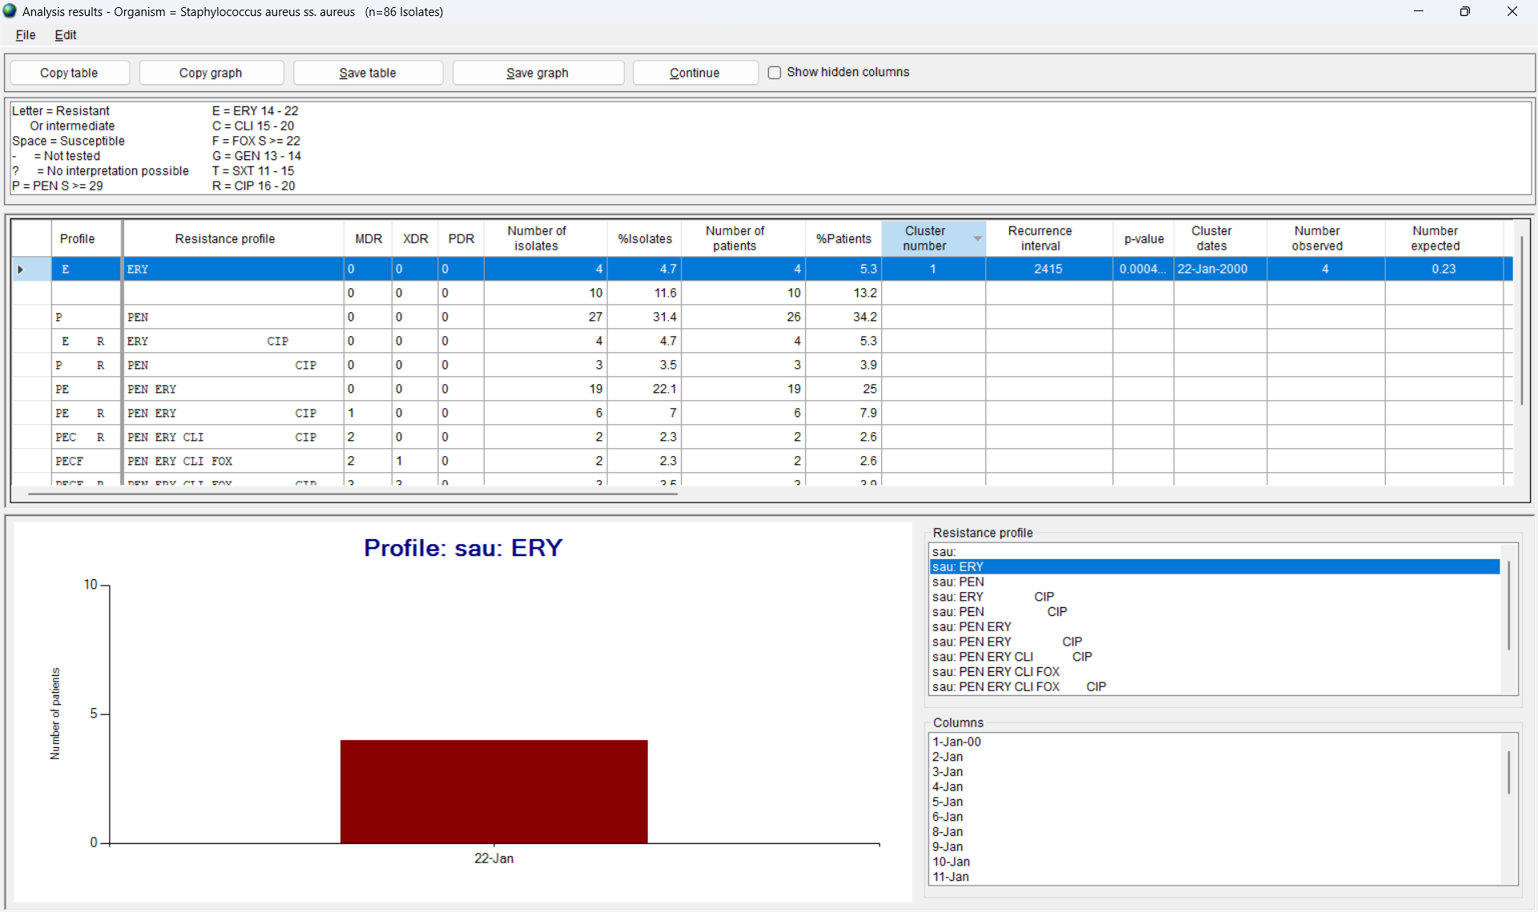
Resistance profiles and cluster detection
5
E

Slide 43
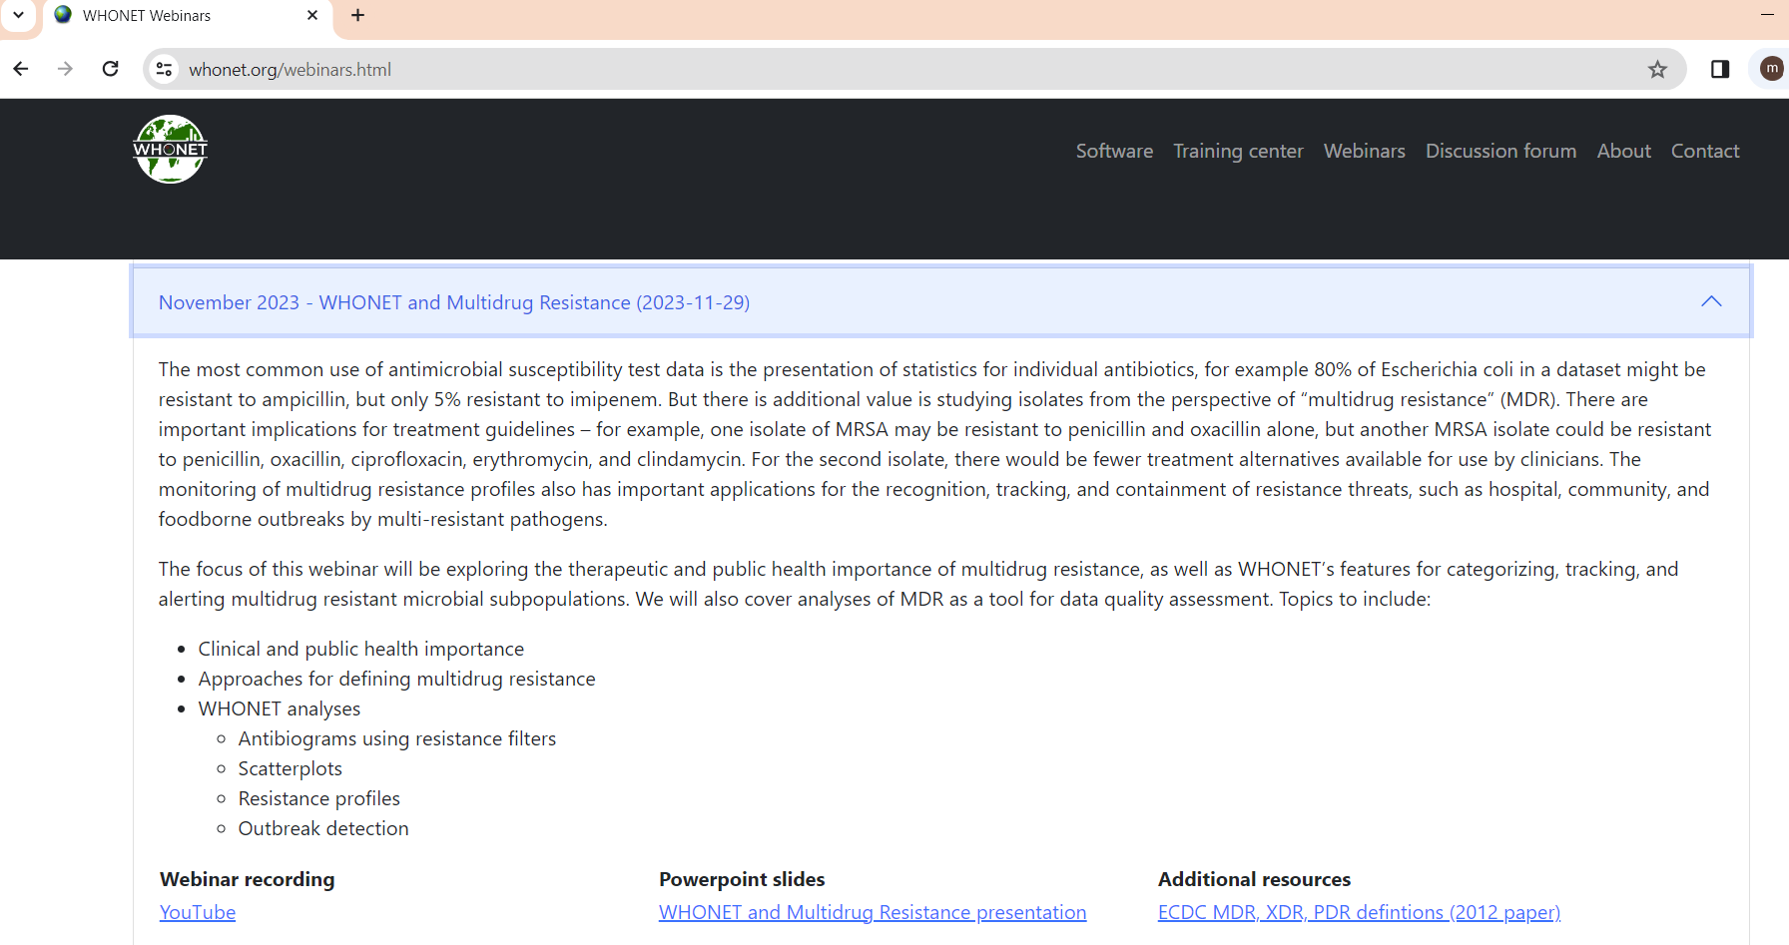
WHONET webinar on resistance profiles
5
E
A two-hour webinar was held in November 2023: “WHONET and multidrug resistance”. www.whonet.org/webinars.html
There is no requirement to listen to this webinar. It is not a part of the WHONET Training Course.

Slide 44
Module 5. Data analysis and interpretation
5
5
A
Objectives and principles
B
%RIS and test measurements
C
Isolate listing and summary
D
Scatterplot
E
Resistance profiles
F
Microbiology alerts
G
Cluster alerts

Slide 45
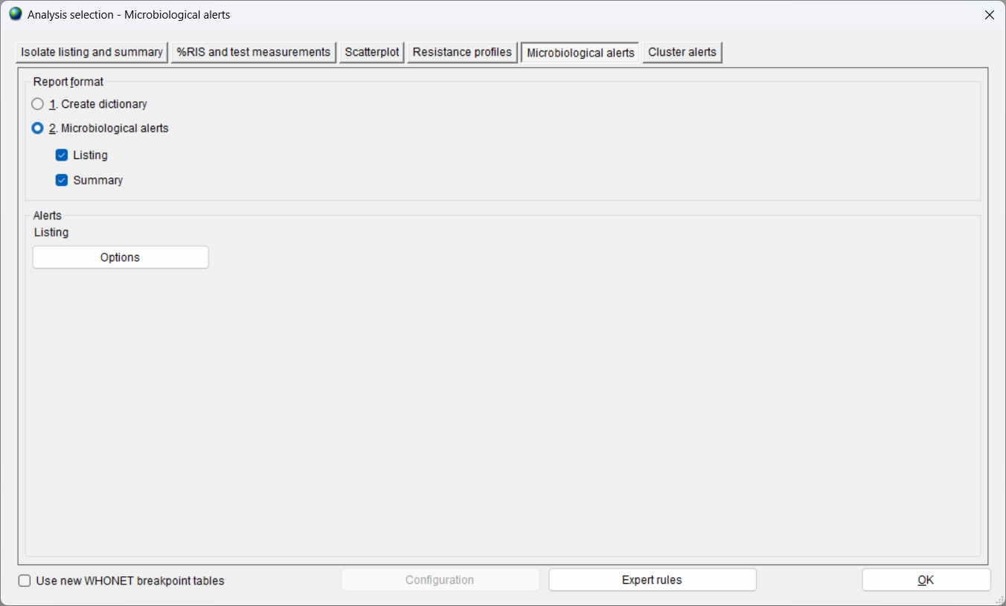
Isolate alerts
5
F
x
x

Slide 46
Three output formats
5
F
Microbiological alerts – Listing
One row = One isolate
You will see a list of isolates that satisfy at least one of the “alert” rules. Rules are categorized in two ways:
Important species, Important resistance, Quality control
High priority, medium priority, low priority
Microbiology alerts – Summary
One row = One kind of alert
You will see the “Number of isolates” for each rule for each laboratory included in the analysis.
BacTrack dictionary
WHONET will create a dictionary file with historical data that can be used in data entry to provide feedback to the user.

Slide 47
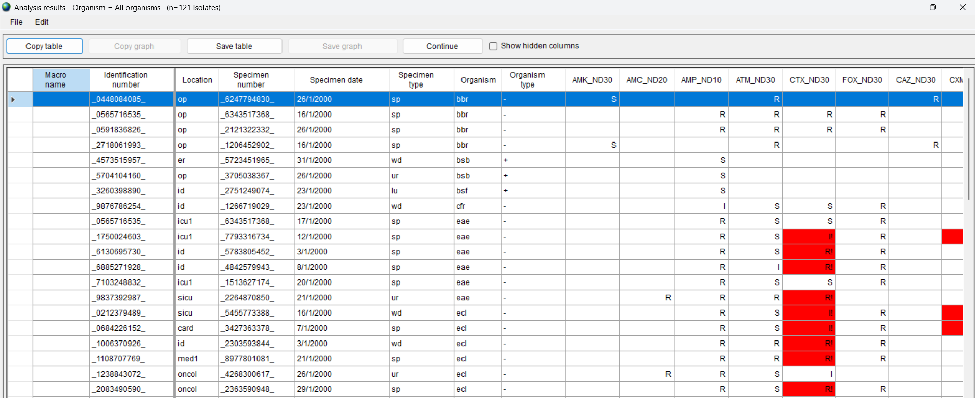
Microbiological alerts - Listing
5
F

Slide 48
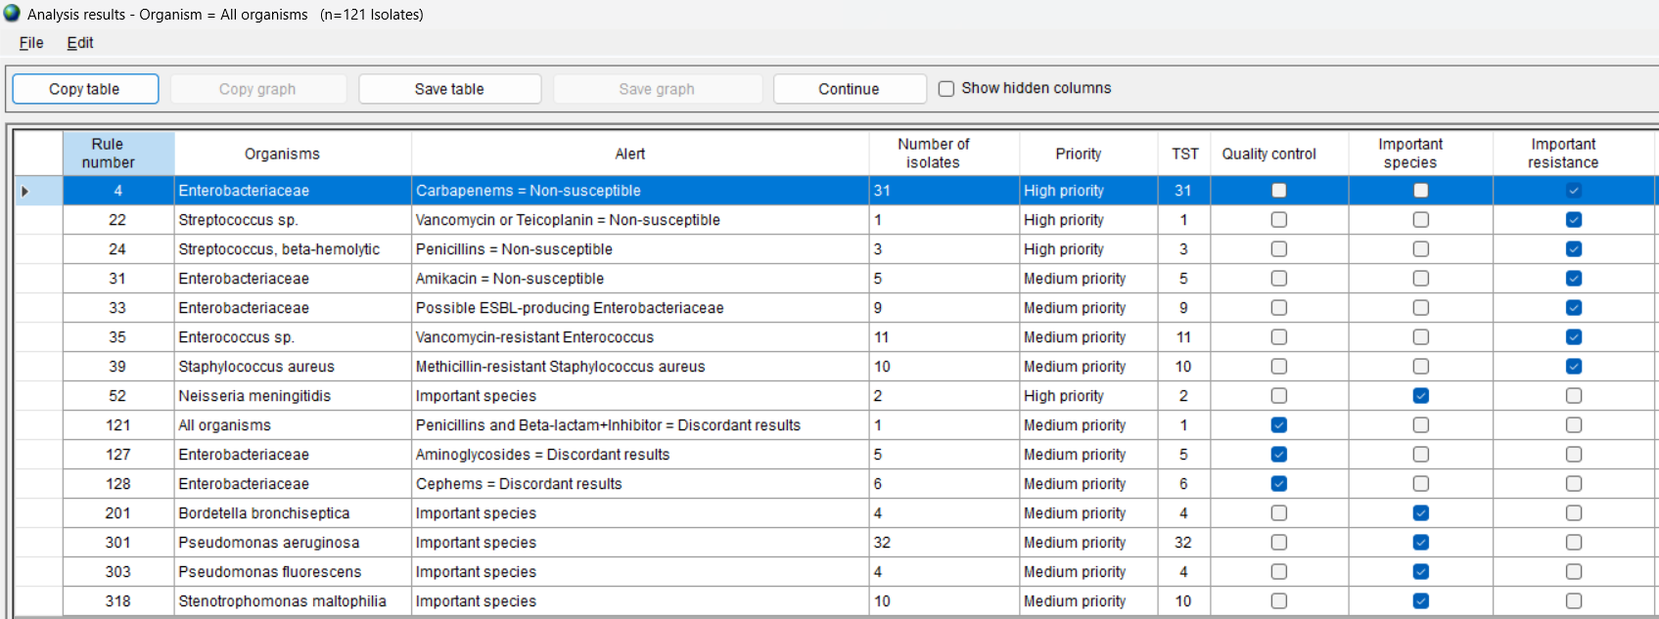
Microbiological alerts - Summary
5
F

Slide 49
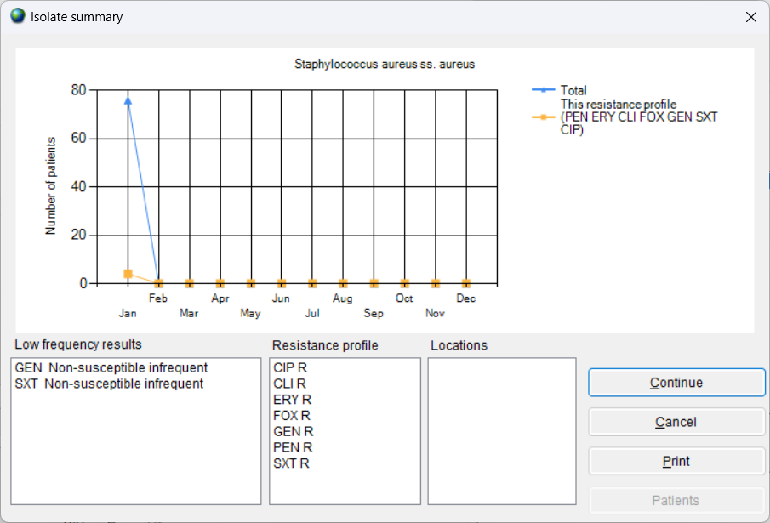
BacTrack summary in data entry
[Create a better example with other data]
5
F

Slide 50
Microbiology alerts
5
F
Epidemiology
One purpose of this analysis is to notify relevant staff of results of special clinical or public health importance, such as “Important species” and “Important resistance”.
This is useful during of data entry to provide immediate notification of alerts in real-time. Alerts can also be provided in data analysis for purposes of weekly or monthly summaries.
Quality assessment
Another purpose of this analysis is to provide “quality control” alerts that maybe suggest errors such as “typing error” or “incorrect organism identification” or “incorrect antimicrobial test results”.
Quality control alerts can also be provided on a weekly or monthly basis to assist in the monitoring of possible errors in the laboratory.

Slide 51
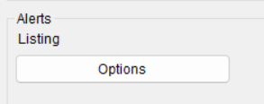
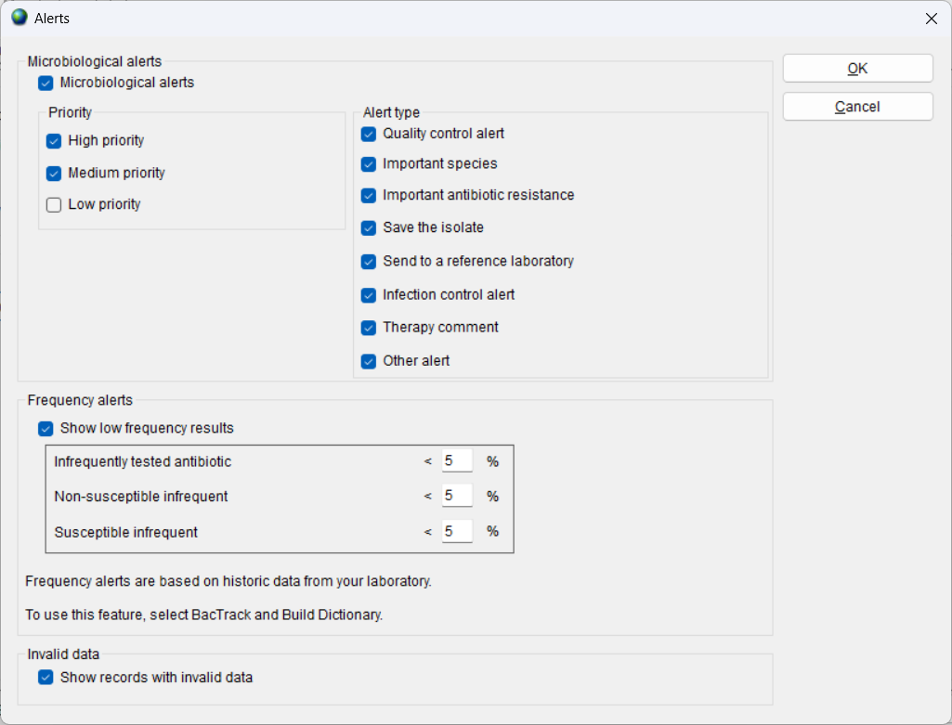
Microbiological alerts – Other options
5
F

Slide 52
Module 5. Data analysis and interpretation
5
A
Objectives and principles
B
%RIS and test measurements
C
Isolate listing and summary
D
Scatterplot
E
Resistance profiles
F
Microbiology alerts
G
Cluster alerts

Slide 53
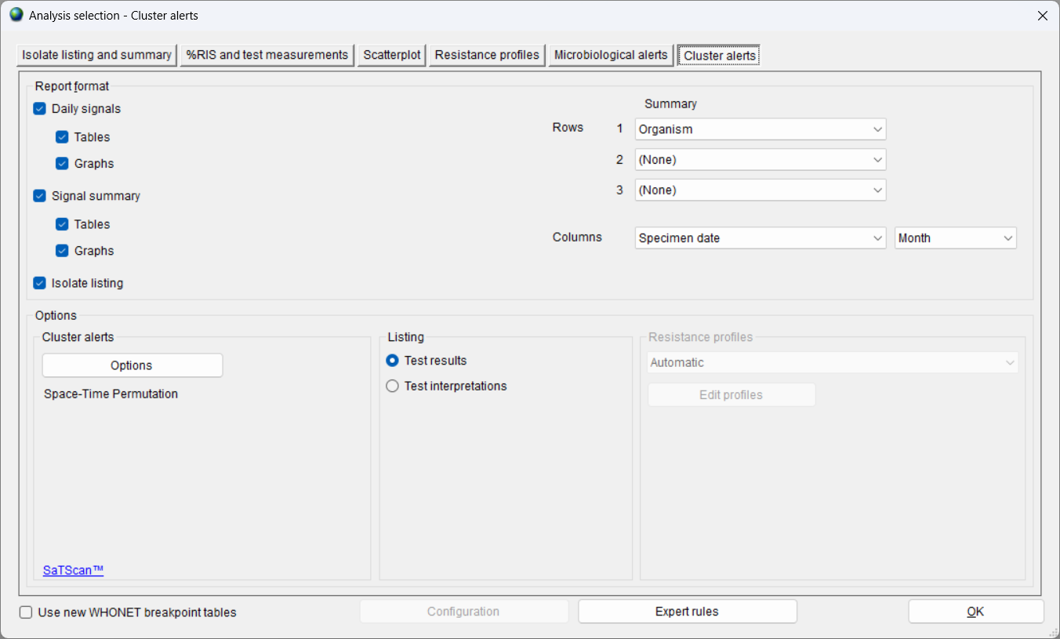
Cluster alerts
5
G

Slide 54
Three output formats
5
G
Daily signals
The daily signals are especially valuable when you choose “Simulated prospective analysis” for cluster detection.
The results include one row for each day that an alert was found. This is useful when the number of patients in a cluster increases in time.
Signal summary
The daily signals are summarized into a single row with “date of the first signal”, “date of last signal”, “number of patients with the first alert”, and “total number of patients”.
Isolate listing
You will see the list of patients associated with each cluster including details such as “specimen date”, “location”, “specimen type”, and “antibiotic results”.

Slide 55
Cluster alerts
5
G
Epidemiology
The primary use of this feature is to find statistically significant increases in cases that might suggest disease outbreaks in the community or hospital settings. Early notification, investigation, and confirmation are key factors for early interventions to understanding and containing outbreaks.
Quality assessment
There are additional factors which can also lead to a statistically significant increase in cases:
Contamination of samples or deficiencies in laboratory reagents
These are not “disease” problems but “quality” problems, and they should also be investigated and corrected.
Changes in patient populations or changes in sampling practices
Changes in laboratory practices
Random variation

Slide 56
Cluster alerts – Other options
5
G

Slide 57
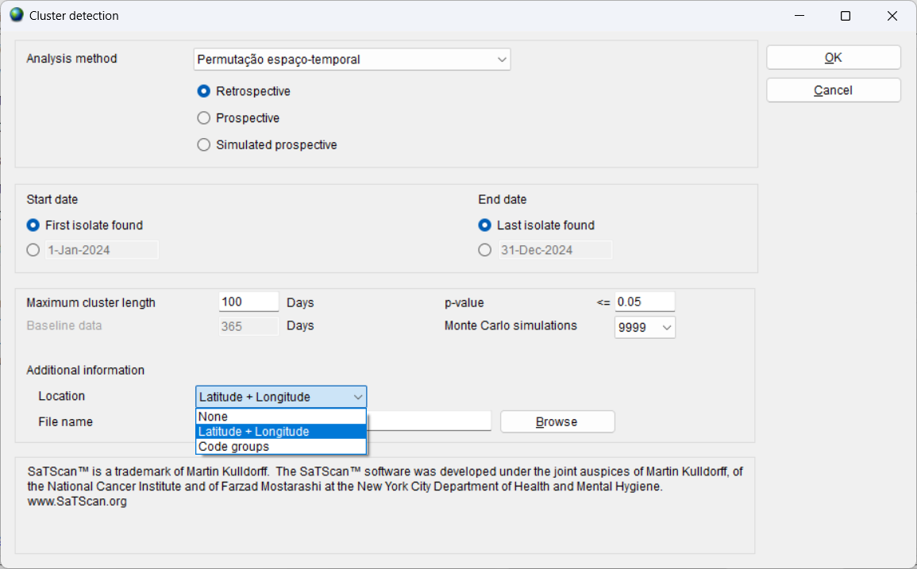
Cluster alerts – Options
5
G

Slide 58
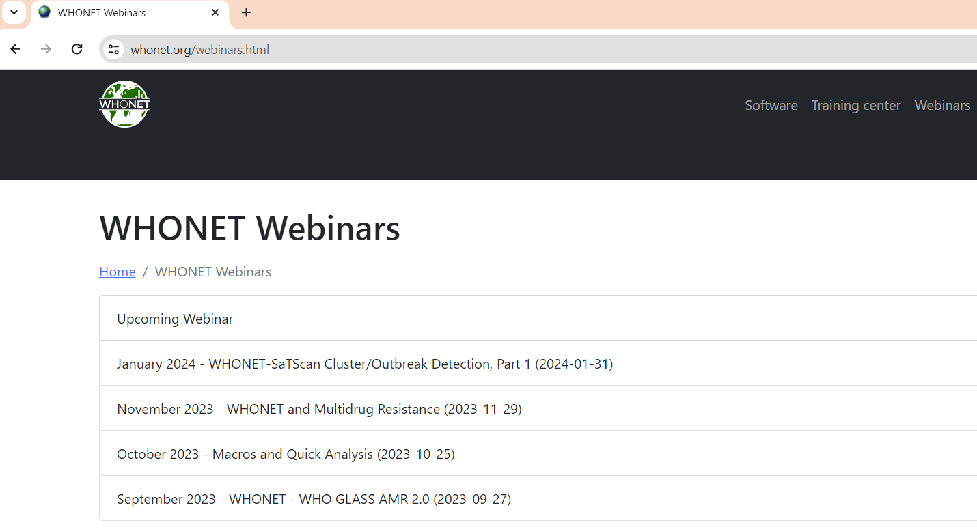
WHONET webinar
5
G
Two webinars on cluster detection with WHONET were held in January (Part 1) and March (Part 2), 2024: “WHONET and cluster/outbreak detection”. www.whonet.org/webinars.html
There is no requirement to listen to these webinars. They are not a part of the WHONET Training Course.
You can also find publications about WHONET-SaTScan on PubMed: https://pubmed.ncbi.nlm.nih.gov/?term=whonet+satscan

Slide 59
4
Thank you for watching Module 5:
5
Next – Module 6: Quick analysis reports

