Slide 1
WHONET Macro and Quick Analysis Reports
John Stelling, MD, MPH, jstelling@whonet.org
Brigham and Women’s Hospital, Harvard Medical School, Boston
WHO Collaborating Centre for Surveillance of Antimicrobial Resistance

Slide 2
Webinar agenda
Comments on the WHONET Webinar series
An introduction to WHONET macros and reports
Data analysis: How to create, use, edit, and backup macros
Quick analysis: WHONET Standard reports (Screen, Excel, Word)
Quick analysis: User-defined reports (Screen, Excel)
Brief introduction to the WHONET Automation Tool
Questions and answers

Slide 3
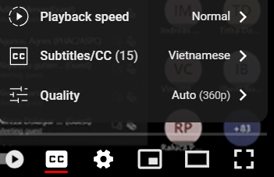
WHONET Webinar Series
You can find the recording, slides, and additional resources on the WHONET website by clicking on “Webinars” on the main menu.
Or you can use the direct link:
https://whonet.org/webinars.html
We have translated our previous webinar into 18 additional languages which are available through the “closed caption” settings of the video on YouTube:
https://www.youtube.com/watch?v=sJNjO0TQcwA
Click on “CC” to turn “Closed Captions” on and off.
Use the “Configuration” icon to choose the desired language.
Afrikaans, Arabic, Chinese (Simplified and Traditional), Farsi, French, German, Indonesian, Japanese, Korean, Lao, Malay, Portuguese, Russian, Spanish, Turkish, Ukrainian, Vietnamese.
Demonstration of the WHONET Webinar website

Slide 4
Possible topics for future webinars
WHONET 2024 release
WHONET analysis and reporting features
Annual antibiograms and CLSI M39
Multidrug resistance
Isolate alerts and outbreak detection with WHONET-SaTScan
Macros and Quick analysis reports
WHONET DHIS2-AMR module
WHONET Automation Tool
WHONET AST interpretation engine
WHONET Community
WHONET Training Center
WHONET Discussion Forum
One Health features of WHONET – FAO and InFARM
Country-, region-, and/or language-specific sessions
Welcome to suggest ideas for future webinars!

Slide 5
Introduction to WHONET macros
Very often, WHONET users wish to repeat the same set of analyses on a regular basis
Daily, weekly, monthly, quarterly, yearly or ad hoc.
They may have wish to customize the analyses for different audiences
Local needs: Laboratory staff, infectious diseases, infection control, pharmacy
National needs: National authorities, stakeholders, epidemiologists, funders
The purpose of macros is to permit you to repeat analyses that you have done previously
The macros will remember the analysis type, organisms, isolate filters, data files, and other analysis parameters that you have selected
You can repeat the analyses on the same data files or on new files from the same laboratory or from other laboratories.
Single WHONET macros can be bundled into multi-part WHONET reports.

Slide 6
Benefits of using WHONET macros and reports
Macros and reports save time and promote consistency with repeated analyses. There is no need to remember all of the details about which organisms and other analysis options were selected.
One WHONET user can create macros and reports for many other WHONET users, which promotes standardization and collaborative discussions of results both within a single institution and across many institutions.
WHONET macros and reports can be automated to run on a periodic basis (daily, weekly, monthly, etc.)

Slide 7
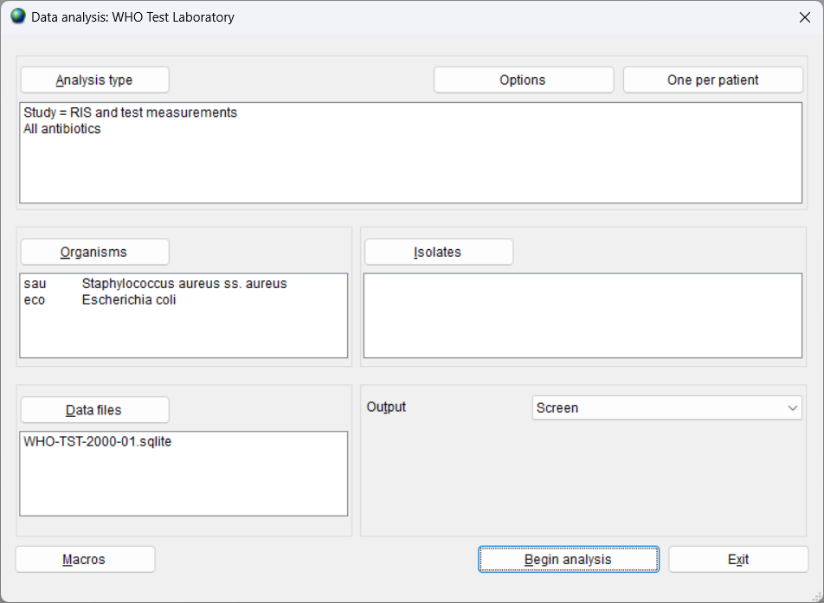
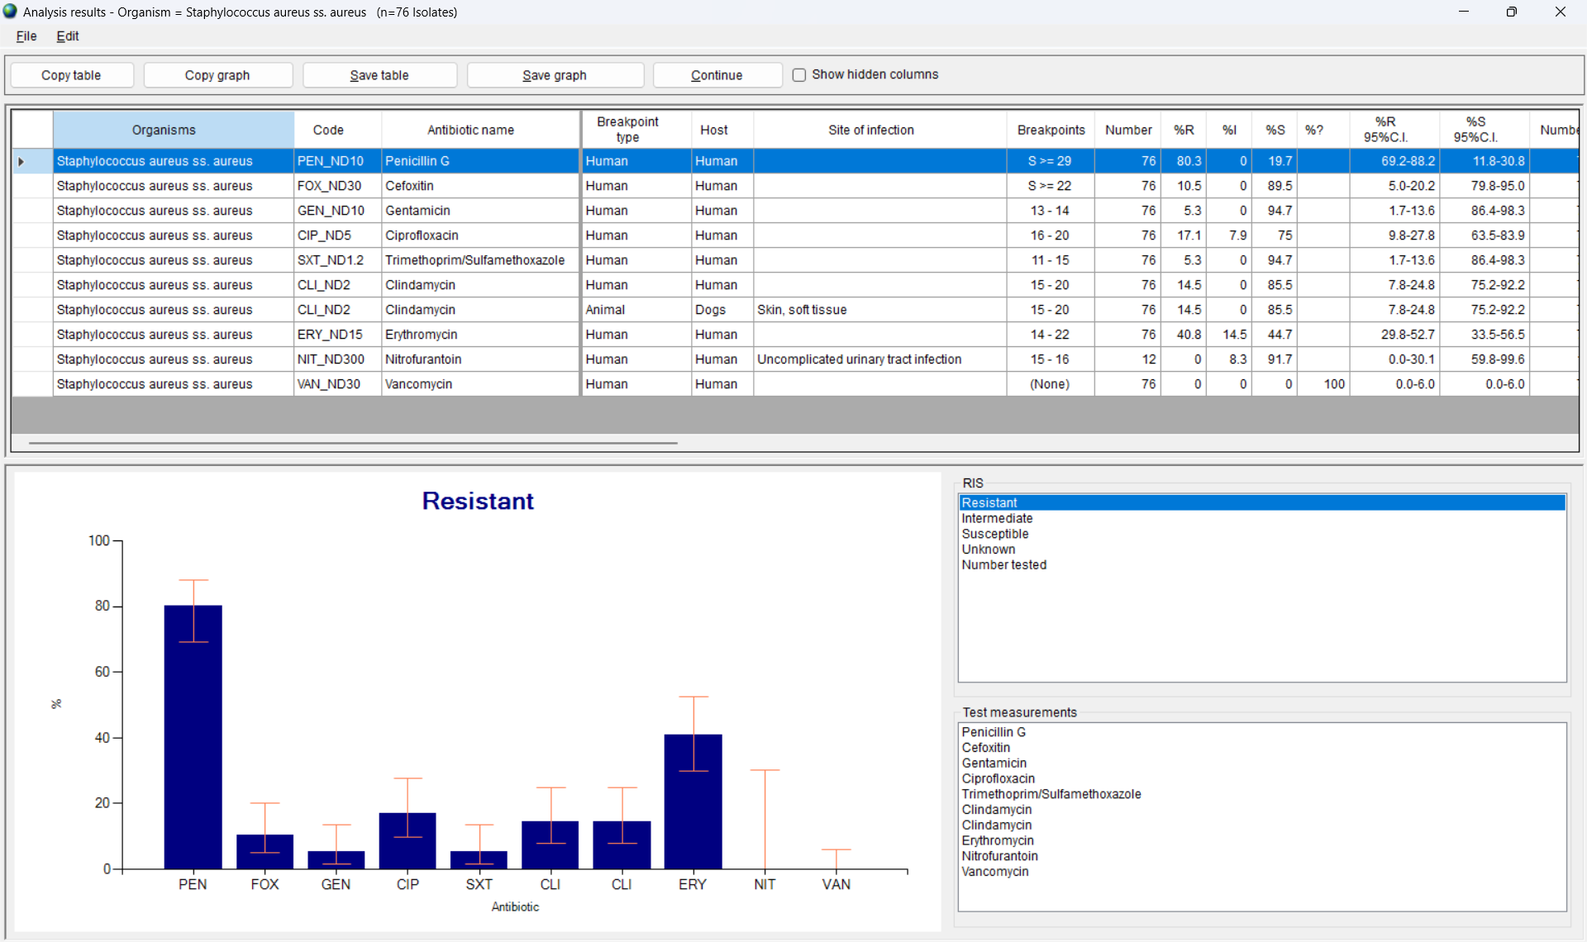
Running a WHONET analysis
Go to WHONET data analysis and choose the analysis parameters that you are interested in.
Example: Using the WHO Test Laboratory, choose “%RIS”, “Staphylococcus aureus” and “Escherichia coli”, and the “WHO-TST-2000-01.sqlite” data file. Also choose “First isolate with antibiotic results”.
You can then “Begin analysis” to ensure that the results agree with your expectations.

Slide 8
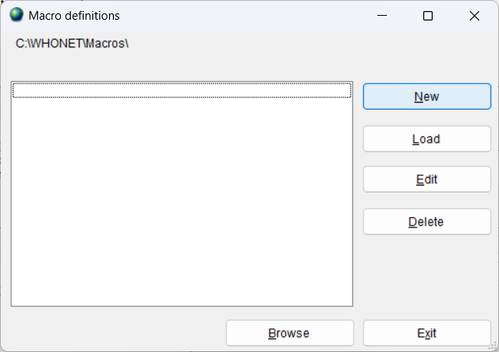
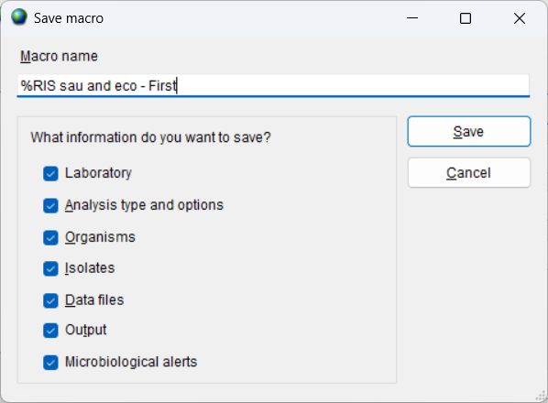
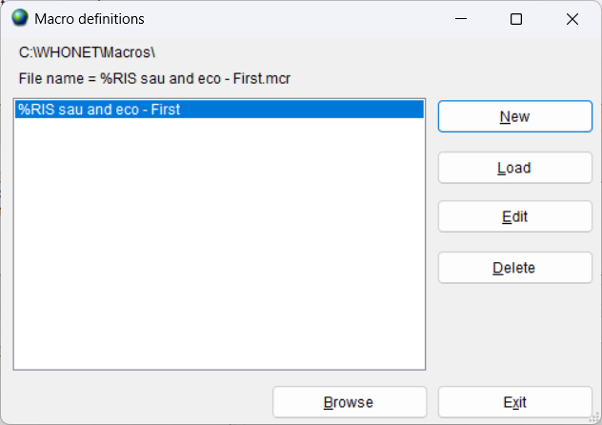
Creating a WHONET macro
Click on “Macros” to get the below screen, then click on “New”.
Enter a name for the new macro, and then click “Save”
Example: %RIS sau and eco – First
Enter a name for the new macro file, and then click “Save”
Example: %RIS sau and eco – First.mcr
By default, your macro files will be saved in C:\WHONET\Macros

Slide 9
Using a WHONET macro
Go to WHONET Data analysis and click “Macros”.
You will see a list of all of the macros. Choose the macro that you are interested in. Click on “Load”.
This will load into the analysis screen the parameters that you selected earlier.
You can either click on “Begin analysis” immediately. Or you can make changes, such as different data files or organisms or isolate filters.

Slide 10
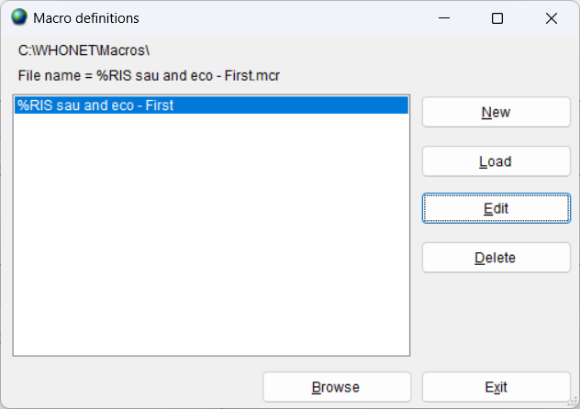
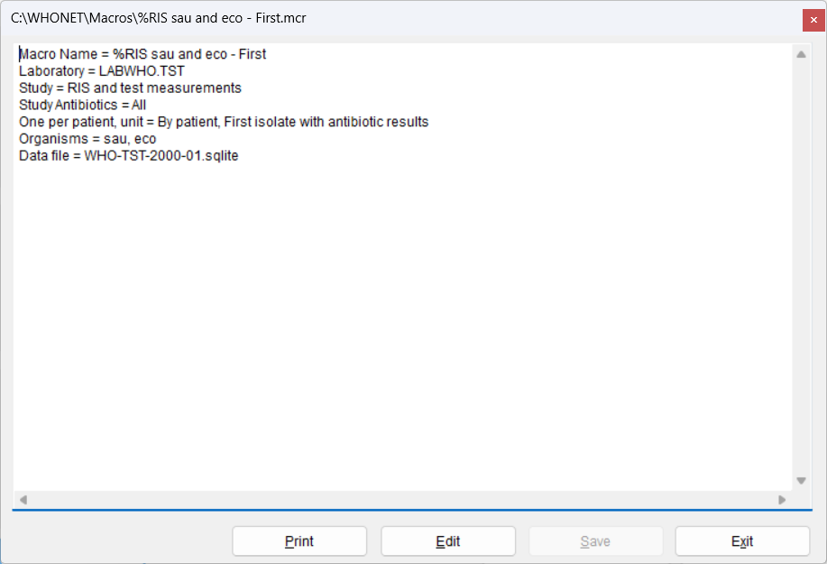
Editing a WHONET macro using WHONET
Go to WHONET Data analysis and click “Macros”.
You will see a list of all of the macros. Choose the macro that you are interested in. Click on “Edit”.
You will then see the parameters that defined for the macro. If you want to make changes, click on “Edit”. Then when you finish, click “Save” and “Exit”.
You can use Windows if you want to rename the macro file.

Slide 11
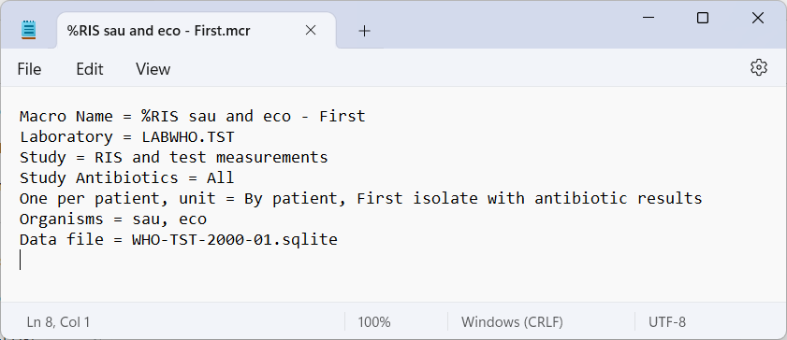
Editing a WHONET macro using NotePad
Macros are simple text files and can be edited with any text editor, such as NotePad.
By default, WHONET macros are saved in C:\WHONET\Macros.
Find the macro that you wish to edit. You can edit this file, or you can make a copy and edit the copy.
Windows File Explorer
NotePad

Slide 12
How to share or backup a WHONET macro
By default, WHONET files are stored in the location C:\WHONET\Macros.
From here, you can make backup copies or send copies to your colleagues by email.
Macros generally have no confidential information in them, so can be freely shared with collaborators
Rare exception: if you define a macro using patient names or other confidential information, then you should not share these.

Slide 13
WHONET Quick analysis features
WHONET Standard reports
Screen and Microsoft Excel
Microsoft Word
User-defined reports
Screen and Microsoft Excel
(Microsoft Word in WHONET 2024)
DHIS2

Slide 14
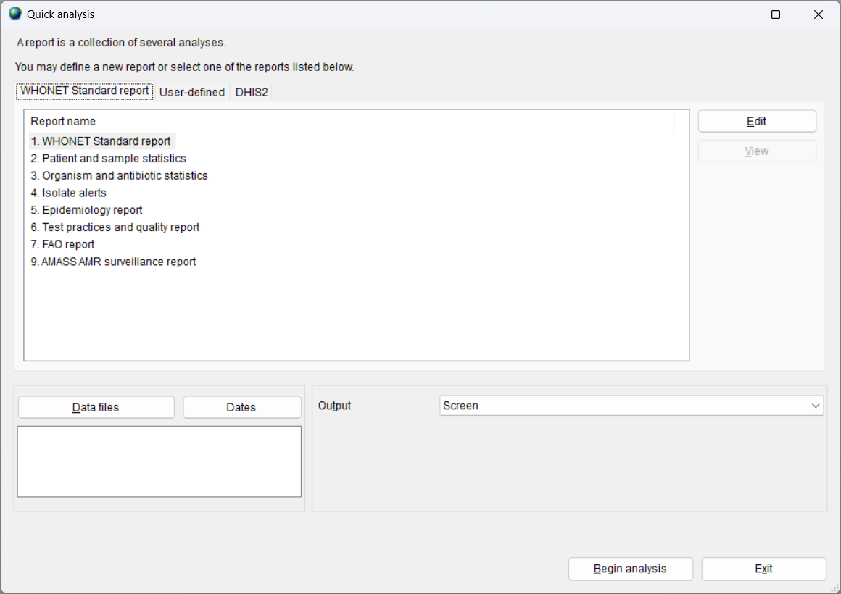
Quick analysis - WHONET Standard reports
Old (To be deleted soon)
1. WHONET Standard report
Screen and Excel
2. Patient and sample statistics
3. Organism and antibiotic statistics
4. Isolate alerts
Word
5. Epidemiology report
6. Test practices and quality report
7. FAO report (in development)
Other
8. AMASS AMR surveillance report (PDF)

Slide 15
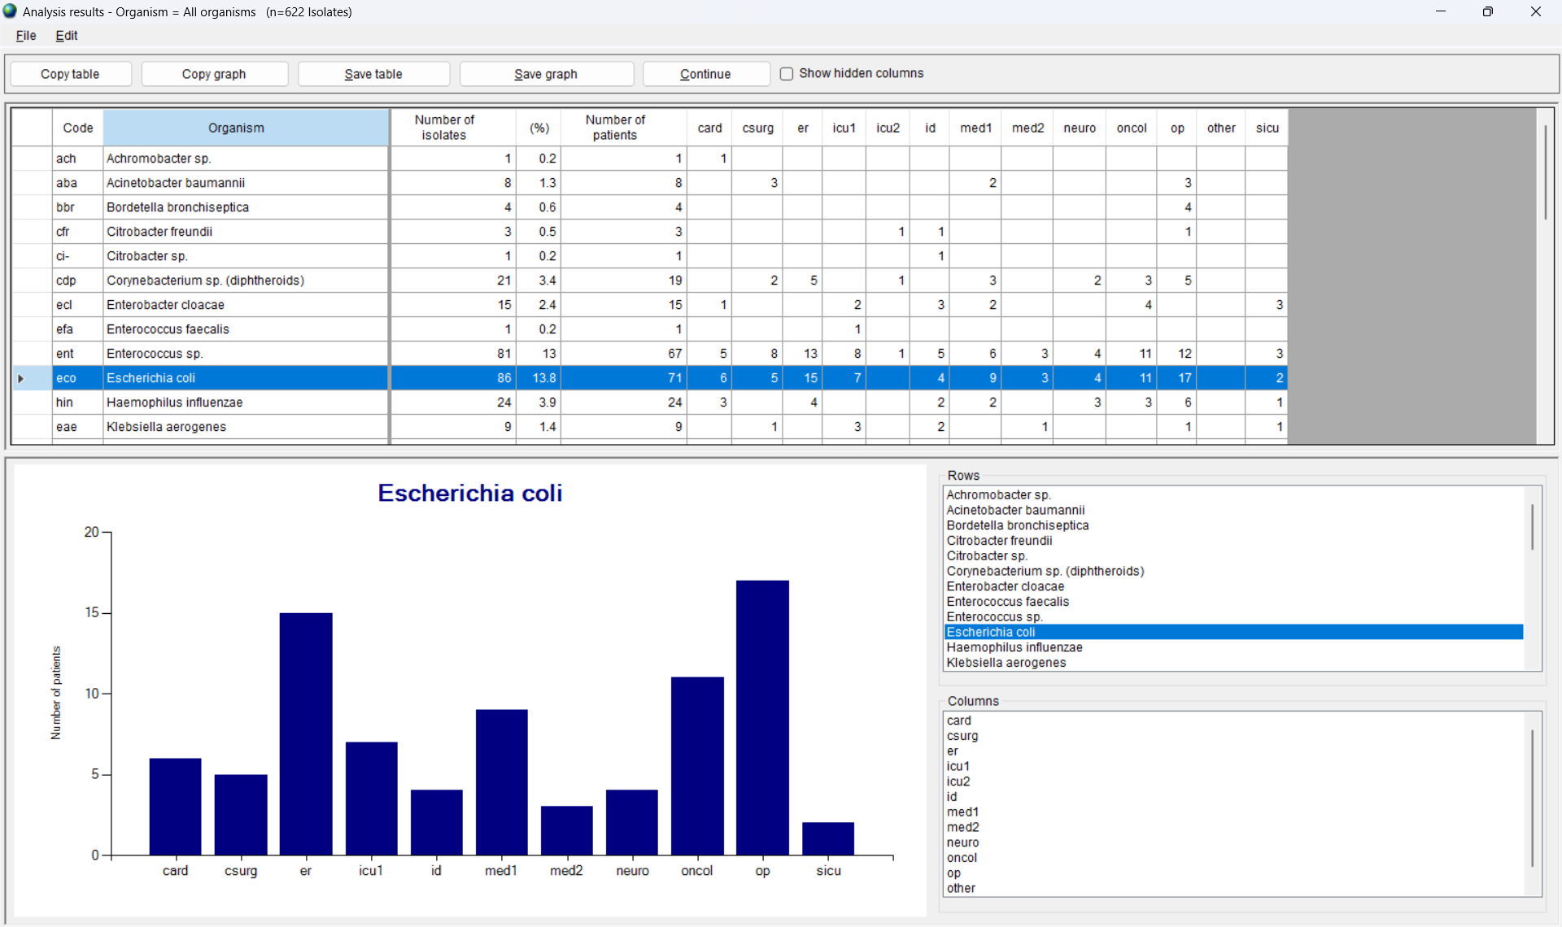
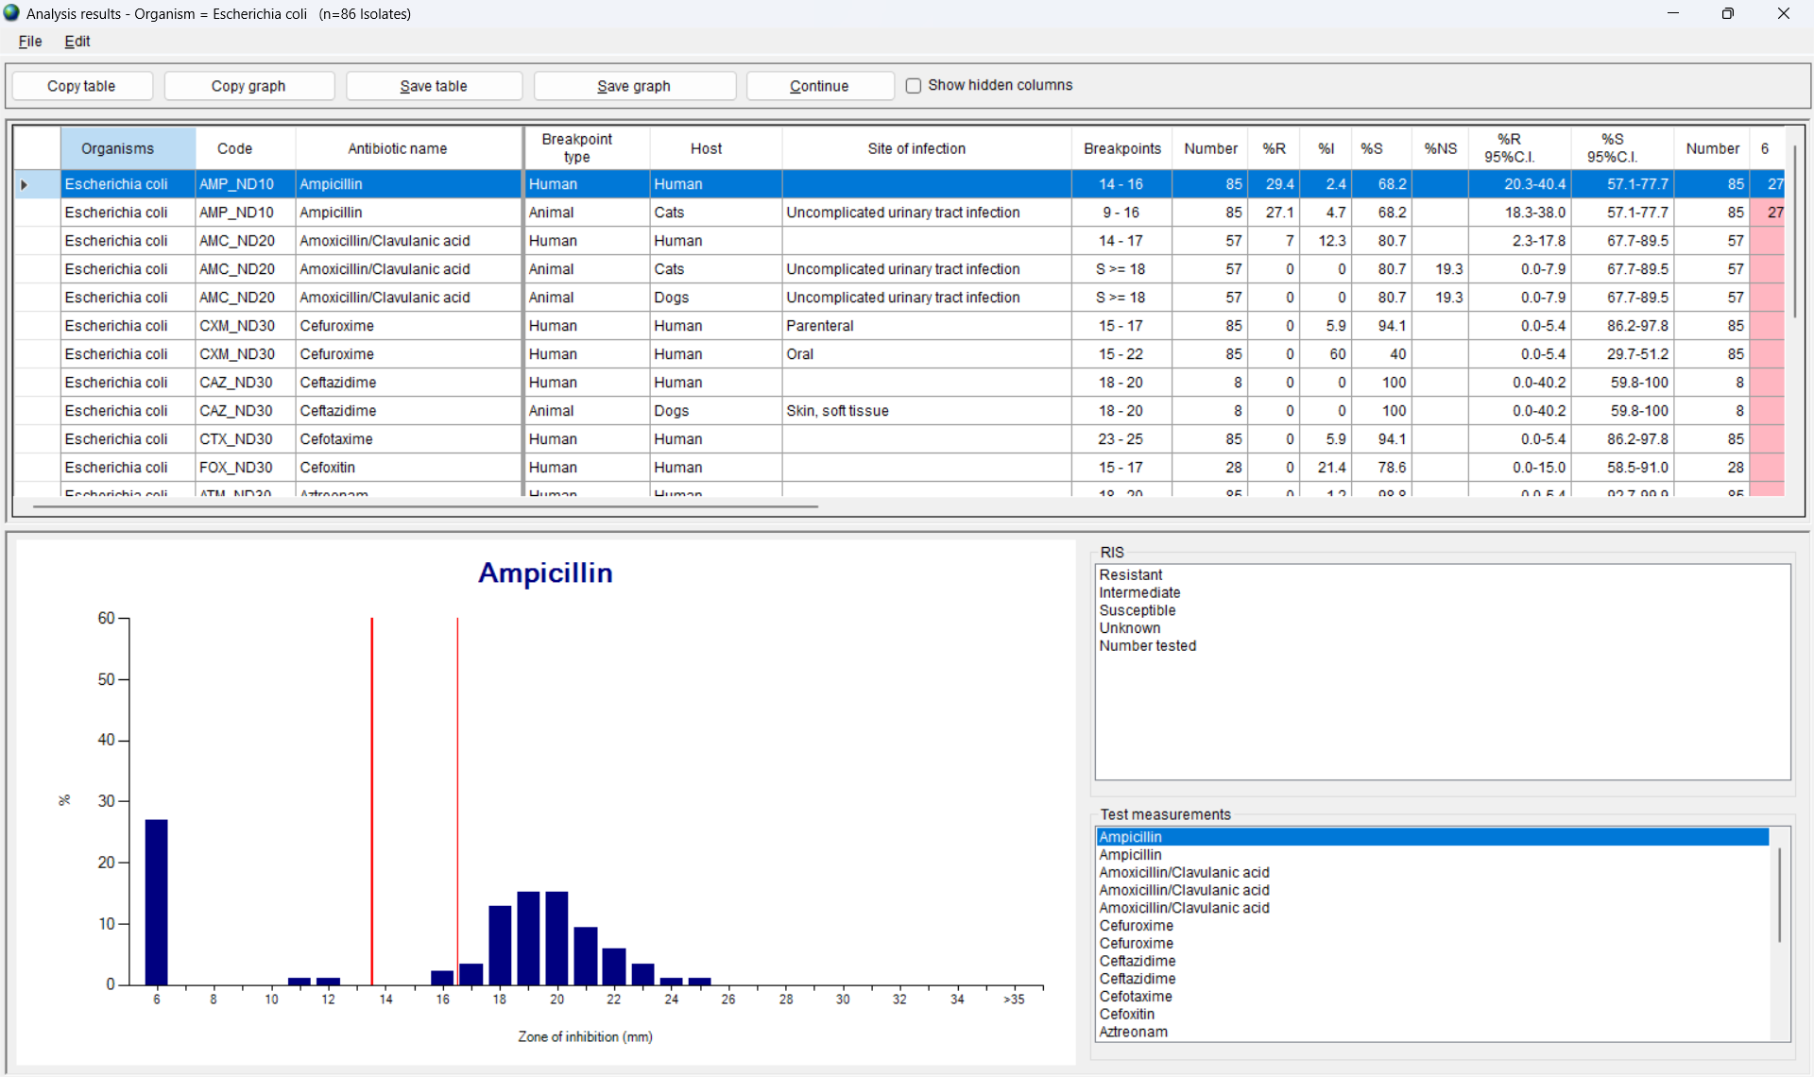
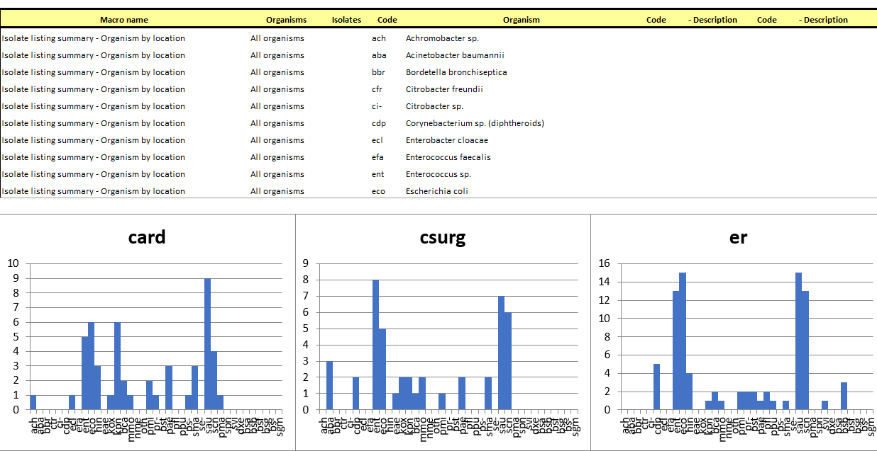
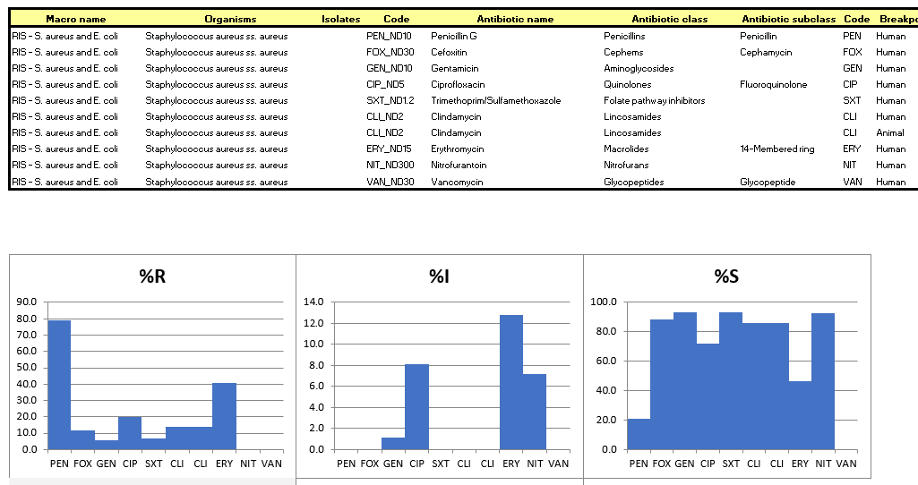
WHONET Organism and antibiotics – Screen and Excel
Organism by location
%RIS for Escherichia coli
Screen
Excel

Slide 16
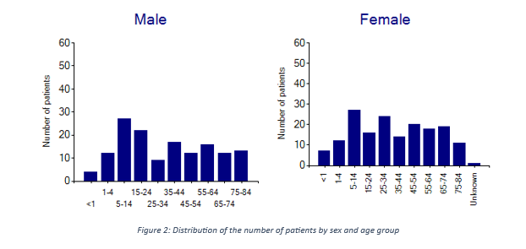
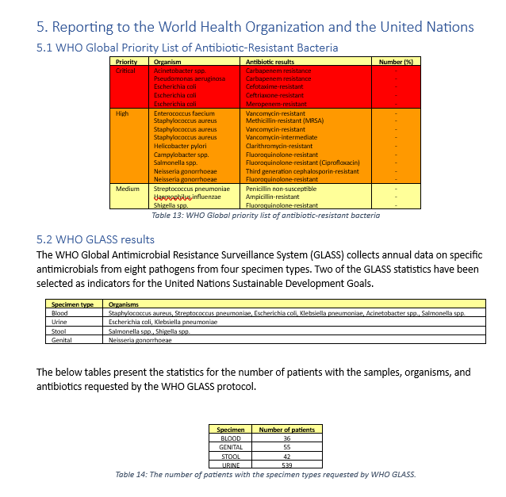
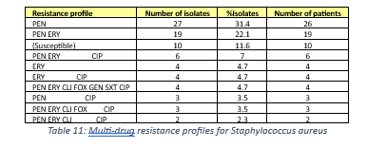
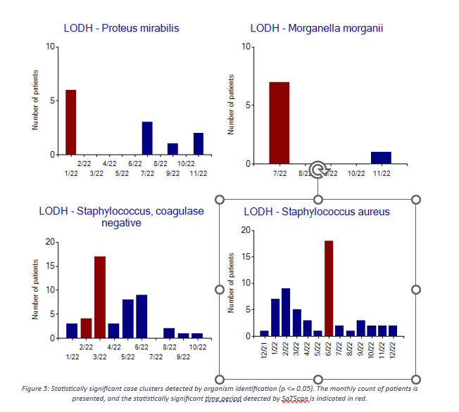
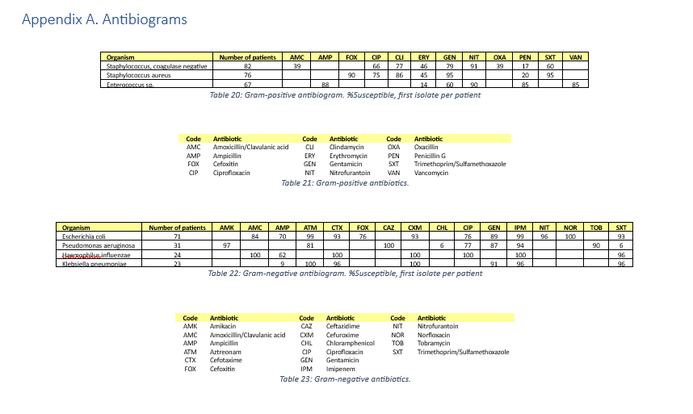
WHONET Epidemiology and Data quality reports

Slide 17
Report types – Advantages and disadvantages
Screen and Excel
Advantages
A large volume of results generated, for example details on “All organisms”
For screen displays, the interface is interactive
You can create your own user-defined reports to meet exactly your analysis needs.
Disadvantages
There is no explanatory text. The user needs to understand what they are looking at and know where to find the results that they are interested in.
The presentation of results is not useful for printouts
Word
Advantages
The report focuses on the highest priority results, for example “Top 10 organisms” with a lot of explanatory text.
The report can easily be printed and shared with local, national, and international colleagues
Disadvantages
The focus is certain priority results defined by the WHONET team.
The content of the report is rigid, and cannot be edited by the user
In future versions of the report
We will include some ability to customize the report – logos, text, content, criteria, thresholds, etc.
We will start to include some automated “highlights” and “recommendations”.

Slide 18
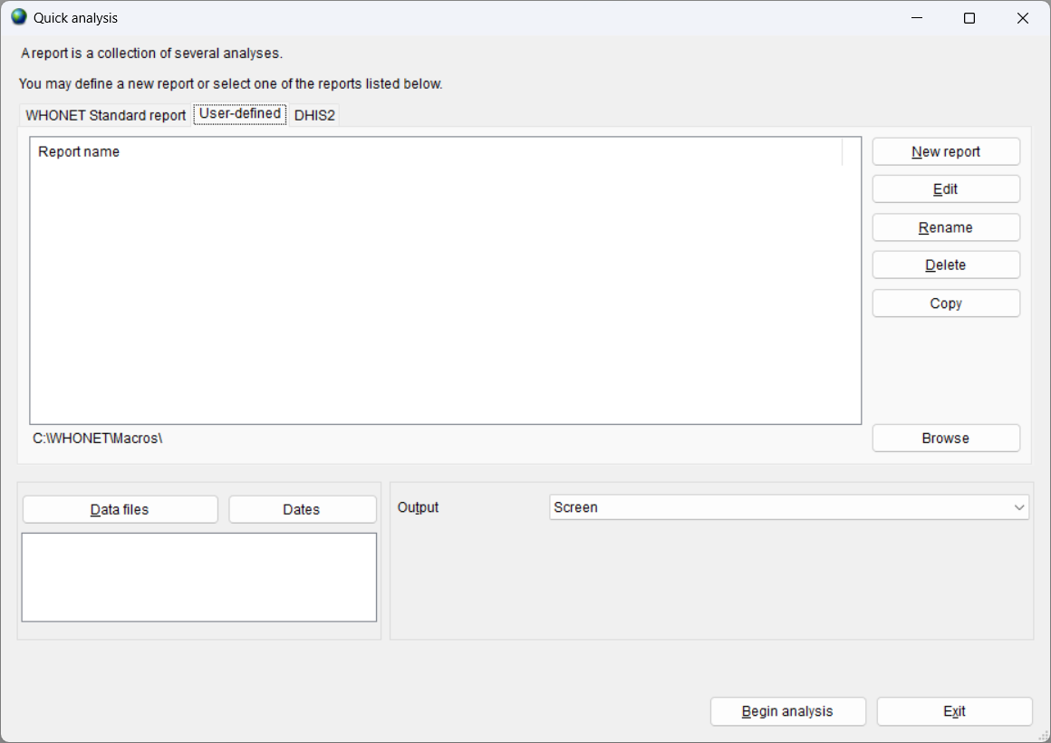
Quick analysis – User-defined reports
Using “New report”, you can create your own bundles of macros.
Give a name to the report, such as “Weekly infection control report” or “Quarterly pharmacy report”.
Choose the macros and subreports that you would like to include in the report.
“Save”, and “Begin analysis” when you are done.
At present, user-defined reports can be visualized on the screen or exported to Excel.
WHONET does not yet support user-defined Word reports, but that is a priority for 2024.

Slide 19
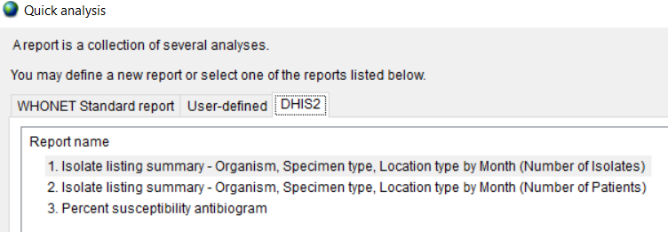
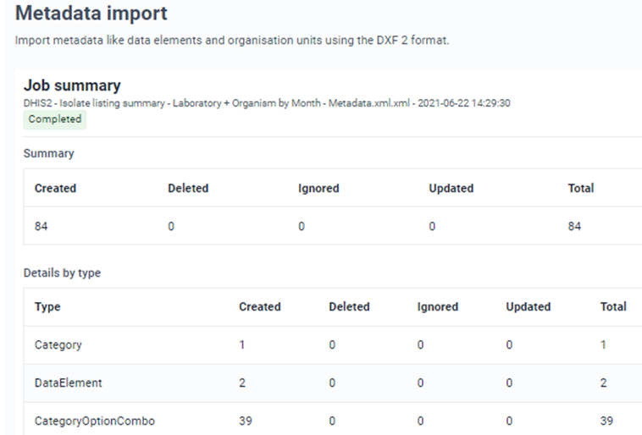
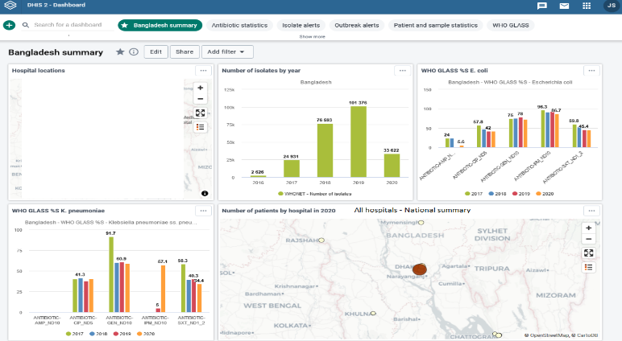
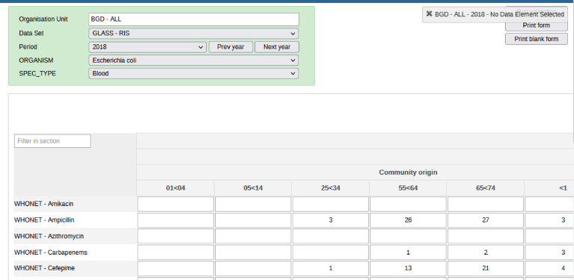
Quick analysis – DHIS2
Metadata, Data Set, and Event import
1. Export analysis results from WHONET
2. Import results into DHIS2
Map edited for confidentiality
3. See the results in DHIS2
4. Visualize the results in DHIS2 with maps and charts

Slide 20
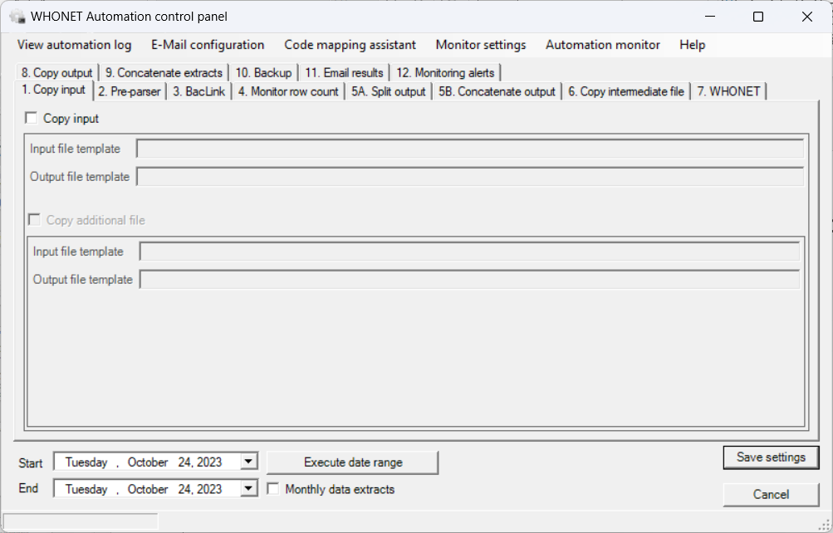
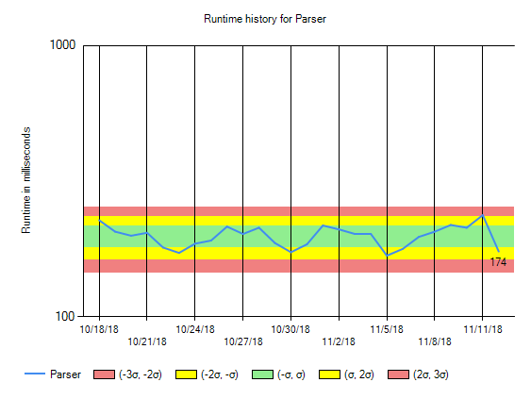
WHONET Automation Tool – Brief introduction
The WHONET Automation Tool can bring automated daily, weekly, and monthly reports.
Alerts for important isolates and possible outbreaks
WHONET and BacLink alerts for data quality issues

Slide 21
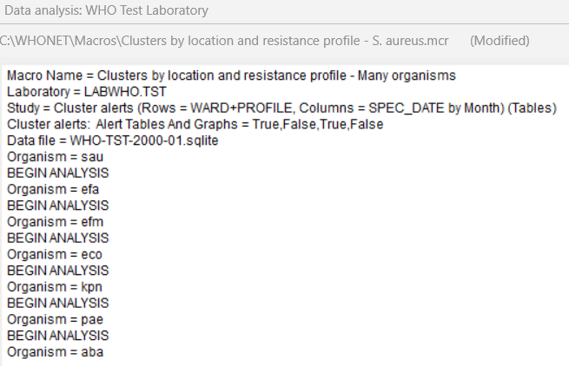
Running many analyses within a single macro
Usually, a macro performs a single WHONET analysis.
But sometimes there is a need to run the same macro for many different organisms or locations or specimen types.
You can use “BEGIN ANALYSIS” to begin a new analysis within the same macro. This is a “hidden” feature that does not appear on the user interface.
Cluster detection for S. aureus
Cluster detection for many species

Slide 22
Thank you!

