Slide 1

Introduction to WHONET 2024
John Stelling, MD, MPH, jstelling@whonet.org
Brigham and Women’s Hospital, Harvard Medical School, Boston
WHO Collaborating Centre for Surveillance of Antimicrobial Resistance

Slide 2
WHONET Webinar series
You can find the videos for past webinars on the WHONET Home Page, click on “Webinars”.
  The audio is available in English. The subtitles are available in approximately 20 languages.
Past webinars
  September – WHONET and WHO GLASS 2.0
  October – WHONET macros and reports
  November – WHONET and multidrug resistance
  January – WHONET-SaTScan and cluster/outbreak detection, Part 1
  March – WHONET-SaTScan and cluster/outbreak detection, Part 2
Today’s webinar
  WHONET 2024 Introduction
Possible ideas for future webinars
  Annual antibiograms and CLSI M39
  WHONET DHIS2-AMR module
  WHONET Automation Tool
  WHONET AST interpretation engine
  WHONET Discussion Forum
  One Health features: WHONET, FAO, and InFARM
  Country-, region-, and/or language-specific sessions
Welcome to suggest ideas for future webinars!
help@whonet.org

Slide 3
Webinar agenda
WHONET Website
  WHONET 2024 materials
  Online WHONET Training Course
  WHONET Discussion Forum
CLSI and EUCAST breakpoint updates
  WHONET interpretation categories
  WHONET Test Interpretation Engine
WHO GLASS modules
Animal Health and One Health modules

Slide 4
Part 1: WHONET Website
WHONET 2024 materials
WHONET Training Course
WHONET Discussion Form

Slide 5
WHONET 2024 Materials
Website review

Slide 6
WHONET Training Course
The course materials can be found at: www.whonet.org/training.html
The course consists of six modules (eventually seven)
  Module 1: Introduction and installation
  Module 2: Laboratory configuration
  Module 3: Data entry
  Module 4: Introduction to data analysis
  Module 5: Data analysis and interpretation (this will be split into Part 1 and Part 2)
  Module 6: Quick analysis and standard reports
The course includes PowerPoint YouTube presentation, exercises, exams, and course completion certification

Slide 7
WHONET Training Course – Hosting platform
The course is currently hosted on the WHONET website
The original goal was to have the course hosted on the OpenWHO platform, www.openwho.org
  However, as of January 2025, the OpenWHO platform will focus on training for emergency and epidemic needs.
  The OpenWHO platform is managed from WHO Headquarters in Geneva
The new goal is to collaborate with the WHO Learning Academy, www.who.int/about/who-academy
  “The WHO Academy is the World Health Organization’s institute for learning.”
  “Our learning platform leverages machine learning and artificial intelligence to provide an engaging and personalised experience for every learner.”
  “The WHO Academy will open to all learners in December 2024, both online and at our new campus in Lyon.”
We anticipate that an adapted version of the course will be hosted with FAO
  Probably FAO Virtual Learning Centres, virtual-learning-center.fao.org
  FAO also hosts the FAO eLearning Academy, elearning.fao.org

Slide 8
WHONET Training Course
Demonstration

Slide 9
WHONET Discussion Forum
Demonstration

Slide 10
Part 2: CLSI and EUCAST breakpoint updates
WHONET interpretation categories
WHONET Test Interpretation Engine

Slide 11
WHONET Interpretation categories
R = Resistant
I definitions
  CLSI – Intermediate
  EUCAST – Susceptible with Increased exposure
S = Susceptible
SDD (CLSI only) : Susceptible, Dose-dependent – comparable to EUCAST “I” category
NS (CLSI only): Not susceptible (when there is no defined “R” category)
WT: Wild type according to Epidemiological Cutoff Values (ECOFFs / ECVs)
NWT: Non-Wild type
?: No interpretation is possible. There are no published breakpoints

Slide 12
Categories R?, I?, S?, NS?, and SDD?
These are utilized only for “off-scale” MIC values that do not align with the currently published breakpoint.
Example
  If the susceptible breakpoint is S ≤ 1, then an MIC equal to 0.5 or 1 is clearly susceptible.
  And MIC recorded as “≤1” is also clearly susceptible
  However, if there is an MIC recorded as “≤4”, then it we cannot say with certainty that the isolate is susceptible.
  This may happen infrequently because of a simple typing mistake. Perhaps the user intended to write MIC ≥ 4.
  However, more frequently it reflects a change in the published breakpoints. For example, an imipenem MIC≤4 was considered to be susceptible until 2010 when CLSI changed the breakpoint to MIC≤1.
  WHONET will assign an interpretation category of “S?” because the “≤” symbol suggests that the isolate is as susceptible as the test would permit, but a “?” because it is possible that the interpretation might not be “S”.
    Most commonly “S?” will mean “Susceptible by the older breakpoints – probably susceptible by the newer breakpoints, but we cannot be certain”.

Slide 13
WHONET Interpretations
Demonstration

Slide 14
WHONET AST Interpretation Engine
“Old WHONET interpretation approach”
  Use of “General breakpoints”
  Mixture of external data tables and internal hard-coded rules, especially for
    Complicated organism hierarches
    Multiple breakpoints (meningitis, nonmeningitis, uncomplicated UTI, horses, fish, etc.)
  Default methods from WHONET 1989 through WHONET 2023
“New WHONET interpretation approach”
  There are no longer “general breakpoints”
  Use of CLSI and EUCAST “Intrinsic resistance tables”
  Everything is now data driven
    Easier maintenance for the WHONET team
    Use of our tables by other groups (MSF Mini-LIMS, Viet Nam web portals, Bhutan LIS, being explored by others)
    Discussions in collaboration with WHO, CLSI, EUCAST, MSF, Wellcome, and others
  Default for WHONET 2024 for new configurations that you create. For existing configurations, WHONET continues to use the old approach – unless you request to switch to the new approach.

Slide 15
Part 3: WHO GLASS modules
WHO GLASS-AMR
WHO GLASS-EGASP
WHO GLASS-FUNGI
WHO GLASS-BACTERIA
WHO ESBL Escherichia coli TriCycle project

Slide 16
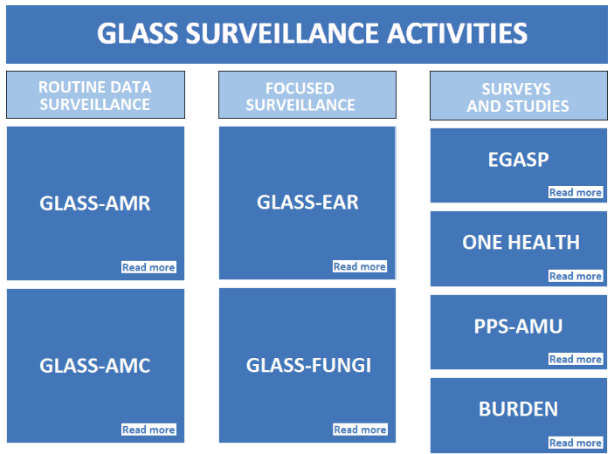
WHO GLASS Modules
GLASS-BACTERIA

Slide 17
WHO GLASS Modules
Demonstration

Slide 18
Part 4: One Health modules and features
FAO InFARM (Global)
FAO AMR Surveillance protocols (Asia-Pacific)
GISSA
SILAB

Slide 19
FAO InFARM
InFARM = International FAO Resistance Monitoring
  www.fao.org/antimicrobial-resistance/resources/infarm-system
Two options for reporting
  Model A: Individual-level reporting, including (ideally) disk diffusion zone diameters and MIC values
  Model B: Annual aggregate reporting on a broad range of animal, specimen, organism, and antibiotic combinations
Regional training workshops
  Americas: Bogota, Colombia: July 2-4, 2024
  Africa: Lusaka, Zambia: July 15-18, 2024
  Asia: Bangkok, Thailand:

Slide 20
AMR surveillance protocols – FAO Region of Asia and the Pacific
Protocols
  https://www.fao.org/antimicrobial-resistance/projects/completed/project-3
  Volume 1: Monitoring and surveillance of AMR in bacteria from healthy animals intended for consumption
  Volume 2: Monitoring and surveillance of AMR in bacterial pathogens from diseased livestock and poultry
  Volume 3: Monitoring and surveillance of AMR in aquaculture
  Volume 4: Monitoring and surveillance of AMR in animal environment
  Volume 5: Monitoring antimicrobial use at the farm level
  (Volume 6: Monitoring of antimicrobial residues)

Slide 21
GISSA - Global Integrated Surveillance System for Antimicrobial Resistance and Antimicrobial Usage
Integrated surveillance of antimicrobial resistance and use: An expert Quadripartite technical group on integrated surveillance established by the QJS in 2022 has developed and agreed on an action plan for 2022-2024 to develop a list of priority outputs, including a Quadripartite guide on integrated surveillance along the One Health spectrum, which is near finalisation. The Global Integrated Surveillance System on Antimicrobial Resistance and Use (GISSA), now in development, aims to serve as a repository pooling data collected from across sectors by the Quadripartite organizations.
  From the February 2024 “The Quadripartite Joint Secretariat on AMR Progress Report”
Primary data resources:
  WHO GLASS – in 2023, 137 countries enrolled and 91 countries reporting AMR data
  FAO InFARM – going live now (June? July?)
  WOAH ANIMUSE – World Organization for Animal Health – Animal antimicrobial USE, amu.woah.org/amu-system-portal
  UN Sustainable Development Goals on AMR (drawn from WHO GLASS statistics)
From the Quadripartite Key Recommendations and Priorities for the 2024 UNGA High-Level Meeting on Antimicrobial Resistance (AMR)
  WHO GLASS and …. “The FAO InFARM (International FAO Antimicrobial Resistance Monitoring) and WOAH ANIMUSE (for ANImal antiMicrobial USE) databases have enabled AMR surveillance in agrifood system, and AMU surveillance in animals and are supporting the development of an integrated AMR surveillance system (Global Integrated Surveillance System for AMR, GISSA).
  The inclusion of new AMR indicators in the SDG monitoring framework and the publication of a Quadripartite One Health priority research agenda for AMR and the WHO global research agenda for AMR in human health are also important steps forward to catalyze action on prioritized areas.

Slide 22
SILAB – Animal health laboratory information system
Useful links
  Home page: www.izs.it/IZS/Cooperation/IZSAM_and_Africa/SILAB_for_Africa_Project
  Publication: pubmed.ncbi.nlm.nih.gov/30767711

Slide 23
WHONET One Health modules
Demonstration

Slide 24
Thank you!

