Slide 1

WHONET-SaTScan and Cluster/Outbreak Detection
John Stelling, MD, MPH, jstelling@whonet.org
Brigham and Women’s Hospital, Harvard Medical School, Boston
WHO Collaborating Centre for Surveillance of Antimicrobial Resistance

Slide 2
WHONET Webinar series
You can find the videos for past webinars on the WHONET Home Page, click on “Webinars”.
  The audio is available in English. The subtitles are available in approximately 20 languages.
Past webinars
  September – WHONET and WHO GLASS 2.0
  October – WHONET macros and reports
  November – WHONET and multidrug resistance
Today’s webinar
  January – WHONET-SaTScan and cluster/outbreak detection, Part 1
Possible ideas for future webinars
  WHONET-SaTScan and cluster/outbreak detection, Part 2
  Annual antibiograms and CLSI M39
  WHONET DHIS2-AMR module
  WHONET Automation Tool
  WHONET AST interpretation engine
  WHONET Discussion Forum
  One Health features: WHONET, FAO, and InFARM
  Country-, region-, and/or language-specific sessions
Welcome to suggest ideas for future webinars!
help@whonet.org

Slide 3
Webinar agenda
Approaches to the detection of possible outbreaks
WHONET and data preparation
WHONET demonstration of cluster detection using default settings
Interpretation of results
WHONET-SaTScan analysis options
Examples from the literature

Slide 4
Approaches to outbreak detection

Slide 5
WHONET – Vision
Human health, animal health, food, and environmental microbiology laboratories worldwide generate a detailed window into evolving microbial populations in real-time. Yet this resource remains largely untapped and underutilized to support policy development and resistance containment interventions.
The use of a common software could and should support local, national, regional, and global collaboration and analyses to support:
  Infection and resistance containment
    Recognition, tracking, and containment of emerging threats in real-time
      Including outbreaks
    Treatment guidelines and antimicrobial stewardship programs
    Public health awareness, advocacy, policy, and interventions
    Basic science, clinical, and operational research
  Diagnostic stewardship and continuous quality improvement in laboratory practices

Slide 6
Strategies for outbreak detection
Anecdotal
Regular manual review of lab data
Statistical algorithms
  Simple rules
  Advanced algorithms with statistical thresholds

Slide 7


Anecdotal detection of community outbreaks

Slide 8
Acinetobacter baumanii
Investigation of a hospital outbreak suspected by clinical staff
Acinetobacter baumannii non-susceptible to:
AMP, CTX, CAZ, LVX, NIT, GEN, and SXT
All Acinetobacter baumannii
Month
Month
Resistance profiles can improve the sensitivity, specificity, and timeliness of outbreak detection
Notes:
8

Slide 9
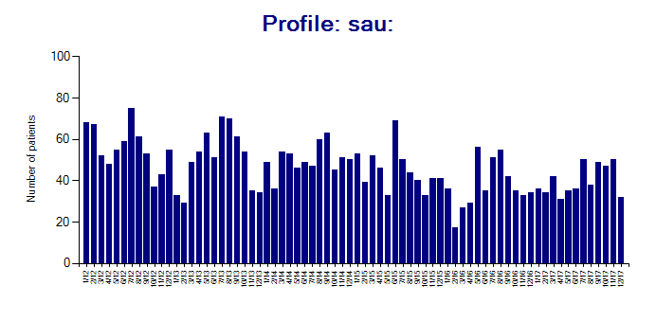
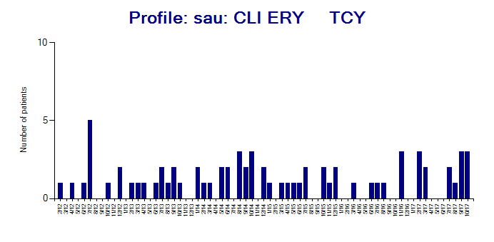
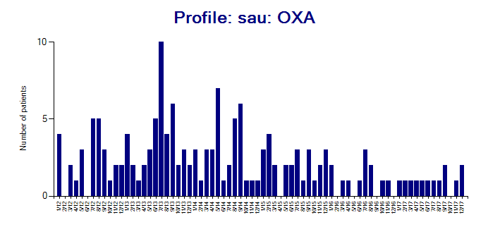
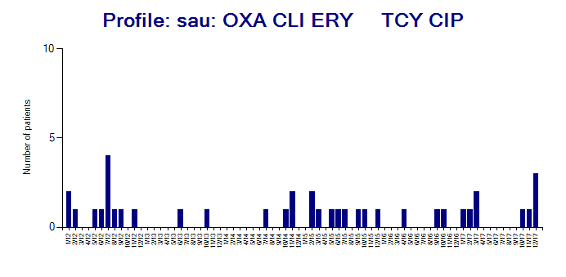
Regular review of routine data
Staphylococcus aureus and resistance profiles 2011-2017
MSSA: Fully susceptible
MSSA: Somewhat resistant
MRSA: Mostly susceptible
MRSA: Very resistant

Slide 10
Traditional statistical methods for outbreak detection… and limitations
Too simple
  For example: “Three new patients with MRSA in a hospital ward in a two-week period”
  But this rule does not consider the size of the ward, the baseline incidence of MRSA, or heterogeneity among MRSA
Very narrow focus
  Only priority species or resistance phenotypes like MRSA and VRE. Others are ignored.
  Rigid time intervals: daily or weekly or monthly
  Rigid geographic units: ward or facility or district or province
Low sensitivity, specificity, and positive predictive value
  Missing many true outbreaks but alerting too many false positives
No automatic adjustments for multiple comparisons

Slide 11
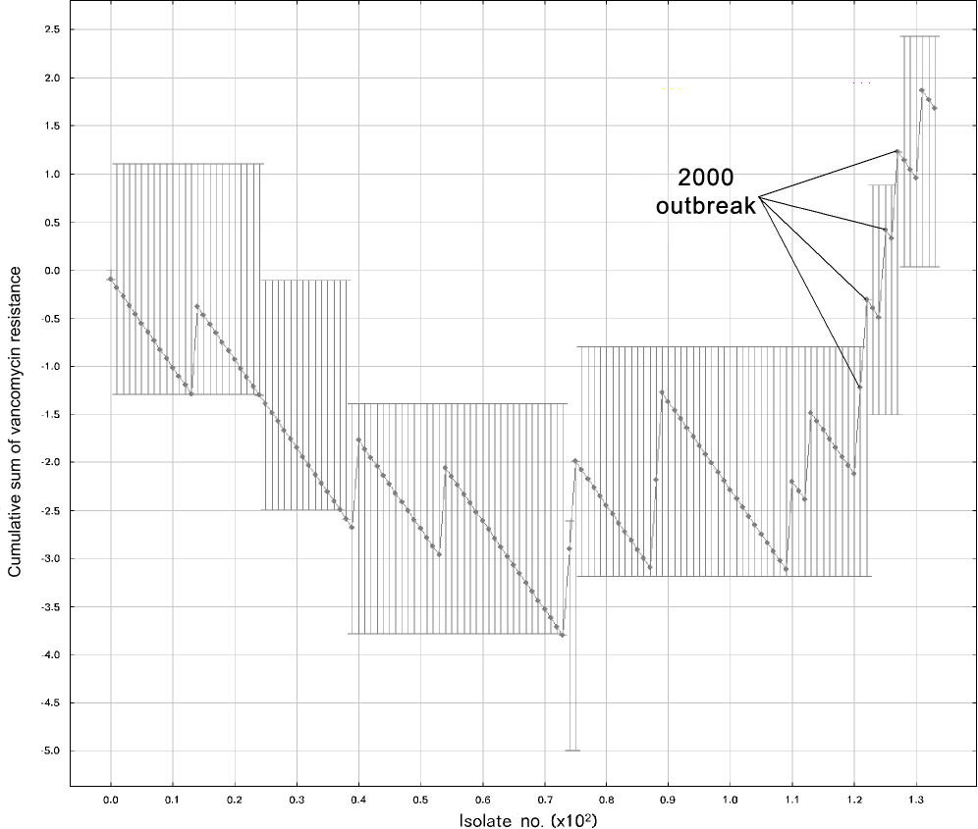
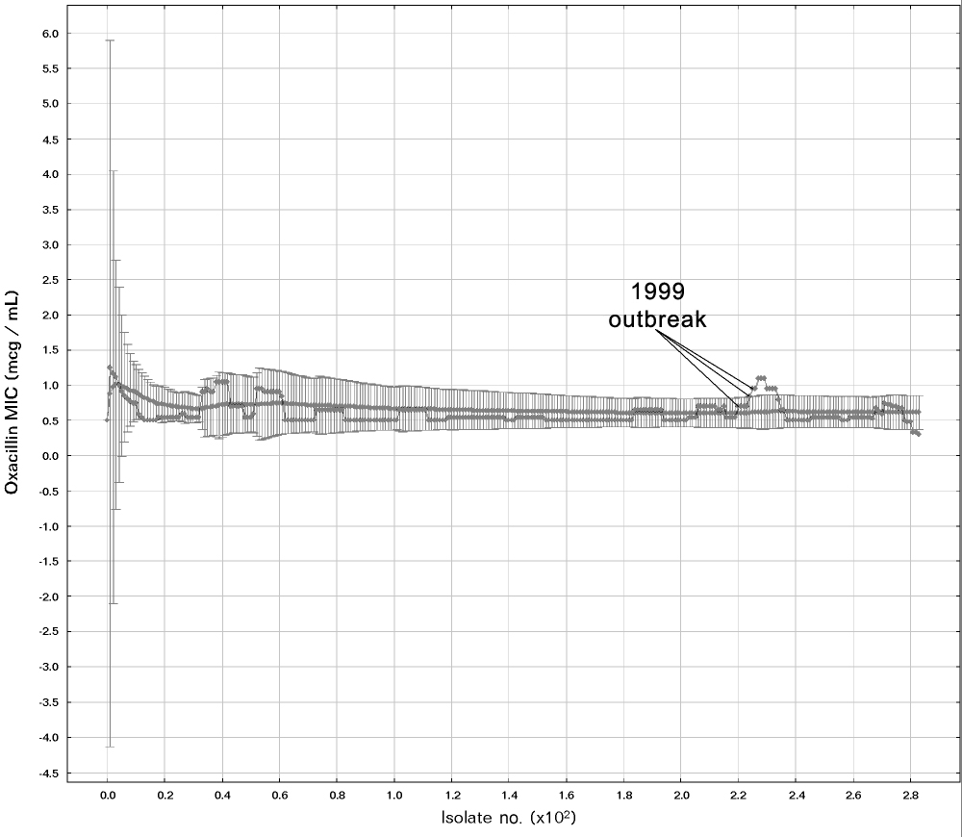
Statistical algorithms for cluster detection available in WHONET
Time-trend analysis
  Cumulative Sums (CUSUM) – from CDC EARS
  Moving Average (MA)
  Exponential Weighted Moving Average (EWMA)
  Temporal Poisson*
  Temporal Uniform*
Spatial trend analysis
  Spatial Multinomial*
Space-Time trend analysis
  Space-Time Permutation*
  Space-Time Uniform*
  Space-Time Multinomial*
  Space-Time Poisson*
CUSUM and VRE
EWMA and S. aureus
WHONET publications, degree theses, and current work.
* Options available in SaTScan

Slide 12
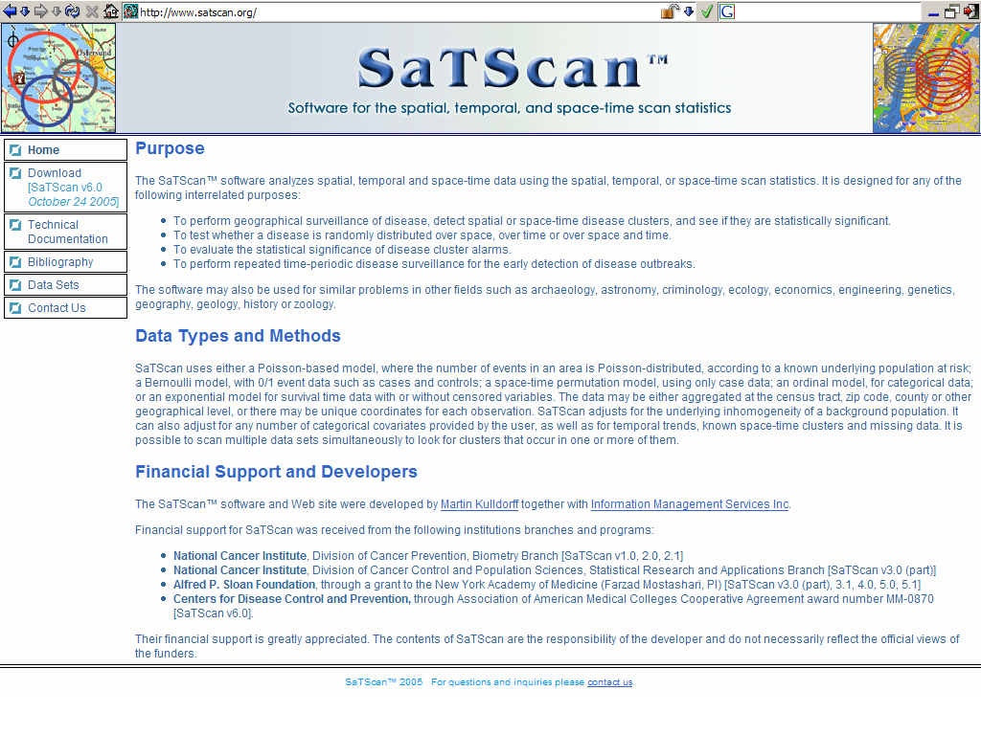
www.satscan.org

Slide 13
SaTScan features
Advanced statistical algorithms for estimating p-values based on (non-parametric) Monte Carlo simulations
Scanning windows in time
Scanning windows in space
Automatic control for multiple comparisons (within a single analysis)
Spatial variables:
  True geographic space (latitudes and longitude)
  Non-parametric geographic space (wards, hospital groupings)
  Conceptual space (resistance profiles)

Slide 14
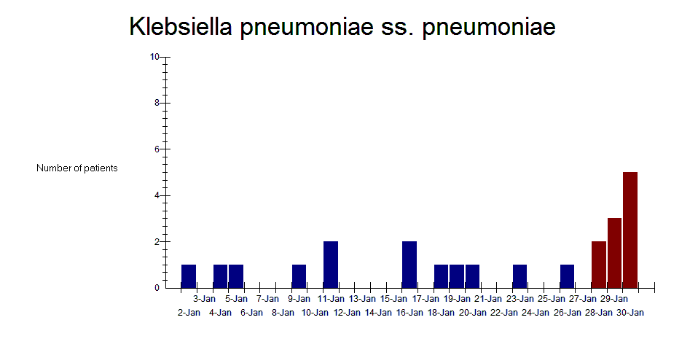
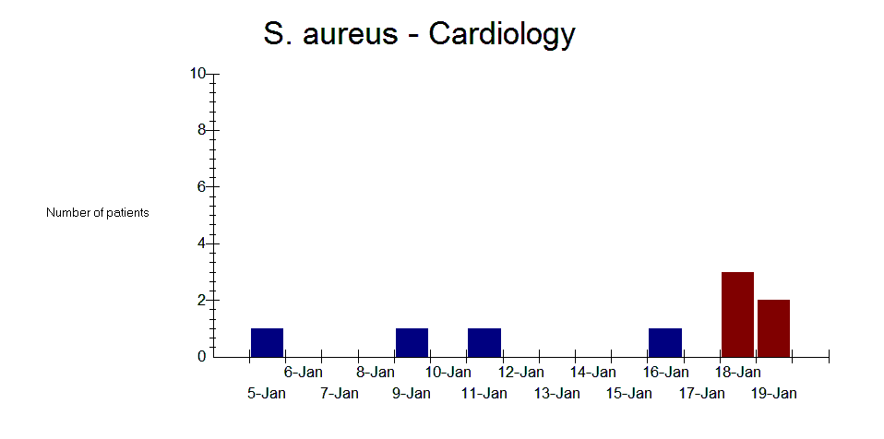
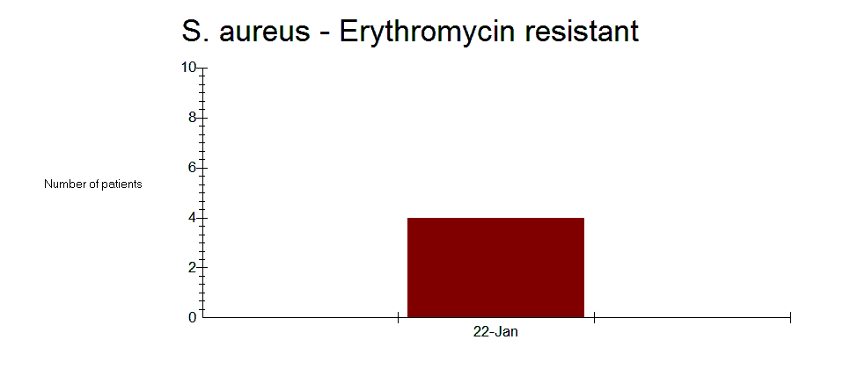
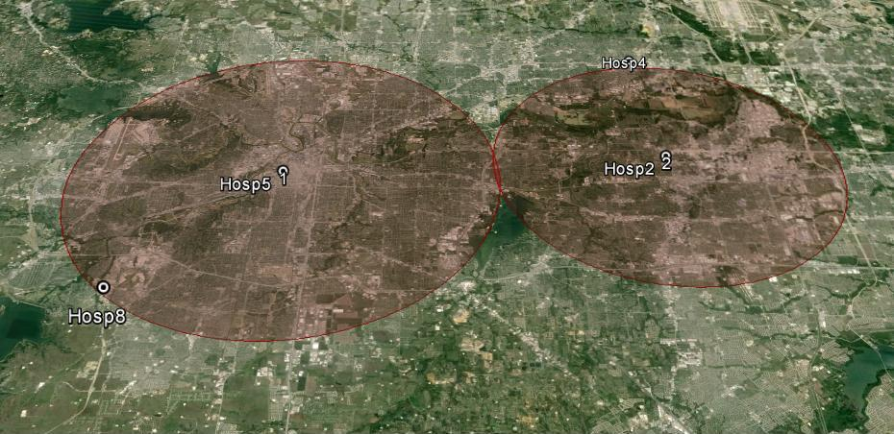
SaTScan and cluster detection by any variable
By organism
By ward
By latitude/longitude
By resistance profile
And by combinations: Ward groups + resistance profile, etc.

Slide 15
WHONET and data preparation

Slide 16
Data preparation
Choose a subset of isolates in which you want to look for possible outbreaks.
Simple data preparation in one step – Covered today in Part 1
  For patients with multiple isolates of the same species, remove “repeat” isolates from the same patient. This will discussed further on the next slide.
Advanced data preparation in multiple steps –Covered in Part 2
  For the detection of outbreaks of hospital-acquired infections:
    Filter for “inpatient” isolates only. This is not ideal since many inpatients have been hospitalized with community infections.
    Filter for “inpatient” isolates on “Hospital Day 3 or later”.
  For the detection of specific priority microbial populations
    Filter for important characteristics, such as MRSA or imipenem-resistant Escherichia coli
  Include or exclude “screening isolates”
  Filtering needs to be accomplished as a series of steps to produce a smaller WHONET file for analysis.

Slide 17
Excluding “repeat” isolates from a patient
Five isolates from the same patient do not represent an outbreak. So we need to remove the repeat isolates from the cluster detection analysis.
There are a few reasonable ways to do this:
  First isolate per patient per species per year
    Especially useful for organisms that are not routinely susceptibility tested (fungi, C. difficile, other anaerobes)
  First isolate with antibiotic results per patient per species per year
    Especially useful for orgranisms that are routinely susceptibility tested (E. coli, S. aureus, P. aeruginosa)
  First isolate with certain resistance results per patient per species per year
    Focus on one antibiotic, e.g. oxacillin or imipenem
    Focus on many antibiotics, e.g. resistance profile antibiotics

Slide 18
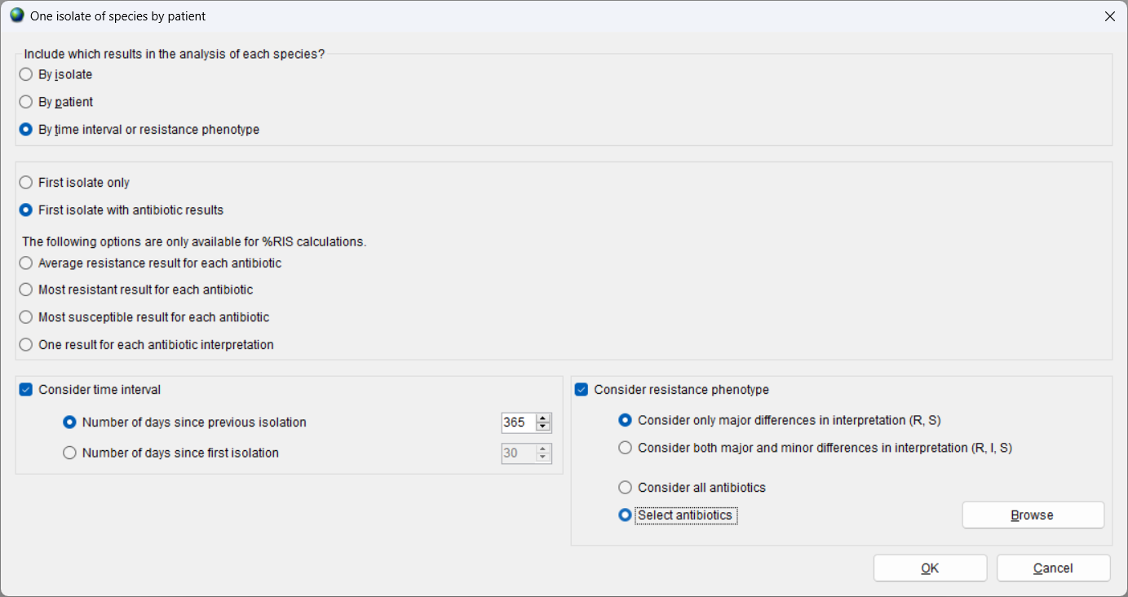
“One per patient” options

Slide 19
WHONET demonstration using default settings
… and interpretation of results

Slide 20
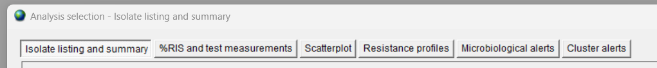



WHONET Analysis types
There are three analyses that include the option for “Cluster alerts”
  Isolate listing and summary – detecting clusters without antibiotic results
  Resistance profiles – detecting clusters with antibiotic results
  Cluster alerts – detecting clusters with or without antibiotic results
Each of these analysis allow you to access the “Options” for cluster alerts

Slide 21
WHONET Demonstration without cluster detection
Example 1
  Analysis type: Isolate listing and summary
    Rows = Organism
    Columns = Specimen date
  Organisms = ALL
  Data file = WHO-TST-2000-01.sqlite
  First isolate per patient per species per year

Slide 22
WHONET Demonstration with cluster detection using the default parameters
Example 1
  Analysis type: Isolate listing and summary
    Rows = Organism
    Columns = Specimen date
  Organisms = ALL
  Data file = WHO-TST-2000-01.sqlite
  First isolate per patient per species per year
  Include cluster alerts = Yes

Slide 23
WHONET Demonstration with cluster detection using the default parameters
Example 1
  Analysis type: Cluster alerts
    Rows = Organism
    Columns = Specimen date
  Organisms = ALL
  Data file = WHO-TST-2000-01.sqlite
  First isolate per patient per species per year
  Include cluster alerts = Yes

Slide 24
WHONET Demonstration with cluster detection using the default parameters
Example 2
  Clusters of Staphylococcus aureus by location
  Analysis type = Isolate listing and summary
    Rows = Location
    Columns = Specimen date
  Organism = sau

Slide 25
WHONET Demonstration with cluster detection using the default parameters
Example 3
  Clusters of Staphylococcus aureus by resistance profile
  Cluster detection variables
    Rows = Resistance profile
    Columns = Specimen date
  First isolate with antibiotic results per patient per species

Slide 26
WHONET Demonstration with cluster detection using the default parameters
Example 4
  Clusters of Staphylococcus aureus by location and resistance profile
  Cluster detection variables
    Rows = Location + Resistance profile
    Columns = Specimen date

Slide 27
Possible explanations of statistically significant case clusters
True disease outbreaks
“Pseudo-outbreaks”
  Contamination of clinical samples
  Poor quality or contamination of laboratory reagents
  Changes in sample collection practices
  Changes in laboratory test practices
  Changes in patient populations
  Random variation

Slide 28
WHONET-SaTScan options

Slide 29
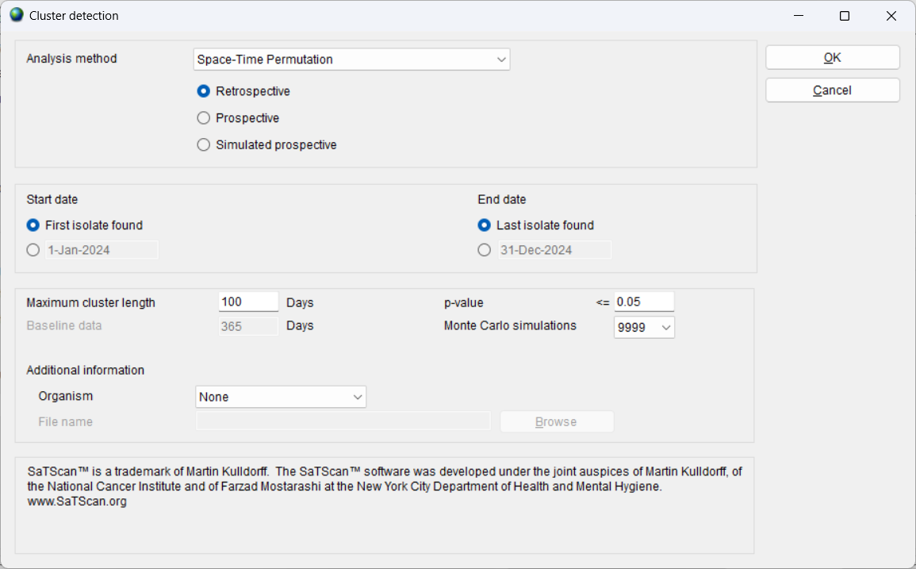
Options for the cluster alerts

Slide 30
Analysis approach
Retrospective analysis
  Were there statistically significant clusters in 2023?
Prospective analysis
  Were there statistically significant clusters on August 15, 2023?
Simulated prospective analysis
  What statistically significant clusters could we have detected in 2023 if we had been run the analysis for every day in 2023?
The retrospective analysis addresses an interesting question.
However, the simulated prospective analysis addresses a more interesting question since it can help to predict the value of cluster detection in the future.

Slide 31
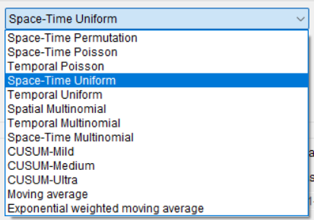
Statistical algorithms and probability models
You can choose between “spatial”, “temporal”, and “spatial-temporal” algorithms.
  The focus of our early analyses and publications was the SaTScan Space-Time Permutation model.
  However, in our recent work, we have switched to use of the Space-Time Uniform model.
  We have also found interesting results with the Spatial Multinomial model.
The three “CUSUM” algorithms are from the CDC’s EARS protocols.

Slide 32
Other parameters
Start date and end date. You can search for clusters at any time in the data period or you can focus on cluster detection in a specific time period, for example within the past month.
Maximum cluster length. SaTScan scans a range of time windows to decide whether there are statistically significant case clusters. The size of the scanning varies from one day up to the maximum cluster length.
  This is not the maximum length of a possible cluster, but rather the size of the maximum time window that SaTScan will evaluate.
Baseline period: This is used for prospective analyses. How much historical data should be analyzed in looking for clusters on a specific date.
Cluster detection thresholds
  For retrospective analysis, we evaluate the p-values
  For prospective analyses, we evaluate the recurrence interval (which is the inverse of the p-value)
Additional information
  Used to define code “groups”, such as groups of wards or groups of hospitals

Slide 33
WHONET parameter settings
For several years, we utilized the below parameters
  Simulated prospective analysis
  Space-Time Permutation
  Maximum cluster length
    30 days for community outbreaks
    60 days for hospital outbreaks
  One year of historical data
  Recurrence interval threshold = 365 days
More recently, we switched to the below parameters
  Simulated prospective analysis
  Space-Time Uniform
  Maximum cluster length
    180 days for hospital outbreaks
  Two years of historical data
  Recurrence interval threshold = 365 days

Slide 34
This is a subset of all features that SaTScan offers.
Demonstration of the SaTScan interface

Slide 35
Examples from the literature

Slide 36
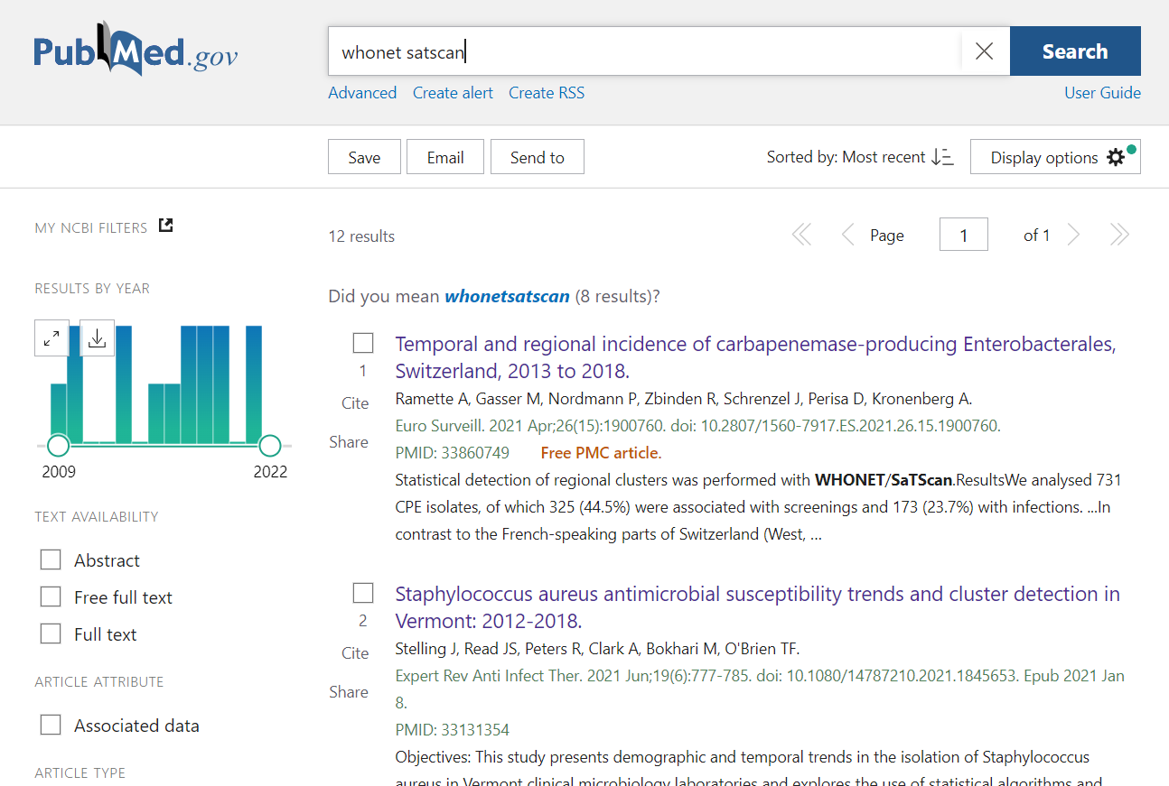
Finding WHONET-SaTScan publications
Use Google to find PubMed
Search for “stelling satscan” or “whonet satscan”
Search results are below

Slide 37
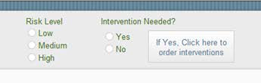
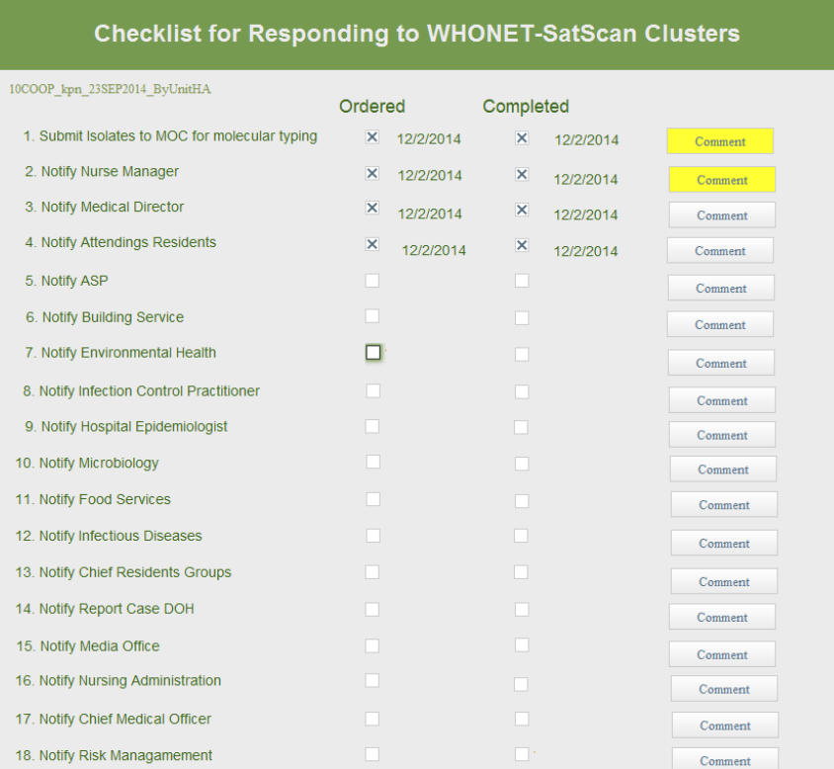
You found a statistical signal… What comes next?
Example from NYU Langome Medical Center

Slide 38
Thank you!

