Slide 1
WHONET-SaTScan and Cluster/Outbreak Detection Part 2
John Stelling, MD, MPH, jstelling@whonet.org
Brigham and Women’s Hospital, Harvard Medical School, Boston
WHO Collaborating Centre for Surveillance of Antimicrobial Resistance

Slide 2
WHONET Webinar series
You can find the videos for past webinars on the WHONET Home Page, click on “Webinars”.
The audio is available in English. The subtitles are available in approximately 20 languages.
Past webinars
September – WHONET and WHO GLASS 2.0
October – WHONET macros and reports
November – WHONET and multidrug resistance
January – WHONET-SaTScan and cluster/outbreak detection, Part 1
Today’s webinar
March – WHONET-SaTScan and cluster/outbreak detection, Part 2
Possible ideas for future webinars
Annual antibiograms and CLSI M39
WHONET DHIS2-AMR module
WHONET Automation Tool
WHONET AST interpretation engine
WHONET Discussion Forum
One Health features: WHONET, FAO, and InFARM
Country-, region-, and/or language-specific sessions
Welcome to suggest ideas for future webinars!
help@whonet.org

Slide 3
Webinar agenda
Summary of Part 1
Analysis parameters
Software demonstration with review of parameters from Part 1
Creation of “meta-groups” and interpretation of results
Macro feature – “BEGIN ANALYSIS”. And user-defined reports
Strategies for assessment and validation of statistical signals
Retrospective data
Prospective data
Optimization of parameters – “robustness analysis”
Advanced data preparation – Creating filtered WHONET files
General value of this feature for multiple purposes
Cluster detection

Slide 4
Review - Webinar agenda for Part 1
Approaches to the detection of possible outbreaks
WHONET and data preparation
WHONET demonstration of cluster detection using default settings
Interpretation of results
WHONET-SaTScan analysis options
Examples from the literature

Slide 5
Part 1 – Strategies for outbreak detection
Anecdotal
Regular manual review of lab data
Statistical algorithms
Simple rules
Advanced algorithms with statistical thresholds

Slide 6
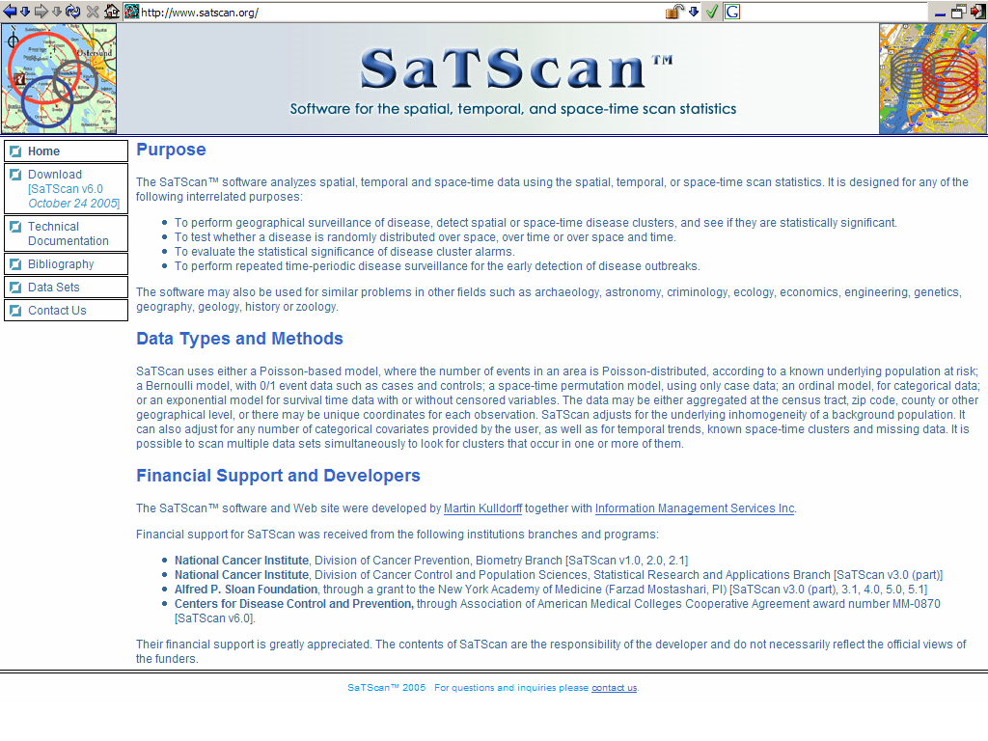
www.satscan.org

Slide 7
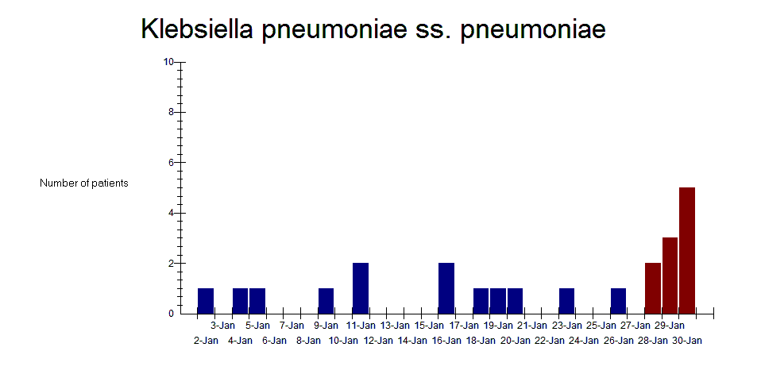
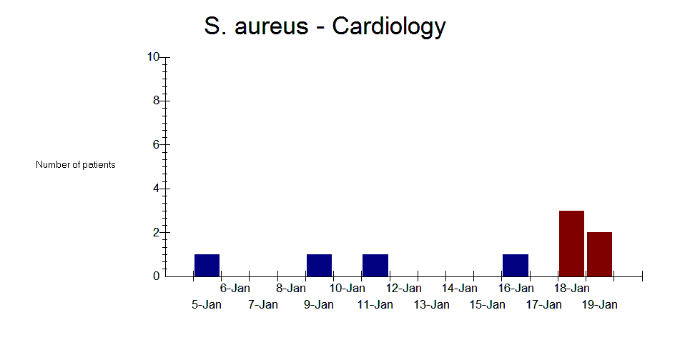
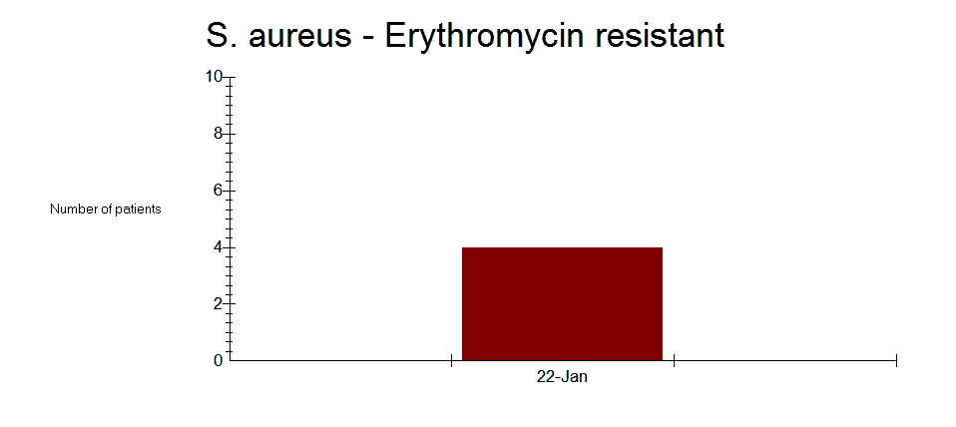
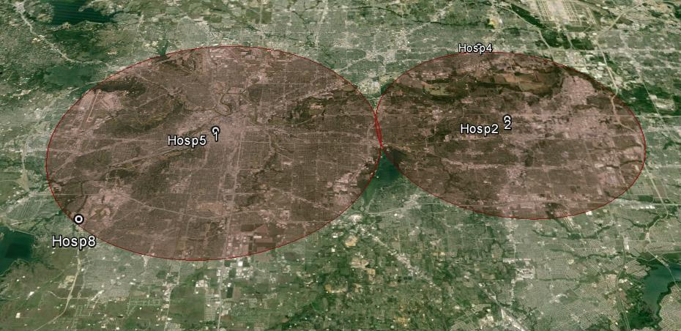
SaTScan and cluster detection by any variable
By organism
By ward
By latitude/longitude
By resistance profile
And by combinations: Ward groups + resistance profile, etc.

Slide 8
Part 1 – WHONET and data preparation

Slide 9
Data preparation
Choose a subset of isolates in which you want to look for possible outbreaks.
Simple data preparation in one step – Covered in Part 1 of the webinar
For patients with multiple isolates of the same species, remove “repeat” isolates from the same patient.
Advanced data preparation in multiple steps –Covered in Part 2 of the webinar
For the detection of outbreaks of hospital-acquired infections:
Filter for “inpatient” isolates only. This is not ideal since many inpatients have been hospitalized with community infections.
Filter for “inpatient” isolates on “Hospital Day 3 or later”.
For the detection of specific priority microbial populations
Filter for important characteristics, such as MRSA or imipenem-resistant Escherichia coli
Include or exclude “screening isolates”
Filtering needs to be accomplished as a series of steps to produce a smaller WHONET file for analysis.

Slide 10
Part 1 – WHONET demonstration using default settings… and interpretation of results

Slide 11
WHONET Analysis types
There are three analyses that include the option for “Cluster alerts”
Isolate listing and summary – detecting clusters without antibiotic results
Resistance profiles – detecting clusters with antibiotic results
Cluster alerts – detecting clusters with or without antibiotic results
Each of these analysis allow you to access the “Options” for cluster alerts

Slide 12
Possible explanations of statistically significant case clusters
True disease outbreaks
“Pseudo-outbreaks”
Contamination of clinical samples
Poor quality or contamination of laboratory reagents
Changes in sample collection practices
Changes in laboratory test practices
Changes in patient populations
Random variation

Slide 13
Part 1 – WHONET-SaTScan options

Slide 14
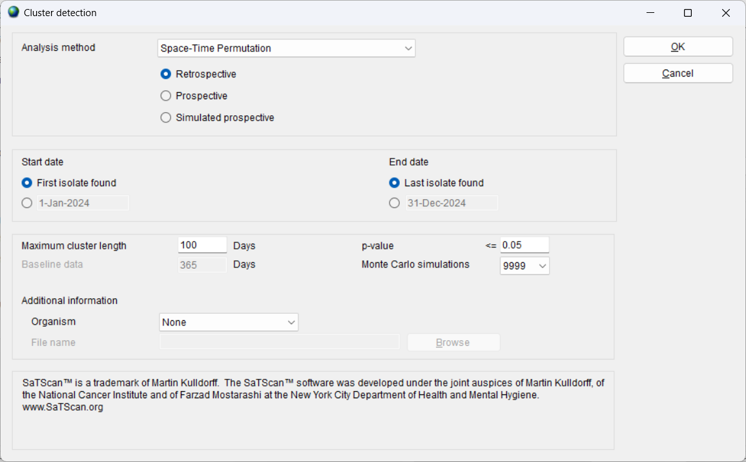
Options for the cluster alerts - Retrospective

Slide 15
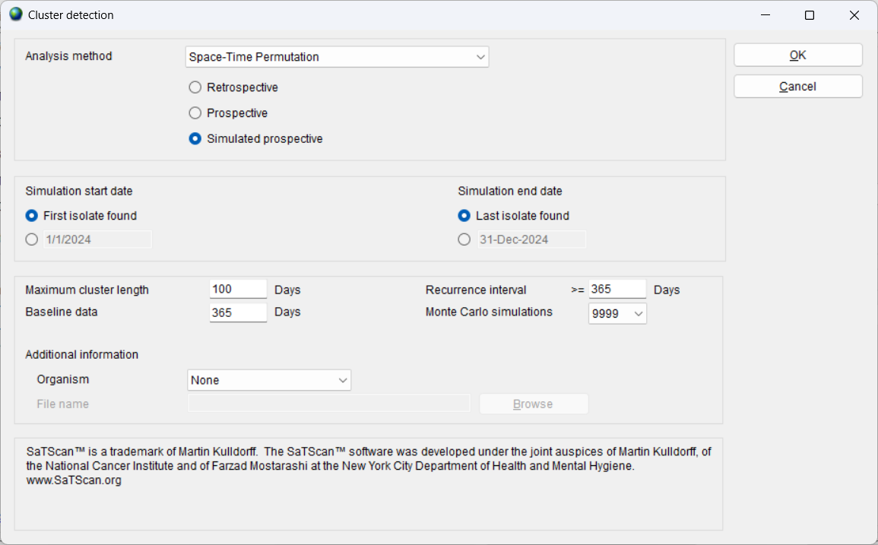
Options for the cluster alerts – Simulated prospective

Slide 16
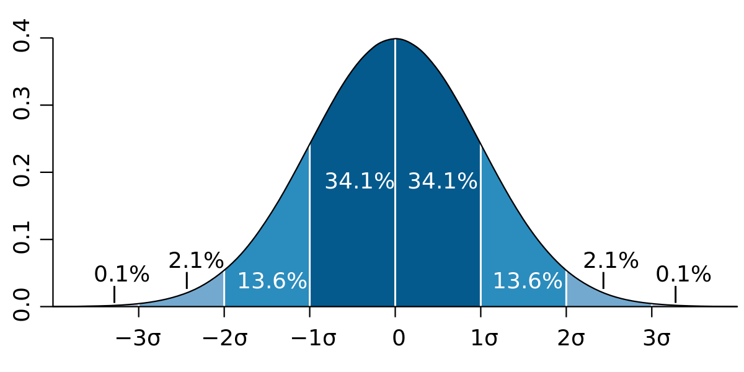
P-values
For a specific time period, there is a general average number of patients that we expect to see.
Sometimes the observed number will be a little above the average and sometimes a little below the average. This is very consistent with random variation.
Sometimes, the number of people observed is much higher or much lower than we would usually expect.
This could still just be random variation. If data are distributed normally, then we expected that the number of patients would be outside of two standard deviations of the mean around 5% of the time.
Or it could also represent a new phenomenon, such as an outbreak.
Is this number of people at the green arrow consistent with random variation?
Or does it suggest that something else is happening, such as an outbreak?
The p-value is an estimate of the probability of seeing this number of people through random variation alone (i.e. no outbreak).

Slide 17
P-value thresholds
If we perform a single WHONET-SaTScan retrospective analysis, then a p-value threshold is reasonable to be used for publications.
If we focus on a single experiment, if the p-value is great than 0.05, we make the traditional conclusion that the number of people is consistent with random variation. We might be wrong, but the numbers are certainly within the range of normal expectations.
On the other hand, if the p-value is less than or equal to 0.05, we make the traditional conclusion that the number of people is not consistent with random variation. We might be wrong, but at least there is a suggestion that something new is happening, such as an outbreak.
For purposes of publications, a threshold of p=0.05 is traditional, but you can use higher or lower thresholds if you wish.
If you choose a higher threshold, like p=0.10, then we will likely increase our detection of some true outbreaks that were only a little outside of expectations (improving the “sensitivity” of cluster detection) but at the risk of mis-categorizing random variation as “possible outbreaks” (worsening “specificity”).
Our goal is not “publications”, but rather saving lives. So, we could adjust our thresholds to reflect how many alerts there are per month on average and how much work it is to investigate the alerts.

Slide 18
P-values and recurrence intervals
A p-value threshold is appropriate for a single retrospective analysis.
However, for simulated prospective analyses, we run individual prospective analyses over many consecutive days. So, under normal variation, we might expect to see significant deviations from expectations around 5% of the time, which is one day out of 20 days (approximately once every three weeks).
So, for simulated prospective analyses, we do not focus on the p-value itself, but rather its inverse called the “Recurrence interval” or “RI”. So, a p-value of 0.05 would correspond to a recurrence interval of 1/0.05, which is 20 days (almost three weeks).
For cluster detection, we are not interested in events that could easily happen by random chance once every 20 days. We would be more interested rare events, like
Once a year. Recurrence interval = 365 days and p-value = 1/365 = 0.00274; or
Once every three months. Recurrence interval = 90 days and p-value = 1/90 = 0.0111
One could also set different thresholds for different kinds of action:
Recurrence intervals from 90 to 180 days. Perhaps take a quick look at the electronic data. If there are no significant concerns, then perhaps “watch and wait”.
Recurrence intervals above 365 days. Perhaps more details investigation of patient risk factors and send isolates out for molecular typing

Slide 19
Caution about p-values and RIs in this presentation
For real work, we would recommend that you use one or two years of historical data.
For this presentation, we are only using one month of free sample data that accompanies WHONET.
We are using this file since it permits you to repeat these analyses after the webinar. But of, course for real work, you should have more data than just one month.

Slide 20
WHONET parameter settings
For several years, we utilized the below parameters
Simulated prospective analysis
Space-Time Permutation
Maximum cluster length
30 days for community outbreaks
60 days for hospital outbreaks
One year of historical data
Recurrence interval threshold = 365 days
More recently, we switched to the below parameters
Simulated prospective analysis
Space-Time Uniform
Maximum cluster length
180 days for hospital outbreaks
Two years of historical data
Recurrence interval threshold = 365 days

Slide 21
Quick demonstration
Example 1. Cluster detection by organism (All organisms)
Example 2. Cluster detection by location (S. aureus)
Example 3. Cluster detection by resistance profile (S. aureus)
Example 4: Cluster detection by location + resistance profile (S. aureus)
Under the “Cluster alerts” analysis, there are three output formats
Detailed signals
Signal summary
Isolate listing

Slide 22
Cluster/outbreak detection – Part 2

Slide 23
Advanced parameters

Slide 24
Non-parametric locations and groups of locations
SaTScan was originally designed for real “parametric” geography, for example using latitudes and longitudes.
The author Martin Kulldorff was able to introduce “non-parametric” geography, which we have found useful:
Medical wards and services
Laboratories and city names (without using latitude and longitude)
Dr. Kulldorff then went a step further to allow for non-parametric groupings of locations that we refer to as “meta-groups” or “meta-locations”. For example:
Within a hospital: “Fifth Floor”, “All ICUs”, “All surgical services”.
Within a geographic area: “Network #1 hospitals”, “Network #5 hospitals”, “Eastern laboratories”, “Tertiary care facilities”, “Chicken farms”, “Sheep farms”
Even though we could apply latitude and longitude for some of these, using “groups” offers greater flexibility in how we decide to group the facilities.

Slide 25
Meta-location groupings
Create a text file and define how you would like the “locations” to be grouped.
Define how locations should be grouped. Use the “[ ]” symbols to mark the name of the location group.
Example – “metawards.txt”
[Cardiology] = card, csurg
[Medicine] = med1, med2, id, neuro, oncol
[ICUs] = icu1, icu2, sicu, oncol
In your WHONET analysis for clusters
Select your “Location” variable.
Under cluster “Options”, under “Additional information”, select “Code groups” and select this file with the definitions.
Run your analysis, and look for clusters which use the “[ ]” symbols.

Slide 26
Macros and “BEGIN ANALYSIS” User-defined reports
Manually edit the macro and type in “BEGIN ANALYSIS” where you want one analysis to end and the next one to start.
The usual “interactive” WHONET will only recognize the first analysis. But for Quick analysis reports, WHONET will continue sequentially through each analysis selected.
Very useful to go through:
Many organisms individually
Many laboratories individually

Slide 27
Strategies for assessment and validation of statistical signals

Slide 28
Retrospective assessment
For historical data, there are limitations on how much we can decide about whether some patient clusters represented an outbreak or not. The information is all in the past, so we have limited ability to do further investigations.
One kind of gold standard: Existing Infection control or other epidemiological records for suspected or investigated or confirmed outbreaks.
This is an excellent place to start. We can check to see whether the statistical clusters found by WHONET-SaTScan were found by traditional methods for cluster recognition. If yes, then WHONET-SaTScan successfully identified these suspected, investigated, and/or confirmed outbreaks. If no, then we could explore why – perhaps the numbers were too small? Perhaps they were very consistent with random variation? What criteria were used to call it an outbreak? Perhaps adjustments to the algorithms could be made to improve detection?
We will then have a large number of statistical clusters found by WHONET-SaTScan, but it is unclear whether these represent “true outbreaks” that were missed by traditional methods (and therefore demonstrating the value of the WHONET algorithms) or “false positives” attributable to random variation.
We cannot say with certainty whether these were real outbreaks or not, but we could make a more objective assessment about whether or not the statistical cluster was interesting to infection control and epidemiology teams (high/medium/low/zero interest)? Would they have sought out additional information? Would they have tried to do any molecular typing? Would they have tried to introduce control measures.

Slide 29
Prospective assessment
In real-time, we have the advantage that we can actively seek additional information from patient records, from molecular typing, from additional screening specimens of the environment, healthcare workers, and other patients.
Core questions:
Are the statistical signals generated by WHONET-SaTScan clinically and epidemiological relevant, i.e. worth notification and investigation?
Following investigation, do we feel that they represent true outbreaks?
Were control and intervention measures put into place?
If yes, did these measures have any impact?
Identification of the cause of the outbreak?
Preventing further spread of the outbreak?
Appropriate early management of patients involved in the oubreak?
Shorter outbreaks with fewer patients and better outcomes.

Slide 30
Optimization of parameters
If we change the various analysis details, does it make a small or a big impact on the statistical findings?
If the impact is small, then the precise choice of parameters is not so important. We can focus on selecting the “optimal” parameters among a set of “reasonable” parameters
If the impact is big, then we should try to understand why. This can help us to finalize our selection of parameters.
As we change parameters:
You will often see that most statistical clusters are consistently detected, despite parameter changes. We can consider details such as “statistical significance” (p-value or recurrence interval), “date of detection”, “number of patients detected” to choose the best set of parametes.
With changes in parameters, sometimes we will pick up some clusters and we will lose othes:
Gaining true positives or losing false positives is good.
Losing true positives or gaining false positives is bad.
But of course, we do not have good criteria for defining “true” and “false” positives. But at least we can try to assign a “level of interest” in the signals.

Slide 31
Advanced data preparation

Slide 32
Creating a WHONET file from a WHONET file
General use
Example #1: One step: Sharing filtered subsets of data with external colleagues, for example “All blood isolates of Streptococcus pneumoniae” and remove or encrypt confidential patient details.
Example #2: Two steps: Generate a list of isolates “Resistant to imipenem or meropenem” and also “Resistant to nitrofurantoin”.
Cluster detection
Example #3: Two steps: Select patients whose first isolates are on hospital day 3 or later.
Other examples:
If “date of admission” is not available, then filter on “inpatient isolates” only
Create a file with CRE isolates only
Create one file including surveillance tests and one file excluding surveillance tests
Macros
For steps that you plan to repeat later, then please save the filtering steps as “Macros” to facilitate convenient and consistent data cleaning steps.

Slide 33
Creating a filtered WHONET file – Example #1
Goal: Create a WHONET file with only Streptococcus pneumoniae isolates from blood and remove confidential patient details.
Steps. One-step data export
Go to Data analysis and create an isolate listing.
Select Streptococcus pneumoniae and Specimen type = Blood”
Enable “encryption” of patient details.
Run the analysis to check the results on the screen.
If everything looks good, then same the results to a new WHONET file.
Send this file to our collaborators (preferably using a secure mechanism)

Slide 34
Creating a filtered WHONET file – Example #2
Goal: Create a list of isolates that are non-susceptible to imipenem or to meropenem and also resistant to gentamicin.
In one step, WHONET permits you to select isolates that are non-susceptible to IPM and MEM and GEN.
Ine step, WHONET permits you to select isolates that are non-susceptible to IPM or MEM or GEN.
But you cannot accomplish “AND” and “OR” in a one-step query.
Steps. Two-step data export
Step #1. Create a new WHONET file that only includes CRE.
For today’s presentation, I will use “Non-susceptible” instead of “Resistant” since none of the isolates were “Resistant”.
Step #2. Using this new file, request isolates that are non-susceptible to nitrofurantoin.
You can then print this list. Or copy/paste to Excel. Or save it as a new WHONET file.

Slide 35
Creating a filtered WHONET file – Example #3
Our goal is finding inpatient clusters of MRSA
Why do we have to do this in two steps instead of one step?
We have the following results from one patient
Isolate #1 is MRSA five days before hospitalization
Isolate #2 is MRSA five days after hospitalization
“One-step filtering”.
Step #1: Take the patient’s first isolate on Hospital Day 3 and later.
The analysis will select Isolate #2 and use this isolate when searching for hospital clusters of MRSA.
“Two-step filtering”
Step #1: Create a filter with patient “First isolates”. WHONET will select Isolate #1.
Step #2: From the results from Step #1, take the patient’s isolate if it occurs on Hospital Day #3 or later.
The analysis will not include this patient. This is more appropriate since the patient had MRSA prior to hospitalization.

Slide 36
Creating a filtered WHONET file – Example #3
Our goal is finding inpatient clusters of MRSA
Step #1. Create a WHONET file with patient “first isolates” of MRSA.
Step #2. Create a WHONET file with patient “first isolates” that happened on Hospital Day #3 or later.

Slide 37
Thank you!

