Slide 1

WHONET and Multidrug resistance
John Stelling, MD, MPH, jstelling@whonet.org
Brigham and Women’s Hospital, Harvard Medical School, Boston
WHO Collaborating Centre for Surveillance of Antimicrobial Resistance

Slide 2
Webinar agenda
Comments on the WHONET Webinar series
Clinical and public health importance
Approaches for defining multidrug resistance
WHONET analyses
  Antibiograms using resistance filters
  Scatterplots
  Resistance profiles
  Outbreak detection
  Resistance phenotype and genotype correlation

Slide 3
WHONET Webinar series
Past webinars
  September – WHONET and WHO GLASS 2.0
  October – WHONET macros and reports
Today’s webinar
  November – WHONET and multidrug resistance
The next webinar will be in January
Possible ideas for future webinars
  Annual antibiograms and CLSI M39
  Isolate alerts and outbreak detection with WHONET-SaTScan
  WHONET DHIS2-AMR module
  WHONET Automation Tool
  WHONET AST interpretation engine
  WHONET Discussion Forum
  One Health features of WHONET – FAO and InFARM
  Country-, region-, and/or language-specific sessions
Welcome to suggest ideas for future webinars!
help@whonet.org

Slide 4
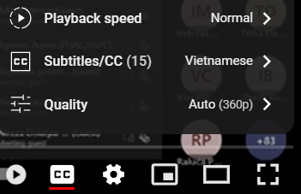
WHONET Webinar Series
You can find the recording, slides, and additional resources on the WHONET website by clicking on “Webinars” on the main menu.
  Or you can use the direct link:
    https://whonet.org/webinars.html
  We have translated our previous webinar into 18 additional languages which are available through the “closed caption” settings of the video on YouTube:
    https://www.youtube.com/watch?v=sJNjO0TQcwA
    Click on “CC” to turn “Closed Captions” on and off.
    Use the “Configuration” icon to choose the desired language.
    Afrikaans, Arabic, Chinese (Simplified and Traditional), Farsi, French, German, Indonesian, Japanese, Korean, Lao, Malay, Portuguese, Russian, Spanish, Turkish, Ukrainian, Vietnamese.
Demonstration of the WHONET Webinar website

Slide 5
Multidrug resistance
When an organism is resistant to several antibiotics, then we describe it as “multidrug resistant”.
  However, a variety of definitions have been proposed over time for different organisms and for different purposes.
Clinical consequences: There are impacts on therapy decisions for individual patients, for treatment guidelines, and for formulary decisions.
  Increased morbidity and mortality
  Increased healthcare costs because of documented MDR
  Increased healthcare costs because of the concern about possible MDR
  Increased use of agents with higher toxicities (aminoglycosides, chloramphenicol)
Epidemiological insights: Monitoring multidrug resistance profiles can be utilized for recognizing and tracking “phenotypic clones”.
  Phenotypic monitoring is valuable for recognizing new strains and for the detection of possible community and hospital outbreaks
  Phenotypes do not provide the same level of detail as genotypes, but the results are low cost and routinely available. Molecular typing can be performed to confirm problems suggested by the phenotypes.

Slide 6
Morbidity and mortality due to MDR
In the absence of antibiotic treatment, one would generally expect the morbidity and mortality associated with infections due to resistant bacteria and due to susceptible bacteria to be similar.
  The primary difference between infections due to susceptible bacteria and resistant bacteria is in the availability and cost of effective treatment options, not in pathogenicity
  Morbidity and mortality are higher in resistant infections because of the use of ineffective antibiotics, either because of: 1) lack of diagnostic testing or; 2) lack of access to effective agents.
  Examples: Mycobacterium tuberculosis, Neisseria gonorrhoeae, Escherichia coli, Acinetobacter baumannii
However, there is an increasing number of examples where multidrug-resistant bacteria are also more virulent and transmissible than susceptible bacteria.
  Virulence factors are also determined by genetic elements that can be transferred on plasmids and pathogenicity islands, and these can be linked to resistance genes. The consequence is a rise in organisms that are both more virulent and more difficult to treat.
  Examples include MRSA, Escherichia coli ST131, and Salmonella Typhimurium DT104

Slide 7
Conceptual difference between single-drug resistance, multi-drug resistance, and “pan-drug” resistance
The microbiology laboratory can guide you in selecting an effective drug.
  Susceptible strains can be treated with any antibiotic generally recognized as effective for the infection.
  With single drug resistance, most antibiotics would work except for one. Antimicrobial susceptibility testing (AST) can indicate which drug to avoid.
  With multi-drug resistance, AST takes on increasing importance to determine which drugs would and would not work.
The microbiology laboratory can only confirm the problem – there is no effective drug available.
  With resistance to all locally available drugs, AST can only provide confirmation. It is important to work with pharmacies and drug procurers to ensure the availability of effective agents, perhaps expanding the essential drugs list.
  With resistance to all commercially available drugs, AST can only provide confirmation. This is a major challenge for the pharmaceutical industry.

Slide 8
Definitions of Multidrug resistance
Over the years, a number of definitions for “multidrug resistance” have been proposed.
Some have been well-standardized and accepted in the international literature
  Mycobacterium tuberculosis:
    MDR TB = Multidrug-resistant TB = “Resistant to at least isoniazid and rifampin”
    XDR TB = Extensively drug-resistant TB = “Resistant to isoniazid, rifampin, a fluroquinolone, and a second-line injectable (amikacin, capreomycin, and kanamycin) OR Resistant to isoniazid, rifampin, a fluroquinolone, and bedaquiline or linezolid” (CDC definition)
  Neisseria gonorrhoeae
    MDR = resistant to one of the category I antibiotics (injectable extended spectrum cephalosporins, oral extended-spectrum cephalosporins, and spectinomycin) and at least two of the category II antibiotic classes (penicillins, fluoroquinolones, azithromycin, aminoglycosides and carbapenems)
    XDR: resistant to two or more of the antibiotic classes in category I and three or more in category II
  Salmonella spp.
    Resistance profiles are often presented with results from AMP, CHL, STR, SUL, TCY (ACSSuT)
    ACCSuT + Fluoroquinolone
  Routine bacterial pathogens: 2012 paper from Magiorakis et al. led by the ECDC with proposed definitions for MDR, XDR, and PDR

Slide 9
MDR/XDR/PDR definitions from 2012 paper
Magiorakis et al. Multidrug-resistant, extensively drug-resistant and pandrug-resistant bacteria: an international expert proposal for interim standard definitions for acquired resistance, Clin Microbiol Infect 2012 Mar; 18(3):268-81.
Organisms included: Staphylococcus aureus, Enterococcus spp., Enterobacteriaceae, Pseudomonas aeruginosa, and Acinetobacter spp.
Definitions
  MDR: Non-susceptible to at least 1 agent in ≥3 antimicrobial categories in the relevant table
  XDR: Non-susceptible to at least 1 agent in all but 2 or fewer antimicrobial categories in the table
  PDR: Non-susceptible to all agents in all antimicrobial categories in the table
Some problems with the ECDC definitions
  The testing recommendations for XDR and PDR are not practical for routine clinical laboratories
    “Possible XDR” and “Possible PDR”
  There is no clear correlation between MDR/XDR/PDR category and treatment outcomes
  Possible update to 2012 paper: Working group of the EU-US Transatlantic Taskforce on Antimicrobial Resistance (TATFAR)
Note – There is an incorrect comment in the definition of XDR, which has been confirmed by ECDC staff. PDR is a subset of XDR, which is a subset of MDR.

Slide 10
Newer proposals for monitoring MDR
These definitions are often customized to local or national treatment guidelines and formularies.
  They may have more practical relevance since they more closely reflect routine test practices and pharmacy formularies
  They may be more relevant with regards to decisions on antimicrobial policy and essential drug lists
  They may have more direct correlation with treatment outcomes
  May be valuable for the design of clinical trials focused specifically on treatment alternatives for infections with multi-resistant pathogens
Examples:
  UDR = Usual Drug Resistance: From GARDP: “Usual drug resistance describes isolates that are not fully susceptible wild-type strains but that can nonetheless be readily treated with standard therapies.”
  DTR = Difficult-to-Treat Resistance. Example from the 2015 CDC definition for Gram-negative bacteremia: “intermediate or resistant to all reported agents in carbapenem, beta-lactam, and fluoroquinolone categories (including additional agents when results are available)”
    DTR for urinary pathogens = “Resistant to all carbapenem, beta-lactam, and fluoroquinolones plus nitrofurantoin and trimethoprim/sulfamethoxazole”
    DTR with oral agents

Slide 11
WHONET features for analysis of multidrug resistance
Antibiograms
Scatterplots
Resistance profiles
Cluster detection
Correlation of phenotypes and genotypes

Slide 12
WHONET Antibiograms for MDR
Create a typical antibiogram
Filter on relevant antibiotic test results
Examples:
  Demonstration: Antibiogram for MRSA
  Demonstration: Antibiogram for Gram-negative organisms resistant to at least one third-generation cephalosporin (resistance within one antibiotic subclass)
  Antibiogram for Gram-negative organisms resistant to amikacin, ceftriaxone, and piperacillin/tazobactam (resistance across drug classes and subclasses)

Slide 13
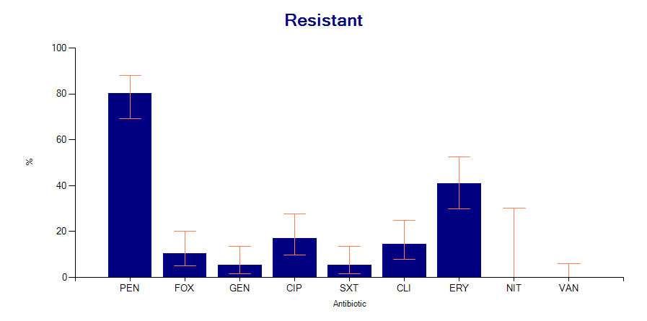
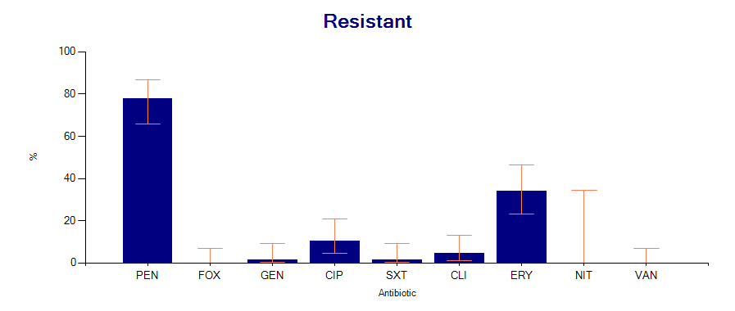
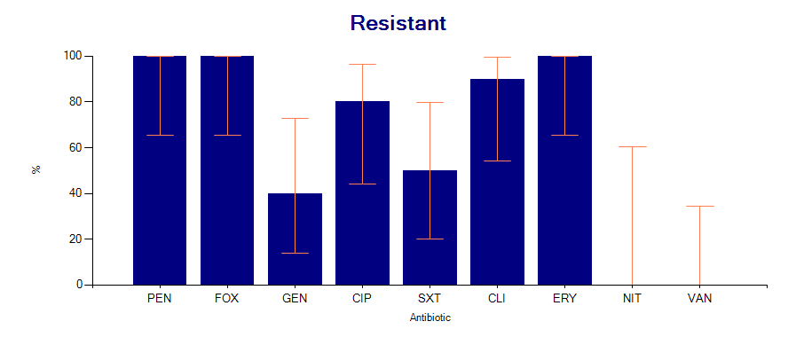
Staphylococcus aureus - %Resistant
All S. aureus
(N = 76)
MSSA
(N = 68)
MRSA
(N =10)

Slide 14
Scatterplot
In a scatterplot, we compare the results of two antibiotic tests.
  Antibiotics of the same class: Escherichia coli with cefotaxime and ceftazidime. Useful for the phenotype classification of ESBLs and development of treatment guidelines.
  Antibiotics of different classes: Staphylococcus aureus with oxacillin (MIC) and ciprofloxacin. Useful for exploring linkage of genes and development of treatment guidelines
  Two test methods:
    Klebsiella pneumoniae with imipenem disk and imipenem MIC (same antibiotic). Useful for confirming important results
    Streptococcus pneumoniae with oxacillin disk and penicillin MIC (different antibiotics). Useful for confirming important results
The scatterplot can be done in two ways:
  Using test measurements (zone and MIC measurements) – Useful to infection control and molecular epidemiologists for recognizing subpopulations
  Using test interpretations (RIS) – Useful to the pharmacy in evaluating treatment alternatives. Also useful for inferring possible resistance mechanisms.

Slide 15
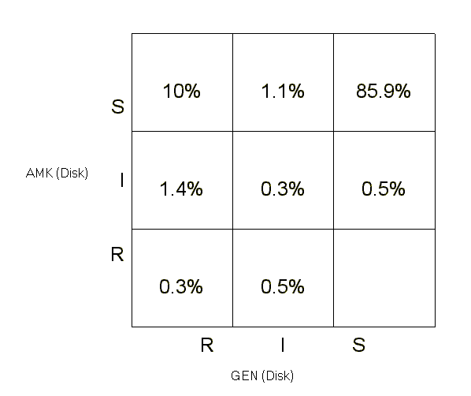
Scatterplot – Klebsiella pneumoniae
Gentamicin and amikacin interpretations
Correction conclusions
  Both GEN and AMK are very effective
  AMK is more effective than GEN – by approximately 10%
Incorrect conclusion
  AMK is always a better choice than GEN
A better conclusion
  GEN is a good first line agent for non-life-threatening community infections
  AMK would be a more appropriate choice for ICU patients and life-threatening community infections
Quality comment: None of isolates are AMK-R and GEN-S. Such findings could be true, but they could also suggest a problem in test quality.

Slide 16
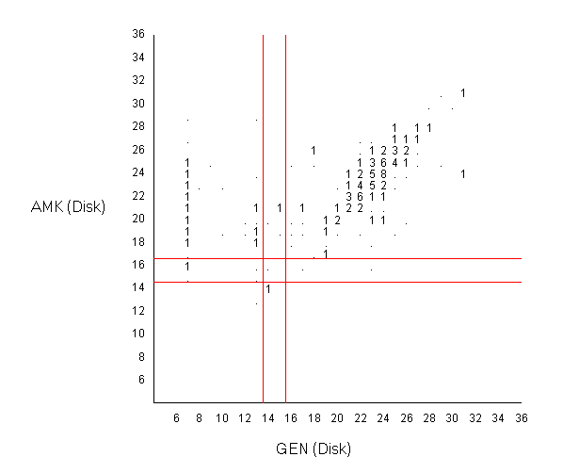
Scatterplot – Klebsiella pneumoniae
Gentamicin and amikacin measurements
There seem to be three large phenotypic groups, one smaller one, and some outliers
  Group A – Susceptible “Wild Type”
  Group B – High-level resistance to GEN and small decrease in AMK susceptibility
  Group C – Borderline resistance to GEN and decreased AMK susceptibility
  Group D – Borderline resistance to GEN and AMK
Group B
Group A
Group C
Group D
Quality comment: None of isolates are AMK-R and GEN-S. Such findings could be true, but they could also suggest a problem in test quality.

Slide 17
Scatterplot
Demonstration
Example: Staphylococcus aureus
  Comparison of PEN and OXA
  Comparison of OXA and ERY

Slide 18
Multidrug resistance in WHONET
Two approaches
ECDC approach
  Consider the number of antibiotic categories that the organism is resistant and susceptible to
  Especially valuable for advocacy purposes and monitoring MDR over time
WHONET approach
  Consider specifically which antibiotics each isolate is resistant and susceptible to
  Especially value for phenotype monitoring and outbreak detection

Slide 19
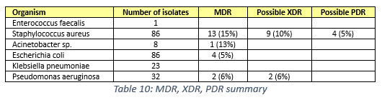
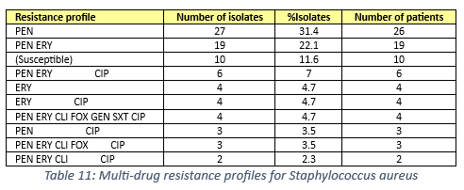
Two approaches for tracking MDR
ECDC Paper
WHONET Resistance profiles
MRSA
MRSA

Slide 20
Selecting the antibiotics for the “Resistance profile” analysis
WHONET has two similar concepts – “Panels” and “Profiles”
  Panels: The antibiotics defined in the “Panels” are used in Data entry. You select the antibiotics that you frequently test, either as first-line or second-line antibiotics.
  Profiles: The antibiotics defined in “Profiles” are used in Data analysis to define multidrug resistance. It is usually a subset of the “Panel” antibiotics.
You can define the antibiotics for the resistance profiles in one of two ways:
  Manually – You select the antibiotics that should be included
  Automatic configuration – WHONET will select antibiotics for you
    But after an automatic configuration, we suggest that you manually review them, and you may wish to make some modifications.

Slide 21
Defining resistance profile antibiotics manually
Go to “Modify laboratory”, “Antibiotics”, “Profiles”, and select one of the organism groups, such as “Staphylococcus spp.”
Then choose the antibiotics that you want to include.
  The most important criterion is frequency of testing. You should only include antibiotics that are regularly tested. You can get this information from the %RIS analysis.
  Ideally, each of the antibiotics selected should be tested at least 95% or 98% of the time, but there is no specific threshold.
    For purposes of outbreak detection, you do not want to exclude too many isolates with incomplete results because you might miss the outbreak.
    For purposes of general recognition of phenotype groups, then a lower threshold could still be reasonable
  For the number of antibiotics in the resistance profile, there is no specific minimum number, but we usually try to include somewhere between 6 and 10 antibiotics, but this is not always possible.

Slide 22
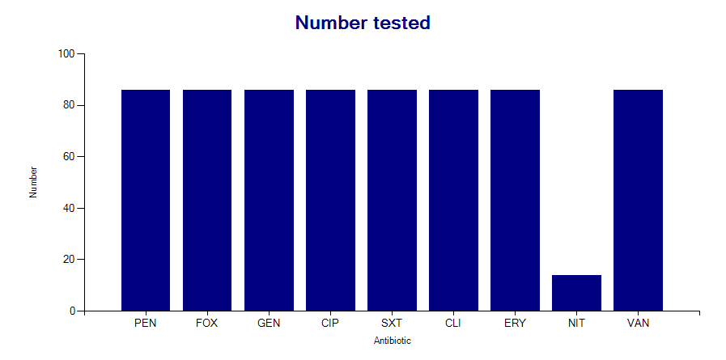
Selection of resistance profile antibiotics
Staphylococcus aureus – Disk diffusion results
Include
PEN
FOX
GEN
CIP
SXT
CLI
ERY
Exclude
NIT – infrequently tested
VAN – No validated breakpoints

Slide 23
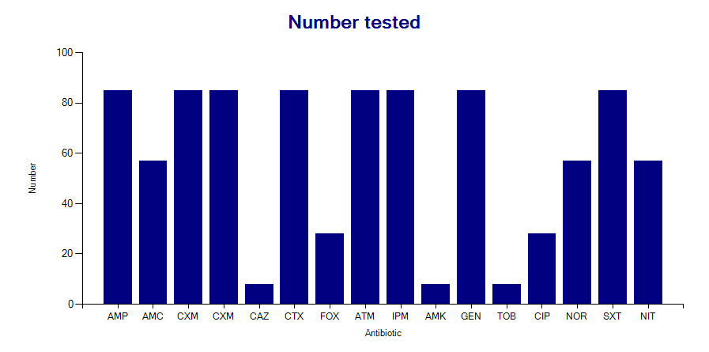
Selection of resistance profile antibiotics
Escherichia coli – Disk diffusion results
Include
AMP
CXM
CTX
ATM
IPM
GEN
SXT
Exclude – incomplete testing
AMC, NOR, NIT – tested only in urine
FOX, CIP – tested only in non-urine
CAZ, AMK, TOB – second line testing

Slide 24
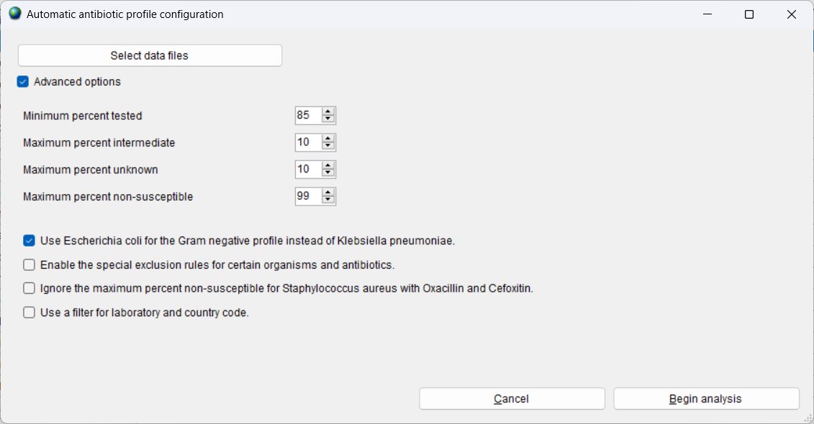
Additional criteria for selecting profile antibiotics
Include “interesting” drugs and exclude “uninteresting” or unreliable drugs
Exclude drugs that are very similar – unless the differences are believable and interesting, e.g. IPM and MEM…. Or CIP and LVX
Other options the configuration screen

Slide 25
Configuration of resistance profiles
Demonstration: Manual selection of profile antibiotics
Demonstration: Automatic configuration of profile antibiotics
  Review of the results and manual optimization
Feature: “Exclude isolates that are missing antibiotic results”

Slide 26
Challenges with selecting profile antibiotics
Part 1
For a single laboratory - inconsistent test practices in the laboratory
  Change of antibiotics, stock outages, day-to-day changes in testing decisions
  It will not be possible to include antibiotics are only tested as “second line”. Results will only be available for a small proportion of all isolates.
  It is a more common problem for laboratories that do disk diffusion because of the limited number of first-line antibiotics that many laboratories test. For MIC instruments, there is usually a large number of drugs tested simultaneously.
Challenges for a national data manager
  The same challenges as above
  In addition, laboratories often have different test practices. For example, some may test IPM while others may test MEM

Slide 27
Challenges with selecting profile antibiotics
Part 2
Possible “solutions”
  Decrease the number of antibiotics selected to a minimum set with consistent testing.
  Combine results for similar drugs, e.g. combine the MEM and IPM columns
    Some changes are possible in WHONET
    Other changes can be made with Microsoft Access, DB Browser for SQLite, etc.
  Establishing minimal national testing recommendations to improve comparability and completeness of results

Slide 28
Cluster detection using resistance profiles
Traditional outbreak detection typically relies solely on just a few high-level organism characteristics
  Species name: Klebsiella pneumoniae
  Single resistance characteristic: MRSA or CRE-Klebsiella pneumoniae
  Serotype: Salmonella Typhi or Salmonella Enteritidis
There are additional routine characteristics that could also be utilized but this is not done by most groups
  Resistance profiles: A standard WHONET feature
  Biochemical patterns: These could be “bionumbers” or biotypes” generated by systems such as API20E, Vitek, Microscan, and Phoenix. We did one proof-of-concept paper on this.
In a few cases, molecular typing is already performed routinely
  Enteric pathogens with PFGE (PulseNet) or Whole-Genome Sequencing
  However, the primary use of molecular typing at present is not to find outbreaks but to confirm suspected outbreaks

Slide 29
Acinetobacter baumanii
Investigation of a hospital outbreak suspected by clinical staff
Acinetobacter baumannii non-susceptible to:
AMP, CTX, CAZ, LVX, NIT, GEN, and SXT
All Acinetobacter baumannii
Month
Month
Resistance profiles can improve the sensitivity, specificity, and timeliness of outbreak detection
Notes:
29

Slide 30
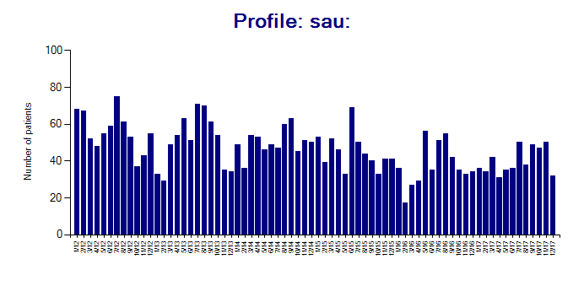
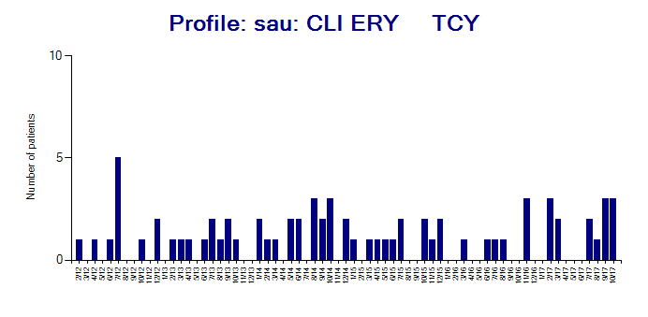
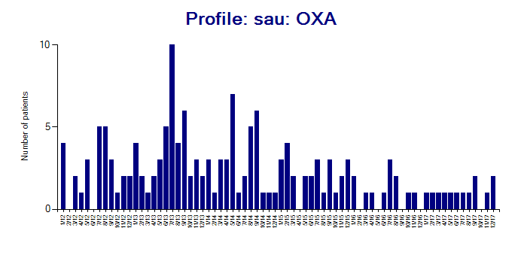
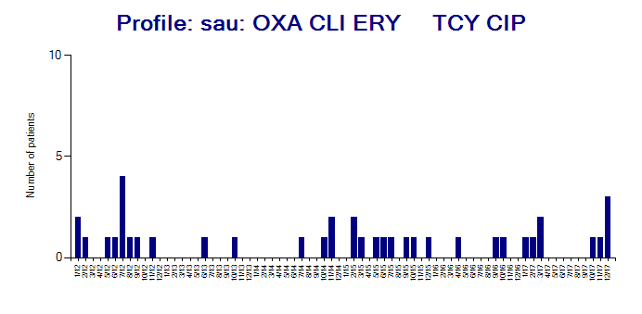
Staphylococcus aureus
Multi-resistance profiles with possible clusters 2011-2017
MSSA: Fully susceptible
MSSA: Somewhat resistant
MRSA: Mostly susceptible
MRSA: Very resistant

Slide 31
Resistance profile – Isolate listing and summary
Demonstration: Resistance profiles – manual review
  Also discussion of MDR/XDR/PDR categories
Demonstration: Cluster detection with SaTScan
  With “Resistance profile” as the location variable
  With “Location + Resistance profile” as the location variables
  The use of SaTScan (www.satscan.org) for statistical detection of case clusters will be covered in a future webinar

Slide 32
Monitoring resistance phenotypes is distinct from monitoring of resistance genotypes – but it is a useful substitute
Strains with the same resistance phenotype can have diverse genotypes.
  This is especially true for strains with “wild type” and relatively susceptible strains
Strains with the same resistance genotype can have diverse phenotypes
  This can be due to variability in gene expression or due to deficiencies in laboratory test practices.
Despite these limitations, tracking resistance phenotypes is valuable because the results are available routinely from all isolates. If there is a possible outbreak suspected, then molecular typing can be utilized for confirmation.

Slide 33
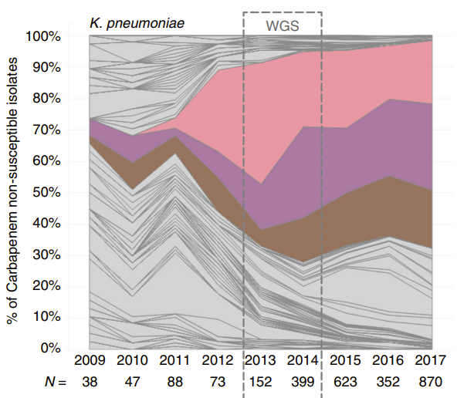
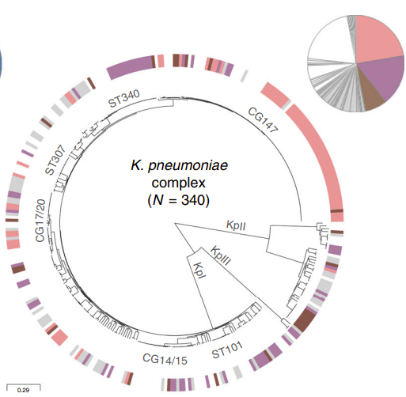
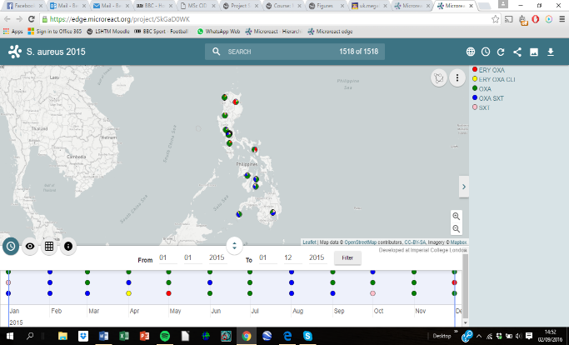

Use of resistance phenotypes to improve understanding of the molecular epidemiology of CRE-Klebsiella pneumoniae in the Philippines
Figure 4: Screenshot of Microreact File for S. aureus 2015
A representative screenshot of a Microreact File showing the geographical distribution of resistance phenotypes S. aureus in the Philippines in the year 2015.
This is a map for MRSA. The CRE K. pneumoniae graph was not available when this presentation was prepared.

Slide 34
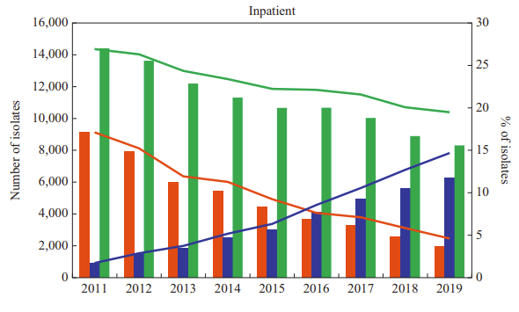
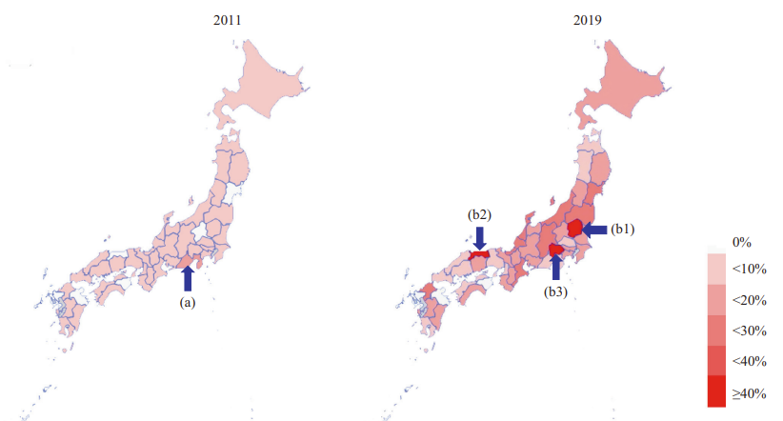
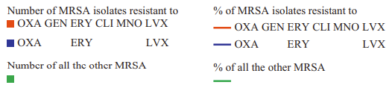
Use of resistance phenotypes to improve understanding of MRSA epidemiology in Japan

Slide 35
Thank you!

