Slide 1


WHONET and FAO InFARM
Division of Infectious Diseases, Brigham and Women’s Hospital, Boston, United States
WHO Collaborating Centre for Surveillance of Antimicrobial Resistance

Slide 2

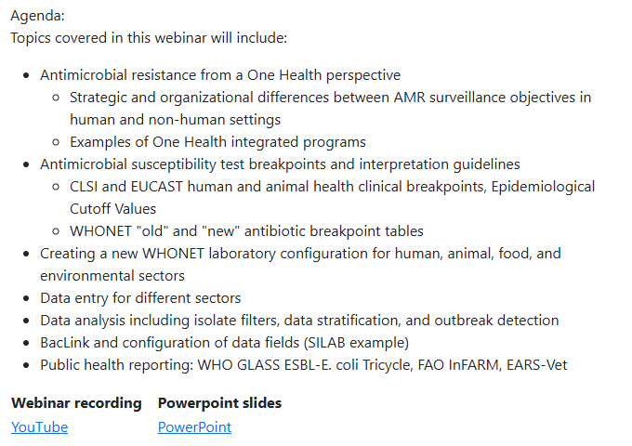
https://whonet.org/webinars.html

Slide 3
Agenda for today
WHONET Team: Key points from previous webinar
FAO Team: InFARM Overview
WHONET Team: Exporting data from WHONET to InFARM files
FAO Team: Uploading InFARM files to the FAO InFARM platform
WHONET Team: BacLink Demonstration and InFARM
Questions and answers
  You can write questions into the chat box any time. Adam will respond to some questions immediately. For others, we will respond in between presentations and after the final presentation.
  You can write to us anytime at help@whonet.org
  You can submit questions to the WHONET Discussion Form
  We can also organize follow-up trainings and support sessions

Slide 4
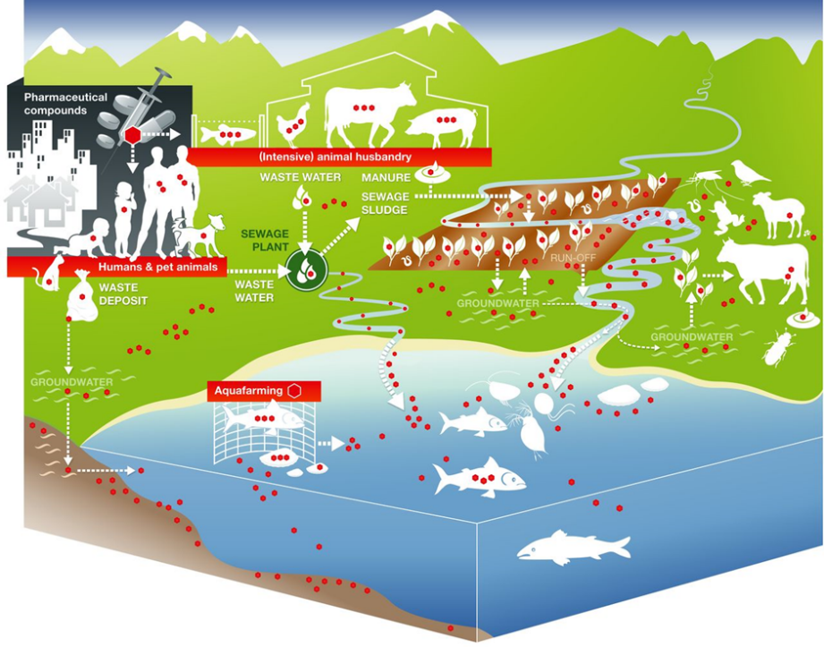
Antimicrobial use and resistance from a One Health perspective
Antimicrobial usage in humans, animals and agriculture, and resulting dispersion of antimicrobial residues into aquatic and terrestrial environments
(represented by red dots) (source: Berkner et al., 2014)
AMR drivers are selection and spread
Diverse data are needed in all spaces at all levels
Slide adapted from Dr. Jaap Wagenaar

Slide 5
WHONET and Surveillance objectives
1
A
Objectives |  | Local | National | Regional | Global
Policy and advocacy
 | Priority setting and funding | X | X | X | X
 | Awareness and education | X | X | X | X
 | Legislation and regulation |  |  | X | X
Epidemiology of resistant microbes
 | Pathogen and resistance trends | X | X | X | X
 | Recognition of emerging threats | X | X | X | X
 | Disease and economic burden | X | X | X | X
 | Benchmarking |  | X | X | X
Resistance containment
 | Treatment guidelines | X | X
 | Response to emerging threats | X | X | X | X
 | Assessment of interventions | X | X | X | X
 | New diagnostics and therapeutics |  |  | X | X
Capacity-building
 | Laboratory capacity | X | X | X | X
 | Epidemiological capacity | X | X | X | X

Slide 6
Confidentiality issues
Human health data
  Confidentiality of the person: patient identifiers (names, dates of birth, medical conditions)
  Healthcare institution confidentiality
  Societal confidentiality
Animal health and food data
  Food-producing animals: confidentiality of the farm, manufacturer, region, country, associations with food production practices
  Non-food-producing animals: region, country, societal
Environmental data
  Region, country, societal, sources of contamination and residues

Slide 7
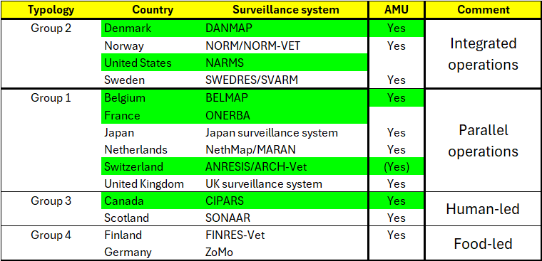
One Health Programs
Programs with interactive data portals in green
BMC Public Health. 2024 Jun 27;24(1):1717.

Slide 8
1
Antimicrobial susceptibility test breakpoints and interpretation guidelines
Notes:
1

Slide 9
Which breakpoints should I utilize for reporting and data analysis?
Human clinical breakpoints
  Appropriate for use in human samples to guide therapy decisions and treatment guidelines in human patient populations
  Appropriate for use animal, food, and environmental samples where the goal is assessment of the direct clinical consequences of infection by the microbe in human populations
  Appropriate for use in all sectors to facilitate comparison of results
Animal clinical breakpoints
  Appropriate for results from diseased animal. Also relevant for samples from healthy animals, deceased animals, food, and environmental samples where the goal is the development of treatment guidelines for diseased animals
Epidemiological Cutoff Values
  Appropriate for use in samples from any sector where the goal is the phenotypic recognition of strains with possible resistance mechanisms.
  Appropriate for use in all sectors to facilitate comparison of results
Conclusion: 1) All are relevant and needed; 2) you need zone diameter and MIC measurements to flexibly choose the breakpoints. Simple RIS categories are not sufficient.

Slide 10
Status of breakpoint development
CLSI – www.clsi.org
  Human clinical breakpoints – very well developed. M100, M45, etc.
  Animal clinical breakpoints – well developed, but primarily for dogs and cats. VET01, VET60, VET03/VET04. Limited number of priority antimicrobial breakpoints for food-production animals
  Epidemiological Cutoff Values (ECVs) – very few.
EUCAST – www.eucast.org
  Human clinical breakpoints – very well developed, EUCAST Excel and PDF files
  Animal clinical breakpoints – a very small number have been published to the VetCAST website
  Epidemiological Cutoff Values (ECOFFs) – many MIC and Disk ECOFFs, but undergoing ongoing reviews and revisions. Publication of ECOFFs and TECOFFs (Tentative ECOFFs). Available on the EUCAST website
Because of the incomplete availability of breakpoints:
  For comparison across sectors, data analysts will often use human breakpoints or ECOFFs
  For diseased animal clinical breakpoints, CLSI is a good option – especially for cats, dogs, horses, and bovine mastitis
  For ECOFFs, EUCAST is a good option. These values are also relevant for CLSI MIC results and – if CLSI uses the same disk potencies – for CLSI disk diffusion results

Slide 11
Where to find the breakpoints?
CLSI: www.clsi.org
EUCAST: www.eucast.org
  VetCAST: https://www.eucast.org/vetcast
Web page review

Slide 12
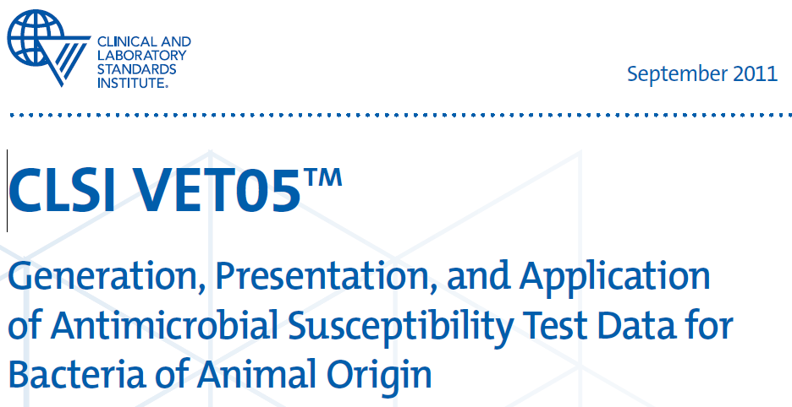
CLSI VET05 Report

Slide 13
2
FAO InFARM Presentation
See separate slideset
Notes:
1

Slide 14
2
Exporting data from WHONET to InFARM files
Notes:
1

Slide 15
2
InFARM priority fields
There are three priority and mandatory fields for FAO InFARM reporting
Data year
  2020, 2024, 2026, etc.
Data representativeness
  PILOTLOC, PILOTNAT, SYSTEMATIC
Surveillance program
  Healthy animals and food: ANIMPH, AQUAPH, FOODPH
  Diseased animals: ANIMAH, AQUAAH
Notes:
1

Slide 16
2
Presence or absence of InFARM priority fields in the WHONET file
Data year (2020, 2024, 2026, etc.): If all of the data in a WHONET file are from the same year, then “Data year” does not need to be in the WHONET file. You can tell WHONET when you export the data. But if the data come from different years, then “Data year” must be in the WHONET file.
Data representativeness (PILOTLOC, PILOTNAT, SYSTEMATIC): If all of the data in a WHONET file have the same “Data representativeness”, then this information does not need to be in the WHONET file. You can tell WHONET when you export the data. But if the information is mixed, then “Data representativeness” must be in the WHONET file.
Surveillance program (ANIMPH, ANIMAH, AQUAPH, AQUAH, FOODPH): If all of the data in a WHONET file are from the same “Surveillance program”, then this information does not need to be in the WHONET file. You can tell WHONET when you export the data. But if the information is mixed, then “Surveillance program” must be in the WHONET file.
Notes:
1

Slide 17
3
New WHONET-InFARM Validation Report
Demonstration
Notes:
1

Slide 18
2
FAO InFARM Upload presentation
See separate presentation
Notes:
1

Slide 19
4
BacLink and InFARM
Notes:
1

Slide 20
1
Laboratory data management systems
A
Many laboratories in the world continue to rely on paper notebooks to management their microbiology test results. For these laboratories, WHONET could be a very appropriate system for clinical reporting and data analysis.
  However, BacLink is not needed since there is no local IT system
Most laboratories do have some data system in place:
  Very simple desktop applications, such as Microsoft Excel. This is common in low-resource settings. It is also common for special research projects and protocols.
  Laboratory instruments
    MIC instruments: Vitek, BD Phoenix, MicroScan, Sensitire, etc.
    Disk diffusion camera systems (some of which can also read MIC plates): SIRScan, Biomic, etc.
  Laboratory Information Systems
    Locally developed versus national versus international
    Free versus commercial
    Some systems only cover microbiology test results, while others also support other clinical laboratory areas, such as blood bank, hematology, and biochemistry

Slide 21


1
The purpose of BacLink
A
Situation: Laboratories around the world have diverse systems that serve important functions for day-to-day laboratory, clinical reporting, medical archives, and billing. However, these systems are incompatible and usually have minimal capabilities for data analysis and public health reporting.
Opportunity: Staff have taken the time and effort to computerize laboratory results on a daily basis. If we can extract these data into compatible systems, we have the basis of a low-cost, sustainable, real-time system for surveillance, alerts, and action.
Purpose of BacLink – Transformation of data exported from diverse existing and incompatible systems into standardized WHONET files for purposes of analysis, sharing, and public health reporting.
BacLink
Incompatible local systems
Standard WHONET files

Slide 22
1
Getting data from your system into WHONET
A
Step 1: Export data from your system
Step 2: Examine your data file: contents and structure
Step 3: Configure BacLink to understand your data file structure and codes
Step 4: Use BacLink to convert your data into WHONET files
Step 5: Getting started with WHONET
Optional - Step 6: Automated daily downloads and conversions

Slide 23
1
Step 2. Examine your data file
A
Content: Is the desired information in the data extract?
  Patient and animal: Name, Patient/Animal ID, Sex, Age/Date of Birth, Date of admission
  Location: Sampling location
  Specimen: Specimen date, Specimen type, Specimen number
  Organism: Organism
  Antibiotic results: Name, interpretation, method, measurement
  For FAO InFARM: Data year, Data representativeness, Surveillance program
  Other (but often not available): Diagnosis, Physician, Gram stain, etc.
Format: Are the data elements nicely structured?
  Simple rows and columns
  Try to avoid “Free text” and inconsistencies in date formats
  Each data element should be in its own cell. Don’t put more than one organism or more than one antibiotic result into a single cell
Collaborate with the IT developers until you are satisfied with the data content and data format

Slide 24
5
Importing SILAB data into WHONET
Demonstration
Notes:
1

Slide 25
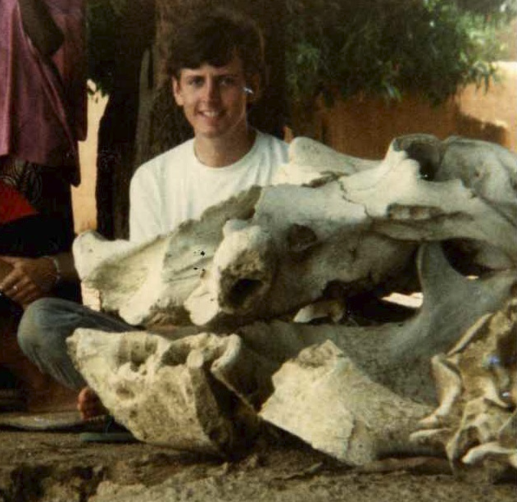
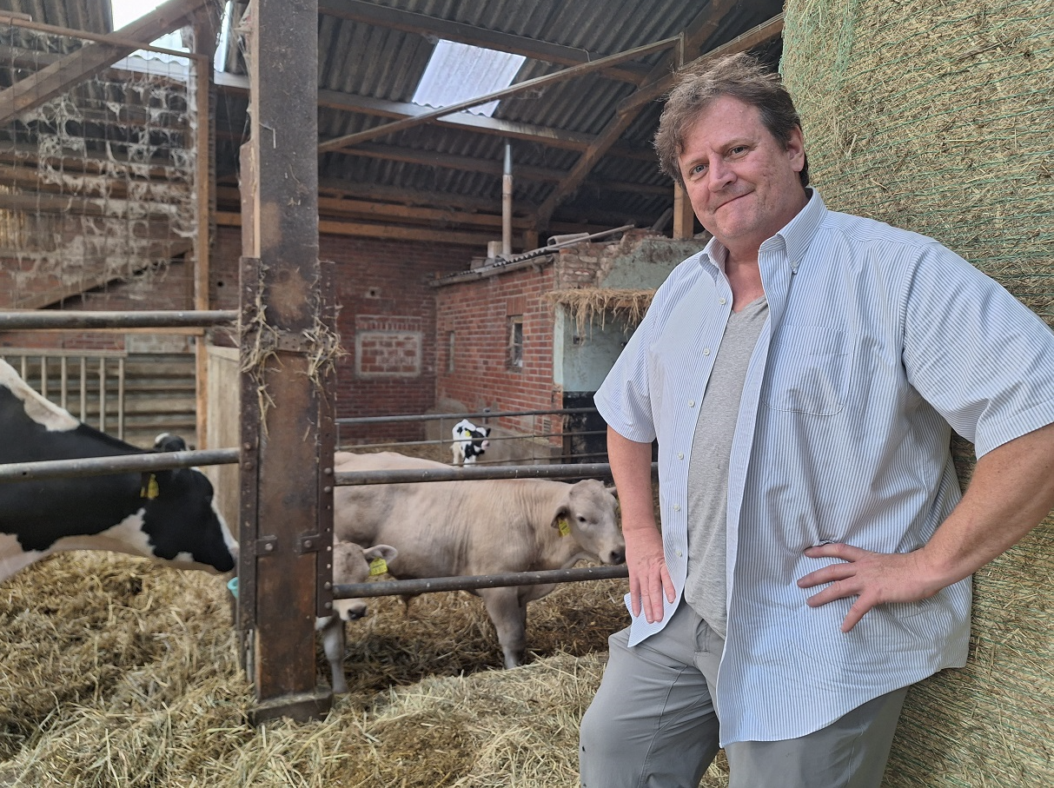
Aw ni baara…. Aw ni baaraji!
Thank you!!!

