Slide 1


WHONET and One Health Applications
Division of Infectious Diseases, Brigham and Women’s Hospital, Boston, United States
WHO Collaborating Centre for Surveillance of Antimicrobial Resistance

Slide 2
Agenda
Antimicrobial resistance from a One Health perspective
  Strategic and organizational differences between AMR surveillance objectives in human and non-human settings
  Examples of One Health integrated programs
Antimicrobial susceptibility test breakpoints and interpretation guidelines
  CLSI and EUCAST human and animal health clinical breakpoints, Epidemiological Cutoff Values
  WHONET “old” and “new” antibiotic breakpoint tables
WHONET
  Laboratory configuration for different sectors
  Data entry for different sectors
  Data analysis including isolate filters, data stratification, and outbreak detection
  Public health reporting: FAO InFARM, WHO GLASS ESBL-E. coli Tricycle, EARS-Vet
BacLink
  Importing data with BacLink – SILAB example

Slide 3
1
Antimicrobial resistance from a One Health perspective
Notes:
1

Slide 4
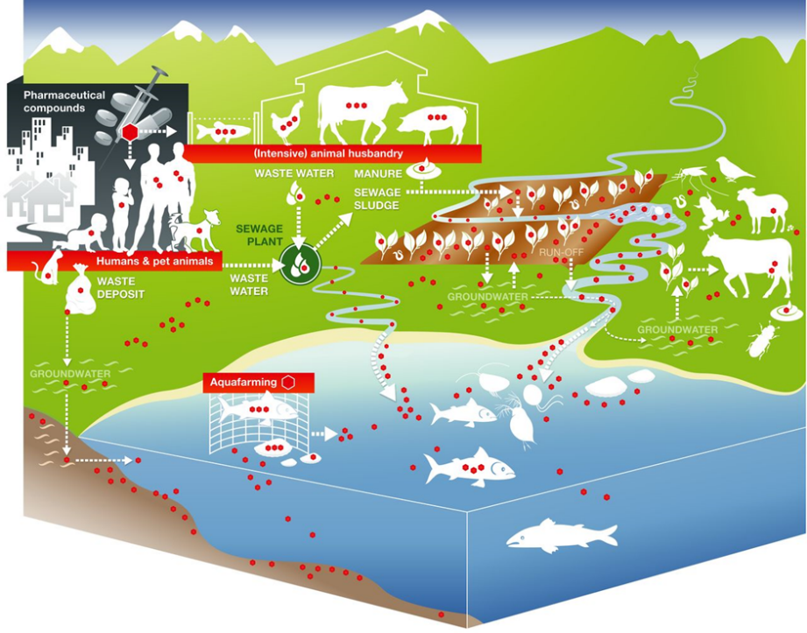
Antimicrobial use and resistance from a One Health perspective
Antimicrobial usage in humans, animals and agriculture, and resulting dispersion of antimicrobial residues into aquatic and terrestrial environments
(represented by red dots) (source: Berkner et al., 2014)
AMR drivers are selection and spread
Diverse data are needed in all spaces at all levels
Slide adapted from Dr. Jaap Wagenaar

Slide 5
EPIDEMIOLOGY OF ANTIMICROBIAL RESISTANCE
Fuel & Potable Ethanol
AQUACULTURE
Fuel Ethanol Producers
Sea / Lakes
Swimming
Drinking Water
Distillers Grain By-Products
Drinking water
Rivers and Streams
Industrial &
Household
Antibacterial
Chemicals
Land Fill
SOIL
Farm Effluents and Manure Spreading
Sewage
Dead stock
WILDLIFE
Rendering
Offal
Vegetation,
Seed Crops, Fruit
SWINE
HUMAN
SHEEP
CATTLE
HOSPITALIZED
COMMUNITY
- URBAN
-RURAL
Animal
Feeds
Re-mix
FOOD ANIMALS
Commercial
Abattoirs /
Processing
Plants
Handling
Preparation
Consumption
VEAL
CALVES
Meat
EXTENDED
CARE
FACILITIES
POULTRY
TRAVELLERS
OTHER
FARMED
LIVESTOCK
COMPANION
ANIMALS
Direct
Contact
After Linton AH (1977), modified by Irwin RJ - 2012 version
IMPORTS

Slide 6

WHONET and Surveillance objectives
1
A
Objectives |  | Local | National | Regional | Global
Policy and advocacy
 | Priority setting and funding | X | X | X | X
 | Awareness and education | X | X | X | X
 | Legislation and regulation |  |  | X | X
Epidemiology of resistant microbes
 | Pathogen and resistance trends | X | X | X | X
 | Recognition of emerging threats | X | X | X | X
 | Disease and economic burden | X | X | X | X
 | Benchmarking |  | X | X | X
Resistance containment
 | Treatment guidelines | X | X
 | Response to emerging threats | X | X | X | X
 | Assessment of interventions | X | X | X | X
 | New diagnostics and therapeutics |  |  | X | X
Capacity-building
 | Laboratory capacity | X | X | X | X
 | Epidemiological capacity | X | X | X | X

Slide 7
Regulatory approaches for restricting the use of growth promoters in food-producing animals
“Precautionary principle”
  “philosophical and legal approach to innovations with potential for causing harm when extensive scientific knowledge on the matter is lacking. It emphasizes caution, pausing and review before leaping into new innovations that may prove disastrous” (Wikipedia)
  European Union banning of growth promotion in food-producing animals in 2006.
“Demonstrated harm principle”
  “Harm principle refers to a theory of crime that an action can only be banned if it causes harm to someone”
  United States FDA banning of fluoroquinolones in poultry water in 2005
  Proposed legislation, but not passed
    “Strategies To Address Antimicrobial Resistance” Act (STAAR)
    “Pioneering Antimicrobial Subscriptions To End Upsurging Resistance” Act (PASTEUR)

Slide 8
Confidentiality issues
Human health data
  Confidentiality of the person: patient identifiers (names, dates of birth, medical conditions)
  Healthcare institution confidentiality
  Societal confidentiality
Animal health and food data
  Food-producing animals: confidentiality of the farm, manufacturer, region, country, associations with food production practices
  Non-food-producing animals: region, country, societal
Environmental data
  Region, country, societal, sources of contamination and residues

Slide 9
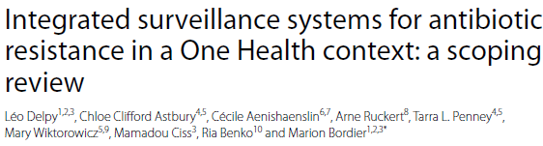
Recent review article
Information integration
  Populations and commodities under surveillance
  Antimicrobial use
  Other AMR information
Structural integration
  Supervision: Organization, Sector
  Data collection and management: Organization, Integration point
  Data analysis and interpretation: Organization, Integration point
  Communication and dissemination: Organization, Integration point
BMC Public Health. 2024 Jun 27;24(1):1717

Slide 10
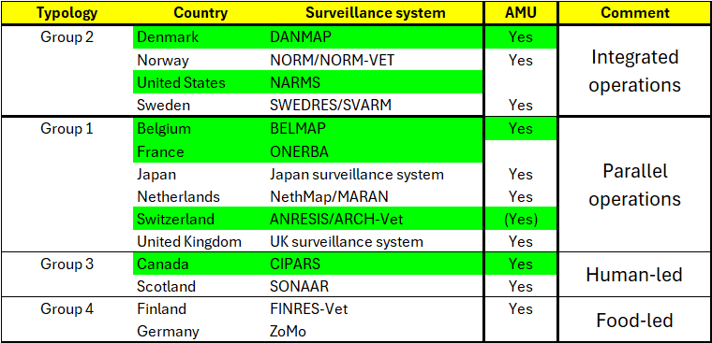
One Health Programs
Programs with interactive data portals in green
BMC Public Health. 2024 Jun 27;24(1):1717.

Slide 11
One Health interactive data portals
With Antimicrobial Use data
  Belgium: belmap.shinyapps.io/BELMAP2024_App
  Canada: www.canada.ca/en/public-health/services/surveillance/canadian-integrated-program-antimicrobial-resistance-surveillance-cipars/interactive-data.html
  Denmark: www.danmap.org
  Switzerland: www.anresis.ch/antibiotic-resistance
Without Antimicrobial Use data
  France
    Human: bigdata.onerba.org
    Animal: shiny-public.anses.fr/resapath2
  United States:
    Human: wwwn.cdc.gov/narmsnow
    Animal and Food: www.fda.gov/animal-veterinary/national-antimicrobial-resistance-monitoring-system/narms-now-integrated-data
Others not mentioned in article
  WHO GLASS, InFARM, GISSA (In development)
  Fleming Fund AMROH projects and collaborations
  Viet Nam, Bangladesh, ResistanceBank.org

Slide 12
1
Antimicrobial susceptibility test breakpoints and interpretation guidelines
Notes:
1

Slide 13
Clinical breakpoints
There is a common misperception that the purpose of routine antimicrobial susceptibility testing (AST) is to identify “resistant” bacteria.
This is not precisely the case. The primary goal is not identifying bacteria that have resistance genes but rather guiding physicians in the selection of effective treatment in infected patients.
A laboratory finding of “Susceptible” for an antibiotic suggests that most patients should respond to therapy with this antibiotic, even if some bacteria that possess a resistance gene), i.e. the microbe is clinically susceptible to the antibiotic. There are many examples of bacteria with low or moderate degrees of resistance where the patient would still respond to therapy.
In contrast, a finding of “Resistant” for an antibiotic suggests that there is a high likelihood of treatment failure, i.e. the microbe is “clinically resistant”.
The likelihood of a successful clinical outcome would thus depend not only on the resistance genes possessed by an Infar organism, but also on the pharmacokinetic/pharmacodynamic (PK/PD) parameters of the infection… and these may depend on the site of infection (meningitis, urinary track infection, etc.) and animal species (human, cat, dog, adult horse, young horse, fish, etc.).

Slide 14
Epidemiological Cutoff Values
In 1990, JD Williams proposed the concept of disk diffusion and MIC “microbiological breakpoints” to aid in the phenotypic discrimination between bacteria that possess no resistance gene to a particular antibiotic (“Wild Type”) from those that do (“Non-Wild Type”).
EUCAST developed this concept further as “Epidemiologically Cutoff Values”, abbreviated to ECOFFs by EUCAST and to ECVs by CLSI.
The goal of ECOFFs/ECVs thus is not prediction of clinical outcomes, but rather discrimination bacteria that have no phenotypic evidence of a resistance gene (“Wild Type”) and those that do (“Non-Wild Type”).
An ECOFF/ECV is a characteristic of the microbial species and is not impacted by animal species or clinical syndrome or other PK/PD considerations.
For a bacteria with a low degree of resistance, it would be common for an organism to be “microbiologically resistant” (Non-Wild Type), but “clinically susceptible”.

Slide 15
Which breakpoints should I utilize for reporting and data analysis?
Human clinical breakpoints
  Appropriate for use in human samples to guide therapy decisions and treatment guidelines in human patient populations
  Appropriate for use animal, food, and environmental samples where the goal is assessment of the direct clinical consequences of infection by the microbe in human populations
  Appropriate for use in all sectors to facilitate comparison of results
Animal clinical breakpoints
  Appropriate for results from animal (both healthy and diseased), food, and environmental samples where the goal is the development of treatment guidelines in diseased animals
Epidemiological Cutoff Valuers
  Appropriate for us in results from any sector where the goal is the phenotypic recognition of which strains have or do not have a resistance mechanism.
  Appropriate for use in all sectors to facilitate comparison of results
Conclusion: 1) All are relevant and needed; 2) you need zone diameter and MIC measurements to flexibly choose the breakpoints. Simple RIS categories are not sufficient.

Slide 16
Status of breakpoint development
CLSI – www.clsi.org
  Human clinical breakpoints – very well developed.. M100, M45, etc.
  Animal clinical breakpoints – well developed, but primarily for dogs. VET01, VET60, VET03/VET04,
  Epidemiological Cutoff Values – very few
EUCAST – www.eucast.org
  Human clinical breakpoints – very well developed, EUCAST file
  Animal clinical breakpoints – a very small number have been published to the VetCAST website
  Epidemiological Cutoff Valuers – many MIC and Disk ECOFFs, but undergoing ongoing reviews and revisions. Publication of ECOFFs and TECOFFs (Tentative ECOFFs)
Because of the incomplete availability of breakpoints:
  For comparison across sectors, data analysts will only use human breakpoints or ECOFFs
  For animal clinical breakpoints, CLSI is a good option – especially for cats, dogs, horses, and bovine mastitis
  For ECOFFs, EUCAST is a good option. These values should work for MIC results and for disk diffusion results if CLSI utilizes the same disk potencies.

Slide 17
WHONET – “old” and “new” tables for AST interpretation
“Old” approach to breakpoint management
  Based on the earlier concept for “General breakpoints” that applied to most bacterial species with a few exceptions.
  Implemented in WHONET as a mixture of data tables with the organisms, breakpoint values, and QC ranges and hard-coded rules within the WHONET source code to handle complexities, like organism hierarchies, infection-specific breakpoints, and special rules (MRSA, BLNAR, etc.)
“New” approach to breakpoint management
  All information required for interpretation is available in data tables that can be utilized by WHONET and also by other laboratory information systems.
  Able to handle the complexities of organism hierarchies, infection and animal-specific breakpoints, intrinsic resistance, special rules, ECOFFs, etc.
  Available within WHONET since 2000, and utilized by default since June 2025
How to upgrade from the “old” approach to the “new one”
  WHONET will automatically ask you
  You can select in “Laboratory configuration” or during “Data analysis” – to be covered during the demonstration

Slide 18
1
WHONET
Notes:
1

Slide 19
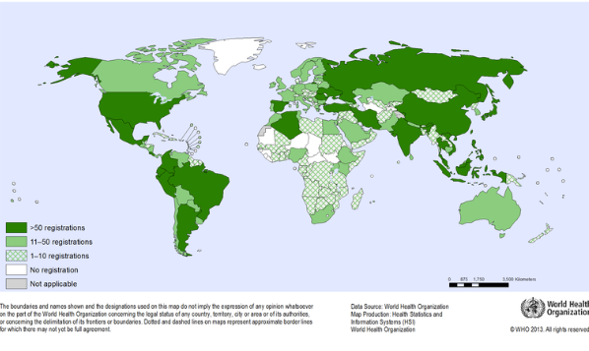
1
What is WHONET?
  WHONET is a widely-used free software developed for the management and analysis of microbiology laboratory data to support local, national, regional, and global activities to understand and fight infectious diseases with a special focus on antimicrobial resistance.
WHONET is a desktop software developed for Microsoft Windows
.
You can also run WHONET on MacOS computers utilizing a Windows partition, a Windows Virtual machine, or a Windows emulation software.
  WHONET Use Survey: https://www.surveymonkey.com/r/WHONET2026

Slide 20
1
WHONET Modules
A
  Laboratory configuration
  Data entry
    Option 1: Manual data entry
    Option 2: Import existing data with BacLink
  Data analysis
    Interactive data analysis
    Quick analysis
    Public health reporting – including InFARM… to be covered in the June 2026 webinar in collaboration with FAO

Slide 21
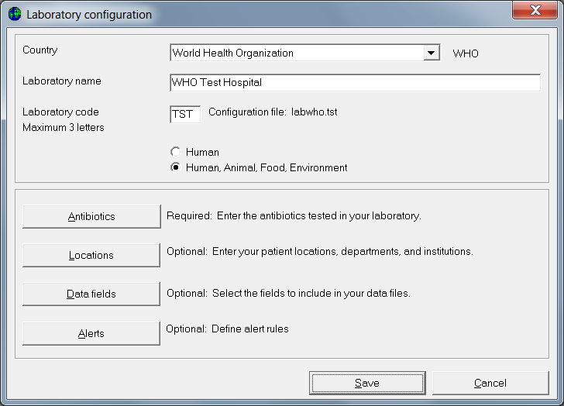
1
Laboratory configuration
A

Slide 22
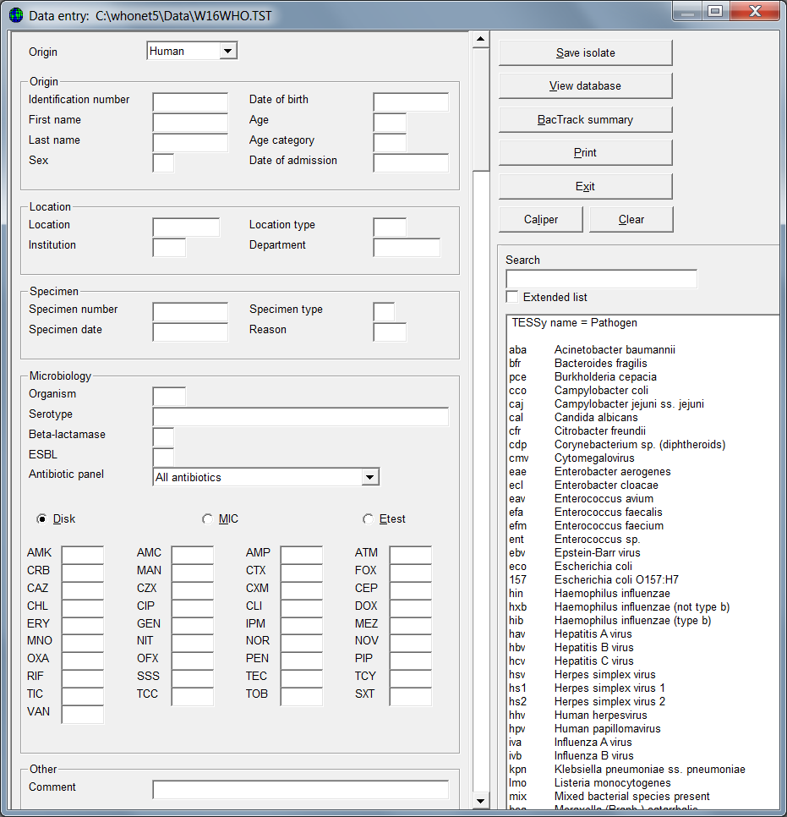
1
Data entry – Manual
A
Sector
Patient, animal, food, environmental details
Specimen location
Specimen details
Organism
Antibiotic results
Other

Slide 23
1
Data entry – Import with BacLink
A
Capturing data from existing information systems….
to be presented in the next section.

Slide 24
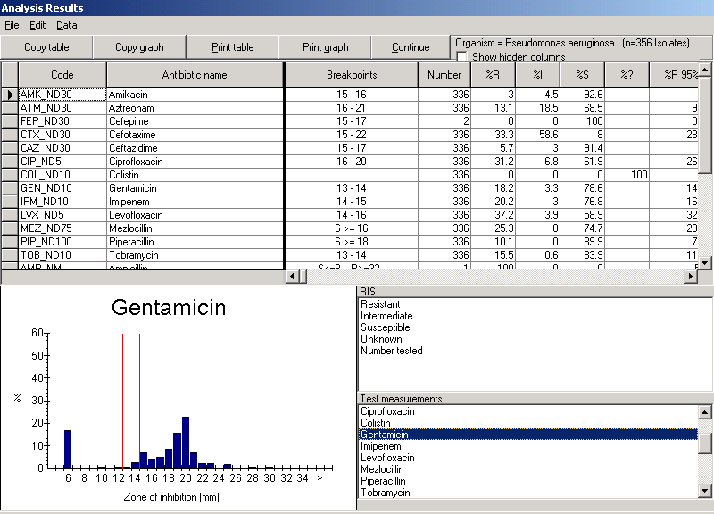
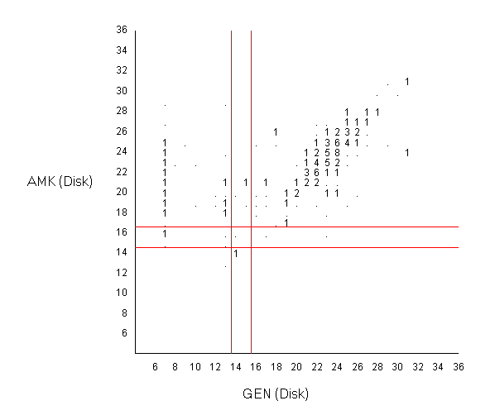
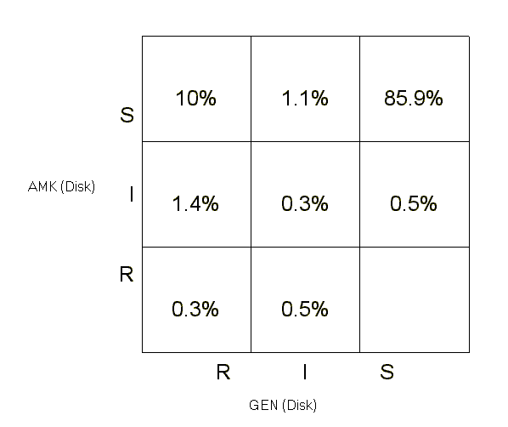
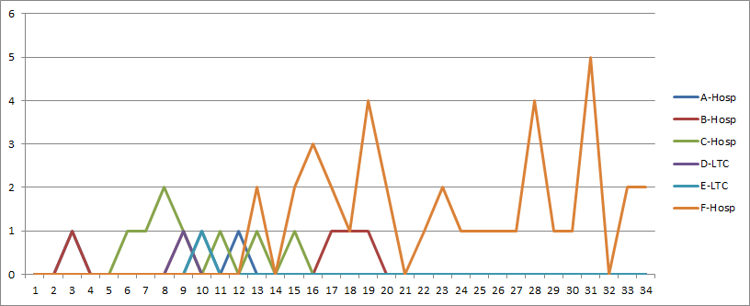
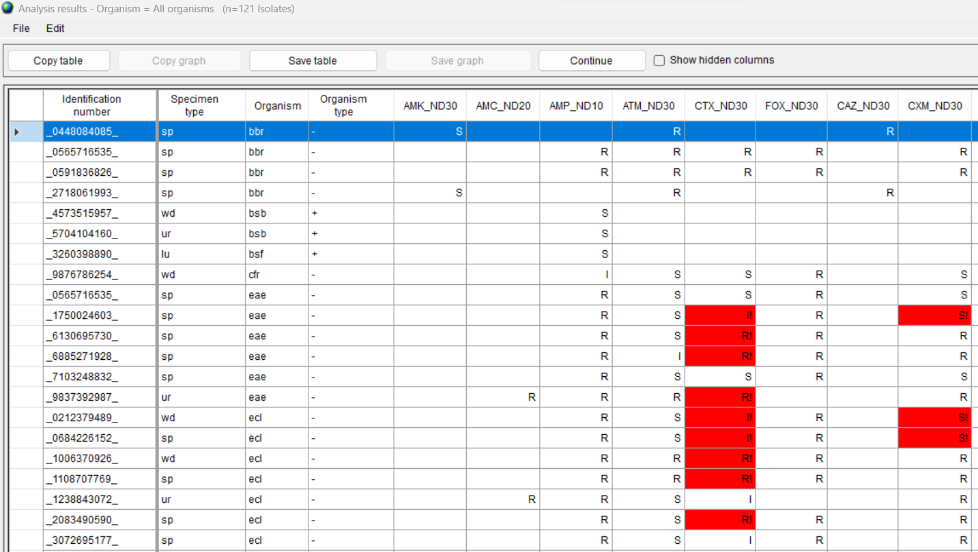
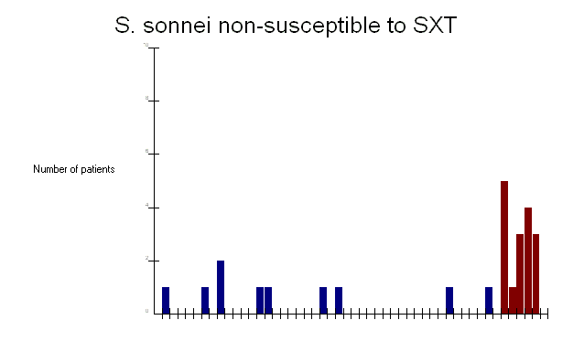
1
Data analysis, alert, and report features
A
%RIS and histograms
Scatterplot
Resistance profiles
Hospital F
Hospital C
Hospital B
Nursing homes
Microbiology alerts
Outbreak detection

Slide 25
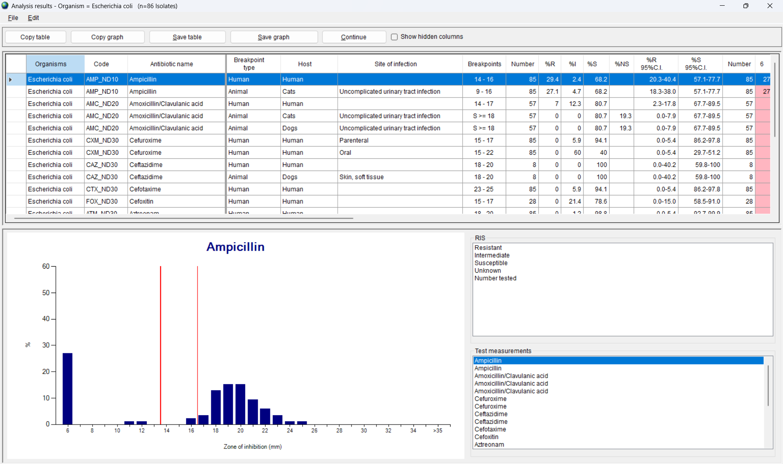
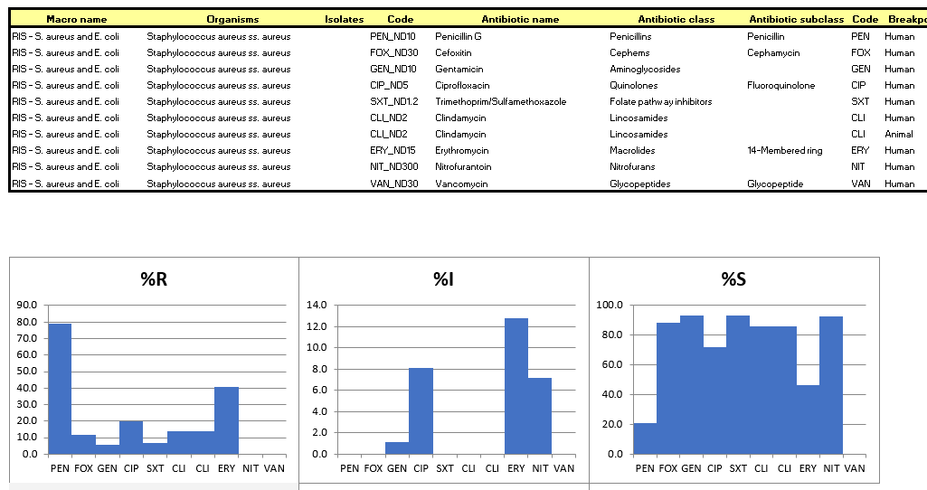
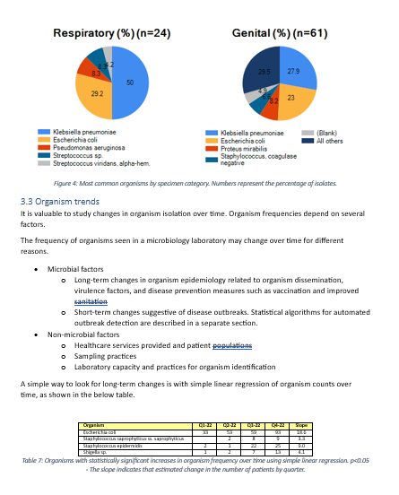
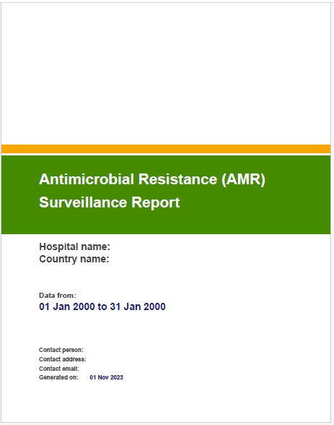
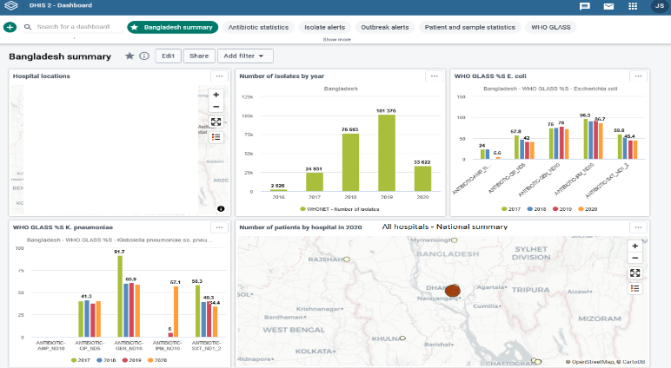
1
Quick Analysis - Output options
A
Screen
Excel
Word
PDF (AMASS)
DHIS2
www.amass.website
www.dhis2.org

Slide 26


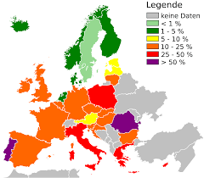
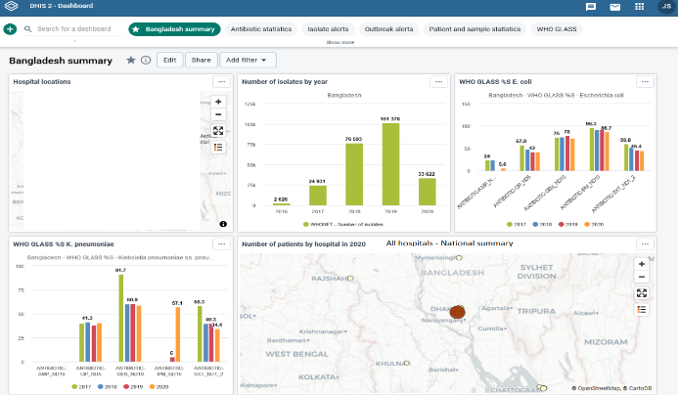
1
Data exports and interoperability
A
As mentioned in the discussion of “data imports” with BacLink, the principle of interoperability is very important to ensure efficiency, sustainability, and impact of collaborative efforts.
This is also true in data exports. WHONET has the ability to export to a number of public health reporting systems such GLASS modules (GLASS-AMR, GLASS-FUNGI, GLASS-EGASP), FAO InFARM, DHIS2, AMASS, EARS-Net, CAESAR, ASIARS-Net, MicroReact, and others.
WHO GLASS
FAO InFARM
EARS-Net
DHIS2
AMASS

Slide 27
1
Adaptations for One Health surveillance
A
  Introduced in 2001 with gradual improvements over time with support from WHO, FAO, USDA, FDA, and many others
  Expanded data field lists, code lists, and analyses
    Animal species, production types, food types, etc.
    Specimen types, pathogens, antimicrobials, etc.
    Data entry and report templates for FAO surveillance protocols, InFARM, and the WHO ESBL-producing Escherichia coli TriCycle project
  Interpretation guidelines
    CLSI Human and animal clinical breakpoints
    EUCAST Human and animal clinical breakpoints
    EUCAST Epidemiological Cutoff Values for MIC results
  Training data set with One Health results
    100 isolates each of human, animal, food, and environmental origin

Slide 28
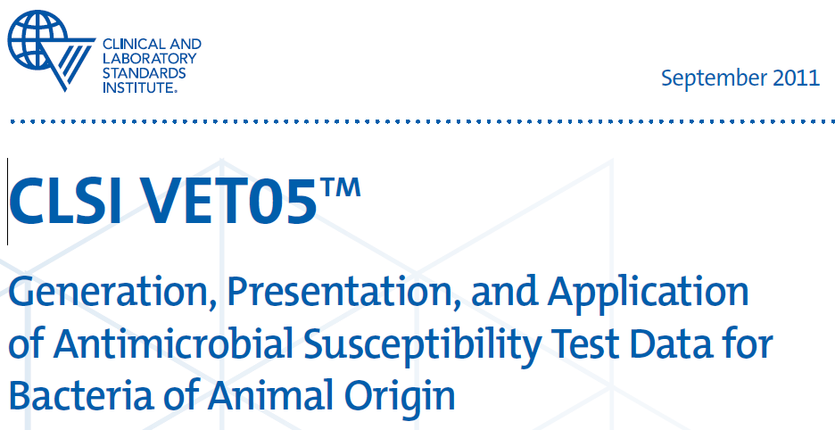
CLSI VET05 Report

Slide 29
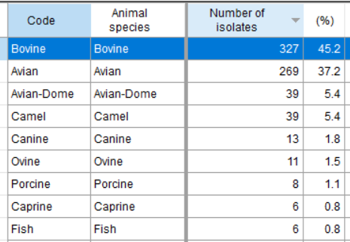
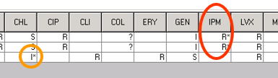
CLSI VET05 9.1 – Isolate listings for important or unlikely phenotypes
Isolate listing summaries
Objectives
  Identification of results of clinical and public health significance
  Identification of possible errors in organism identification or susceptibility test results
  Summaries of sample/patient demographics by animal species, location, organism, specimen type, and time
Examples
Most common animal species
Microbiology alerts

Slide 30
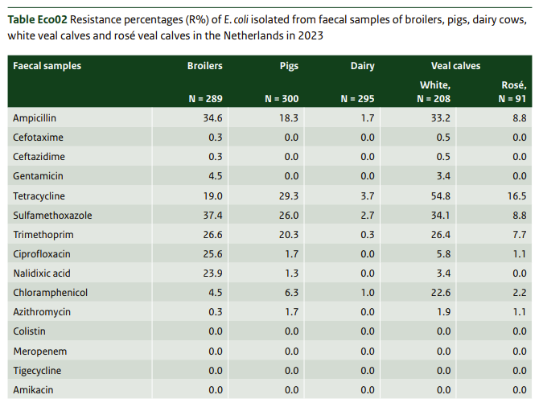
CLSI VET05 9.2 – Statistics for Susceptibility Test Interpretations
Objectives
  Antibiogram summaries: Monitoring of trends, treatment guidelines, benchmarking, quality improvement, hypothesis testing and risk factor identification, monitoring impact of interventions
Example

Slide 31
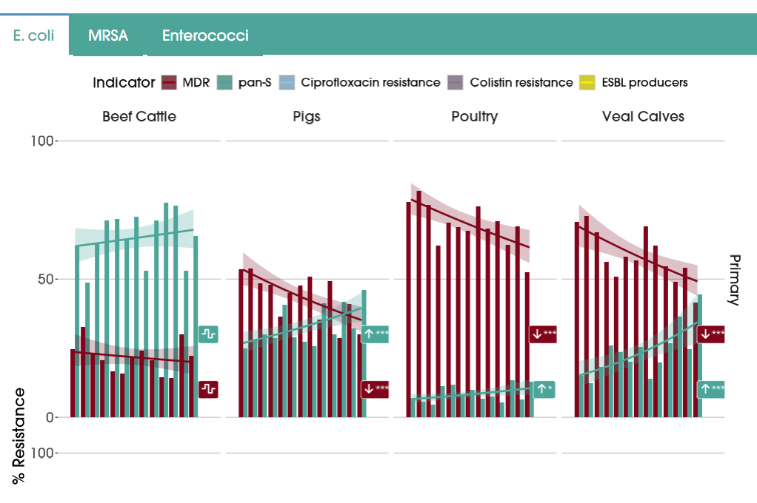
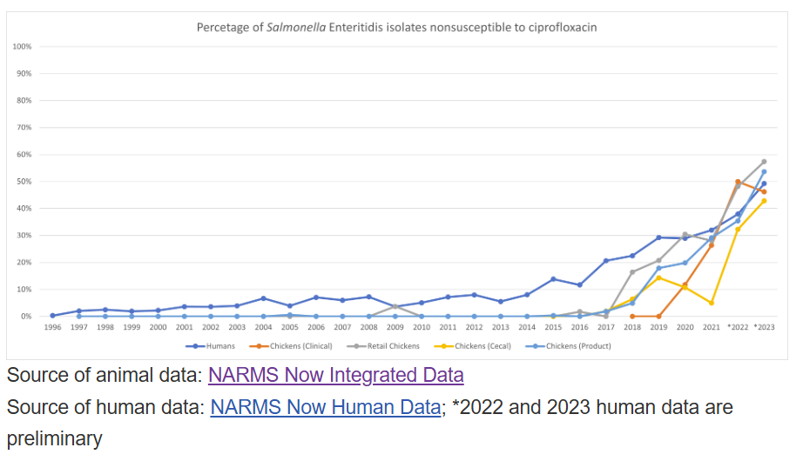
Interpretation statistics – Temporal trends

Slide 32
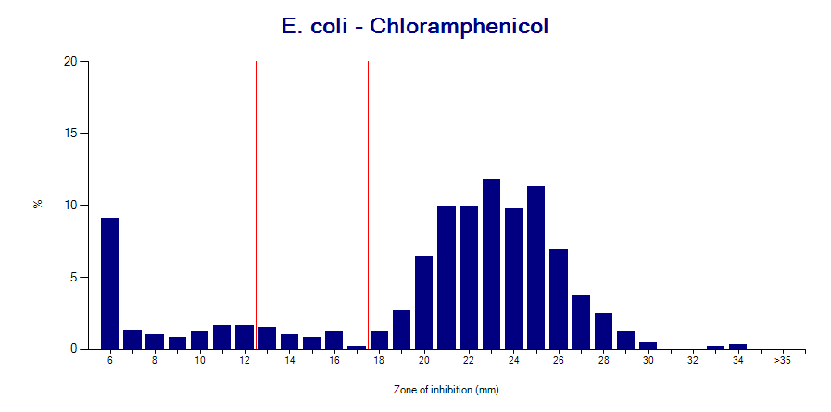
CLSI VET05 9.3 – Frequency distributions of test measurements
Objectives
  Recognition of (phenotypic) microbial subpopulations
  Inferences on possible resistance mechanisms
  Prioritization of strains for molecular typing
  Quality assessment of AST results
Examples
Disk measurements for E. coli and CHL
R
I
S

Slide 33
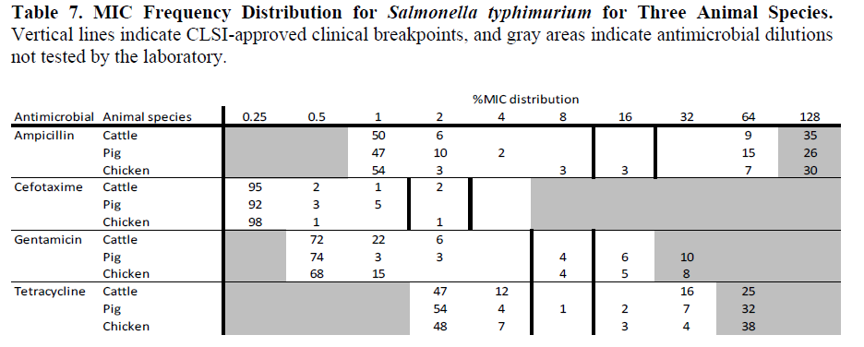
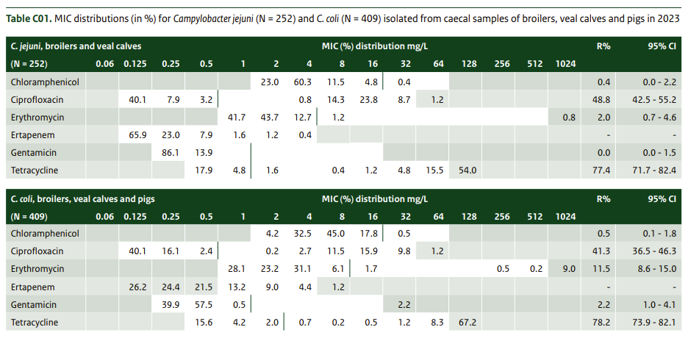
CLSI VET05 9.3 – Frequency distributions of test measurements

Slide 34
CLSI VET05 9.5 – Antimicrobial coresistance and cross-resistance
Objectives with two antibiotic tests (Scatterplots)
  Identify correlations among AST results
    Different methods with the same (or similar) antibiotic
    Same method with similar antibiotics
    Same method with unrelated antibiotics
  Quality assessment
  Treatment guidelines
Example – Two similar antibiotics

Slide 35
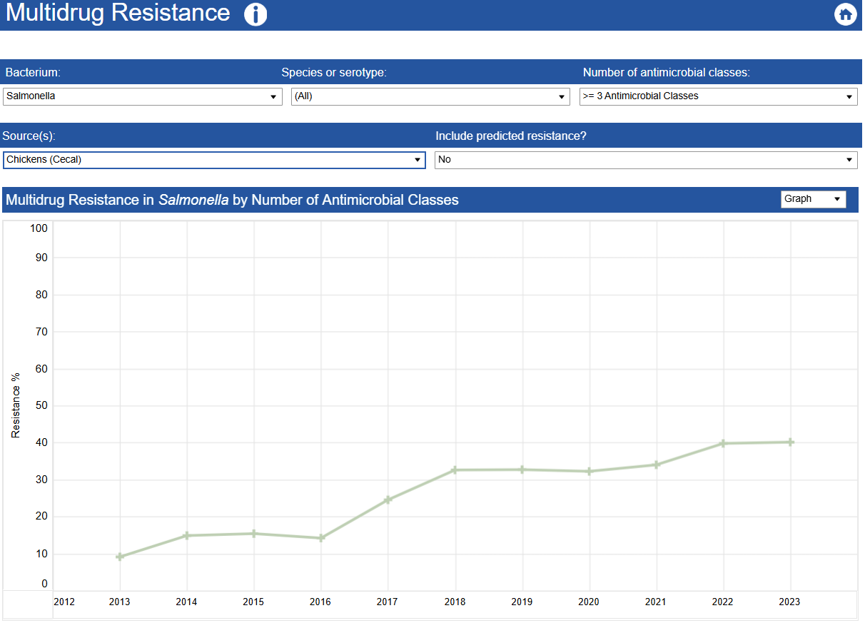
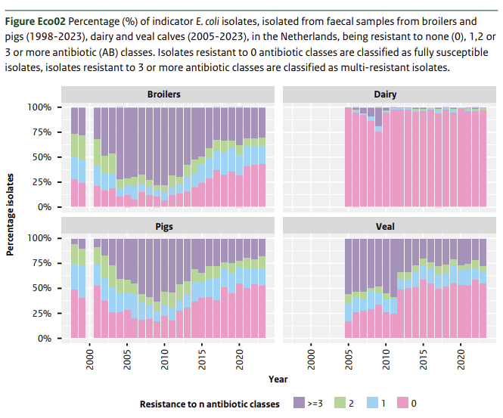
Multidrug resistance tracking – Number of classes/subclasses
By number of classes
  ECDC approach for MDR/XDR/PDR

Slide 36
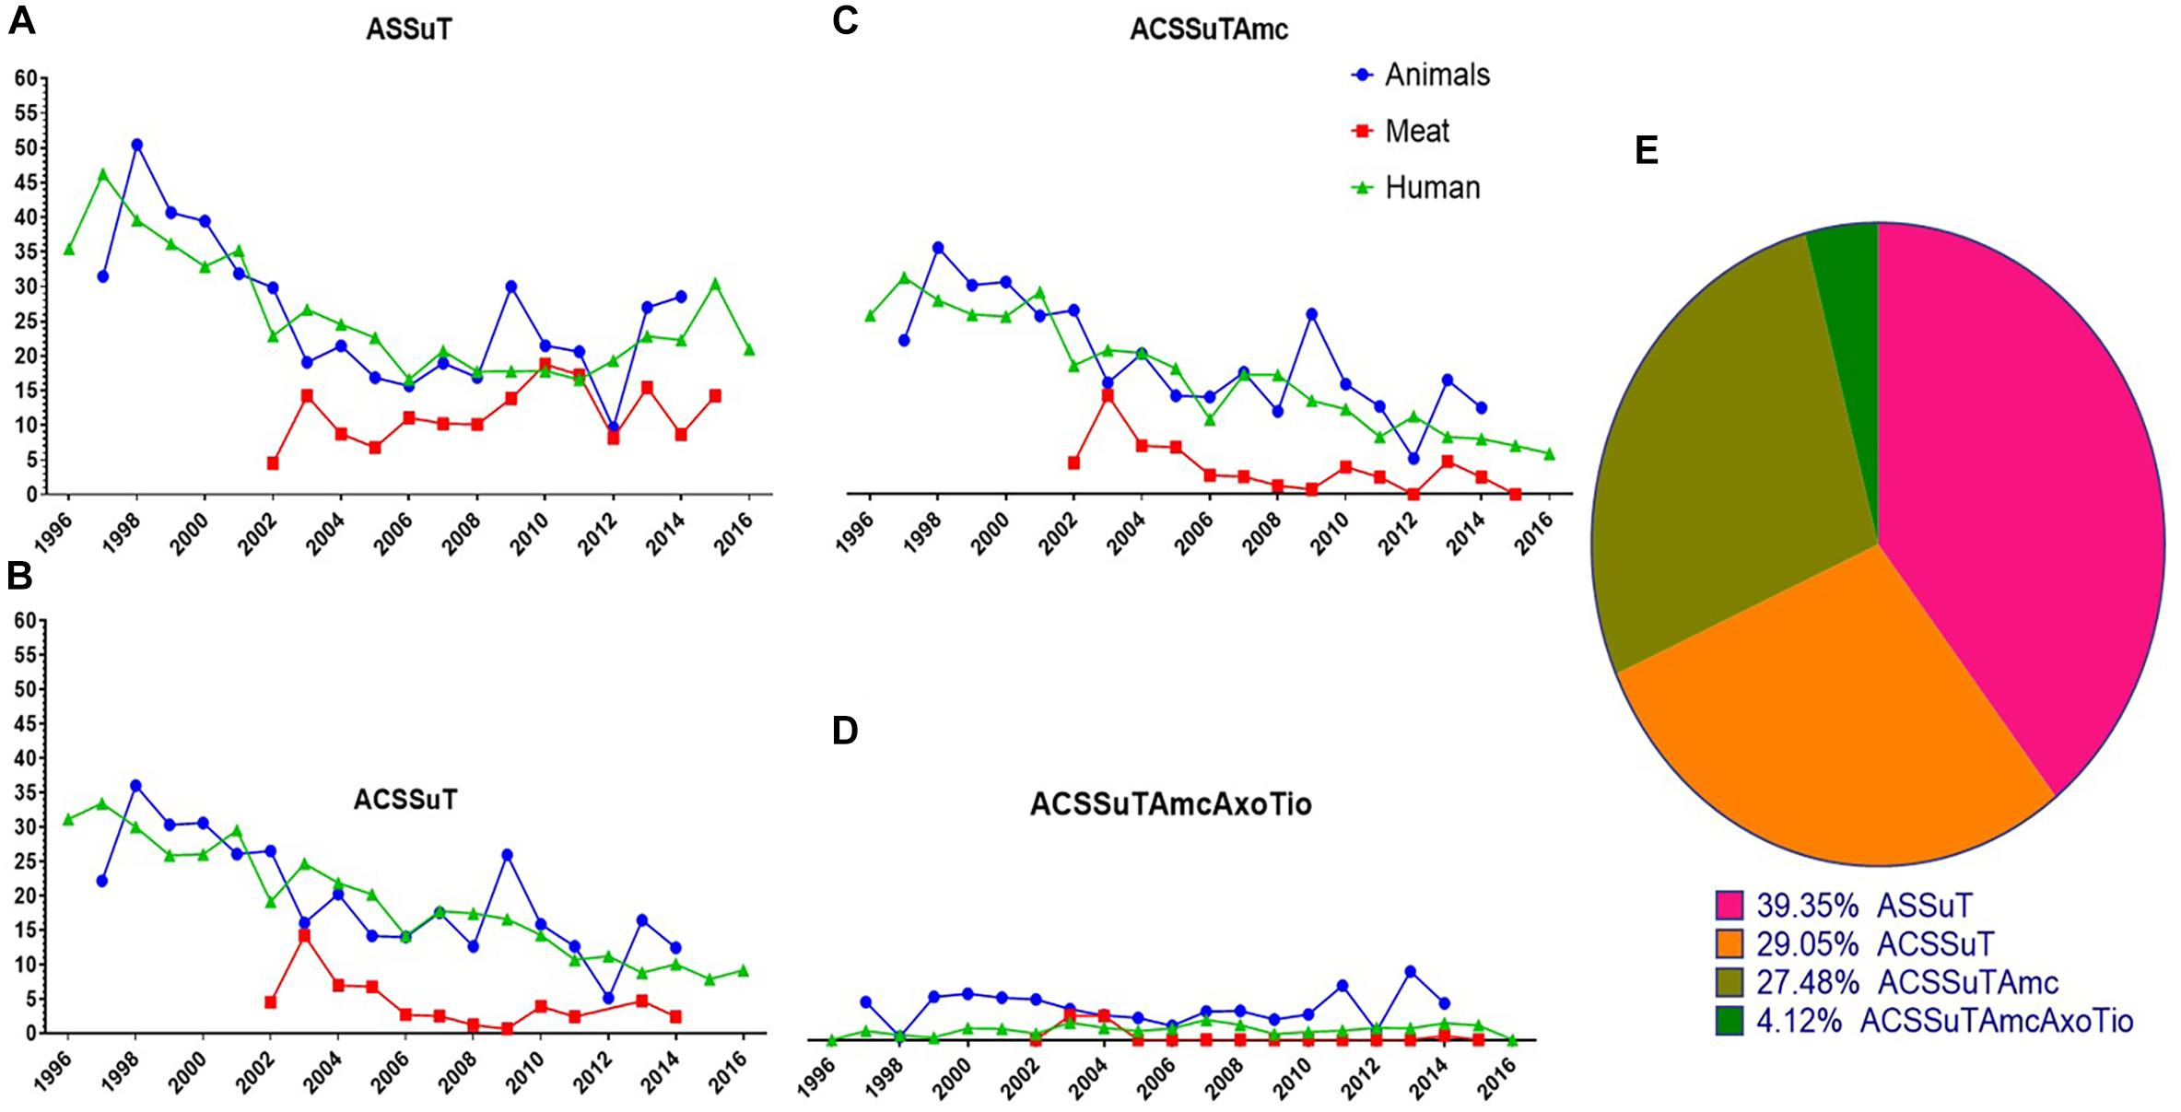
Multidrug resistance tracking – Specific MDR profiles
By specific antibiotic profile sets
https://www.frontiersin.org/files/Articles/450730/fmicb-10-00985-HTML-r1/image_m/fmicb-10-00985-g004.jpg

Slide 37
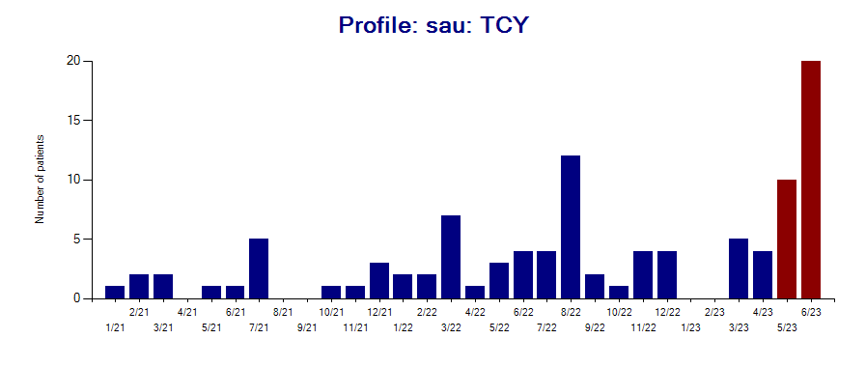
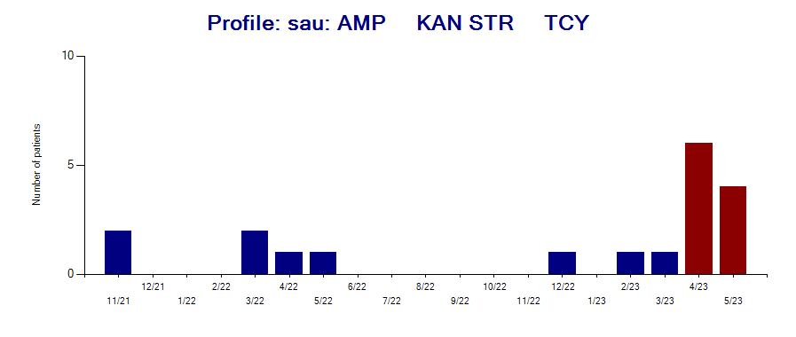
Detection of possible outbreaks
Statistical algorithms
  Farrington
  Weighted moving averages
  CDC EARS, CDC SODA
  SaTScan
Multidrug resistance profiles and cluster detection with WHONET-SaTScan
Outbreak detection

Slide 38
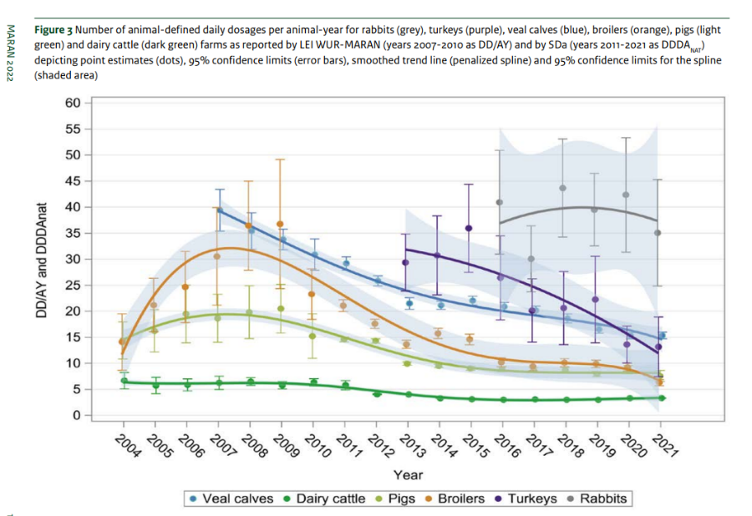
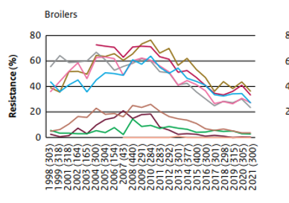
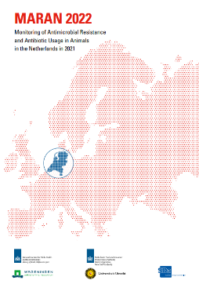
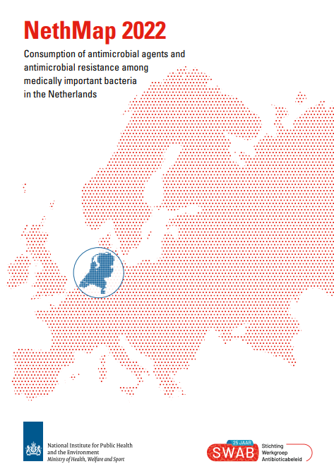
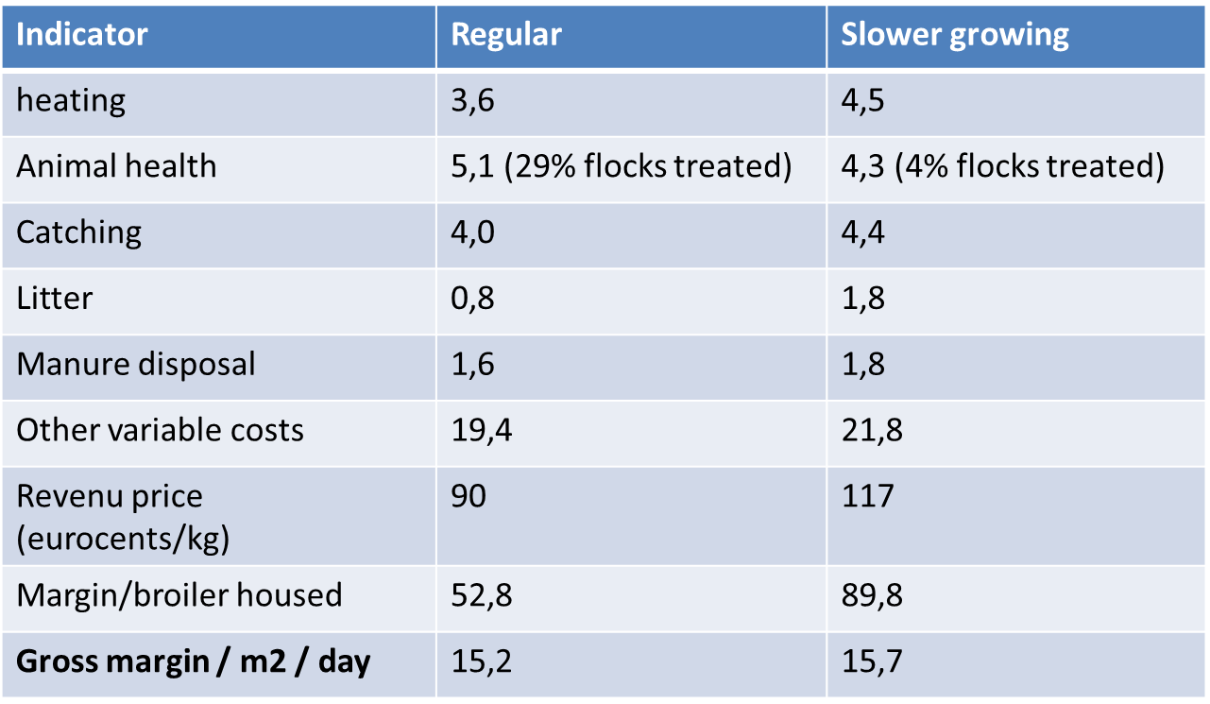
Netherlands example
Decreasing use
Decreasing resistance
Sustained profitability
Adapted from slides from Dr. Jaap Wagenaar

Slide 39
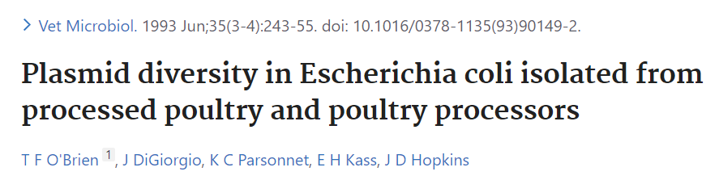


Slide 40
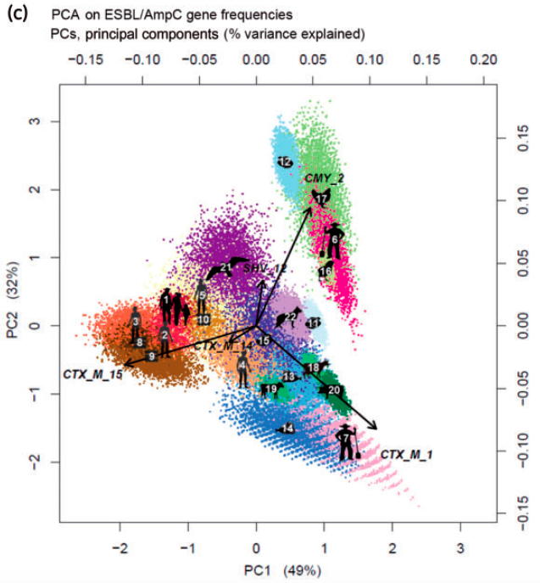
ESBL-producing Escherichia coli. ESBL/AmpC gene frequencies by sampling population
For ESBL-producing E. coli in the Netherlands
Limited similarity between farm animals and humans in clinical settings or general population
Farmers/family members very similar to animal reservoirs (occupational ESBL transmission)
Human to human attribution overall highly relevant
1/3rd of human ESBL has non-human source
Taken from: Dorado-Garcia et al, JAC, 2017 and Mughini-Gras, Lancet Plan Health 2019.
Slide from Dr. Jaap Wagenaar

Slide 41
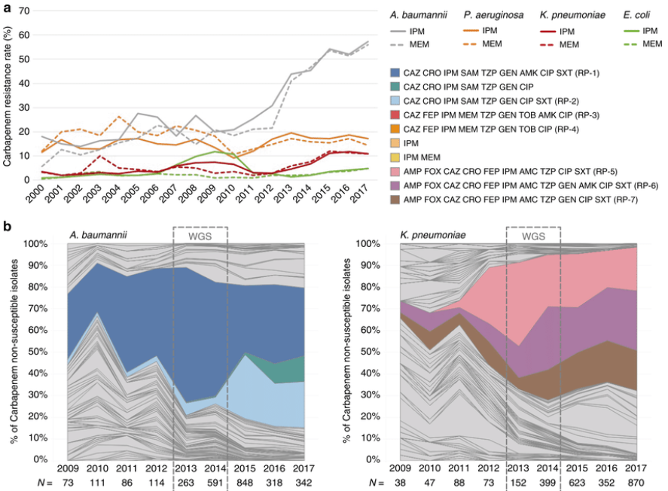
Correlation of phenotypes and genotypes

Slide 42
1
BacLink
Notes:
1

Slide 43
1
Laboratory data management systems
A
Many laboratories in the world continue to rely on paper notebooks to management their microbiology test results. For these laboratories, WHONET could be a very appropriate system for clinical reporting and data analysis.
  However, BacLink is not needed since there is no local IT system
Most laboratories do have some data system in place:
  Very simple desktop applications, such as Microsoft Excel. This is common in low-resource settings. It is also common for special research projects and protocols.
  Laboratory instruments
    MIC instruments: Vitek, BD Phoenix, MicroScan, Sensitire, etc.
    Disk diffusion camera systems (some of which can also read MIC plates): SIRScan, Biomic, etc.
  Laboratory Information Systems
    Locally developed versus national versus international
    Free versus commercial
    Some systems only cover microbiology test results, while others also support other clinical laboratory areas, such as blood bank, hematology, and biochemistry

Slide 44

1
The purpose of BacLink
A
Situation: Laboratories around the world have diverse systems that serve important functions for day-to-day laboratory, clinical reporting, medical archives, and billing. However, these systems are incompatible and usually have minimal capabilities for data analysis and public health reporting.
Opportunity: Staff have taken the time and effort to computerize laboratory results on a daily basis. If we can extract these data into compatible systems, we have the basis of a low-cost, sustainable, real-time system for surveillance, alerts, and action.
Purpose of BacLink – Transformation of data exported from diverse existing and incompatible systems into standardized WHONET files for purposes of analysis, sharing, and public health reporting.
BacLink
Incompatible local systems
Standard WHONET files

Slide 45
1
Getting data from your system into WHONET
A
Step 1: Export data from your system
Step 2: Examine your data file: contents and structure
Step 3: Configure BacLink to understand your data file structure and codes
Step 4: Use BacLink to convert your data into WHONET files
Step 5: Getting started with WHONET
Optional - Step 6: Automated daily downloads and conversions

Slide 46
5
Importing SILAB data into WHONET
Demonstration
Notes:
1

Slide 47
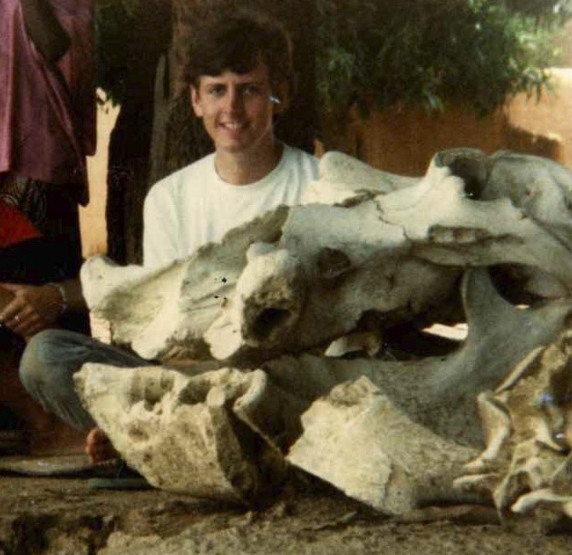
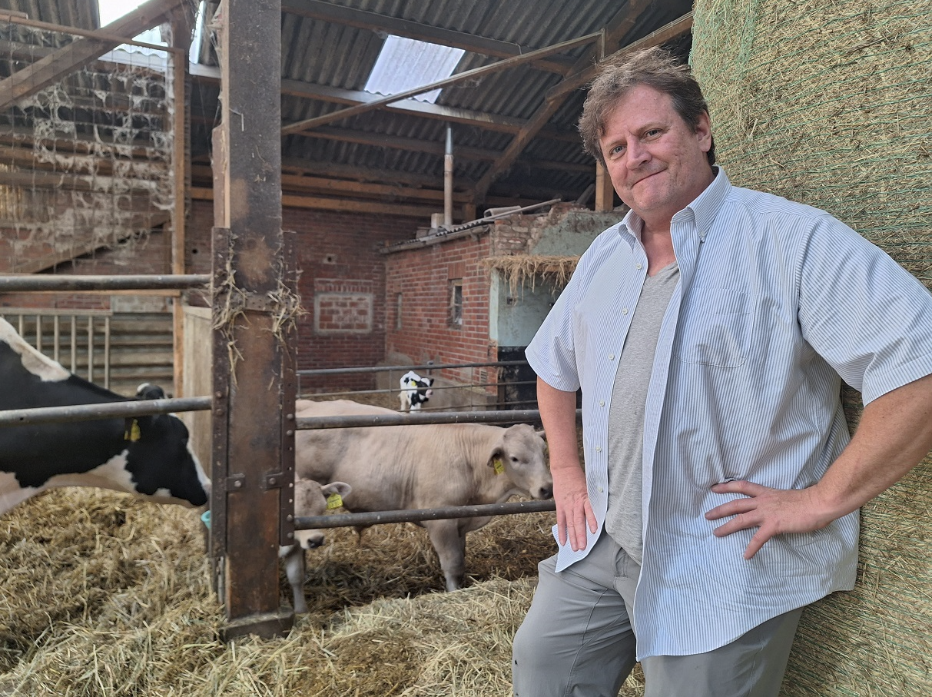
Aw ni baara…. Aw ni baaraji!
Thank you!!!

